Slide 1
Healthcare Predictive Analytics & Population Health Intelligence
HealthConnect Rwanda · Data Science track
Emmanuella Esi Arhin · AnalystLab Africa Experience Lab

Slide 2
The data supports fewer questions than the brief asks
273,602
5
8.3%
1,756
rows across 27 CSV files
tables not supplied (admissions, labs, prescriptions, referrals, facility master)
of bills, diagnoses and payments link to an appointment
feedback records usable for facility comparisons
Admission, length of stay, labs, prescriptions and referrals: proxy or not computable
Only 12 months of data: no seasonality
Distributions look simulated (uniform ages, no age or sex gradients)
AnalystLab Africa · Week 6 · Data Science
Notes:
27 datasets, 273,602 rows. Five tables named in the brief were not supplied.

Slide 3
Data quality: 6 critical and 10 high-severity findings
Facility, department and doctor on an appointment agree in only ~5% of rows
55,000 bills, diagnoses and payments point to non-existent appointments
Billing status labels contradict payments; 30% of ratings contradict comments
Children recorded with adult heights, weights, marriages and degrees
All 2,000 beds are "Available"; 874 appointments are future-dated
AnalystLab Africa · Week 6 · Data Science
Notes:
No rows deleted; issues flagged and handled.

Slide 4
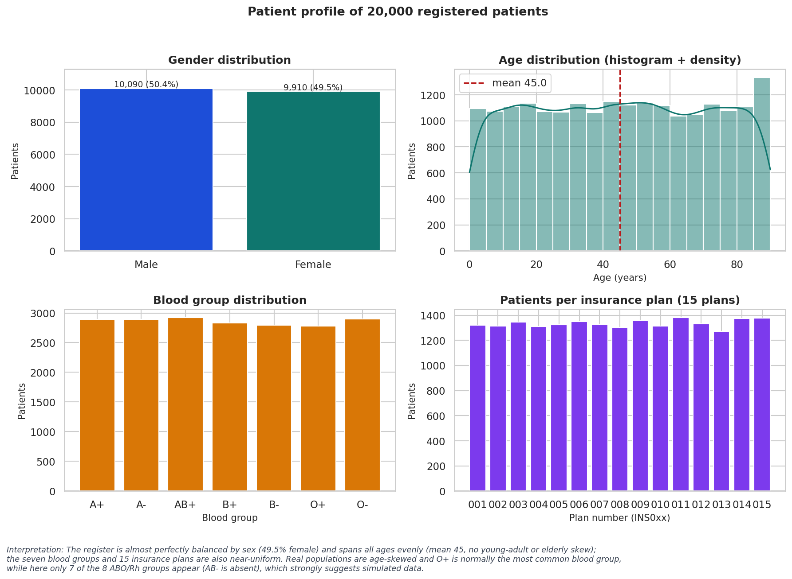
Patients: evenly spread, 75% chronic
20,000 registered; 4,443 (22%) seen in the extract
Mean age 45, 49.5% female
75% chronic, flat across age, sex, province
1,005 children recorded with hypertension
Every patient has an insurance plan: no uninsured group
AnalystLab Africa · Week 6 · Data Science

Slide 5
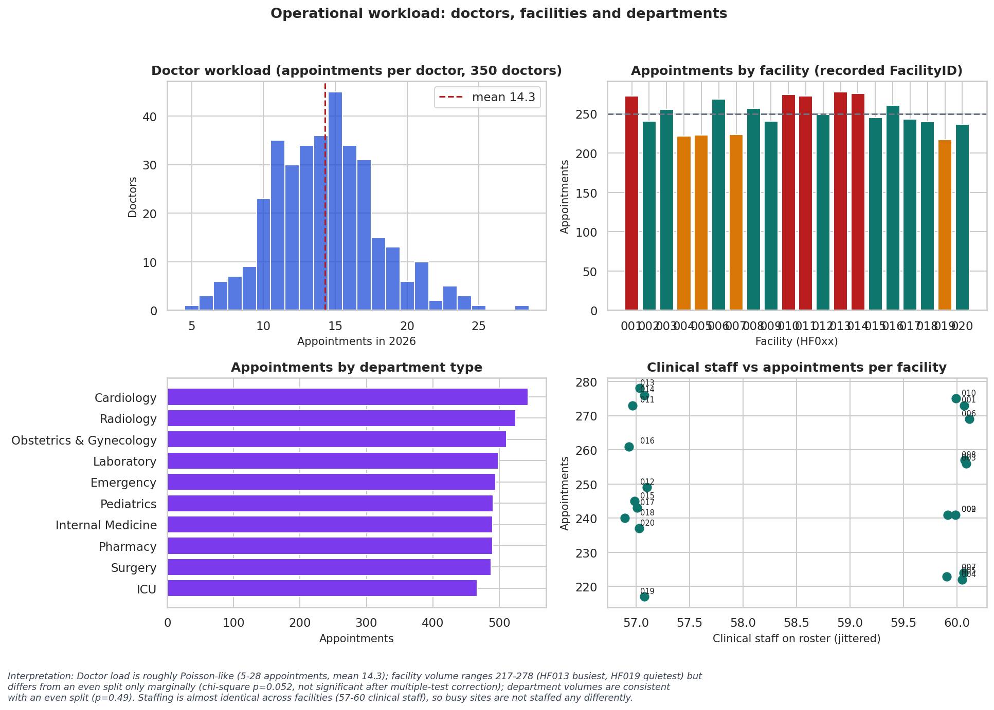
Operations: load differs, rosters do not
Doctors: 5-28 appointments (mean 14.3)
Facilities: 217-278 appointments; gap only marginal (p=0.052)
Load per clinical staff differs ~32% across facilities
Rosters: 57-60 clinical staff everywhere
Bed occupancy not computable
AnalystLab Africa · Week 6 · Data Science

Slide 6
Finance: 0.92bn RWF unpaid and half of claims pending
0.92bn
50%
~90%
RWF outstanding (9.9% of billings)
21,028 claims pending (2.44bn RWF)
of the bill paid, whatever the status label says
Status (Paid / Partially Paid / Pending) does not match payments: test 9, p = 0.64
Pending claims are spread evenly across RSSB, MMI, Private and Radiant
Management revenue summary (1.13bn) does not reconcile with billing (9.31bn)
Summary swings 67M-146M a month independent of volume
AnalystLab Africa · Week 6 · Data Science

Slide 7
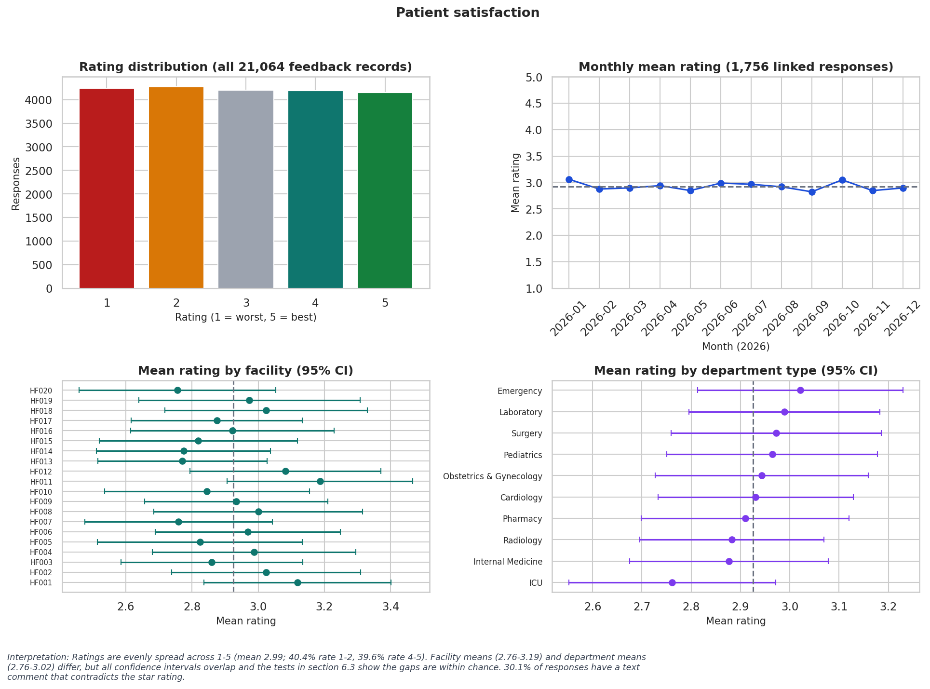
Satisfaction: 40% rate 1-2, with no site or driver to blame
Mean 2.99 across 21,064 ratings
Facilities and departments do not differ (p = 0.80, 0.88)
No variable predicts rating (R² ≤ 0)
30% of comments contradict ratings
AnalystLab Africa · Week 6 · Data Science

Slide 8
Eleven hypothesis tests: none survive correction
Question | p | Holm p | Decision
Billing: insurance-backed vs self-pay bills | 0.155 | 1.000 | Fail to reject H0
Satisfaction differs across the 20 facilities | 0.795 | 1.000 | Fail to reject H0
Admission proxy rate differs between age groups | 0.104 | 0.935 | Fail to reject H0
Chronic-condition prevalence differs by age group | 0.570 | 1.000 | Fail to reject H0
Chronic-condition prevalence differs by province | 0.046 | 0.502 | Fail to reject H0
Payment completeness differs by Billing.Status label | 0.643 | 1.000 | Fail to reject H0
Chronic prevalence by province: raw p = 0.046, Holm-adjusted p = 0.50. Uncorrected tests mislead.
AnalystLab Africa · Week 6 · Data Science
Notes:
Holm correction across 11 tests, alpha 0.05.

Slide 9
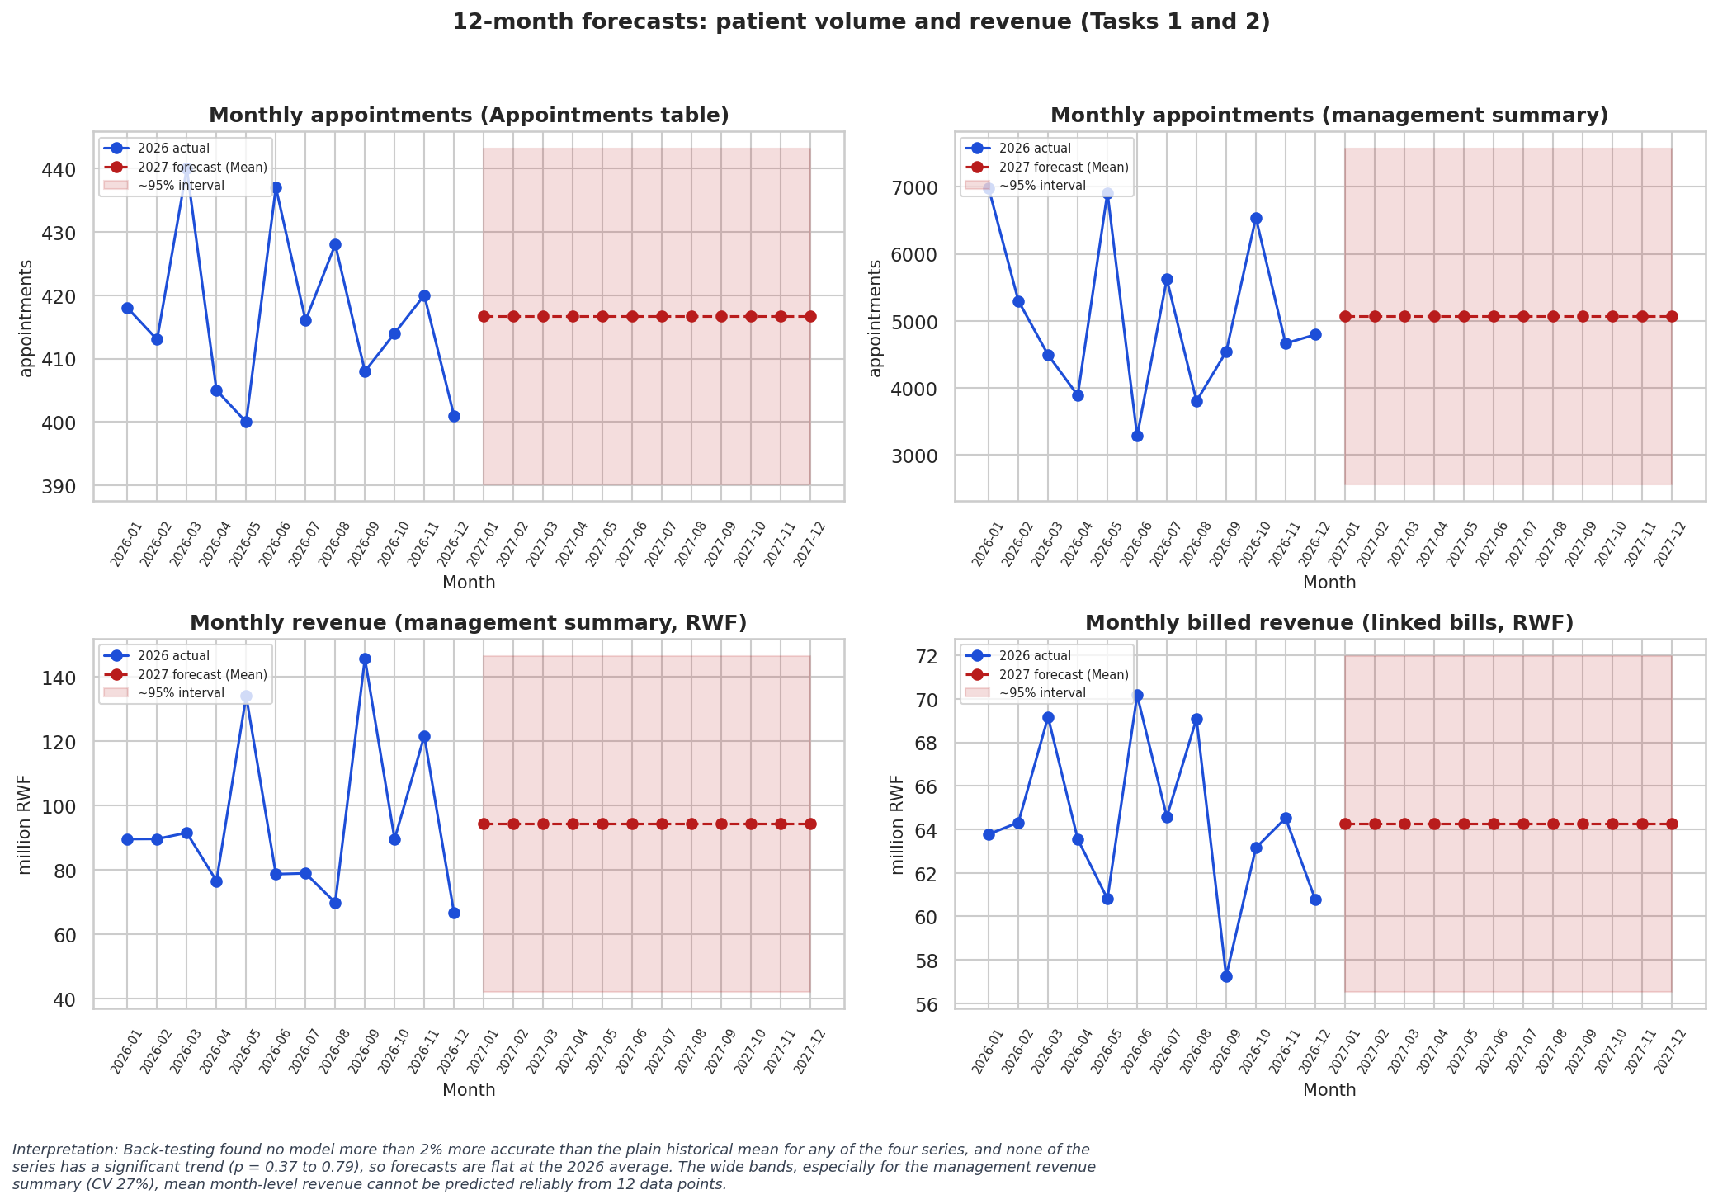
Forecasts: flat at the 2026 average, with wide bands
No series has a significant trend (p 0.37-0.79)
2027 appointments in extract: ~417 a month
Management revenue swings too widely to forecast (CV 27%)
Department overload ranking is a watch-list, not evidence
AnalystLab Africa · Week 6 · Data Science
Notes:
12 monthly points per series; the plain mean wins the back-test.

Slide 10
Predictive models: nothing beats the baseline
0.505
R² ≈ 0
0.516
Admission-proxy AUC (0.50 = chance)
Satisfaction regression, 1,756 appointments
Chronic-risk screen AUC
No Admissions table: target is a proxy (Emergency + Severe diagnosis)
Patient-grouped cross-validation; bootstrap CIs include 0.50
Permutation importances are all within noise of zero
Conclusion: do not deploy any of these models
AnalystLab Africa · Week 6 · Data Science

Slide 11
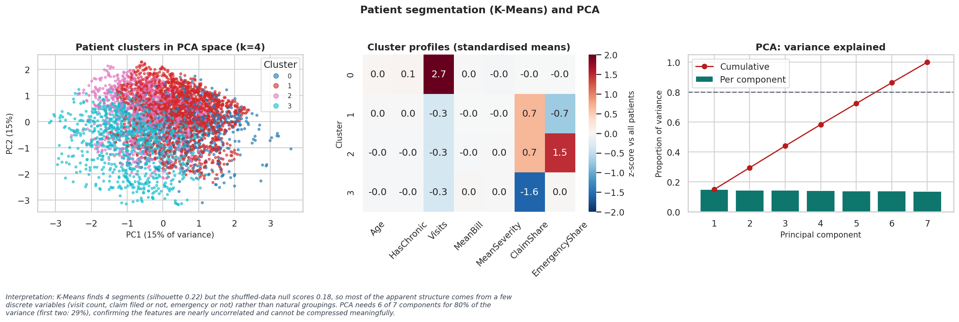
Segmentation: useful for planning, not natural clusters
Patients: repeat visitors (~510), emergency-only, routine insured, self-pay
Facilities: busier (9) vs quieter (11), stable
Departments: no better than random; not used
PCA needs 6 of 7 components for 80% of variance
AnalystLab Africa · Week 6 · Data Science

Slide 12
Recommendations
Area | Action | Confidence
Data pipeline | Enforce appointment keys; add admissions, lab, prescription, referral, facility tables | High
Revenue | Rebuild payment status from payments; collections list; 30-day claim target; reconcile finance summary | High
Satisfaction | Network-wide patient-journey review; link surveys to appointments; structured reason codes | Medium
High-risk patients | Audit chronic coding; universal outreach to 5,028 flagged patients | Medium
Staffing | Balance doctor panels; pilot moving 2-3 staff to highest-load sites; re-measure | Low-Medium
Expansion | No capex on this evidence; re-forecast with 24+ months of data | Medium
AnalystLab Africa · Week 6 · Data Science

Slide 13
Limitations and next steps
Results are provisional: the data look simulated and 91.7% of transactions are orphaned
Next 30 days: repair keys, obtain missing tables, fix payment status
Next quarter: rebuild admission, LOS and risk models on real outcomes; re-forecast with 24+ months
Before deployment: fairness checks by sex, age band and province; human oversight; privacy and governance review
AnalystLab Africa · Week 6 · Data Science

