Slide 1
Pipelines, workflows, and pitfalls
Ayal Gussow
12/06/2018

Slide 2
Outline
Pipeline
Practical tips
Previous projects
Independent work

Slide 3
SKLearn Pipeline
You want to fit and optimize the process.
Example

Slide 4
Practical Advice

Slide 5
Most common ML questions
Should I use feature X?
Do I need to normalize the data?
How should I preprocess the data?
Which model should I use?
How should I assess my results? (metric and threshold)
Do I have enough data?

Slide 6
Most common ML questions
Though we can provide tools to find the answer to some of these questions, the answer generally depends on the problem.
There really is no one-size-fits-all.

Slide 7
Example: 2016 presidential predictions
You want to predict presidential election outcome.
How would you do it?

Slide 8
Example: 2016 presidential predictions
You want to predict presidential election outcome.
Data choices: polling data, economic data, demographics
Model choices: Directly predict the outcome, predict each state and summarize into outcome, probabilistic simulations, etc

Slide 9
Example: 2016 presidential predictions
You want to predict presidential election outcome.
538 prediction: 80% Dem win
Others: 99% Dem win
Undecided voters. Ignored vs add to uncertainty.
Polling errors. Independent vs correlated.

Slide 10
Example: 2016 presidential predictions
You want to predict presidential election outcome.
Michigan
Pennsylvania
North Carolina

Slide 11
Example: 2016 presidential predictions
You want to predict presidential election outcome.
Michigan
Pennsylvania
North Carolina
What are the chances that there is an error in all three states?

Slide 12
Example: 2016 presidential predictions
You want to predict presidential election outcome.
Michigan
Pennsylvania
North Carolina
If one is off, the others probably are too, in the same direction…

Slide 13
Example: 2016 presidential predictions
You want to predict presidential election outcome.
538 prediction: 80% Dem win
Others: 99% Dem win
Undecided voters. Ignored vs add to uncertainty.
Polling errors. Independent vs correlated.

Slide 14
Example: 2016 presidential predictions
You want to predict presidential election outcomes, using a combination of polling and economic data.
538 prediction: 80% Clinton win
Others: 99% Clinton win
https://53eig.ht/2IokwGv

Slide 15
When Building A Model
Use sense.
Use your domain knowledge.
Probe the model, see if you can understand it and if it makes sense. It’s not a black box.

Slide 16
Generic Workflow

Slide 17
Workflow Framework
Data acquisition / loading
Feature creation
Feature normalization
Feature selection
Machine learning model
Combining multiple models
Reporting / Utilization

Slide 18
Data acquisition / loading
If we are fortunate our data may already be in a usable format but more often extensive work is needed to generate something usable.
What type of data do we have?
Do we need to combine data from multiple sources?
Is our data structured in such a way it can be used directly?
Does our data need to be cleaned?
Does our data have issues with confounding?

Slide 19
Feature creation
Can our data be used directly?
What features have been used previously for similar tasks?

Slide 20
Feature normalization
Does our method require normalization?
What do we gain and what do we lose in normalizing?
Outliers?
Z-score normalization?
Min-max normalization?

Slide 21
Feature selection
General Rule:
The number of features we have compared with our sample size will determine whether feature selection is needed. We may choose in the first instance not to use feature selection.
Observe performance on the validation dataset (learning curves, cross-validation) to detect overfitting and perhaps use fewer features.

Slide 22
Feature selection
Feature selection philosophies: balance expertise with feature selection methods.
Note that less data makes feature selection harder.

Slide 23
Machine learning model
Which algorithm to use will depend on the type of task and the size of the dataset. As with the preceding steps it can be difficult to predict the optimal approach.

Slide 24
Combining multiple models
An additional step that can frequently boost performance is combining multiple different models. It is important to consider that although there are advantages combining different models can make the result more difficult to interpret.
The models may be generated by using a different algorithm and/or different features.
Example:
Cat or not cat?

Slide 25


Combining multiple models
An additional step that can frequently boost performance is combining multiple different models. It is important to consider that although there are advantages combining different models can make the result more difficult to interpret.
The models may be generated by using a different algorithm and/or different features.
Example:
Cat or not cat?
Not cat!
Cat!

Slide 26
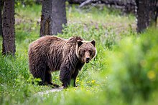
Combining multiple models
An additional step that can frequently boost performance is combining multiple different models. It is important to consider that although there are advantages combining different models can make the result more difficult to interpret.
The models may be generated by using a different algorithm and/or different features.
Example:
Cat or not cat?
Cat!

Slide 27
Combining multiple models
Two-step:
Is there a furry creature in the picture?
Is it a cat?

Slide 28
Reporting / Utilization
Finally we need to be able to utilize the model we have generated. This typically takes the form of receiving a new sample and then performing all the steps used in training to make a prediction.
If we are generating a model only to understand the structure of the data we already have then the new samples may be the test dataset we set aside at the beginning.
Trusting vs understanding the predictions.

Slide 29
Experimentation, diagnosis and overfitting

Slide 30
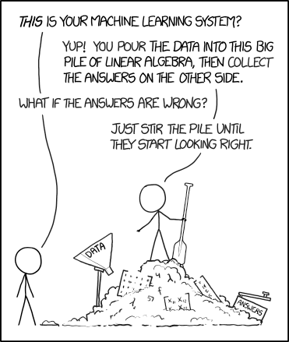
Overfitting vs Experimentation
Generally, it’s desirable to try different approaches.
Try to be mindful of why you are trying different approaches, and don’t just try every possible approach until you find one that is mildly better than others.
Other “approaches”: Removing outliers, changing evaluation metric (FDA), and so forth.

Slide 31
Diagnosing the issue
Listen to the data.
Use learning curves to determine whether you need a better model or more data.
Delve into the model and the data. What’s working? What isn’t? Why isn’t it working? Which samples are being misclassified? Why? Does it make sense?

Slide 32
Tracking and Optimization
Some advanced tools:
Git (https://bit.ly/QC6KDB)
Sacred (https://bit.ly/2KYjsKB)
Snakemake (https://bit.ly/2QBLnFu)

Slide 33
Common Pitfalls

Slide 34
Training / test set contamination
E.g. identical sequences from closely related species.

Slide 35

Poorly chosen negative set
You may not be predicting what you think you are.

Slide 36
Biased Data
You may not be predicting what you think you are.

Slide 37
Biased Data
You may not be predicting what you think you are.
You’re head of a university department and you are accused of bias in graduate student acceptance.
To get around this, you decide to have a “neutral” arbitrator – a neutral algorithm that decides which students are accepted. It attempts to predict which students are most likely to become “successful” scientists, based on existing “successful” scientists.
You find that your algorithm has the same biases you do.

Slide 38
Biased Data
You may not be predicting what you think you are.
Don’t take results at face value...
…but listen to the data.

Slide 39
Treating measures as absolute
An AUC of 0.97!
If it’s way too good to be true, it’s probably not.
(permutation tests, predicting all as one class)

Slide 40
Complex before simple
Sometimes ML isn’t needed, or a simpler ML will suffice.
Always start small – subset, simulated, etc. Then expand.
Pay attention to the model and the data before choosing your next step.
AI, ML, Deep Learning, etc – buzzwords.

Slide 41
Final Project

Slide 42
Project
Your grade is not dependent on success.
Make sure it is clear.

Slide 43
Project
The final project will consist of the following components:
1) Project documentation. Each project should have documentation clarifying its goal and functionality. The code itself should be well-documented, with comments spread out to aid understanding. Functions and classes should have docstrings describing their functionality, inputs and outputs.
2) Project code. The code should be well-organized and easy to read. It should also be written modularly, so that each part of code is reusable. The code should run and produce the correct output under different conditions. It should also have robust error checking.
3) Project presentation. Each student will present their project at the end of the semester. The idea here is to present the project’s goals, input, and output, preferably while showing snippets of code.
Project grades will be determined based on the components outlined above, with each component representing 33% of the project grade.

Slide 44
NHL Playoffs - Classification Problem
Series
Games
0
0
1
4
2
8
3
12
4
16

Slide 45
Data
Seasons: 1989-2017
1994, 2004, 2012 were lockout years
16 teams/year
385 data points
26 features
Tested on 2015 playoffs
Data was scaled with StandardScaler()
https://www.hockey-reference.com/

Slide 46

cohen, fbi, raid, stormy, raid, mueller, corruption, nda
https://github.com/tweepy/tweepy
147000 tweets

Slide 47
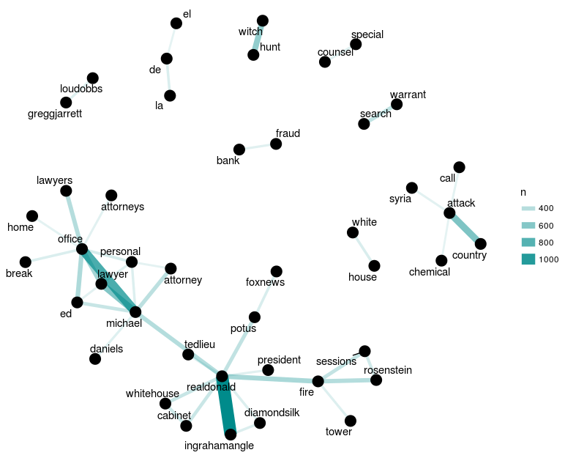
Word Co-ocurrences

Slide 48
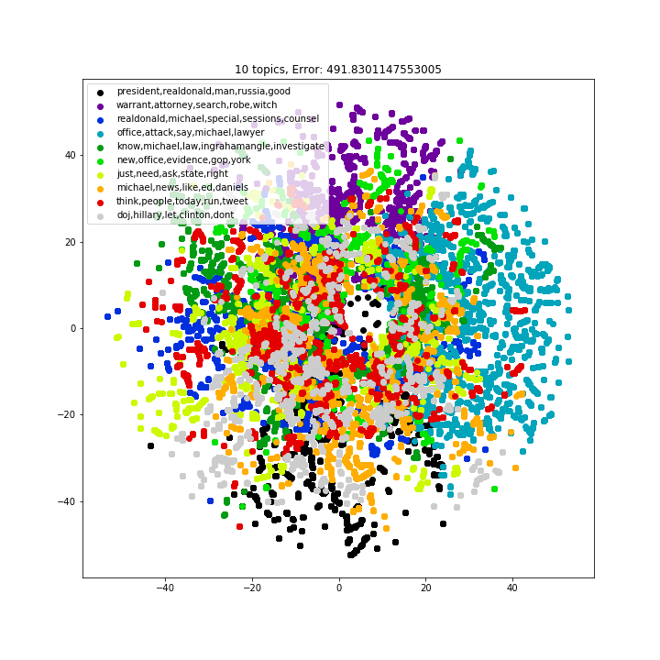
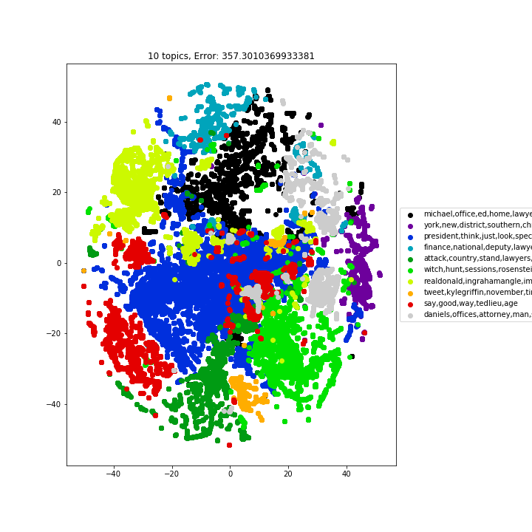

Slide 49
Using a premade dataset and challenge

