Slide 1
Datapath Design in RISC-V (R and I format Instructions)
Sparsh Mittal
Slide courtesy: Dr Garcia (UC Berkeley)

Slide 2
Background topics

Slide 3
Reminder from Digital Logic Course
Use muxes to select among input
S input bits selects 2^{S} inputs
Each input can be n-bits wide, indep of S
Can implement muxes hierarchically
ALU can be implemented using a mux
Coupled with basic block elements
N-bit adder-subtractor done using N 1-bit adders with XOR gates on input
XOR serves as conditional inverter

Slide 4
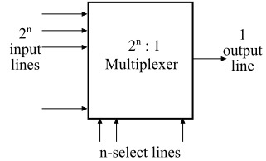
MUX
2:1 MUX
4:1 MUX
2^{n}:1 MUX

Slide 5
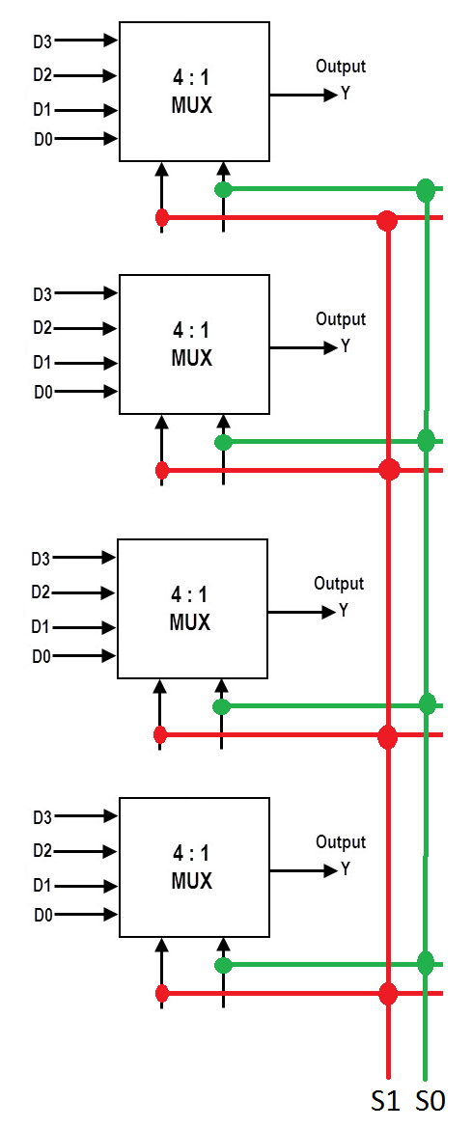
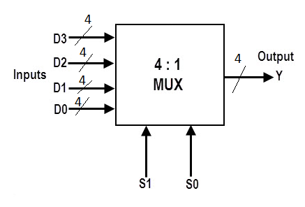
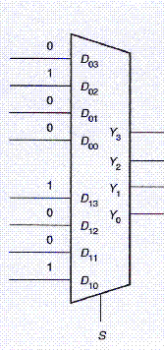
Multi-bit MUX

Slide 6
Three-to-eight-line decoder

Slide 7
Shifter
An N-bit shifter can be built from N N:1 multiplexers.
The input is shifted by 0 to N-1 bits, depending on the value of the log₂N-bit select lines.

Slide 8
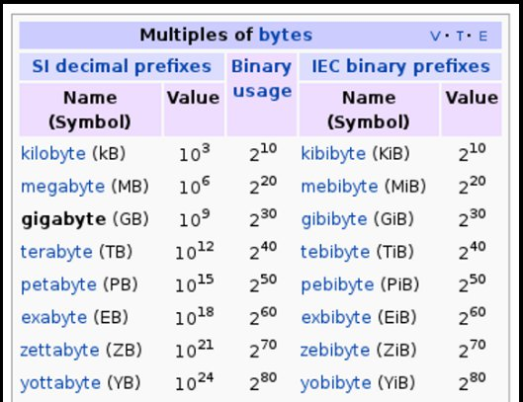

Slide 9
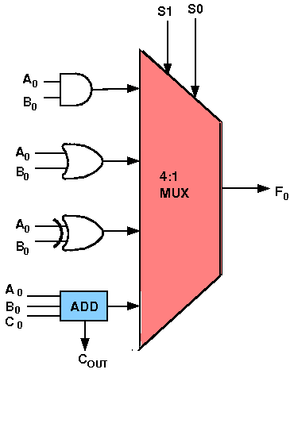
ALU design using MUX
The circuit functionality of a 1 bit ALU is shown here, depending upon the control signal S₁ and S₀ the circuit operates as follows:
S₁ = 0 , S₀ = 0, the output is A And B,
S₁ = 0 , S₀ = 1, the output is A Or B,
S₁ = 1 , S₀ = 0, the output is A Xor B,
S₁ = 1 , S₀ = 1, the output is A Add B.

Slide 10
ALU Design using MUX
M1
M2
0
A
3-bit adder
4
0
0
B
0
A
3-bit subtractor
4
0
1
6
B
0
2
B
3-bit subtractor
4
0
A
B
3-bit multiplier
6
3
A
4:1 MUX with 6-bit selection

Slide 11
Single circuit for add and subtractor
The mode input M controls the operation.
M = 0, circuit is adder
M = 1 ➔ subtractor.
M = 1 ➔ B ⊕1 = B’ and C₀ = 1. ➔ B inputs are all complemented and a 1 is added through the input carry.
V= for overflow detection
Four-bit adder–subtractor (with overflow detection)

Slide 12
Our Single-Core Computer so far…
Processor
Memory
Enable?
Read/Write
Input
Control
Program
Datapath
Memory (including
cache) organized around blocks, which are typically multiple words
Address
Bytes
PC
Write Data
Registers
Data
Arithmetic & Logic Unit
(ALU)
ReadData
Output
Processor organized around words and bytes
Processor-Memory Interface
I/O-Memory Interfaces

Slide 13
The CPU
Processor (CPU): the active part of the computer that does all the work (data manipulation and decision-making)
Datapath: portion of the processor that contains hardware necessary to perform operations required by the processor
Control: portion of the processor (also in hardware) that tells the datapath what needs to be done

Slide 14
Building a RISC-V Processor
Notes:
Main point here is to give you an idea of why you won’t be allowed to do certain things in design
All boil down to making sure the chip you get back behaves the way you expected
If don’t follow the rules, fab won’t guarantee functionality

Slide 15
One-Instruction-Per-Cycle RISC-V Machine
On every tick of the clock, the computer executes one instruction
Current state outputs drive the inputs to the combinational logic, whose outputs settles at the values of the state before the next clock edge
At the rising clock edge, all the state elements are updated with the combinational logic outputs, and execution moves to the next clock cycle
pc
Combinational Logic
clock
IMEM
Reg[]
DMEM

Slide 16
State Required by RISC-V32 “I” (Integer) ISA
Each instruction reads and updates this state during execution:
Registers (x0..x31)
Register file (regfile) Reg holds 32 registers x 32 bits/register: Reg[0]..Reg[31]
First register read specified by rs1 field in instruction
Second register read specified by rs2 field in instruction
Write register (destination) specified by rd field in instruction
x0 is always 0 (writes to Reg[0]are ignored)
Program counter (PC)
Holds address of current instruction
Memory (MEM)
Holds both instructions & data, in one 32-bit byte-addressed memory space
We’ll use separate memories for instructions (IMEM) and data (DMEM)
Instructions are read (fetched) from instruction memory
Load/store instructions access data memory
Notes:
These are placeholders for instruction and data caches

Slide 17
Stages of the Datapath : Overview
Problem: A single, “monolithic” CL block that “executes an instruction” (performs all necessary operations beginning with fetching the instruction and completing with the register access) is be too bulky and inefficient
Solution: Break up the process of “executing an instruction” into stages, and then connect the stages to create the whole datapath
smaller stages are easier to design
easy to optimize (change) one stage without touching the others (modularity)

Slide 18
Five Stages of the Datapath
Stage 1: Instruction Fetch (IF)
Stage 2: Instruction Decode (ID)
Stage 3: Execute (EX) - ALU (Arithmetic-Logic Unit)
Stage 4: Memory Access (MEM)
Stage 5: Write Back to Register (WB)

Slide 19
Basic Phases of Instruction Execution
rd
PC
IMEM
DMEM
rs1
Reg[ ]
ALU
rs2
+4
imm
mux
2. Decode/
Register
Read
1. Instruction
Fetch
5. Register
Write
3. Execute
4. Memory
Clock
time

Slide 20
Datapath Components: Combinational
Combinational Elements
Storage Elements + Clocking Methodology
Building Blocks
OP
CarryIn
Select
A
32
A
A
32
Adder
Sum
32
Result
32
MUX
Y
ALU
32
B
CarryOut
B
32
32
32
B
32
Adder
Multiplexer
ALU

Slide 21
Datapath Elements: State and Sequencing (1/3)
Register
Write Enable:
Negated (or deasserted) (0): Data Out will not change
Asserted (1): Data Out will become Data In on positive edge of clock
Write Enable
Data In
Data Out
N
N
clk

Slide 22
Register addressing
A memory with four words needs two address lines.
The two address inputs go through a 2 * 4 decoder to select one of the four words.
The decoder is enabled with the memory‐enable input.
Memory enable is 0 ==> all decoder outputs are 0. None of the memory words are selected.

Slide 23
Datapath Elements: State and Sequencing (2/3)
RW
RA
RB
Register file (RF) has 32 registers:
Two 32-bit output buses: busA and busB
One 32-bit input bus: busW
x0 is wired to 0
Register is selected by:
RA (number) selects the register to put on busA (data)
RB (number) selects the register to put on busB (data)
RW (number) selects the register to be written via busW (data) when Write Enable is 1
Clock input (clk)
Clk input is a factor ONLY during write operation
During read operation, behaves as a combinational logic block:
RA or RB valid ⇒ busA or busB valid after “access time.”
Write Enable
5
5
5
busA
busW
32 x 32-bit
Registers
32
32
busB
Clk
32

Slide 24
Datapath Elements: State and Sequencing (3/3)
“Magic” memory
One input bus: Data In
One output bus: Data Out
Memory word is found by:
For Read: Address selects the word to put on Data Out
For Write: Set Write Enable = 1: address selects the memory word to be written via the Data In bus
Clock input (CLK)
CLK input is a factor ONLY during write operation
During read operation, behaves as a combinational logic block: Address valid ⇒ Data Out valid after “access time”
Write Enable
Address
Data In
DataOut
32
32
Clk

Slide 25
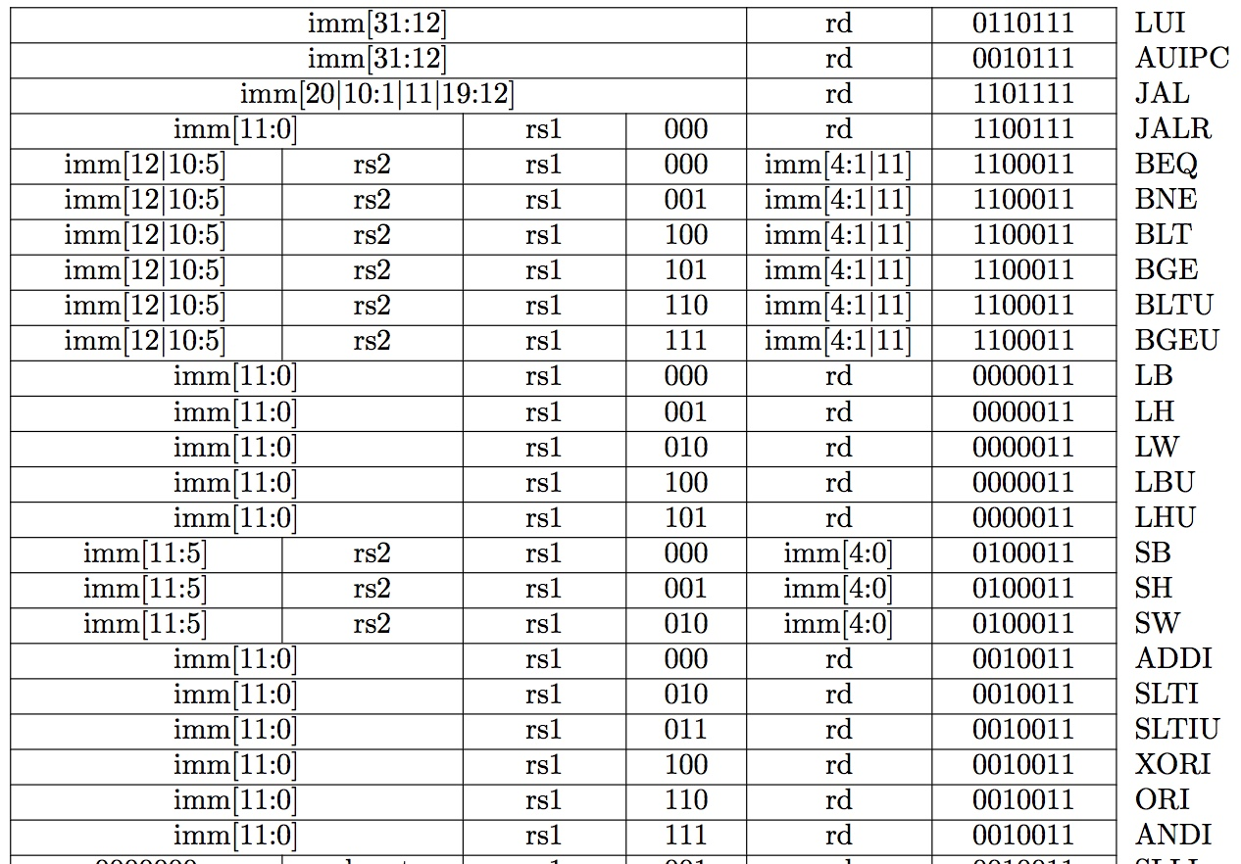
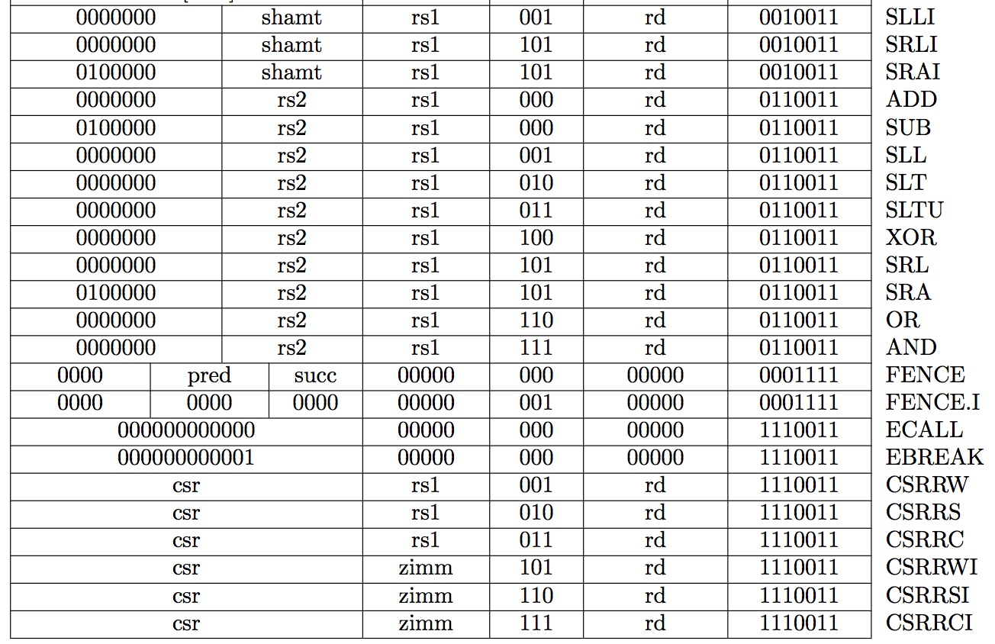
Review: Complete RV32I ISA
Need datapath and control to implement these instructions

Slide 26
Summary of RISC-V Instruction Formats
31
30
25
24
21
20
19
15
14
12
11
8
7
6
0
funct7
rs2
rs1
funct3
rd
opcode
R-type
imm[11:0]
rs1
funct3
rd
opcode
I-type
imm[11:5]
rs2
rs1
funct3
imm[4:0]
opcode
S-type
imm[12|10:5]
rs2
rs1
funct3
imm[4:1|11]
opcode
B-type
imm[31:12]
rd
opcode
U-type
imm[20|10:1|11]]
imm[19:12]
rd
opcode
J-type

Slide 27
R-Format Instructions: Datapath
Notes:
Main point here is to give you an idea of why you won’t be allowed to do certain things in design
All boil down to making sure the chip you get back behaves the way you expected
If don’t follow the rules, fab won’t guarantee functionality

Slide 28
Implementing the add instruction
31
25
24
20
19
15
14
12
11
7
6
0
funct7
rs2
rs1
funct3
rd
opcode
7
5
5
3
5
7
0000000
rs2
rs1
000
rd
0110011
add
rs2
rs1
add
rd
Reg-Reg OP
add rd, rs1, rs2
Instruction makes two changes to machine’s state:
Reg[rd] = Reg[rs1] + Reg[rs2]
PC = PC + 4

Slide 29
Datapath for add
PC = PC + 4
Reg[rd] = Reg[rs1] + Reg[rs2]
+4
Add
DataD
Inst[11:7]
PC
addr
AddrD
Reg[rs1]
pc+4
inst
Inst[19:15]
AddrA
DataA
+
alu
Inst[24:20]
AddrB
Reg[rs2]
ALU
clk
DataB
IMEM
Reg [ ]
Inst[31:0]
clk
RegWriteEnable (RegWEn)
=1
Control logic
31
25
24
20
19
15
14
12
11
7
6
0
0000000
rs2
rs1
000
rd
opcode
add
5
5
add
5
Reg-Reg OP

Slide 30
Implementing the sub instruction
31
25
24
20
19
15
14
12
11
7
6
0
0000000
rs2
rs1
000
rd
0110011
add
0100000
rs2
rs1
000
rd
0110011
sub
sub rd, rs1, rs2
Almost the same as add, except now have to subtract operands instead of adding them
inst[30] selects between add and subtract

Slide 31
Datapath for add/sub
+4
Add
DataD
Inst[11:7]
PC
addr
AddrD
Reg[rs1]
pc+4
inst
Inst[19:15]
AddrA
DataA
+
alu
Inst[24:20]
AddrB
Reg[rs2]
ALU
clk
DataB
IMEM
Reg [ ]
clk
Inst[31:0]
RegWEn
(1=Write, 0=NoWrite)
ALUSel
(add=0/sub=1)
Control logic

Slide 32
Implementing other R-Format instructions
0000000
rs2
rs1
000
rd
0110011
add
0100000
rs2
rs1
000
rd
0110011
sub
0000000
rs2
rs1
001
rd
0110011
sll
0000000
rs2
rs1
010
rd
0110011
slt
0000000
rs2
rs1
011
rd
0110011
sltu
0000000
rs2
rs1
100
rd
0110011
xor
0000000
rs2
rs1
101
rd
0110011
srl
0100000
rs2
rs1
101
rd
0110011
sra
0000000
rs2
rs1
110
rd
0110011
or
0000000
rs2
rs1
111
rd
0110011
and
All implemented by decoding funct3 and funct7 fields and selecting appropriate ALU function

Slide 33
Implementing I-Format - addi instruction
RISC-V Assembly Instruction:
addi x15,x1,-50
31
20
19
15
14
12
11
7
6
0
imm[11:0]
rs1
funct3
rd
opcode
12
5
3
5
7
111111001110
00001
000
01111
0010011
imm=-50
rs1=1
add
rd=15
OP-Imm

Slide 34
Datapath for add/sub
+4
Add
DataD
Inst[11:7]
PC
addr
AddrD
Reg[rs1]
pc+4
inst
Inst[19:15]
AddrA
DataA
+
alu
Inst[24:20]
AddrB
Reg[rs2]
ALU
clk
DataB
IMEM
Reg [ ]
clk
Immediate should
be here
Inst[31:0]
RegWEn
(1=Write, 0=NoWrite)
ALUSel
(add=0/sub=1)
Control logic

Slide 35
Adding addi to Datapath
+4
Add
DataD
Inst[11:7]
PC
addr
AddrD
Reg[rs1]
pc+4
inst
Inst[19:15]
AddrA
DataA
+
alu
Inst[24:20]
AddrB
Reg[rs2]
ALU
clk
DataB
0
IMEM
Reg [ ]
1
clk
Imm[31:0]
Inst[31:0]
RegWEn
(1=Write, 0=NoWrite)
BSel
(rs2=0/ Imm=1)
ALUSel
(add=0/ sub=1)
Control logic

Slide 36
Adding addi to Datapath
+4
+4
Add
Add
DataD
Inst[11:7]
PC
AddrD
PC
addr
Reg[rs1]
pc+4
addr
Inst[19:15]
pc+4
inst
DataA
alu
inst
AddrA
+
Inst[24:20]
AddrB
Reg[rs2]
ALU
clk
DataB
0
clk
IMEM
IMEM
Reg [ ]
1
Inst [31:20]
Bsel = 1
Imm.
Gen
clk
Imm[31:0]
Inst[31:0]
ImmSel=I
RegWEn=1
BSel
(rs2=0/ Imm=1)
ALUSel= add
Control logic

Slide 37
I-Format immediates
-inst[31]-
31 30
20
19
15
14
12
11
7
6
0
imm[11:0]
rs1
funct3
rd
opcode
12
inst[31:0]
------inst[31]-(sign-extension)-------
inst[30:20]
imm[31:0]
inst[31:20]
Imm.
Gen
imm[31:0]
High 12 bits of instruction (inst[31:20]) copied to low 12 bits of immediate (imm[11:0])
Immediate is sign-extended by copying value of inst[31] to fill the upper 20 bits of the immediate value (imm[31:12])
ImmSel=I

Slide 38
R+I Datapath
+4
+4
Add
Add
DataD
Inst[11:7]
PC
AddrD
PC
addr
Reg[rs1]
pc+4
addr
Inst[19:15]
pc+4
inst
DataA
alu
inst
AddrA
+
Inst[24:20]
AddrB
Reg[rs2]
ALU
Works for all other I-format arithmetic instructions (slti,sltiu,andi, ori,xori,slli,srli, srai) just by changing ALUSel
clk
DataB
0
clk
IMEM
IMEM
Reg [ ]
1
Inst [31:20]
Imm.
Gen
clk
Imm[31:0]
Inst<31:0>
ImmSel
RegWEn
BSel
ALUSel
Control logic

Slide 39
“And In conclusion…”
CPU design involves datapath and control logic
Typical five stages of exectution
We built a datapath for arithmetic and logic for RISC-V R and I instructions
…and sketched out control
Will add data memory access (loads, stores), branches, jumps, etc…

