Slide 1
Review
CPU design involves datapath and control logic
Typical five stages of execution
Fetch, Decode, Execute, Memory access, Write back
We built a datapath for arithmetic and logic for RISC-V R and I instructions
And sketched out control
Will add data memory access (loads, stores), branches, jumps, etc…

Slide 2
R+I Datapath
+4
+4
Add
Add
DataD
Inst[11:7]
PC
AddrD
PC
addr
Reg[rs1]
pc+4
pc
addr
Inst[19:15]
pc+4
inst
DataA
alu
inst
AddrA
+
Inst[24:20]
AddrB
Reg[rs2]
ALU
clk
DataB
0
clk
IMEM
IMEM
Reg [ ]
1
Inst [31:20]
Imm.
Gen
clk
Imm[31:0]
Inst[31:0]
ImmSel
RegWEn
BSel
ALUSel
Control logic

Slide 3
Implement lw
lw x14, 8(x2)
RISC-V Assembly Instruction (I-type):
31
20
19
15
14
12
11
7
6
0
imm[11:0]
rs1
funct3
rd
opcode
12
5
3
5
7
offset[11:0]
base
width
dest
LOAD
31
20
19
15
14
12
11
7
6
0
000000001000
00010
010
01110
0000011
imm= +8
rs1=2
LW
rd=14
LOAD
The 12-bit signed immediate is added to the base address in register rs1 to form the memory address
This is very similar to the add-immediate operation but used to create address not to create final result
The value loaded from memory is stored in register rd

Slide 4
Adding lw to Datapath
+4
+4
Add
Add
DataD
1
Inst[11:7]
0
wb
PC
AddrD
PC
addr
Reg[rs1]
pc+4
pc
addr
Inst[19:15]
DataR
pc+4
inst
DataA
alu
inst
AddrA
+
addr
mem
Inst[24:20]
AddrB
Reg[rs2]
ALU
clk
DataB
0
clk
IMEM
IMEM
Reg [ ]
1
DMEM
Inst [31:20]
clk
Imm.
Gen
clk
Imm[31:0]
Inst[31:0]
ImmSel
=I
RegWEn
=1
Bsel
=1
ALUSel
=Add
MemRW
=Read
WBSel
=0
Control logic

Slide 5
All RV32 Load Instructions
imm[11:0]
rs1
000
rd
0000011
lb
imm[11:0]
rs1
001
rd
0000011
lh
imm[11:0]
rs1
010
rd
0000011
lw
imm[11:0]
rs1
100
rd
0000011
lbu
imm[11:0]
rs1
101
rd
0000011
lhu
funct3 field encodes size and ‘signedness’ of load data
Supporting the narrower loads requires additional logic to extract the correct byte/halfword from the value loaded from memory, and sign- or zero-extend the result to 32 bits before writing back to register file.
It is just a mux mod

Slide 6
Adding sw Instruction
sw: Reads two registers, rs1 for base memory address, and rs2 for data to be stored, as well immediate offset!
sw x14, 8(x2)
31
25
24
20
19
15
14
12
11
7
6
0
Imm[11:5]
rs2
rs1
funct3
imm[4:0]
opcode
7
5
5
3
5
7
offset[11:5]
src
base
width
offset[4:0]
STORE
0000000
01110
00010
010
01000
0100011
offset[11:5]
=0
rs2=14
rs1=2
SW
offset[4:0]
=8
STORE
0000000
01000
combined 12-bit offset = 8

Slide 7
Datapath with lw
+4
+4
Add
Add
DataD
1
Inst[11:7]
0
wb
PC
AddrD
PC
addr
Reg[rs1]
pc+4
pc
addr
Inst[19:15]
DataR
pc+4
inst
DataA
alu
inst
AddrA
+
addr
mem
Inst[24:20]
AddrB
Reg[rs2]
ALU
clk
DataB
0
clk
IMEM
IMEM
Reg [ ]
1
DMEM
Inst [31:20]
clk
Imm.
Gen
clk
Imm[31:0]
Inst[31:0]
ImmSel
RegWEn
BSel
ALUSel
MemRW
WBSel
Control logic

Slide 8
Adding sw to Datapath
+4
+4
+4
Add
Add
Add
DataD
1
Inst[11:7]
0
wb
PC
AddrD
PC
PC
addr
Reg[rs1]
addr
addr
Inst[19:15]
DataR
pc+4
pc
DataR
pc+4
pc+4
inst
DataA
alu
inst
inst
AddrA
+
addr
mem
Inst[24:20]
Reg[rs2]
addr
clk
AddrB
DataB
0
ALU
clk
clk
DataW
DataW
IMEM
IMEM
IMEM
DMEM
Reg [ ]
1
DMEM
Inst [31:7]
clk
Imm.
Gen
clk
Imm[31:0]
Inst[31:0]
ImmSel
=S
RegWEn =0
Bsel
=1
ALUSel
=Add
MemRW
=Write
WBSel =*
(*=Don’t care)
Control logic

Slide 9
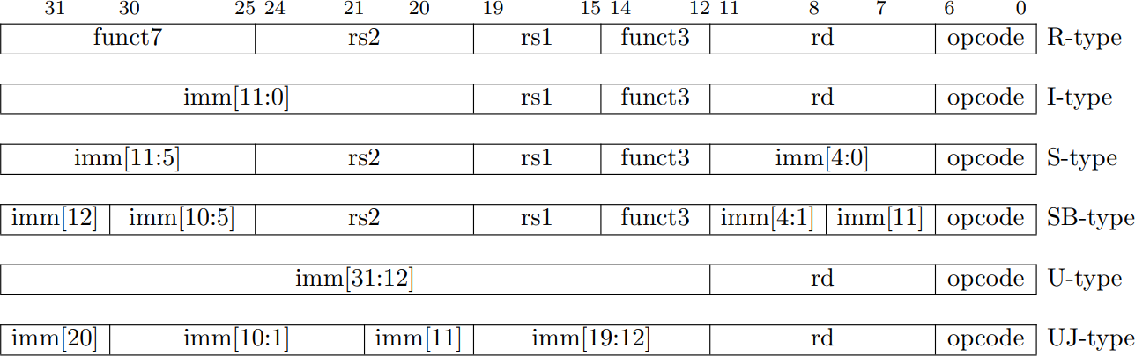
Format summary

Slide 10
I+S Immediate Generation
31
25
24
20
19
15
14
12
11
7
6
0
imm[11:0]
rs1
funct3
rd
I-opcode
I
imm[11:5]
rs2
rs1
funct3
imm[4:0]
S-opcode
S
inst[31:0]
5
5
1
6
I
S
I/S
inst[31] (sign extension)
inst[30:25]
inst[24:20]
I
inst[31] (sign extension)
inst[30:25]
inst[11:7]
S
31
11
10
5
4
0
Just need a 5-bit mux to select between two positions where low five bits of immediate can reside in instruction
Other bits in immediate are wired to fixed positions in instruction
imm[31:0]

Slide 11
Implementing Branches
31
30
25
24
20
19
15
14
12
11
8
7
6
0
imm[12]
imm[10:5]
rs2
rs1
funct3
imm[4:1]
imm[11]
opcode
1
6
5
5
3
4
1
7
offset[12|10:5]
rs2
rs1
funct3
offset[4:1|11]
BRANCH
B-format is mostly same as S-Format, with two register sources (rs1/rs2) and a 12-bit immediate
But now immediate represents values -4096 to +4094 in 2-byte increments
The 12 immediate bits encode even 13-bit signed byte offsets (lowest bit of offset is always zero, so no need to store it)

Slide 12
Datapath So Far
+4
Add
Add
DataD
Reg[rs1]
1
Inst[11:7]
0
wb
PC
addr
AddrD
pc
addr
Inst[19:15]
DataR
inst
DataA
alu
pc+4
inst
AddrA
+
addr
mem
Inst[24:20]
AddrB
ALU
clk
DataB
0
DataW
IMEM
IMEM
Reg [ ]
1
DMEM
Inst [31:7]
clk
Reg[rs2]
clk
Imm.
Gen
Imm[31:0]
Inst[31:0]
ImmSel
RegWEn
Bsel
ALUSel
MemRW
WBSel
Control logic

Slide 13
To Add Branches
Different change to the state:
PC = PC + 4, branch not taken PC + immediate, branch taken
Six branch instructions: BEQ, BNE, BLT, BGE, BLTU, BGEU
Need to compute PC + immediate and to compare values of rs1 and rs2
But have only one ALU – need more hardware

Slide 14
Magnitude Comparator
(A>B) = A₃B₃’ +x₃A₂B₂’+x₃x₂A₁B₁’+x₃x₂x₁A₀B₀’
(A<B) = A₃’B₃ +x₃A₂’B₂+x₃x₂A₁’B₁+x₃x₂x₁A₀’B₀

Slide 15
Branch Comparator
BrEq = 1, if A=B
BrLT = 1, if A < B
BrUn =1 selects unsigned comparison for BrLT, 0=signed
BGE branch: A >= B, if A<B
A<B = !(A<B)
A
Branch
Comp
B
BrU
BrLT
BrEq

Slide 16
Adding Branches
+4
Add
Add
DataD
Reg[rs1]
1
1
Inst[11:7]
0
wb
PC
addr
AddrD
1
pc
addr
Inst[19:15]
DataR
0
inst
DataA
alu
pc+4
inst
AddrA
Branch
Comp
0
+
addr
mem
Inst[24:20]
AddrB
ALU
clk
DataB
0
DataW
IMEM
IMEM
Reg [ ]
1
DMEM
Inst [31:7]
clk
Reg[rs2]
clk
Imm.
Gen
Imm[31:0]
PCSel= taken/not taken
Inst[31:0]
ImmSel
=B
RegWEn =0
BrUn
BrLT
Bsel
=1
ALUSel
=Add
MemRW
=Read
WBSel =*
(*=Don’t care)
BrEq
Asel
=1
Control logic

Slide 17
RISC-V Immediate Encoding
Instruction encodings, inst[31:0]
31
30
25
24
20
19
15
14
12
11
8
7
6
0
funct7
rs2
rs1
funct3
rd
opcode
R-type
imm[11:0]
rs1
funct3
rd
opcode
I-type
imm[11:5]
rs2
rs1
funct3
imm[4:0]
opcode
S-type
imm[12|10:5]
rs2
rs1
funct3
imm[4:1|11]
opcode
B-type
32-bit immediates produced, imm[31:0]
31
25
24
12
11
10
5
4
1
0
-inst[31]-
inst[30:25]
inst[24:21]
inst[20]
I-imm.
-inst[31]-
inst[30:25]
inst[11:8]
inst[7]
S-imm.
-inst[31]-
inst[7]
inst[30:25]
inst[11:8]
0
B-imm.
Upper bits sign-extended from inst[31] always
Only bit 7 of instruction changes role in immediate between S and B

Slide 18
Let’s Add JALR (I-Format)
31
20
19
15
14
12
11
7
6
0
imm[11:0]
rs1
func3
rd
opcode
12
5
3
5
7
offset[11:0]
base
0
dest
JALR
JALR rd, rs, immediate
Two changes to the state
Writes PC+4 to rd (return address)
Sets PC = rs + immediate
Uses same immediates as arithmetic and loads
no multiplication by 2 bytes
LSB is ignored

Slide 19
Datapath So Far, with Branches
+4
Add
Add
DataD
Reg[rs1]
1
alu
Inst[11:7]
1
AddrD
1
0
wb
PC
addr
pc
addr
Inst[19:15]
DataR
0
inst
DataA
alu
pc+4
inst
AddrA
Branch
Comp
0
+
addr
mem
Inst[24:20]
AddrB
ALU
clk
DataB
0
DataW
IMEM
IMEM
Reg [ ]
1
DMEM
Inst [31:20]
clk
Reg[rs2]
clk
Imm.
Gen
Imm[31:0]
PCSel
Inst[31:0]
ImmSel
RegWEn
BrUn
BrLT
Bsel
ALUSel
MemRW
WBSel
Control logic
BrEq
Asel
Control logic

Slide 20
Adding JALR (R[rd] = PC+4; PC = R[rs1] + imm)
+4
Add
Add
pc+4
2
DataD
Reg[rs1]
1
1
Inst[11:7]
0
wb
PC
addr
AddrD
1
pc
addr
Inst[19:15]
DataR
0
inst
DataA
alu
pc+4
inst
AddrA
Branch
Comp
0
+
addr
mem
Inst[24:20]
AddrB
ALU
clk
DataB
0
DataW
IMEM
IMEM
Reg [ ]
1
DMEM
Inst [31:7]
clk
Reg[rs2]
clk
Imm.
Gen
Imm[31:0]
PCSel =taken
Inst[31:0]
ImmSel
=I
RegWEn =1
BrUn
=*
BrLT
=*
Bsel
=1
ALUSel
=Add
MemRW
=Read
WBSel =2
Control logic
Asel
=0
Control logic
BrEq=*

Slide 21
Adding JAL
31
30
21
20
19
12
11
7
6
0
imm[20]
imm[10:1]
imm[11]
imm[19:12]
rd
opcode
1
10
1
8
5
7
offset[20:1]
dest
JAL
JAL saves PC+4 in register rd (the return address)
Set PC = PC + offset (PC-relative jump)
Target somewhere within ±2¹⁹ locations, 2 bytes apart
±2¹⁸ 32-bit instructions
Immediate encoding optimized similarly to branch instruction to reduce hardware cost

Slide 22
Datapath with JALR
+4
Add
Add
pc+4
2
DataD
Reg[rs1]
1
1
Inst[11:7]
0
wb
PC
addr
AddrD
1
addr
Inst[19:15]
DataR
0
inst
DataA
alu
pc+4
inst
AddrA
Branch
Comp
0
+
addr
mem
Inst[24:20]
AddrB
ALU
clk
DataB
0
DataW
IMEM
IMEM
Reg [ ]
1
DMEM
Inst [31:20]
clk
Reg[rs2]
clk
Imm.
Gen
Imm[31:0]
PCSel
Inst[31:0]
ImmSel
RegWEn
BrUn
BrLT
Bsel
ALUSel
MemRW
WBSel
Control logic
Asel
Control logic
BrEq

Slide 23
Adding JAL (R[rd] = PC+4; PC = PC + {imm,1b’0})
+4
Add
Add
pc+4
2
DataD
Reg[rs1]
1
1
Inst[11:7]
0
wb
PC
addr
AddrD
1
addr
Inst[19:15]
DataR
0
inst
DataA
alu
pc+4
inst
AddrA
Branch
Comp
0
+
addr
mem
Inst[24:20]
AddrB
ALU
clk
DataB
0
DataW
IMEM
IMEM
Reg [ ]
1
DMEM
Inst [31:7]
clk
Reg[rs2]
clk
Imm.
Gen
Imm[31:0]
PCSel
=taken
Inst[31:0]
ImmSel =J
RegWEn =1
BrUn
=*
BrLT =*
Bsel=1
ALUSel =add
MemRW
=Read
WBSel =2
Control logic
Asel=1
Control logic
BrEq=*

Slide 24
U-Format for “Upper Immediate” Instructions
31
12
11
7
6
0
imm[31:12]
rd
opcode
20
5
7
U-immediate[31:12]
dest
LUI
U-immediate[31:12]
dest
AUIPC
Has 20-bit immediate in upper 20 bits of 32-bit instruction word
One destination register, rd
Used for two instructions
LUI – Load Upper Immediate
AUIPC – Add Upper Immediate to PC

Slide 25
Implementing LUI (R[rd] = {imm, 12’b0})
+4
Add
Add
wb
pc+4
2
DataD
Reg[rs1]
1
1
Inst[11:7]
0
wb
PC
addr
AddrD
1
addr
Inst[19:15]
DataR
0
inst
DataA
alu
pc+4
inst
AddrA
Branch
Comp
0
+
addr
mem
Inst[24:20]
AddrB
ALU
clk
DataB
0
DataW
IMEM
IMEM
Reg [ ]
1
DMEM
Inst [31:7]
clk
Reg[rs2]
clk
Imm.
Gen
Imm[31:0]
PCSel
=pc+4
Inst[31:0]
ImmSel =U
RegWEn =1
BrUn
=*
BrLT =*
Bsel=1
ALUSel =B
MemRW
=Read
WBSel =1
Control logic
Asel=*
Control logic
BrEq=*

Slide 26
Implementing AUIPC (R[rd] = PC + {imm, 12’b0})
+4
Add
Add
wb
pc
pc+4
2
DataD
Reg[rs1]
1
1
Inst[11:7]
0
wb
PC
addr
AddrD
1
addr
Inst[19:15]
DataR
0
inst
DataA
alu
pc+4
inst
AddrA
Branch
Comp
0
+
addr
mem
Inst[24:20]
AddrB
ALU
clk
DataB
0
DataW
IMEM
IMEM
Reg [ ]
1
DMEM
Inst [31:7]
clk
Reg[rs2]
clk
Imm.
Gen
Imm[31:0]
PCSel
=pc+4
Inst[31:0]
ImmSel =U
RegWEn =1
BrUn
=*
BrLT =*
Bsel=1
ALUSel =Add
MemRW
=0
WBSel =1
Control logic
Asel=1
Control logic
BrEq=*

Slide 27
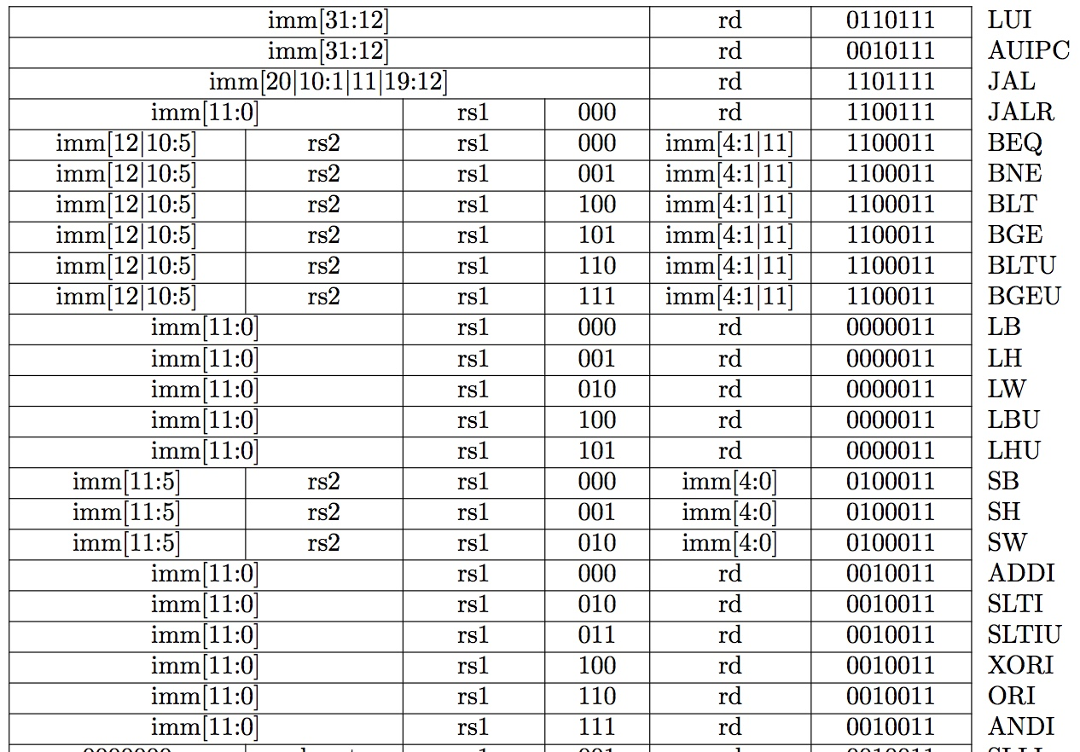
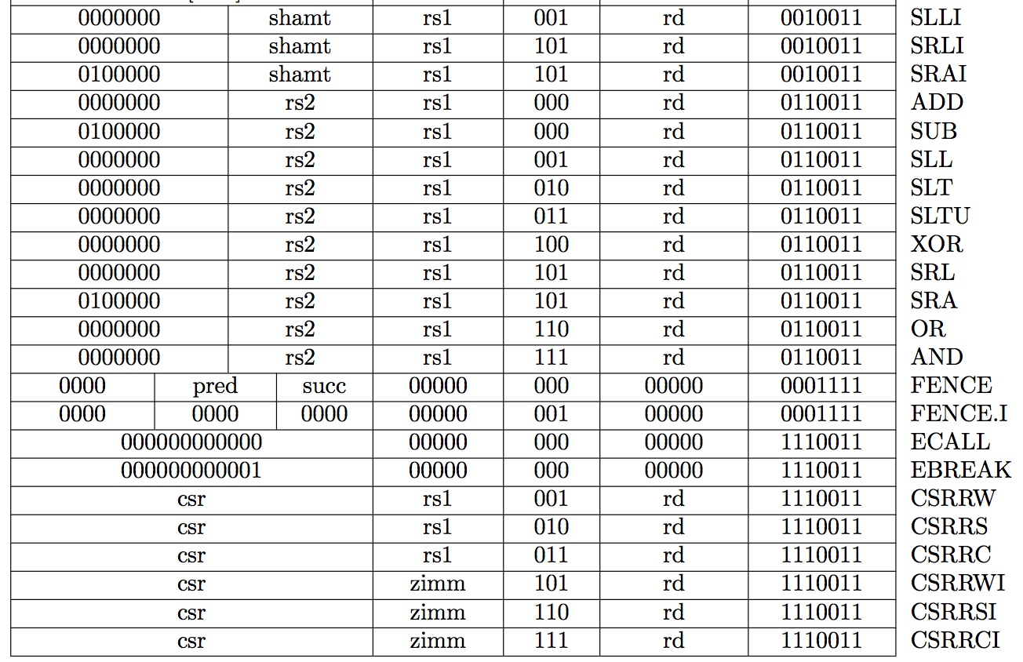
Recap: Complete RV32I ISA
Not covered
RV32I has 47 instructions
37 instructions are enough to run any C program

Slide 28
Complete RV32I Datapath!
+4
Add
Add
wb
pc
pc+4
2
DataD
Reg[rs1]
alu
1
alu
Inst[11:7]
wb
1
PC
AddrD
1
0
addr
addr
Inst[19:15]
DataR
0
inst
DataA
alu
pc+4
inst
AddrA
Branch
Comp
0
+
addr
mem
Inst[24:20]
AddrB
ALU
clk
DataB
0
DataW
IMEM
IMEM
Reg [ ]
1
DMEM
Inst [31:7]
clk
Reg[rs2]
clk
Imm.
Gen
Imm[31:0]
PCSel
Inst[31:0]
ImmSel
RegWEn
BrUn
BrLT
Bsel
ALUSel
MemRW
WBSel
Control logic
Asel
Control logic
BrEq

Slide 29
“And In conclusion…”
We have designed a complete datapath
Capable of executing all RISC-V instructions in one cycle each
Not all units (hardware) used by all instructions
5 Phases of execution
IF, ID, EX, MEM, WB
Not all instructions are active in all phases
Controller specifies how to execute instructions
New instructions can be added with just control?

Slide 30
Branch Immediates (In Other ISAs)
12-bit immediate encodes PC-relative offset of -4096 to +4094 bytes in multiples of 2 bytes
Standard approach: Treat immediate as in range -2048..+2047, then shift left by 1 bit to multiply by 2 for branches
s
imm[10:5]
rs2
rs1
funct3
imm[4:0]
B-opcode
sign-extension
s
imm[10:5]
imm[4:0]
S-Immediate
sign-extension
s
imm[10:5]
imm[4:0]
0
B-Immediate (shift left by 1)
Each instruction immediate bit can appear in one of two places in output immediate value – so need one 2-way mux per bit

Slide 31
RISC-V Branch Immediates
12-bit immediate encodes PC-relative offset of -4096 to +4094 bytes in multiples of 2 bytes
RISC-V approach: keep 11 immediate bits in fixed position in output value, and rotate LSB of S-format to be bit 12 of B-format
s
imm[10:5]
rs2
rs1
funct3
imm[4:0]
B-opcode
sign-extension
s
imm[10:5]
imm[4:0]
S-Immediate
sign-extension
s
imm[10:5]
imm[4:0]
0
B-Immediate (shift left by 1)
Only one bit changes position between S and B, so only need a single-bit 2-way mux

