Slide 1
CONTROL

Slide 2
Review
We have designed a complete datapath
Capable of executing all RISC-V instructions in one cycle each
Not all units (hardware) used by all instructions
5 Phases of execution
IF, ID, EX, MEM, WB
Not all instructions are active in all phases
Controller specifies how to execute instructions
New instructions can be added with just control?

Slide 3
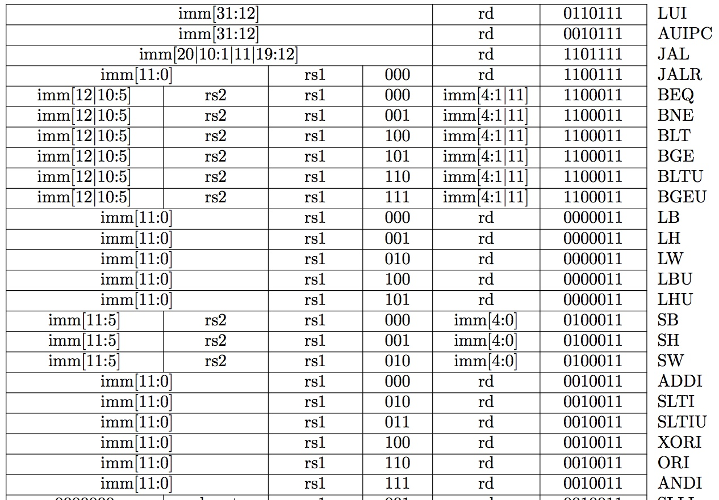
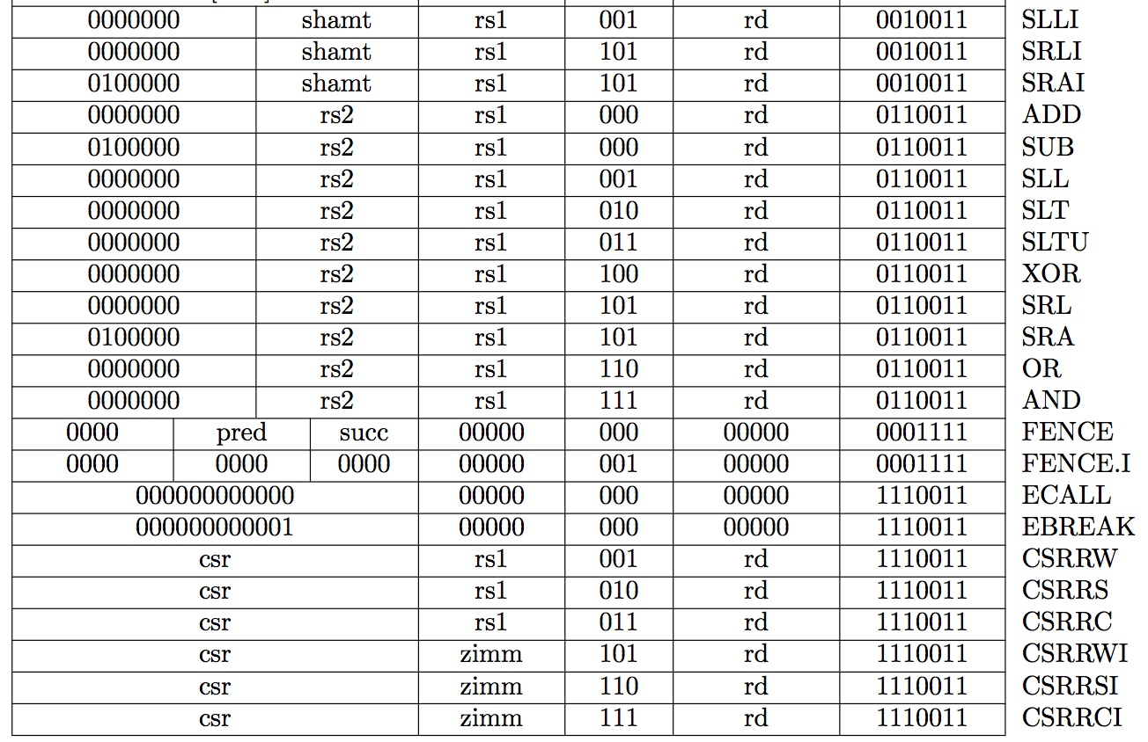
Recap: Complete RV32I ISA
Not covered
RV32I has 47 instructions
37 instructions are enough to run any C program

Slide 4
Complete Single-Cycle RV32I Datapath!
+4
Add
Add
wb
pc
pc+4
2
DataD
Reg[rs1]
alu
1
alu
Inst[11:7]
wb
1
PC
AddrD
1
0
addr
addr
Inst[19:15]
DataR
0
inst
DataA
alu
pc+4
inst
AddrA
Branch
Comp
0
+
addr
mem
Inst[24:20]
AddrB
ALU
clk
DataB
0
DataW
IMEM
IMEM
Reg [ ]
1
DMEM
Inst [31:7]
clk
Reg[rs2]
clk
Imm.
Gen
Imm[31:0]
PCSel
Inst[31:0]
ImmSel
RegWEn
BrUn
BrLT
Bsel
ALUSel
MemRW
WBSel
Control logic
Asel
Control logic
BrEq

Slide 5
Register Transfer Level (RTL)
RTL describes instructions in figures or text
Can use C (or Verilog) to describe RTL
Inst Register Transfers
add R[rd] ← R[rs1] + R[rs2]; PC ← PC + 4
sub R[rd] ← R[rs1] – R[rs2]; PC ← PC + 4
ori R[rd] ← R[rs1] | Imm; PC ← PC + 4
jal R[rd] ← PC + 4; PC ← R[rs1] + Imm
beq if ( R[rs1] == R[rs2] ) PC ← PC + Imm
else PC ← PC + 4

Slide 6
Our Single-Core Computer (w/o FPU, SIMD)
Processor
Memory
Enable?
Read/Write
Input
Control
Program
Cache
Datapath
Memory (including
cache) organized around blocks, which are typically multiple words
Address
Bytes
PC
Write Data
Registers
Data
Arithmetic & Logic Unit
(ALU)
ReadData
Output
Processor organized around words and bytes
Processor-Memory Interface
I/O-Memory Interfaces

Slide 7
Single-Cycle RV32I Datapath and Control
+4
Add
Add
pc+4
2
DataD
Reg[rs1]
1
1
Inst[11:7]
0
wb
PC
addr
AddrD
1
addr
Inst[19:15]
DataR
0
inst
DataA
alu
pc+4
inst
AddrA
Branch
Comp
0
+
addr
mem
Inst[24:20]
AddrB
ALU
clk
DataB
0
DataW
IMEM
IMEM
Reg [ ]
1
DMEM
Inst [31:20]
clk
Reg[rs2]
clk
Imm.
Gen
Imm[31:0]
PCSel
Inst[31:0]
ImmSel
RegWEn
BrUn
BrLT
Bsel
ALUSel
MemRW
WBSel
Control logic
Asel
Control logic
BrEq

Slide 8
Example: add
+4
Add
Add
wb
pc
pc+4
2
DataD
Reg[rs1]
alu
1
alu
Inst[11:7]
wb
1
PC
AddrD
1
0
addr
addr
Inst[19:15]
DataR
0
inst
DataA
alu
pc+4
inst
AddrA
Branch
Comp
0
+
addr
mem
Inst[24:20]
AddrB
ALU
DataB
0
DataW
clk
IMEM
IMEM
Reg [ ]
1
DMEM
Inst [31:7]
clk
Reg[rs2]
clk
Imm.
Gen
Imm[31:0]
PCSel
Inst[31:0]
ImmSel
RegWEn
BrUn
BrLT
Bsel
ALUSel
MemRW
WBSel
=pc+4
=*
=1
=*
=*
=0
=add
=Read
=1
Control logic
Asel
Control logic
BrEq
=*
=0
31
25
24
20
19
15
14
12
11
7
6
0
funct7
rs2
rs1
funct3
rd
opcode
7
5
5
3
5
7

Slide 9
add Execution
+4
Add
Add
alu
wb
DataD
Reg[rs1]
pc
alu
2
1
Inst[11:7]
1
wb
PC
addr
Inst[19:15]
AddrD
1
alu
0
0
addr
inst
DataA
DataR
pc+4
inst
Inst[24:20]
AddrA
Branch
Comp
0
+
addr
mem
clk
AddrB
DataB
0
ALU
DataW
IMEM
IMEM
Inst [31:7]
Reg [ ]
1
DMEM
Imm.
Gen
clk
Reg[rs2]
clk
Imm[31:0]
PCSel
Inst[31:0]
ImmSel
RegWEn
BrUn
BrLT
Bsel
ALUSel
MemRW
WBSel
=pc+4
=*
=1
=*
=*
=0
=add
=Read
=1
Control logic
BrEq
=*
Asel
=0
Clock
PC
1000
1004
PC+4
1004
1008
inst[31:0]
add x1,x2,x3
add x6,x7,x9
Control logic
add control
add control
Reg[rs1]
Reg[2]
Reg[7]
Reg[rs2]
Reg[3]
Reg[9]
alu
Reg[2]+Reg[3]
Reg[7]+Reg[9]
wb
Reg[2]+Reg[3]
Reg[7]+Reg[9]
Reg[1]
???
Reg[2]+Reg[3]

Slide 10
Example: sw
+4
Add
Add
wb
pc
pc+4
2
DataD
Reg[rs1]
alu
1
alu
Inst[11:7]
wb
1
PC
AddrD
1
0
addr
addr
Inst[19:15]
DataR
0
inst
DataA
alu
pc+4
inst
AddrA
Branch
Comp
0
+
addr
mem
Inst[24:20]
AddrB
ALU
DataB
0
DataW
clk
IMEM
IMEM
Reg [ ]
1
DMEM
Inst [31:7]
clk
Reg[rs2]
clk
Imm.
Gen
Imm[31:0]
PCSel
Inst[31:0]
ImmSel
RegWEn
BrUn
BrLT
Bsel
ALUSel
MemRW
WBSel
=pc+4
=S
=0
=*
=*
=1
=add
=Write
=*
Control logic
Asel
Control logic
BrEq
=*
=0
31
25
24
20
19
15
14
12
11
7
6
0
Imm[11:5]
rs2
rs1
funct3
imm[4:0]
opcode
offset[11:5]
src
base
width
offset[4:0]
STORE

Slide 11
Example: beq
+4
Add
Add
wb
pc
pc+4
2
DataD
Reg[rs1]
alu
1
alu
Inst[11:7]
wb
1
PC
AddrD
1
0
addr
addr
Inst[19:15]
DataR
0
inst
DataA
alu
pc+4
inst
AddrA
Branch
Comp
0
+
addr
mem
Inst[24:20]
AddrB
ALU
DataB
0
DataW
clk
IMEM
IMEM
Reg [ ]
1
DMEM
Inst [31:7]
clk
Reg[rs2]
clk
Imm.
Gen
Imm[31:0]
PCSel
Inst[31:0]
ImmSel
RegWEn
BrUn
BrLT
Bsel
ALUSel
MemRW
WBSel
=B
=0
=0
=*
=1
=add
=Read
=*
Control logic
Asel
Control logic
BrEq
=1

Slide 12
Peer Instruction(s): Critical Path (yellkey)
+4
Add
Add
pc+4
wb
pc
alu
2
DataD
Reg[rs1]
1
alu
1
Inst[11:7]
0
wb
PC
addr
AddrD
1
0
addr
inst
Inst[19:15]
DataA
alu
DataR
inst
Critical path for a addi
R[rd] = R[rs1]+imm
pc+4
Inst[24:20]
AddrA
Branch
Comp
0
+
addr
mem
clk
AddrB
DataB
0
ALU
DataW
IMEM
IMEM
Reg [ ]
1
DMEM
Inst [31:7]
clk
Reg[rs2]
Imm.
Gen
clk
Imm[31:0]
PCSel
Inst[31:0]
ImmSel
RegWEn
BrUn
BrLT
Bsel
ALUSel
MemRW
WBSel
Control logic
Asel
Control logic
BrEq
t_{clk-q} + t_{Add} + t_{IMEM} + t_{Reg} + t_{BComp} + t_{ALU} + t_{DMEM} + t_{mux} + t_{Setup}
t_{clk-q} + t_{IMEM} + max{t_{Reg}, t_{Imm}} + t_{ALU} + 2t_{mux} + t_{Setup}
t_{clk-q} + t_{IMEM} + max{t_{Reg}, t_{Imm}} + t_{ALU} + 3t_{mux} + t_{DMEM} + t_{Setup}
None of the above

Slide 13
Peer Instruction(s): Critical Path (citizen try)
+4
t_{setup}
Add
Add
pc+4
wb
pc
alu
2
DataD
Reg[rs1]
1
alu
1
Inst[11:7]
0
wb
PC
addr
AddrD
1
0
addr
inst
Inst[19:15]
DataA
alu
DataR
inst
Critical path for a addi
R[rd] = R[rs1]+imm
pc+4
Inst[24:20]
AddrA
Branch
Comp
0
+
addr
mem
clk
AddrB
DataB
0
ALU
DataW
IMEM
IMEM
Reg [ ]
1
DMEM
Inst [31:7]
clk
Reg[rs2]
Imm.
Gen
clk
Imm[31:0]
PCSel
Inst[31:0]
ImmSel
RegWEn
BrUn
BrLT
Bsel
ALUSel
MemRW
WBSel
Control logic
Asel
Control logic
BrEq
t_{clk-q} + t_{Add} + t_{IMEM} + t_{Reg} + t_{BComp} + t_{ALU} + t_{DMEM} + t_{mux} + t_{Setup}
t_{clk-q} + t_{IMEM} + max{t_{Reg}, t_{Imm}} + t_{ALU} + 2t_{mux} + t_{Setup}
t_{clk-q} + t_{IMEM} + max{t_{Reg}, t_{Imm}} + t_{ALU} + 3t_{mux} + t_{DMEM} + t_{Setup}
None of the above

Slide 14
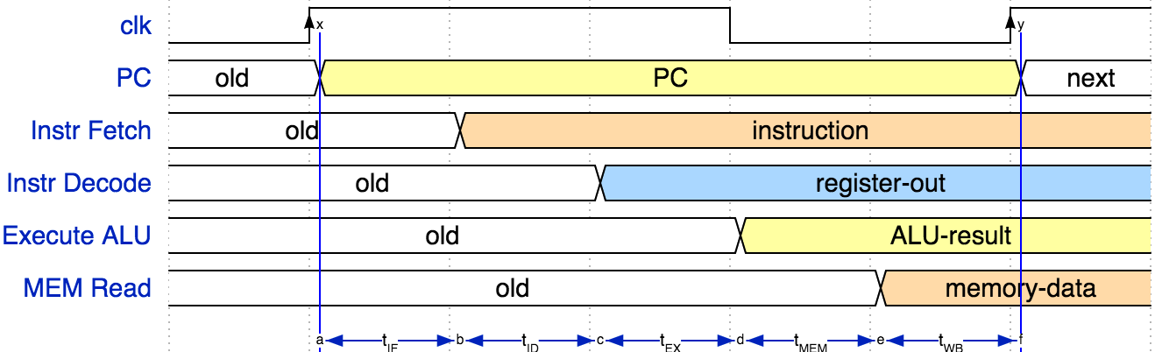
Instruction Timing
IF | ID | EX | MEM | WB | Total
I-MEM | Reg Read | ALU | D-MEM | Reg W
200 ps | 100 ps | 200 ps | 200 ps | 100 ps | 800 ps

Slide 15
Instruction Timing
Instr | IF = 200ps | ID = 100ps | ALU = 200ps | MEM=200ps | WB = 100ps | Total
add | X | X | X |  | X | 600ps
beq | X | X | X |  |  | 500ps
jal | X | X | X |  |  | 500ps
lw | X | X | X | X | X | 800ps
sw | X | X | X | X |  | 700ps
Maximum clock frequency
f_{max} = 1/800ps = 1.25 GHz
Most blocks idle most of the time
E.g. f_{max,ALU} = 1/200ps = 5 GHz!

Slide 16
Control Logic Truth Table
Inst[31:0] | BrEq | BrLT | PCSel | ImmSel | BrUn | ASel | BSel | ALUSel | MemRW | RegWEn | WBSel
add | * | * | +4 | * | * | Reg | Reg | Add | Read | 1 | ALU
sub | * | * | +4 | * | * | Reg | Reg | Sub | Read | 1 | ALU
(R-R Op) | * | * | +4 | * | * | Reg | Reg | (Op) | Read | 1 | ALU
addi | * | * | +4 | I | * | Reg | Imm | Add | Read | 1 | ALU
lw | * | * | +4 | I | * | Reg | Imm | Add | Read | 1 | Mem
sw | * | * | +4 | S | * | Reg | Imm | Add | Write | 0 | *
beq | 0 | * | +4 | B | * | PC | Imm | Add | Read | 0 | *
beq | 1 | * | ALU | B | * | PC | Imm | Add | Read | 0 | *
bne | 0 | * | ALU | B | * | PC | Imm | Add | Read | 0 | *
bne | 1 | * | +4 | B | * | PC | Imm | Add | Read | 0 | *
blt | * | 1 | ALU | B | 0 | PC | Imm | Add | Read | 0 | *
bltu | * | 1 | ALU | B | 1 | PC | Imm | Add | Read | 0 | *
jalr | * | * | ALU | I | * | Reg | Imm | Add | Read | 1 | PC+4
jal | * | * | ALU | J | * | PC | Imm | Add | Read | 1 | PC+4
auipc | * | * | +4 | U | * | PC | Imm | Add | Read | 1 | ALU
CS 61c
Lecture 12: Control & Performance

Slide 17
Control Realization Options
ROM
“Read-Only Memory”
Regular structure
Can be easily reprogrammed
fix errors
add instructions
Popular when designing control logic manually
Combinatorial Logic
Today, chip designers use logic synthesis tools to convert truth tables to networks of gates

Slide 18
Single-Cycle RISC-V RV32I Datapath
+4
Reg[]
pc
pc+4
pc
wb
1
alu
1
DataD
Reg[rs1]
ALU
2
alu
0
DMEM
0
IMEM
inst[11:7]
AddrD
Addr
1
pc+4
Branch Comp.
Reg[rs2]
DataR
wb
inst[19:15]
AddrA
DataA
0
0
DataW
mem
inst[24:20]
AddrB
DataB
1
inst[31:7]
Imm.
Gen
imm[31:0]
Control Logic
PCSel
inst[31:0]
ImmSel
RegWEn
BrUn
BrEq
BrLT
BSel
ASel
ALUSel
MemRW
WBSel

Slide 19
Single-Cycle RISC-V RV32I Datapath
+4
Reg[]
pc
pc+4
pc
wb
1
alu
1
DataD
Reg[rs1]
ALU
2
alu
0
DMEM
0
IMEM
inst[11:7]
AddrD
Addr
1
pc+4
Branch Comp.
Reg[rs2]
DataR
wb
inst[19:15]
AddrA
DataA
0
0
DataW
mem
inst[24:20]
AddrB
DataB
1
inst[31:7]
Imm.
Gen
imm[31:0]
Control Logic
PCSel
inst[31:0]
ImmSel
RegWEn
BrUn
BrEq
BrLT
BSel
ASel
ALUSel
MemRW
WBSel

Slide 20
“And In conclusion…”
We have built a processor (almost)!
Capable of executing all RISC-V instructions in one cycle each
Not all units (hardware) used by all instructions
Critical path changes
5 Phases of execution
IF, ID, EX, MEM, WB
Not all instructions are active in all phases
Controller specifies how to execute instructions
Implemented as ROM or logic (we’ll show you next time)

