Slide 1

Onboarding Adapter Prototype
Andres Calderon

Slide 2
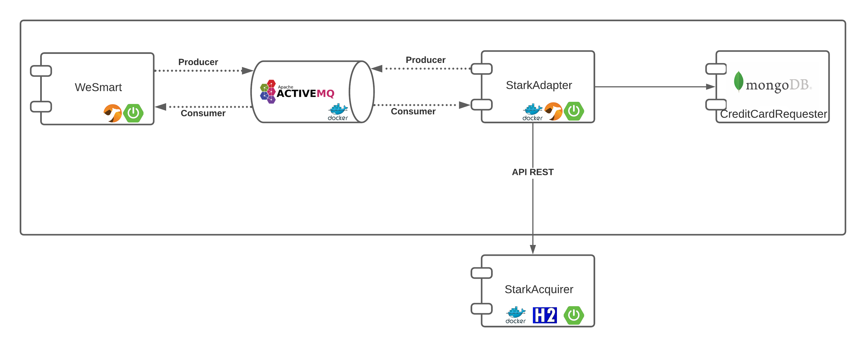
Component Diagram

Slide 3
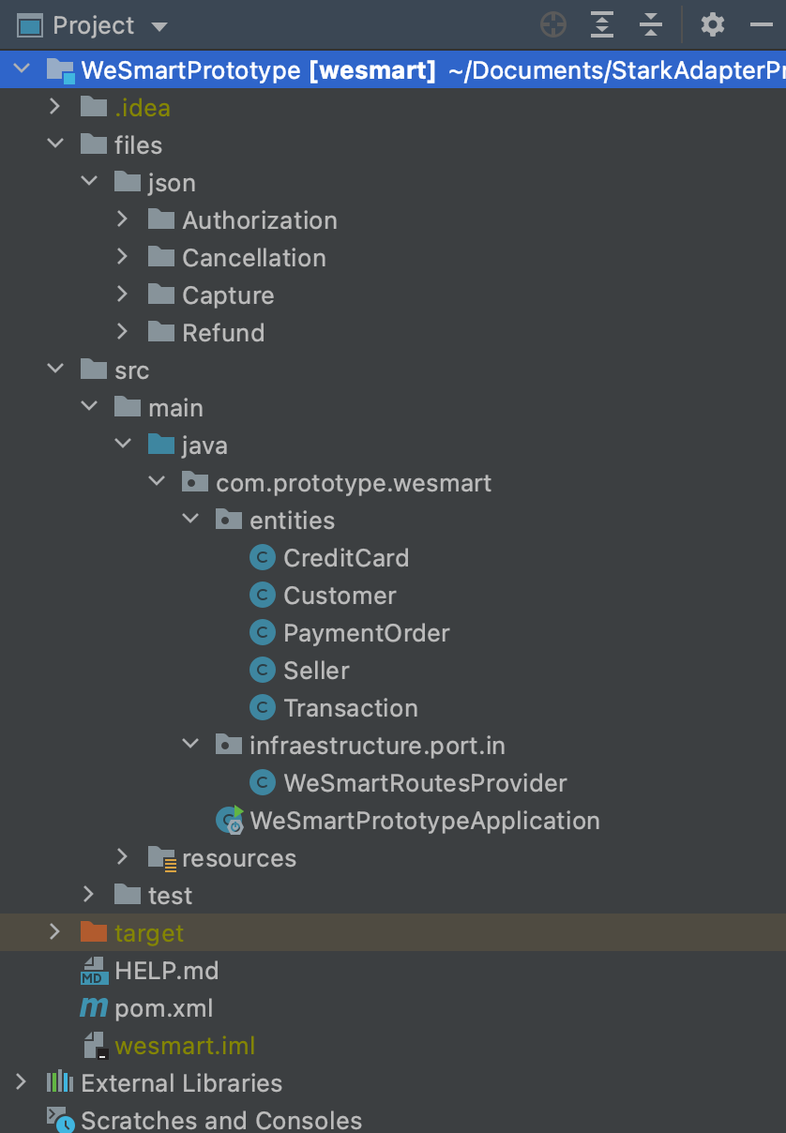
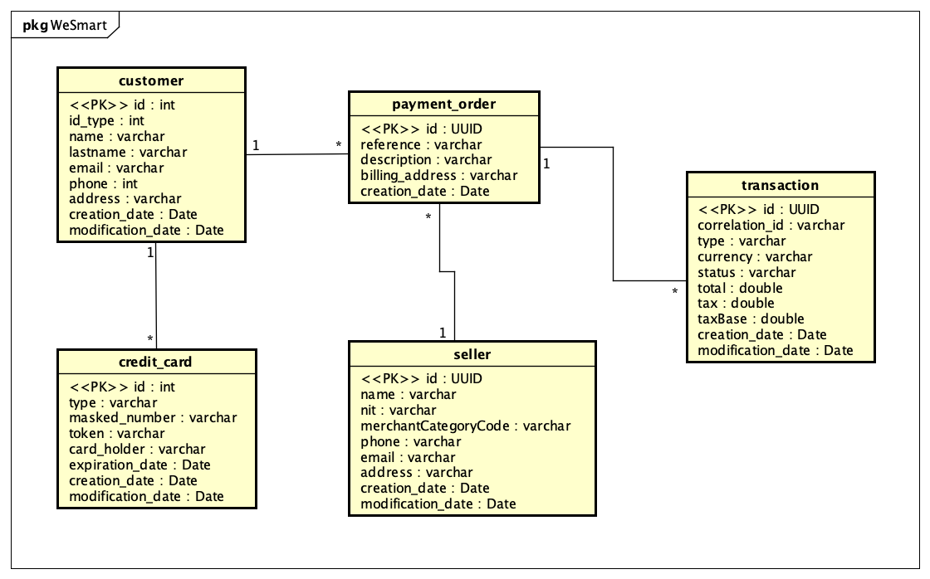


WeSmart
Project Package
Entity Relationship Diagram

Slide 4
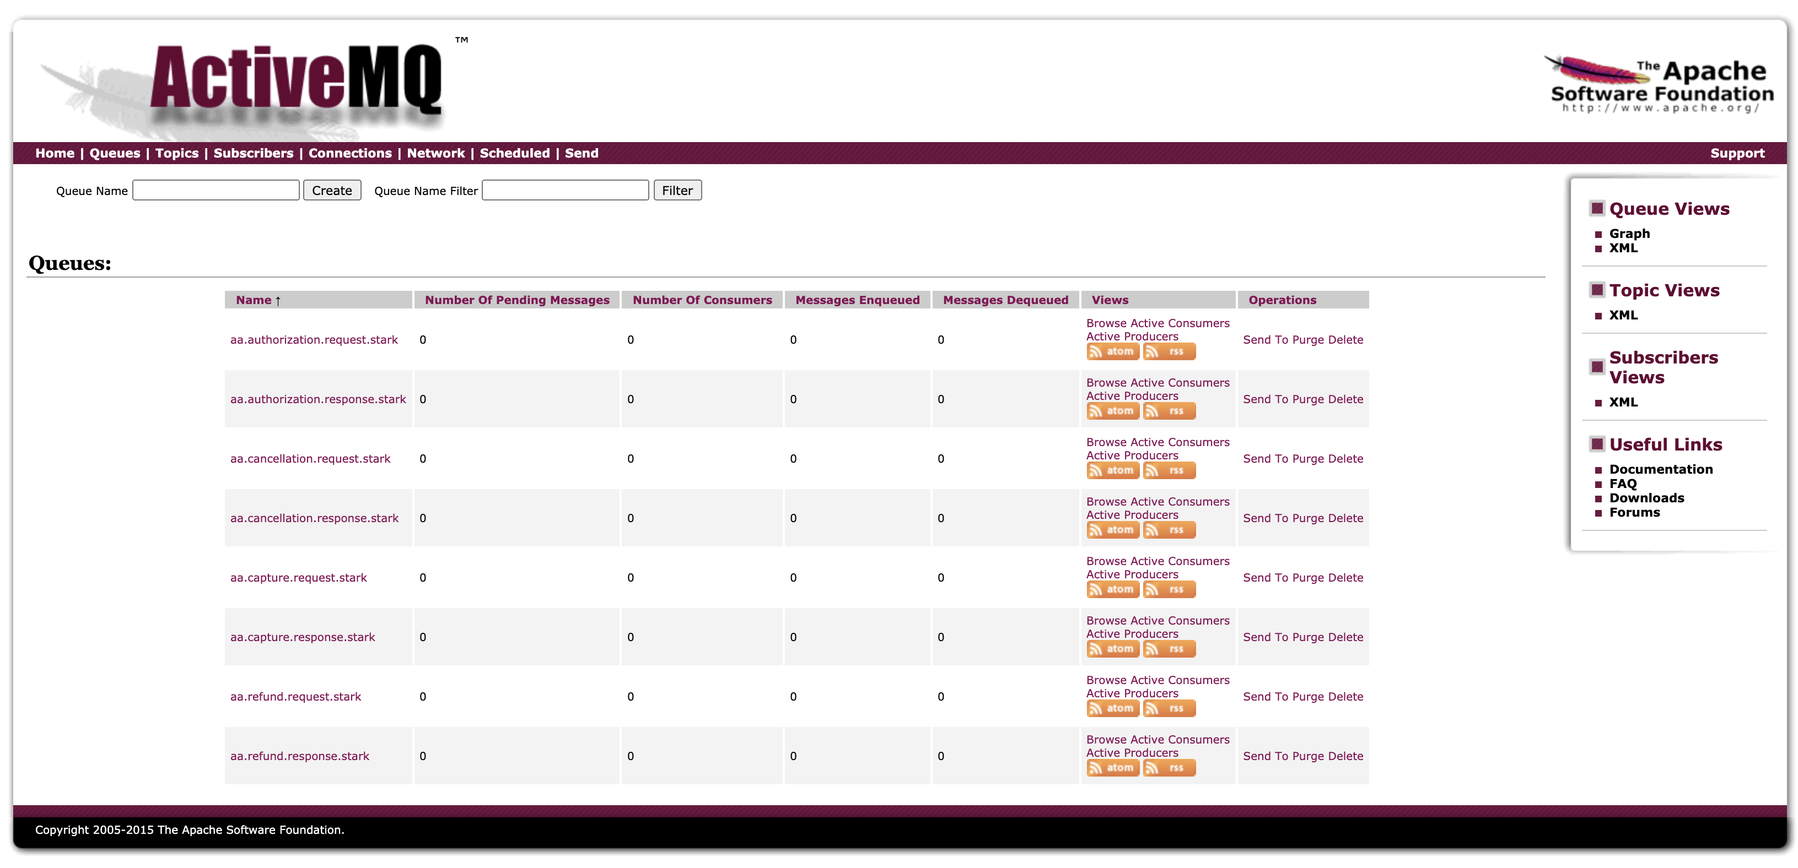
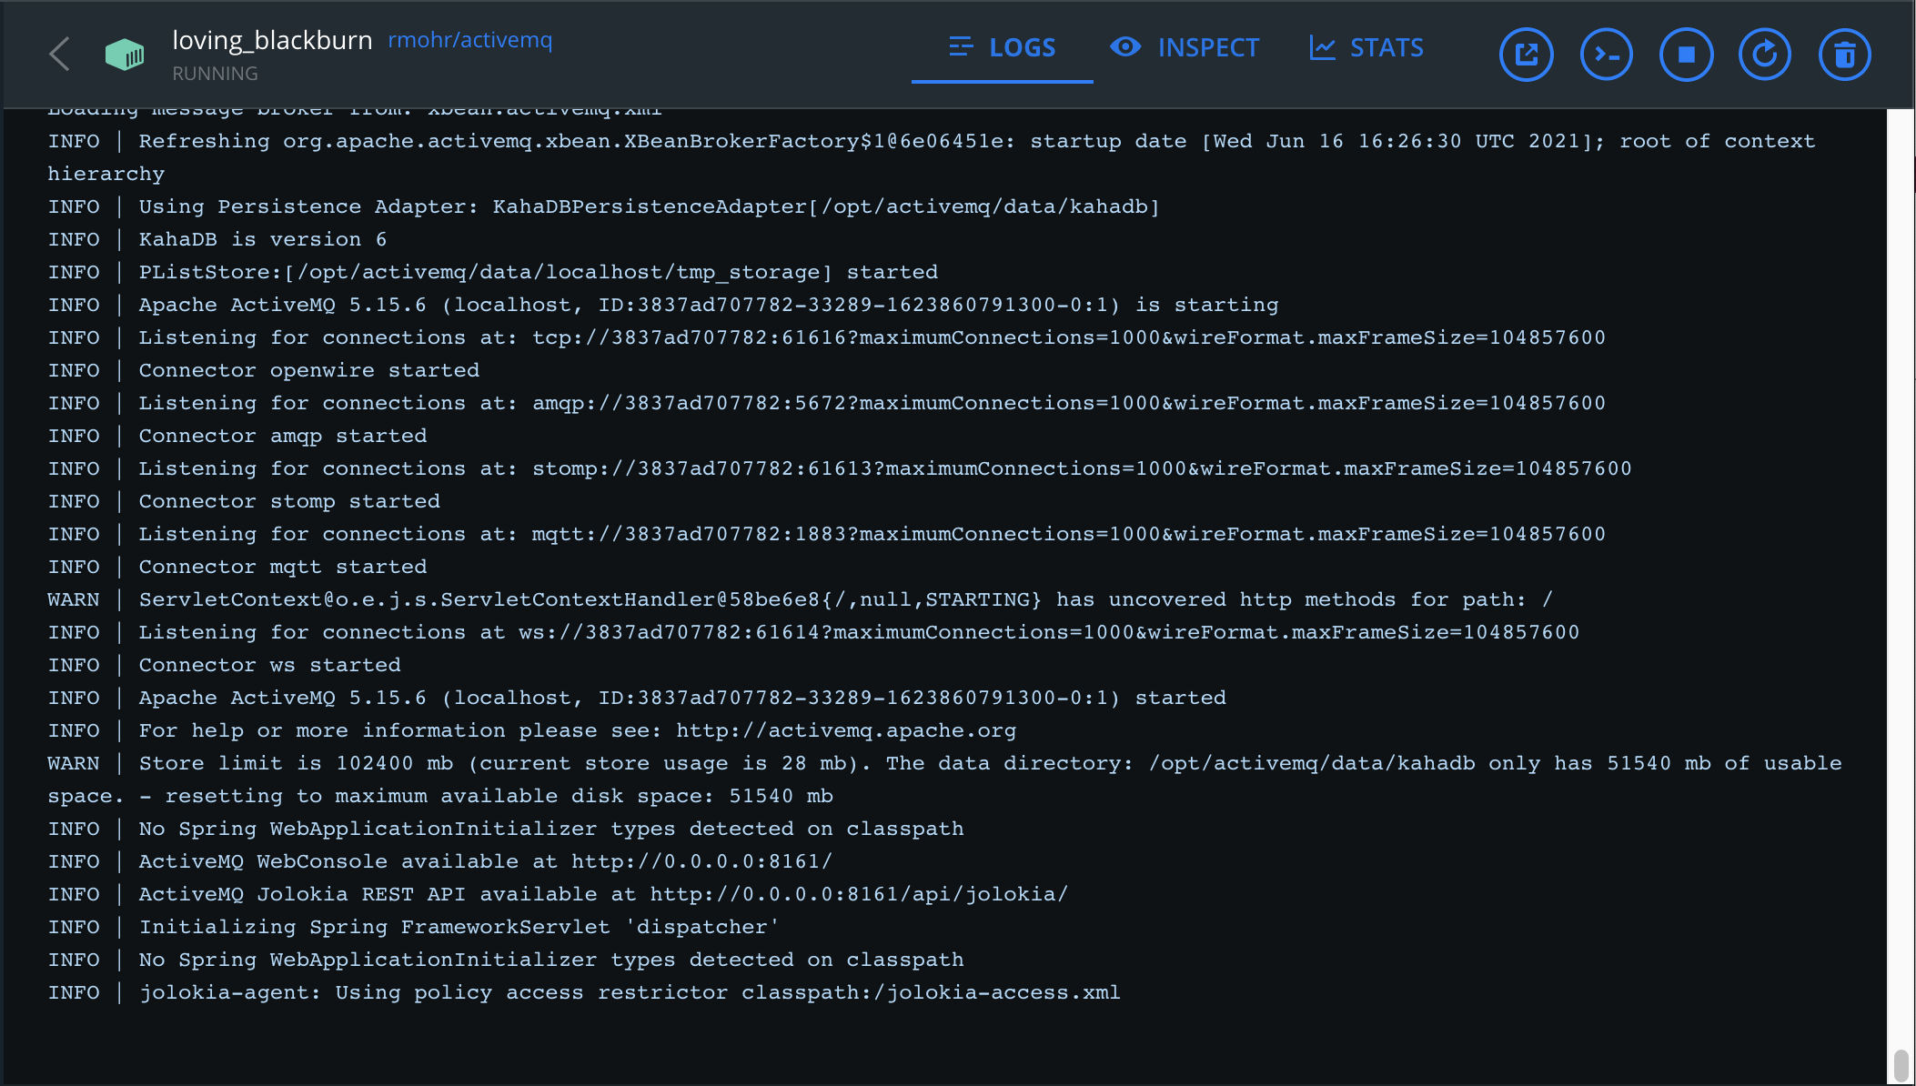

ActiveMQ

Slide 5


Stark Acquirer – Simulation
Business rules:
Special features:
Only accepts users and credit cards already created in the network.
Supported operations
Authorization
Capture
Void
Refund
Unsupported operations
Authorizations and Capture
Partial Refund
The persistence is made using a H2 database.
H2 console exposed.
Use of MyBatis as persistence framework.
Exposed port: 8002
Dockerized application.
Endpoints:
/authorization
/capture
/void
/refund

Slide 6
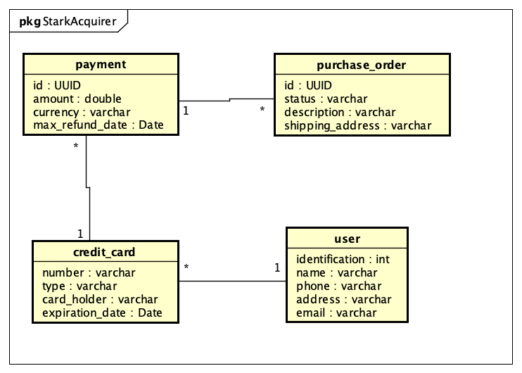
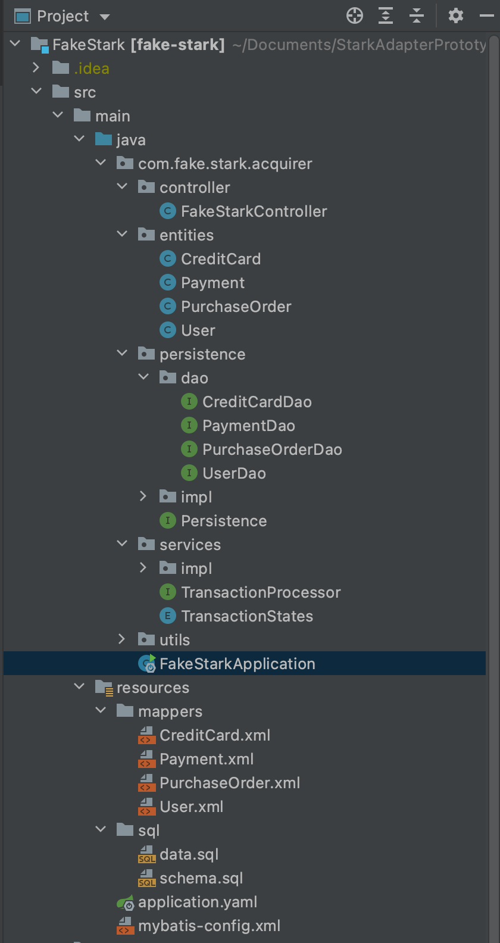
Stark Acquirer – Simulation
Entity Relationship Diagram
Project Package

Slide 7
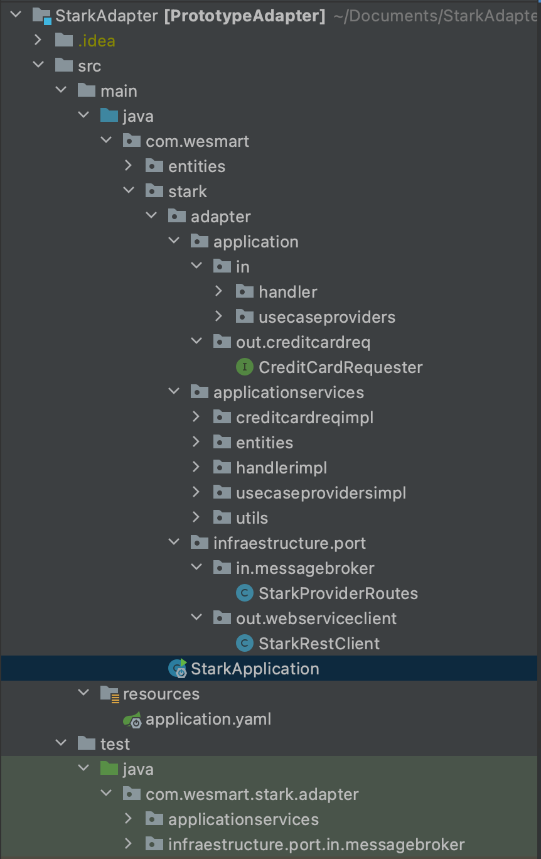
Stark Adapter
Project Package:
Special features:
Use of Apache Camel as EIP.
Exposed port: 8001
Dockerized application.
Use of okhttp for request/response API

Slide 8
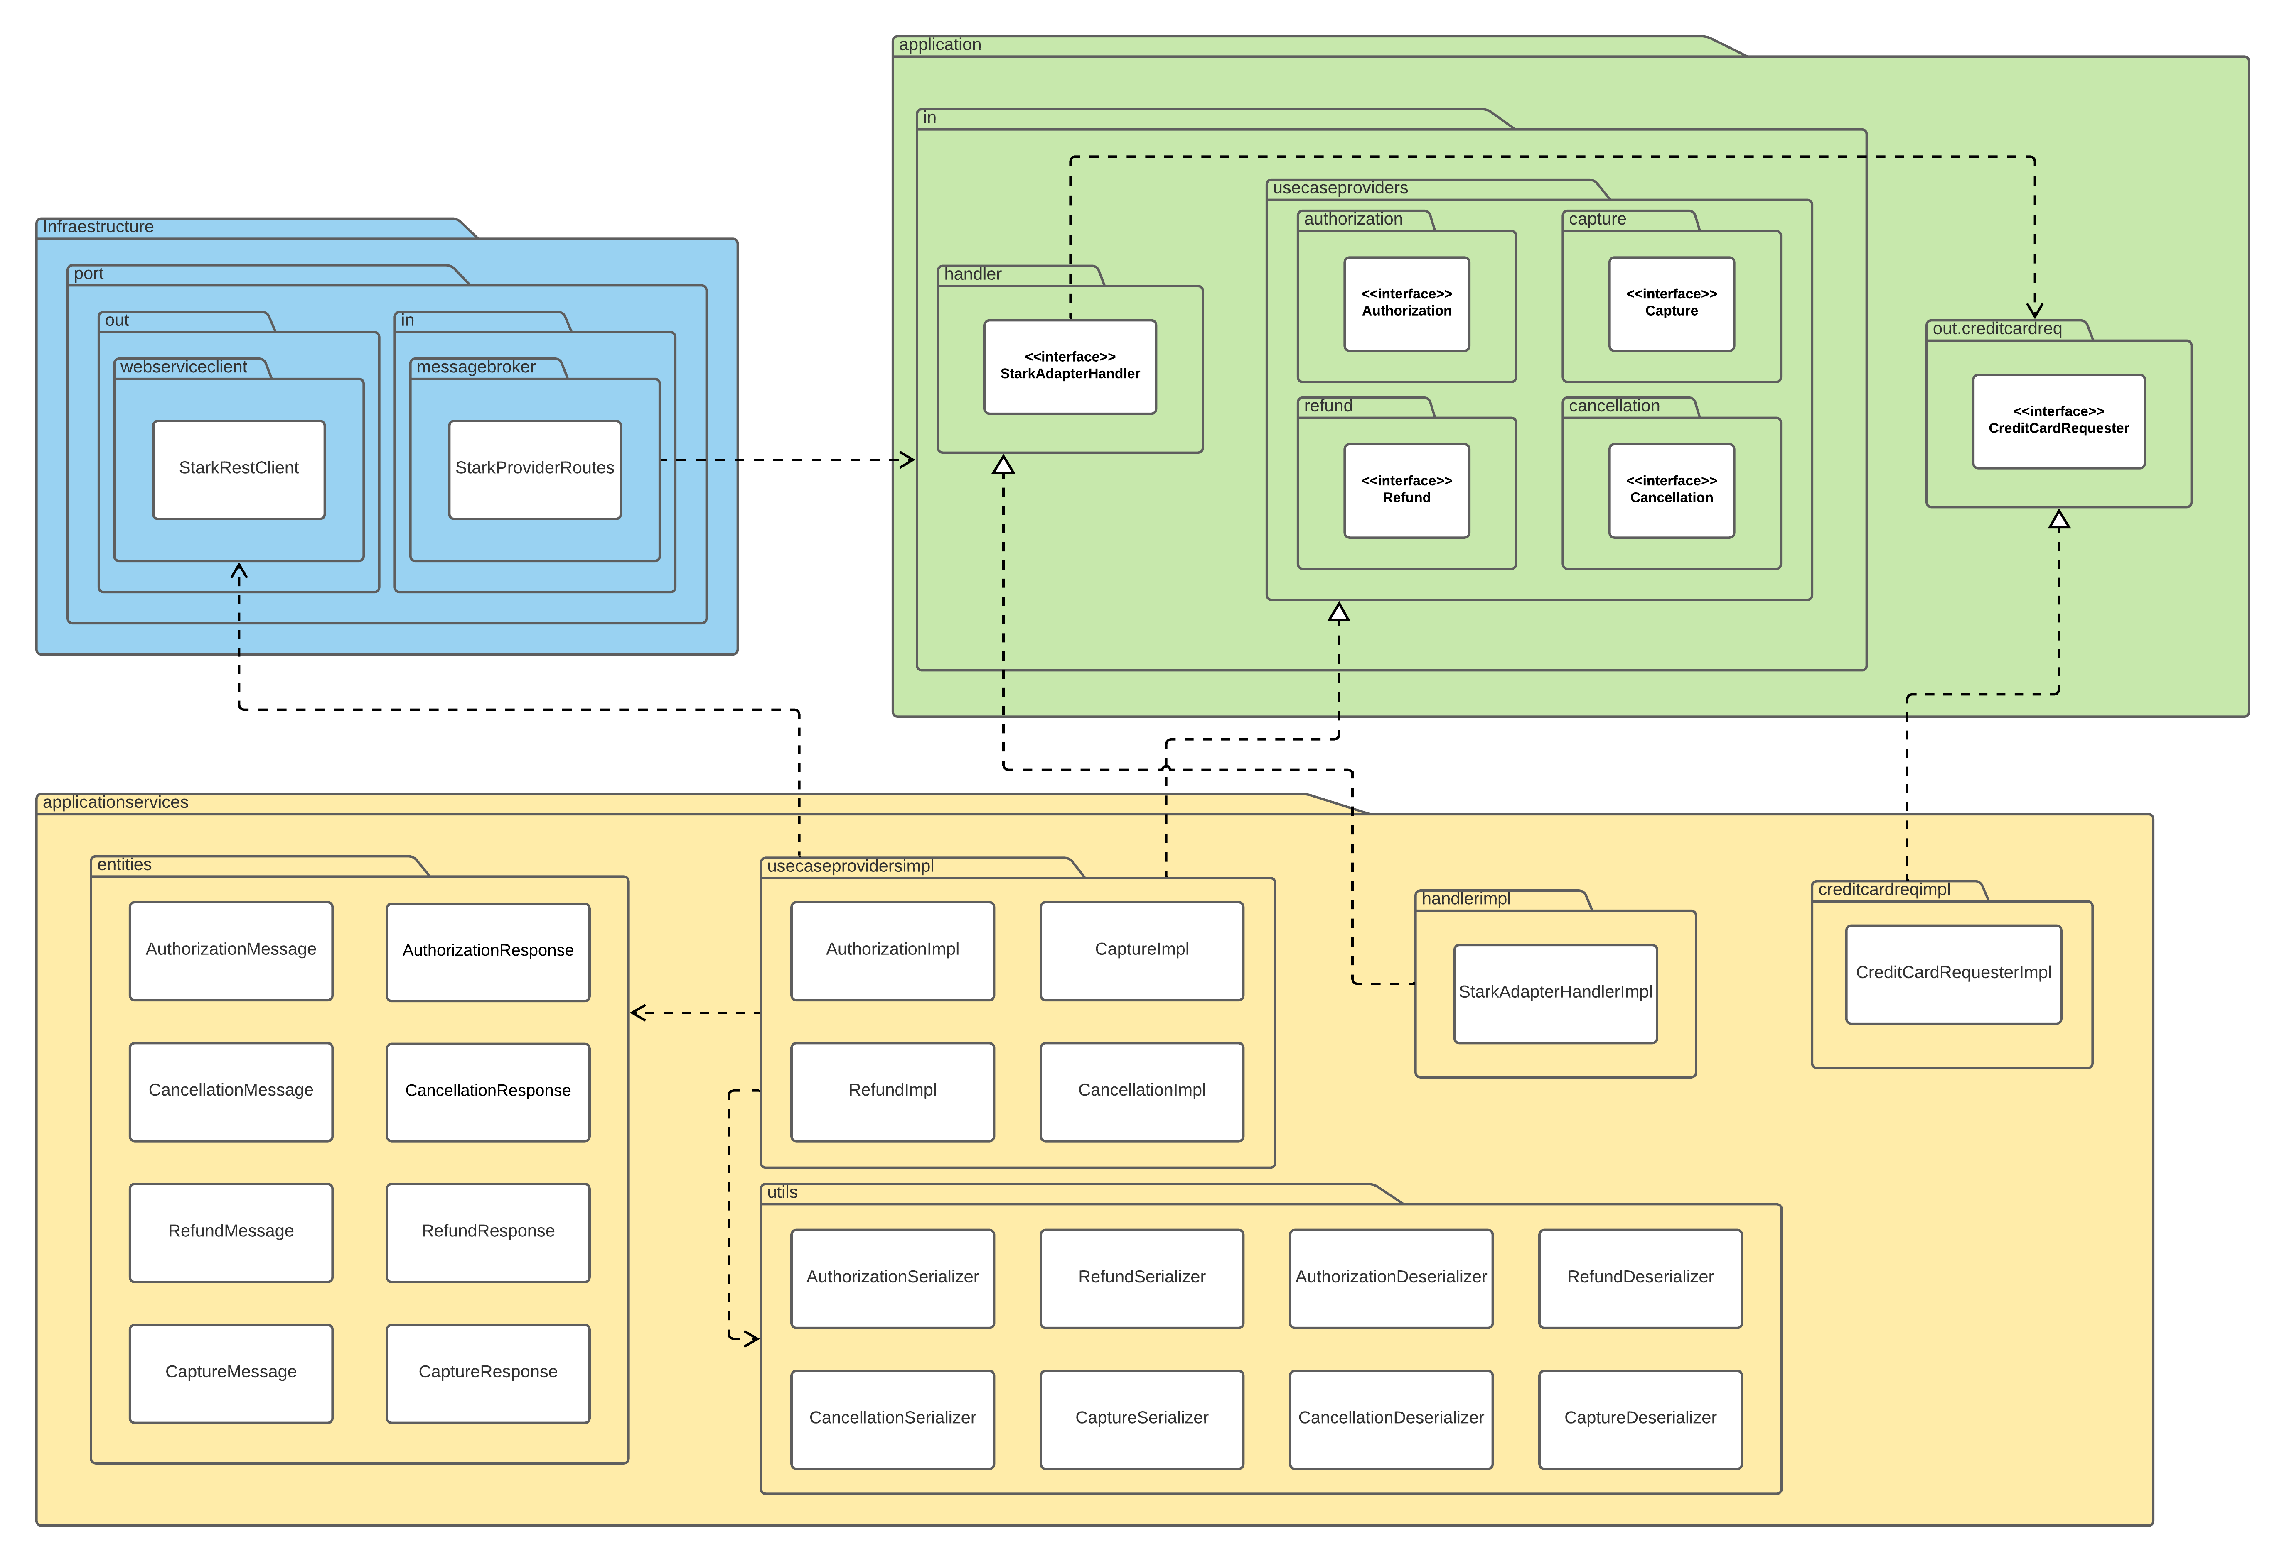
Stark Adapter
Package Diagram

