Slide 1

Vita Collab
Using public data to improve public health.

Slide 2
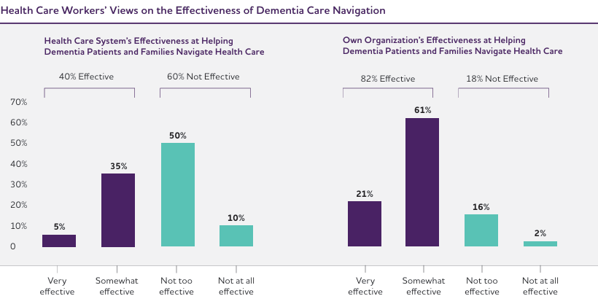
How can we transform that 60% of perceived ineffectiveness in the health system into opportunities for improvement and hope?
Where every decision can change a life, our platform emerges as a ray of hope. 60% of healthcare workers believe the current system is not effective in helping dementia patients and their families navigate healthcare. However, 82% believe in the effectiveness of their own organization. This discrepancy calls us to action.

Slide 3
Problem
Lack of coordination in health care
Delays in outbreak identification
Inefficiency in resource management
Difficulties in communication between different institutions that result in fragmented care.
Lack of early warning systems impede rapid response to disease outbreaks.
Unequal distribution of medical and health resources that does not align with the needs of the population.
Linguistic and cultural barriers
Limited access to health data
Difficulties in providing adequate health services due to linguistic and cultural diversity.
Lack of access to up-to-date and relevant health data for informed decision making.

Slide 4
Solution
Improved communication and collaboration
Predictive outbreak analysis
Facilitate a constant flow of information between institutions for more coordinated and efficient care.
Use data to predict and quickly respond to potential disease outbreaks.
Optimization of resource distribution
Multilingual accessibility
Analyze the health needs of the population for a more effective allocation of resources.
Offer the platform in multiple languages to overcome language barriers and improve inclusion.

Slide 5

Live Demo

Slide 6
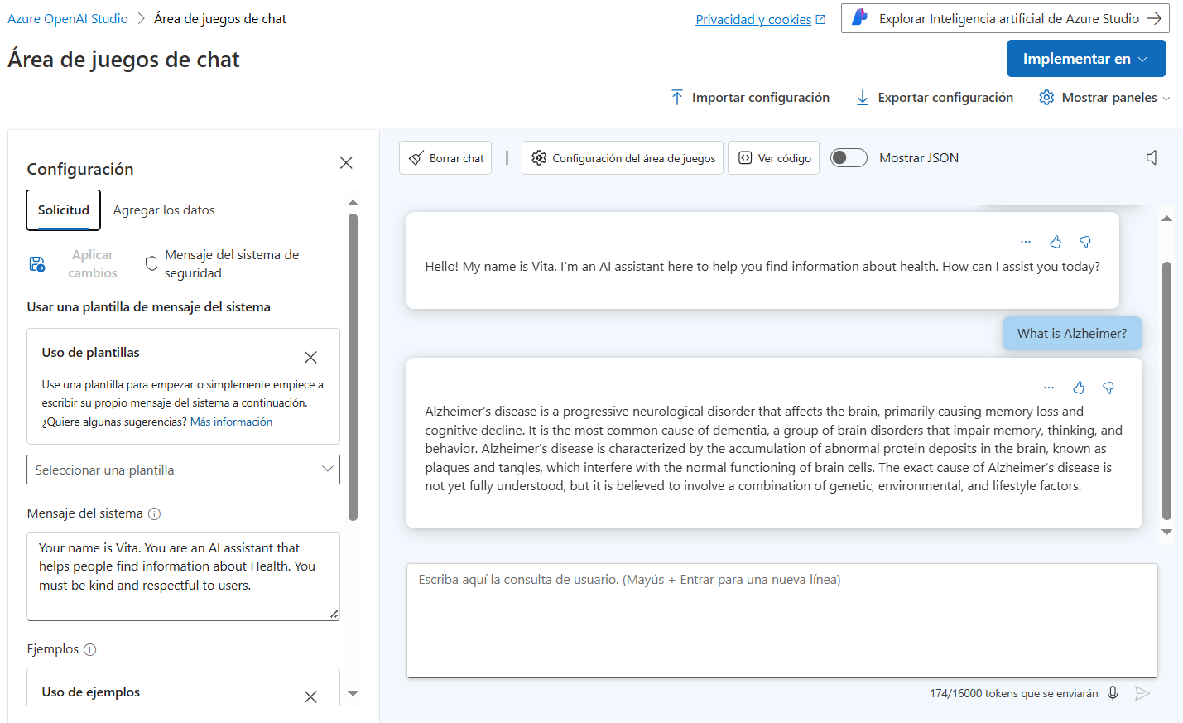

Slide 7
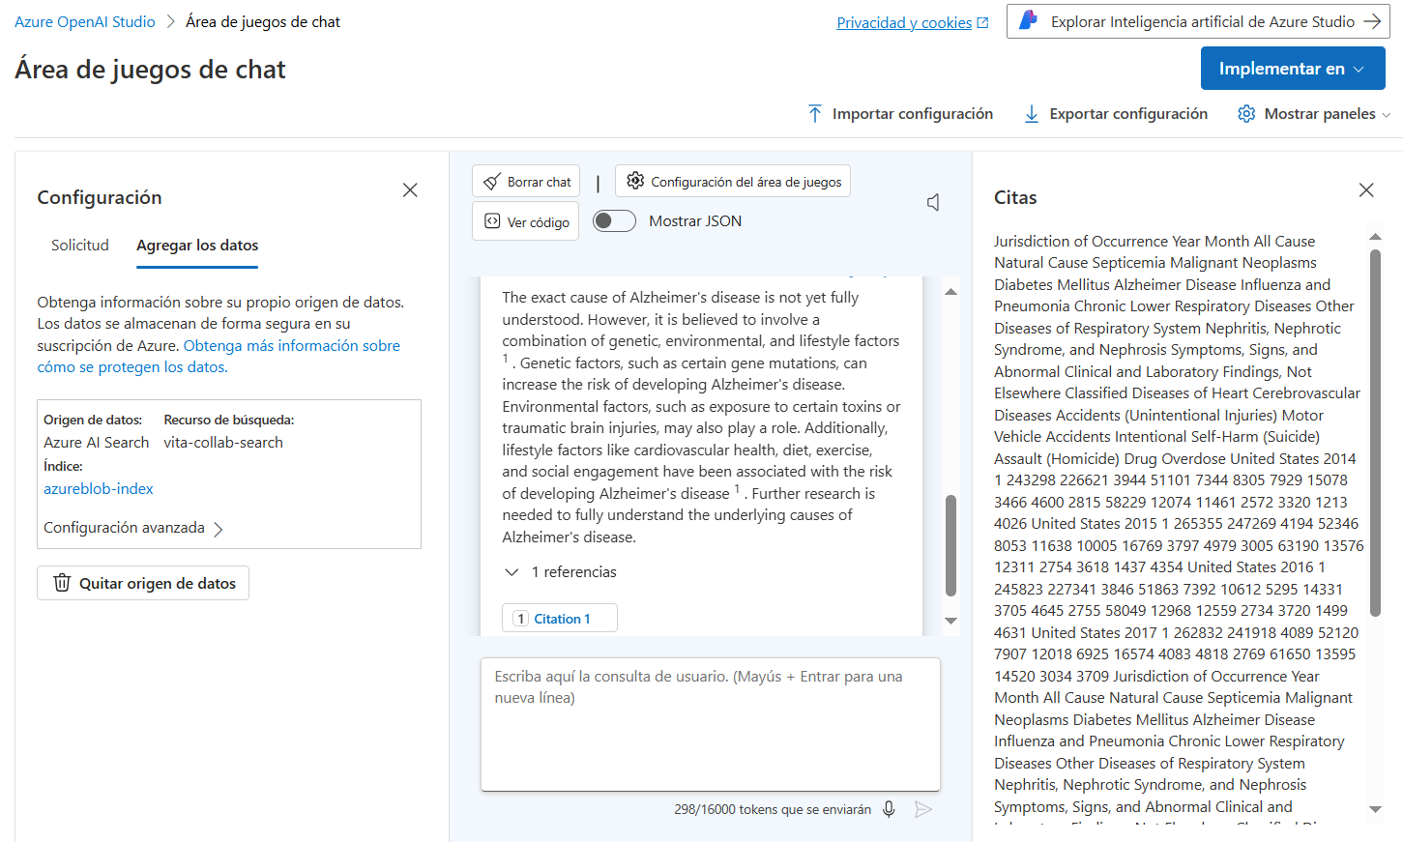

Slide 8
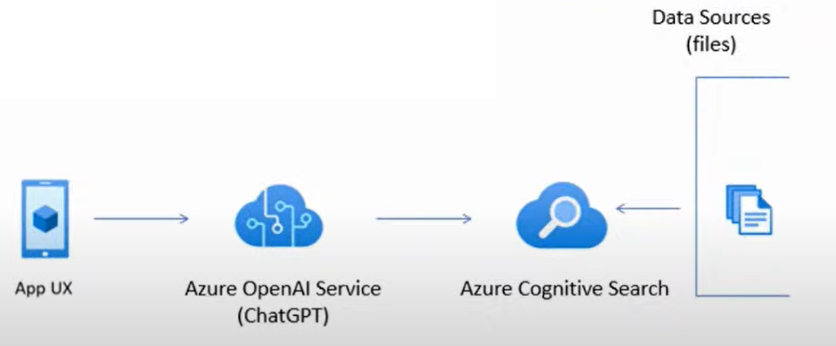
solution architecture

Slide 9

Implementation
efficient and scalable
Our platform is designed to handle large volumes of data from multiple sources in real time, which is crucial for early detection of outbreaks and rapid response to public health emergencies.
Responsible AI
Ensure that the platform is accessible to all users and that information is available in different languages, which you can achieve with Azure Search and OpenAI's multilingual capabilities. As well as that AI processes and algorithms are transparent for users and interested parties. This includes clear documentation on how data is collected, processed and used.

Slide 10

Benefits
Interinstitutional Collaboration
Facilitation of joint work between different groups.
Data-Based Decisions
Making decisions based on data and scientific evidence.
Accessibility
Information that is understandable and accessible to everyone involved.

Slide 11


Meet the team
Carlos Nieto
BI Analist
Franklin canduri
Developer

Slide 12

Summary
Our cross-agency collaboration platform addresses the critical need to improve public health decision-making through the integration and analysis of public data. In response to the current problem of insufficient coordination between agencies, we have developed a solution that collects data on diseases, population and health resources, analyzes it to predict outbreaks and detect unusual patterns, and facilitates communication and collaboration between those involved. Deployed using a wide range of Azure services, our platform is robust and scalable, ensuring optimal performance and constant innovation. Key benefits include significant improvement in response to health emergencies, effective inter-agency collaboration, informed decisions based on solid data, and accessibility of information for all users, including in different languages. With this platform, we seek to transform public health governance and promote more effective and collaborative knowledge management.

Slide 13
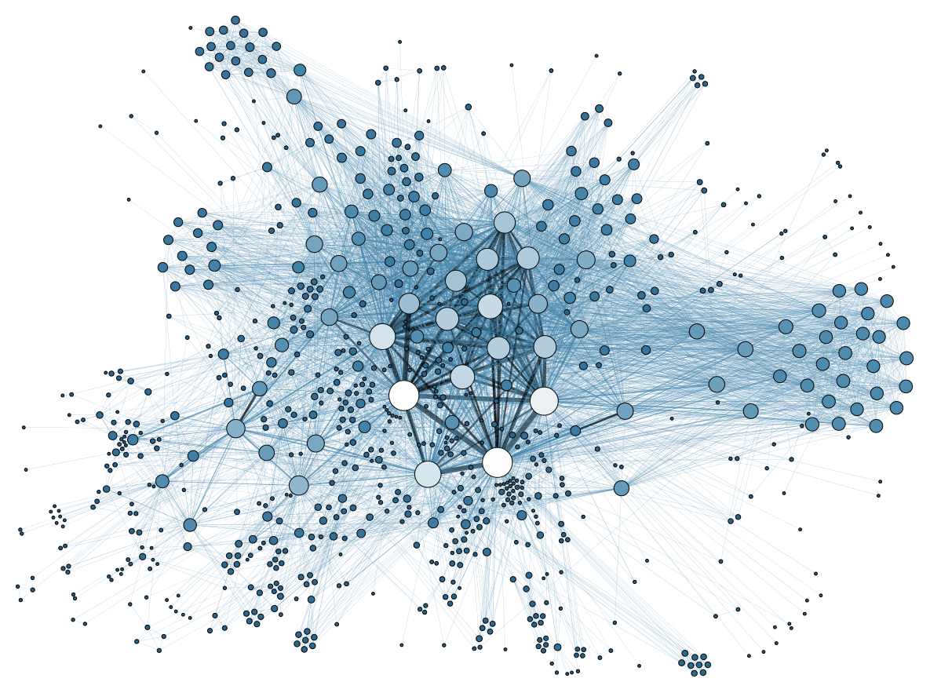
Thank you

