Slide 1



TESTE
View in Power BI
Last data refresh:
06/08/2026 11:58:47 UTC
Downloaded at:
07/08/2026 13:50:11 UTC

Slide 2
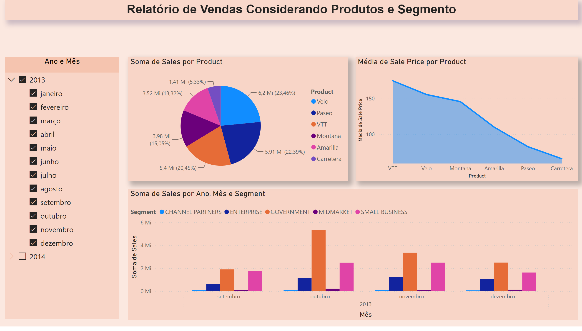
Página 1
Notes:
pieChart
No alt text provided
areaChart
No alt text provided
clusteredColumnChart
No alt text provided
listSlicer
No alt text provided
textbox
No alt text provided

Slide 3
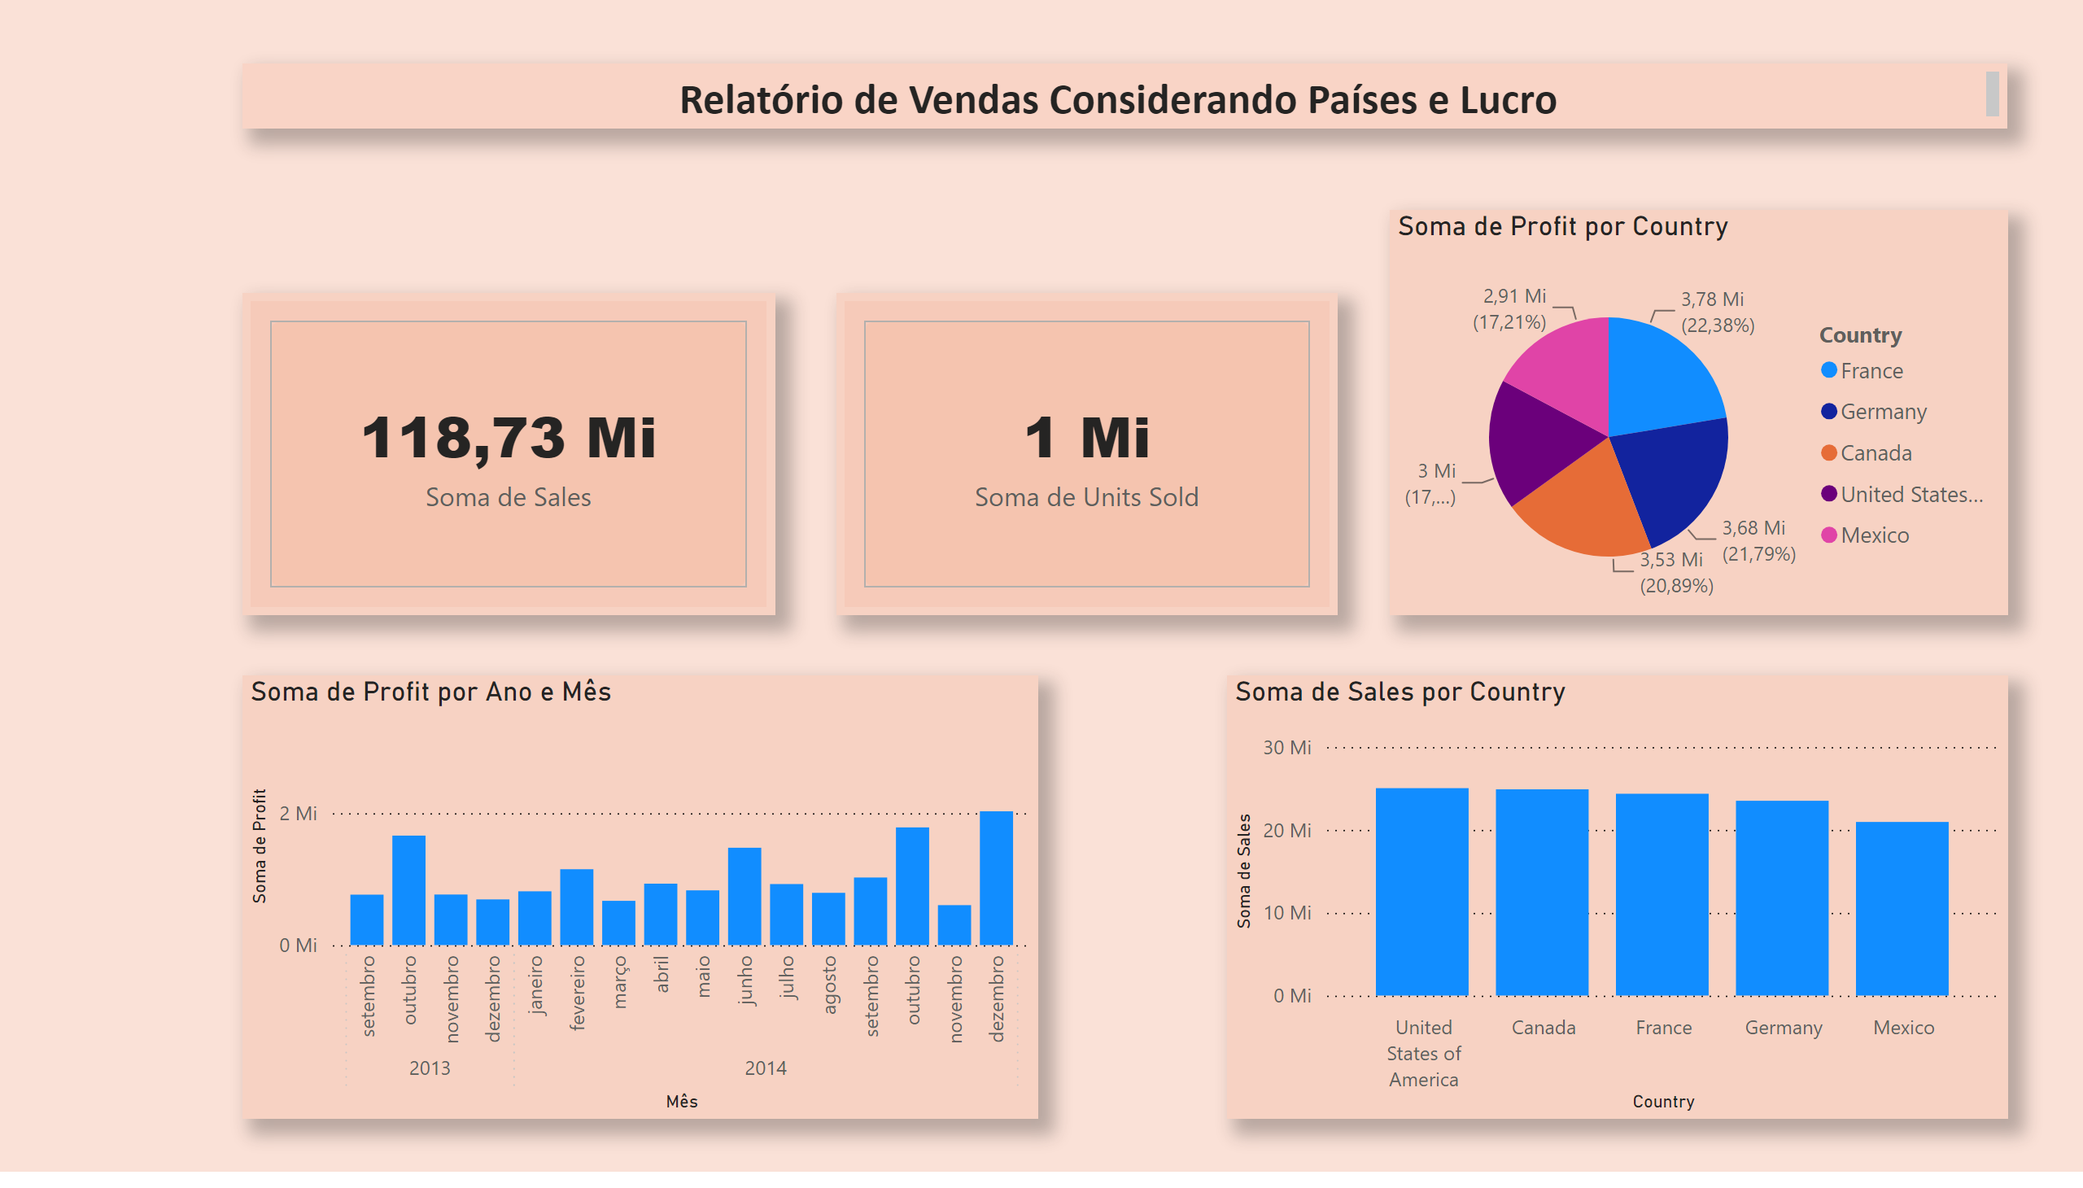
Página 2
Notes:
clusteredColumnChart
No alt text provided
pieChart
No alt text provided
textbox
No alt text provided
cardVisual
No alt text provided
cardVisual
No alt text provided
clusteredColumnChart
No alt text provided

Slide 4
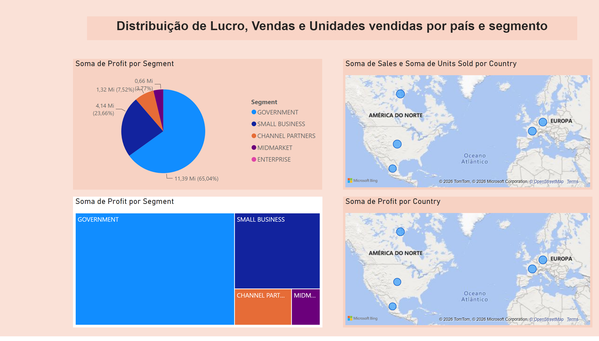
Página 3
Notes:
pieChart
No alt text provided
treemap
No alt text provided
map
No alt text provided
map
No alt text provided
textbox
No alt text provided

