Slide 1
Mini Chat App
Technology used in making the project
Reactjs
Firebase
Vite
Context API
React-Router library
What is Reactjs ?
React is a JavaScript library for building user interfaces.
What is Vite ?
Vite is a web development build tool that is designed to be fast and lightweight. It is a modern alternative to tools like Webpack, and aims to improve the development experience by providing fast build times and hot module reloading.
What is Firebase ?
Firebase is a mobile and web application development platform developed by Google. It provides a variety of tools and services for building and maintaining applications, including a real-time database, user authentication, and hosting.

Slide 2
Why I used Firebase in my mini chat app ?
Real-time database: Firebase's real-time database allows you to store and sync data in real time, which is essential for a chat app. The database updates automatically when data changes, so users can see new messages as soon as they are sent.
Authentication: Firebase provides a number of tools for managing user accounts and authentication, which can be helpful when building a chat app. You can use Firebase's authentication providers to allow users to sign in with their existing accounts, or you can create your own custom authentication system.
Storage: Firebase's storage service can be used to store and serve user-generated content like images and videos. This can be helpful when building a chat app, as users may want to send each other photos or other media.

Slide 3
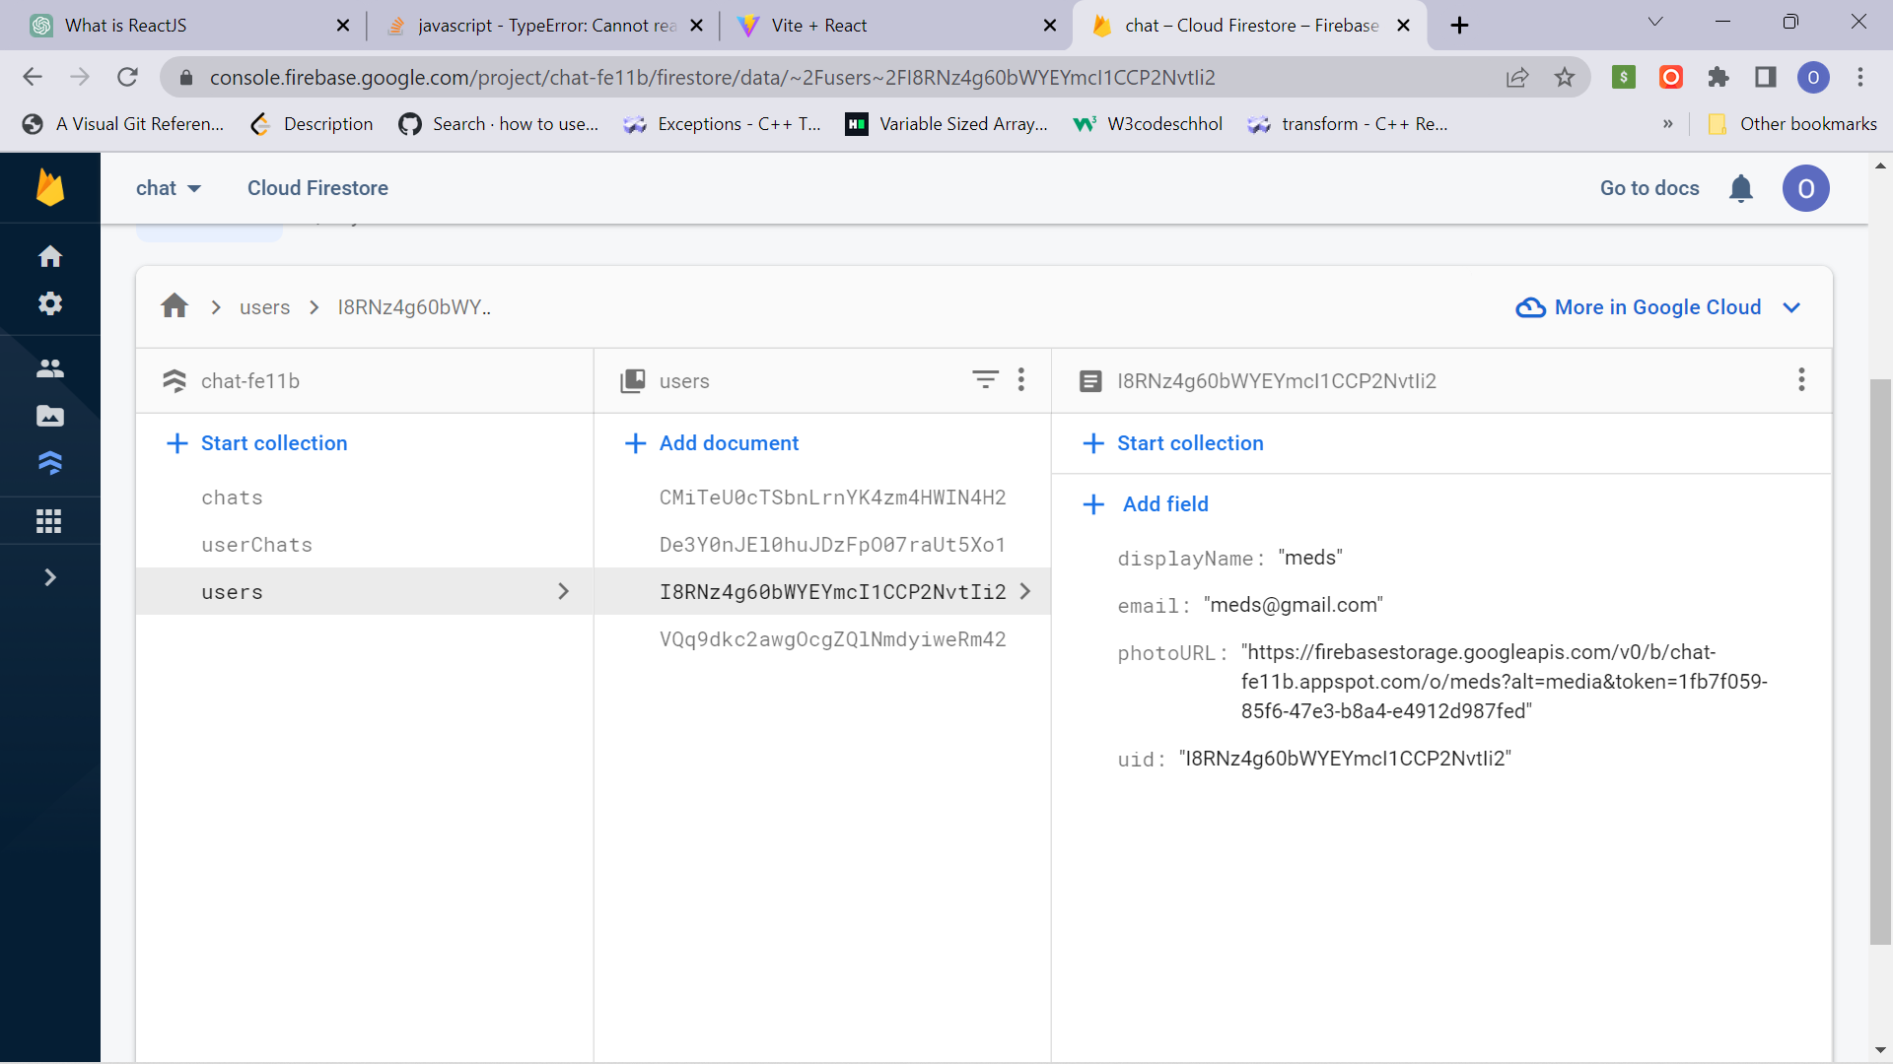
Firebase is a NoSql database
NoSQL databases are designed to be flexible and scalable, and are well-suited for storing large amounts of data that may have complex relationships.
Firebase is a cloud-hosted NoSQL database that uses a document-oriented data model, which means that it stores data as a collection of documents.
Each document can contain any number of key-value pairs, and these documents can be nested to represent complex relationships.
Firebase provides a real-time API that allows you to sync data across all connected clients in real time, which makes it well-suited for building real-time applications like chat apps.

Slide 4
What makes this chat app unique ?
There are many things that make a chat app unique compared to other types of apps.
Real-time communication: Chat apps allow users to communicate in real time, sending and receiving messages as they are typed. This is different from other types of apps, where the user may need to refresh the page or perform an action to receive new data.
Asynchronous communication: Chat apps allow users to communicate asynchronously, meaning that they do not need to be online at the same time to communicate. This is different from phone or video calls, which require both parties to be available at the same time.
Persistent conversations: Chat apps typically store a history of past conversations, allowing users to review previous messages and catch up on conversations that they may have missed.

Slide 5
Future Features I would like to work on :
Delete user account
Location sharing option
Anonymous chat session
Profile update features
And many more…….

Slide 6
Resources
Resources I extensively used for my project :
https://firebase.google.com/docs
https://stackoverflow.com/
https://www.youtube.com/
https://netninja.dev/

