Slide 1
Online code editor
Medha Bisht

Slide 2
Introduction​
What is a Code Editor? Why Use ReactJS for a Code Editor? Features of a Code Editor Built with ReactJS Demo
Future work ideas Conclusion

Slide 3
Introduction
Code Editor
At its core, a code editor is a software tool that allows programmers to write and edit source code. It provides a dedicated environment for developers to work on their programming projects, offering features designed to enhance productivity, streamline coding workflows, and catch errors.
Text Editors: Lightweight editors with minimal features, primarily focused on editing plain text.
Integrated Development Environments (IDEs): Comprehensive editors that provide a complete set of tools for development, including features like code debugging, version control integration, and more
Text Editor
IDE

Slide 4
Why use react ?
React
React has a vibrant and active community, providing a wide range of libraries, tools, and plugins that can be used to enhance a code editor's functionality. You can leverage existing React.js libraries and components for tasks like syntax highlighting, linting, code formatting, and more.
Component based architecture
Virtual DOM
Reusable UI components
Developer friendly

Slide 5
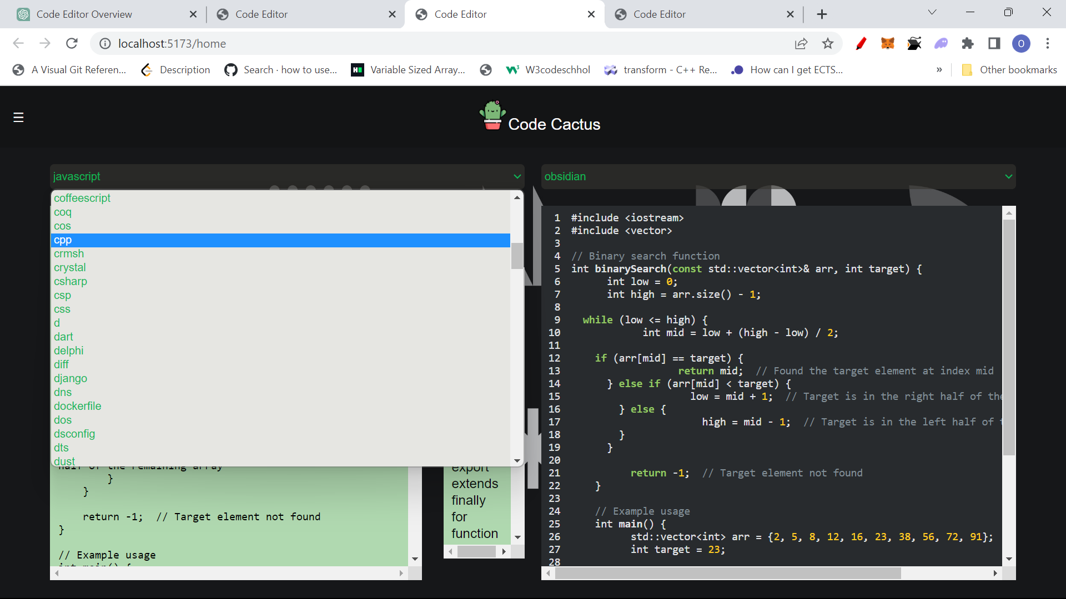
FEATURES OF CODE EDITOR BUILT WITH REACT
Themes
Syntax Highlighting
Indentation
Keywords autosuggest

Slide 6
FUTURE WORK IDEAS
More editor functionality in compiler
Copy Code Feature
Code Formatting
Live Sharing
Improving UI and basic functionalities
Live Syntax error detect
Chatbot

Slide 7
THANK YOU

