Slide 1
Heteroskedasticity

Slide 2
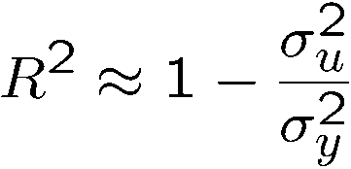
Heteroskedasticity
Consequences of heteroskedasticity for OLS
  OLS still unbiased and consistent under heteroskedastictiy!
  Also, interpretation of R-squared is not changed
  Heteroskedasticity invalidates variance formulas for OLS estimators
  The usual F tests and t tests are not valid under heteroskedasticity
  Under heteroskedasticity, OLS is no longer the best linear unbiased estimator (BLUE); there may be more efficient linear estimators
Unconditional error variance is unaffected by heteroskedasticity (which refers to the conditional error variance)

Slide 3
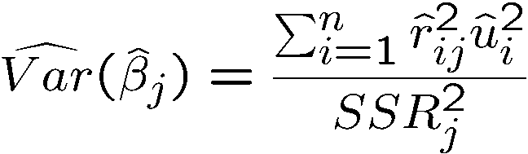
Heteroskedasticity
Heteroskedasticity-robust inference after OLS estimation
  Formulas for OLS standard errors and related statistics have been developed that are robust to heteroskedasticity of unknown form
  All formulas are only valid in large samples
  Formula for heteroskedasticity-robust OLS standard error
  Using these formulas, the usual t test is valid asymptotically
  The usual F statistic does not work under heteroskedasticity, but heteroskedasticity robust versions are available in most software
Also called White/Huber/Eicker standard errors. They involve the squared residuals from the regression and from a regression of x_{j} on all other explanatory variables.

Slide 4
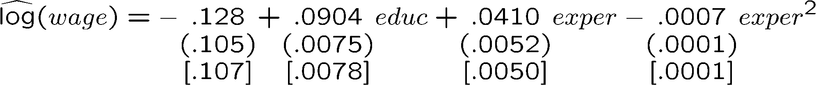



Heteroskedasticity
Example: Hourly wage equation
Heteroskedasticity robust standard errors may be larger or smaller than their nonrobust counterparts. The differences are often small in practice.
  F statistics are also often not too different.
If there is strong heteroskedasticity, differences may be larger. To be on the safe side, it is advisable to always compute robust standard errors.

Slide 5
Heteroskedasticity
Testing for heteroskedasticity
  It may still be interesting whether there is heteroskedasticity because then OLS may not be the most efficient linear estimator anymore
Breusch-Pagan test for heteroskedasticity
Under MLR.4
The mean of u² must not vary with x₁, x₂, …, x_{k}

Slide 6
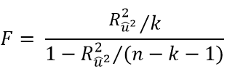

Heteroskedasticity
Breusch-Pagan test for heteroskedasticity (cont.)
Regress squared residuals on all expla-natory variables and test whether this regression has explanatory power.
A large test statistic (= a high R-squared) is evidence against the null hypothesis.
Alternative test statistic (= Lagrange multiplier statistic, LM). Again, high values of the test statistic (= high R-squared) lead to rejection of the null hypothesis that the expected value of u² is unrelated to the explanatory variables.

Slide 7
Heteroskedasticity
Example: Heteroskedasticity in housing price equations
Heteroskedasticity
In the logarithmic specification, homoskedasticity cannot be rejected

Slide 8

Heteroskedasticity
The White test for heteroskedasticity
Disadvantage of this form of the White test
  Including all squares and interactions leads to a large number of estimated parameters (e.g. k=6 leads to 27 parameters to be estimated)
Regress squared residuals on all expla-natory variables, their squares, and in-teractions (here: example for k=3)
The White test detects more general deviations from heteroskedasticity than the Breusch-Pagan test

Slide 9

Heteroskedasticity
Alternative form of the White test
Example: Heteroskedasticity in (log) housing price equations
This regression indirectly tests the dependence of the squared residuals on the explanatory variables, their squares, and interactions, because the predicted value of y and its square implicitly contain all of these terms.

Slide 10
Heteroskedasticity
Weighted least squares estimation
Heteroskedasticity is known up to a multiplicative constant
The functional form of the heteroskedasticity is known
Transformed model

Slide 11
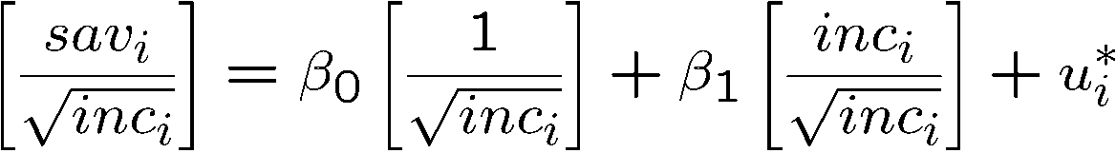
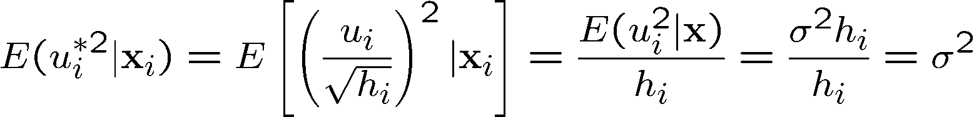
Heteroskedasticity
Example: Savings and income
The transformed model is homoskedastic
If the other Gauss-Markov assumptions hold as well, OLS applied to the transformed model is the best linear unbiased estimator
Note that this regression model has no intercept

Slide 12
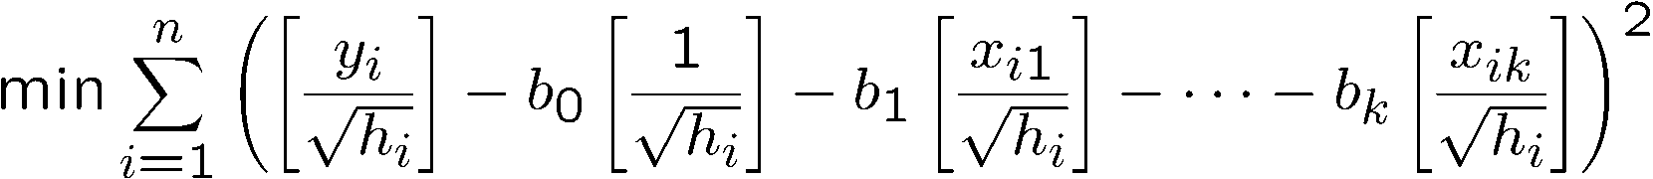
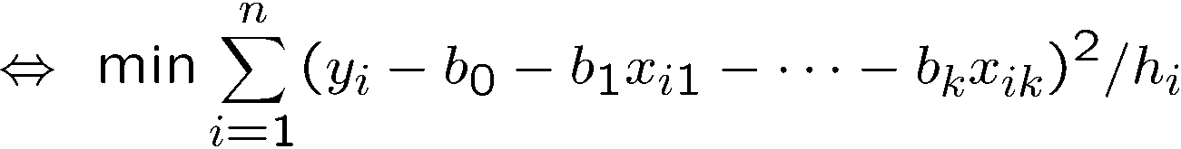
Heteroskedasticity
OLS in the transformed model is weighted least squares (WLS)
Why is WLS more efficient than OLS in the original model?
  Observations with a large variance are less informative than observations with small variance and therefore should get less weight
WLS is a special case of generalized least squares (GLS)
Observations with a large variance get a smaller weight in the optimization problem

Slide 13
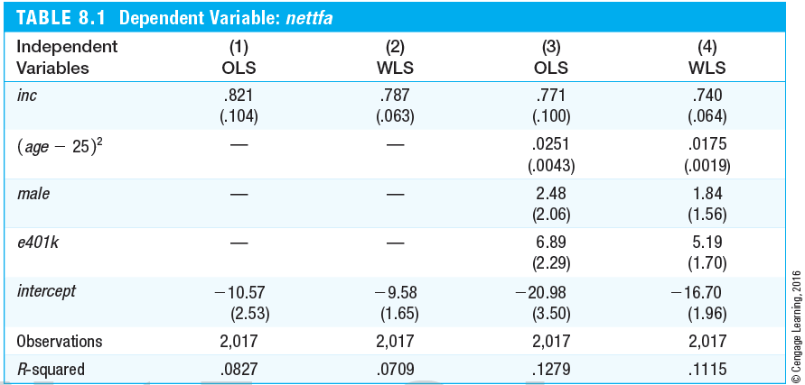
Heteroskedasticity
Example: Financial wealth equation
Net financial wealth
Assumed form of heteroskedasticity
WLS estimates have considerably smaller standard errors (which is line with the expectation that they are more efficient).
Participation in 401K pension plan

Slide 14
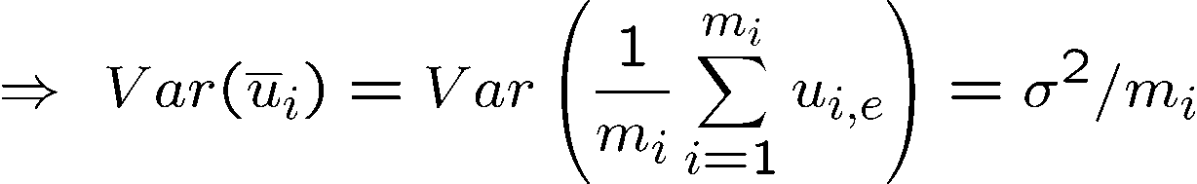
Heteroskedasticity
Important special case of heteroskedasticity
  If the observations are reported as averages at the city/county/state/-country/firm level, they should be weighted by the size of the unit
Average contribution to pension plan in firm i
Average earnings and age in firm i
Percentage firm contributes to plan
Heteroskedastic error term
Error variance if errors are homoskedastic at the individual-level
If errors are homoskedastic at the individual-level, WLS with weights equal to firm size m_{i} should be used. If the assumption of homoskedasticity at the individual-level is not exactly right, one can calculate robust standard errors after WLS (i.e. for the transformed model).

Slide 15
Heteroskedasticity
Unknown heteroskedasticity function (feasible GLS)
Assumed general form of heteroskedasticity; exp-function is used to ensure positivity
Multiplicative error (assumption: independent of the explanatory variables)
Use inverse values of the estimated heteroskedasticity funtion as weights in WLS
Feasible GLS is consistent and asymptotically more efficient than OLS.

Slide 16
Heteroskedasticity
Example: Demand for cigarettes
Estimation by OLS
Smoking restrictions in restaurants
Cigarettes smoked per day
Logged income and cigarette price
Reject homo-skedasticity

Slide 17

Heteroskedasticity
Estimation by FGLS
Discussion
  The income elasticity is now statistically significant; other coefficients are also more precisely estimated (without changing qualit. results)
Now statistically significant

Slide 18

Heteroskedasticity
What if the assumed heteroskedasticity function is wrong?
  If the heteroskedasticity function is misspecified, WLS is still consistent under MLR.1 – MLR.4, but robust standard errors should be computed
  WLS is consistent under MLR.4 but not necessarily under MLR.4‘
  If OLS and WLS produce very different estimates, this typically indi-cates that some other assumptions (e.g. MLR.4) are wrong
  If there is strong heteroskedasticity, it is still often better to use a wrong form of heteroskedasticity in order to increase efficiency

Slide 19

Heteroskedasticity
WLS in the linear probability model
Discussion
  Infeasible if LPM predictions are below zero or greater than one
  If such cases are rare, they may be adjusted to values such as .01/.99
  Otherwise, it is probably better to use OLS with robust standard errors
In the LPM, the exact form of heteroskedasticity is known
Use inverse values as weights in WLS

