Slide 1


P.S.V COLLEGE OF ENGINEERING AND TECHNOLOGY
(Approved by AICTE, New Delhi & Affiliated to Anna University, Chennai)
Accredited by NAAC with ‘A’ Grade
(Inclusion Under Section 2(f) & 12(B) of the UGC Act,1956)
(AN ISO 9001:2015 Certified Institution)
DEPARTMENT OF COMPUTER SCIENCE AND ENGINEERING
LOW-COST EYE GESTURE COMMUNICATION SYSTEM FOR PEOPLE WITH MOTOR DISABILITIES
Guided By :
Prof R. Monisha.M.E.,
Project Co-Ordinator:
Mr. C. Prakash Narayanan.M.Ε.,
Presented By :
Deenadayalan. R (611821104006)
Dineshkumar. V (611821104008)
Suriya. A (611821104051)

Slide 2
ABSTRACT
Individuals with severe motor disabilities, such as those caused by ALS, cerebral palsy, or spinal cord injuries, often face significant challenges in communication and interaction with their environment
The system utilizes a webcam or an infrared-based eye-tracking module to detect and interpret eye movements, which are then mapped to predefined commands for speech synthesis, device control, and text input.
Machine learning algorithms process real-time eye gestures, ensuring high accuracy and responsiveness.
Unlike expensive commercial alternatives, this system leverages affordable hardware and open-source software, making it accessible to a wider population.

Slide 3
OBJECTIVES
Detect eye movements and blinks accurately.
Map gestures to predefined control commands.
Provide voice feedback to the user.
Send commands to Arduino for hardware control.
Control servo and DC motors to move a wheelchair or robot.

Slide 4
SYSTEM OVERVIEW
Uses a camera to capture eye movements.
Processes video frames with MediaPipe and OpenCV.
Maps eye gestures to commands (e.g., look left → move left).
Sends commands to Arduino via serial communication.
Arduino controls motors to move wheelchair/platform.

Slide 5
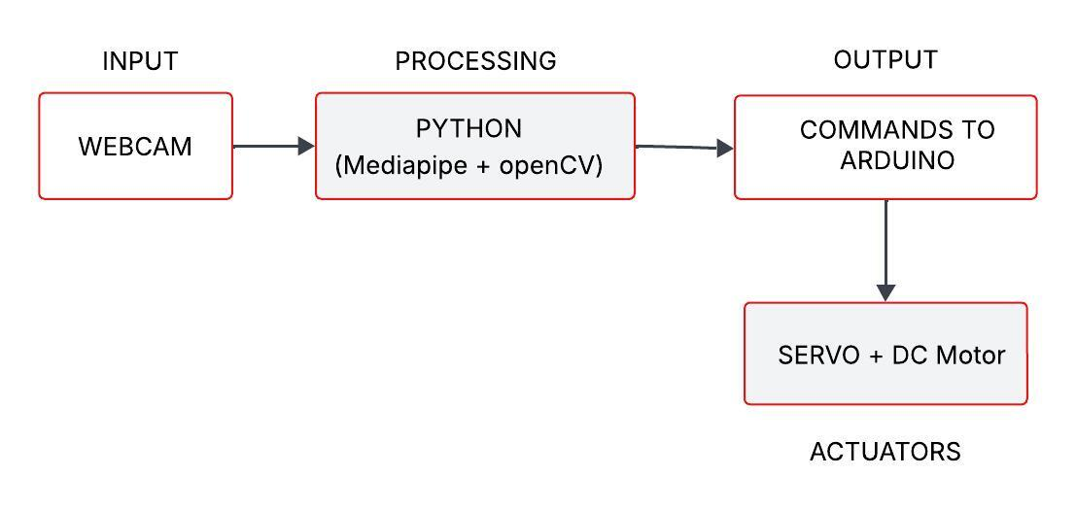
BLOCK DIAGRAM

Slide 6
LITERATURE SURVEY
S. No. | Title / Paper | Methodology | Year | Limitations
1 | Eye-Controlled Communication for the Disabled | Used infrared-based eye tracking systems to control communication software | 2002 | High cost and non-portable setup
2 | Gaze-Based Assistive Technology | Used commercial gaze tracking devices (Tobii EyeX) with calibration for precise tracking | 2014 | Expensive, requires calibration
3 | Real-time Eye Tracking Using OpenCV | Used webcam + OpenCV with Haar cascade for eye region detection | 2017 | Limited accuracy, affected by lighting
4 | Low-cost Human-Computer Interaction using Eye Gestures | Used rule-based logic with webcam input to recognize gestures | 2018 | Basic implementation, lacks adaptability
5 | Design of Assistive Communication System for People with Disabilities | Combined image processing with TTS output | 2019 | Needs optimization for gesture accuracy

Slide 7
EXISTING SYSTEM
The existing wheelchair systems incorporate various technologies, each with its own set of limitations. The Tobii Eye Tracker utilizes infrared-based eye tracking technology.
Brain-Computer Interface (BCI) Wheelchairs rely on EEG signals for movement control, requiring extensive training and posing an affordability challenge.
Gaze-Controlled Wheelchairs function through webcam-based eye tracking, necessitating high processing power for smooth operation.
Joystick-Controlled Smart Wheelchairs use joysticks integrated with sensors, but they require hand movement, making them unsuitable for individuals with limited mobility. Lastly, Voice-Controlled Wheelchairs operate through speech recognition systems; however, they are not ideal for users who are speech-impaired.

Slide 8
PROPOSED SYSTEM
The primary goal of the low-cost eye gesture communication system is to enable individuals with motor disabilities to communicate effectively and autonomously.
It aims to provide an intuitive interface that can be used easily through eye movements, fostering independence.
The system uses a standard webcam or a mobile camera to continuously capture the user’s face and eye movements. It employs computer vision techniques, primarily using OpenCV with Haar Cascade or Dlib, to detect the face and localize the eye region.
These gestures are then classified using either rule-based logic or simple machine learning algorithms, and each gesture is mapped to a predefined command or message.

Slide 9
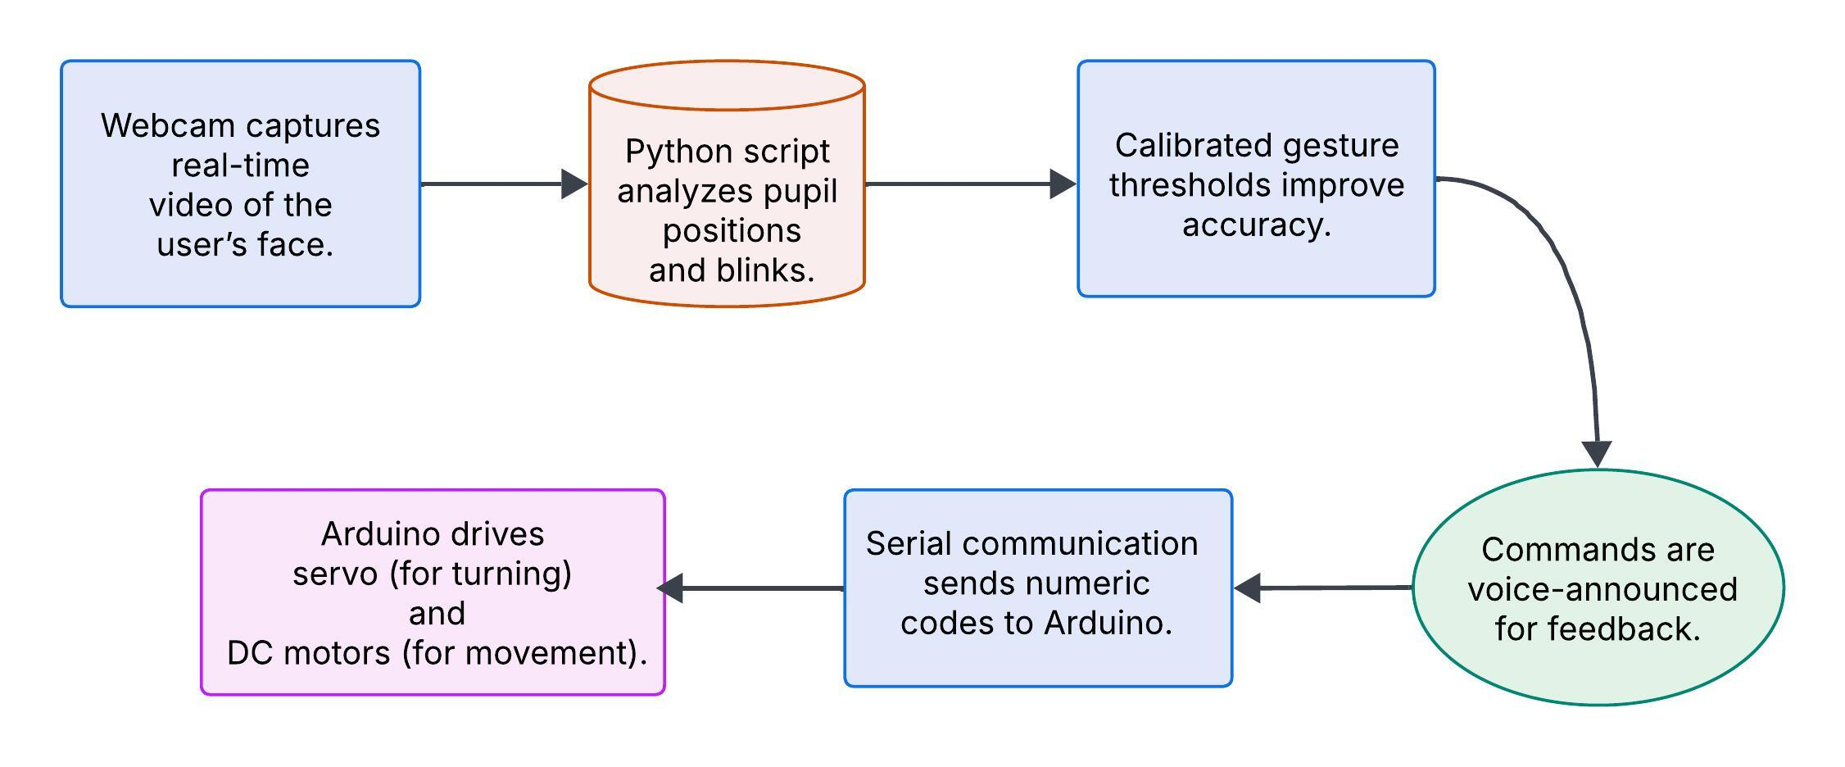
ARCHITECTURE DIAGRAM

Slide 10
MODULES
Eye Tracking Module
Image Processing Module
Gesture Recognition Module
Command Processing Module
Microcontroller Module
Motor Control Module
Feedback & Safety Module

Slide 11
MODULE DESCRIPTION
1. Eye Tracking Module
Captures eye movements using specialized sensors, enabling intuitive interaction for users with limited mobility.
2. Image Processing Module
Analyzes visual inputs and detects key features necessary for efficient system operation.
3. Gesture Recognition Module
Interprets user gestures to facilitate control, ensuring an alternative means of communication.
4. Command Processing Module
Deciphers incoming commands, translating user input into actionable system directives.
5. Microcontroller Module
Acts as the brain of the system, orchestrating data flow and command execution.

Slide 12
MODULE DESCRIPTION
6. Motor Control Module
Regulates movement and position adjustments based on processed inputs.
7. Feedback & Safety Module
Ensures user safety through real-time monitoring and corrective mechanisms.

Slide 13
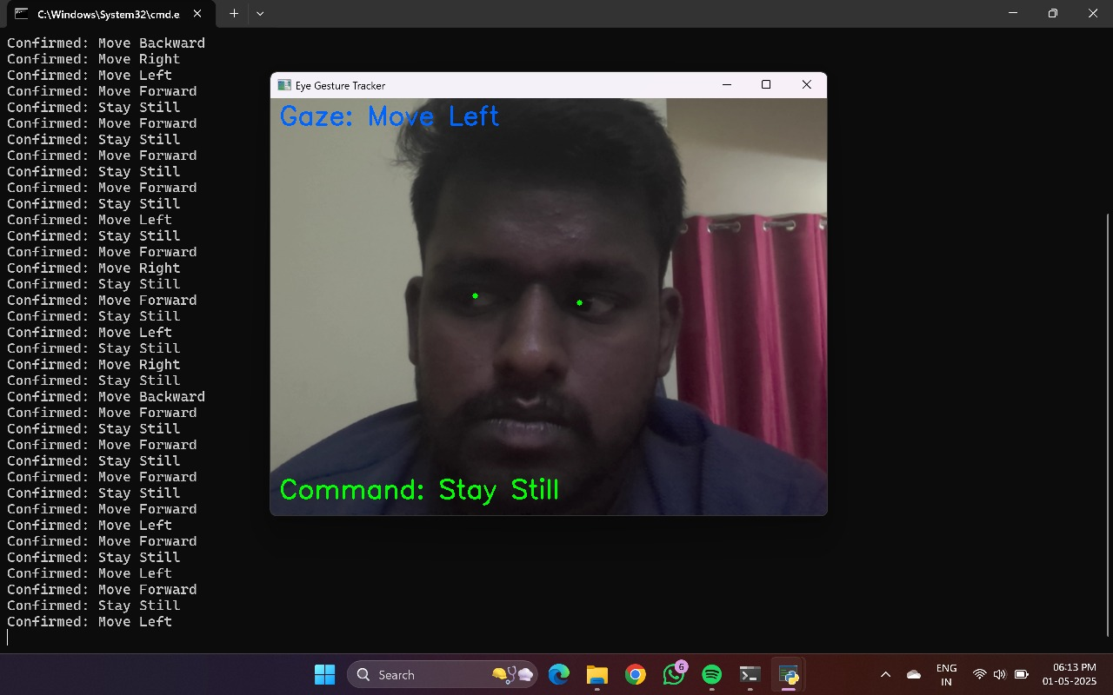
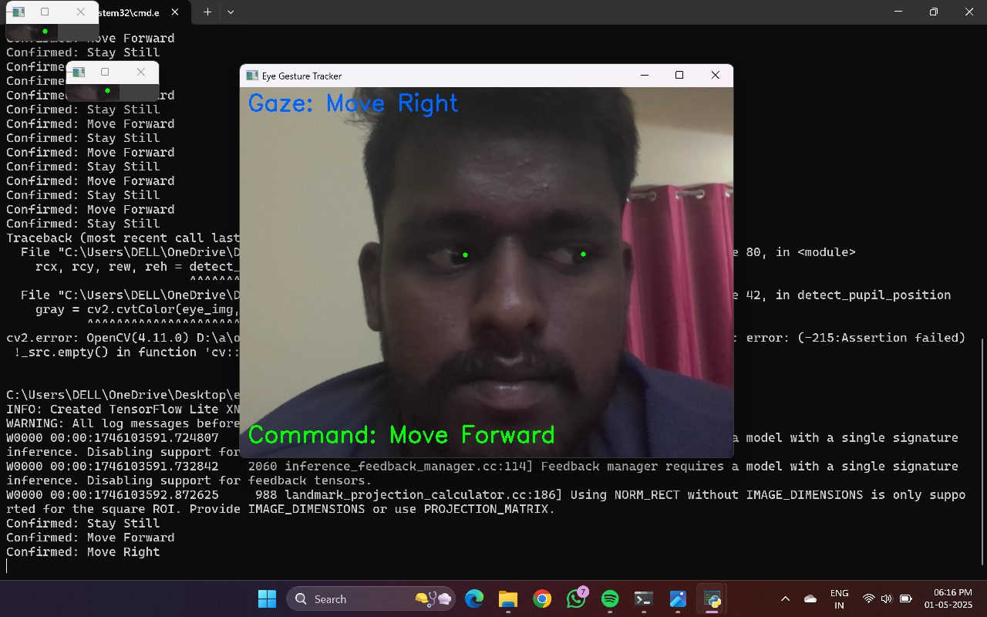
OUTPUT
Move Left
Move Right

Slide 14
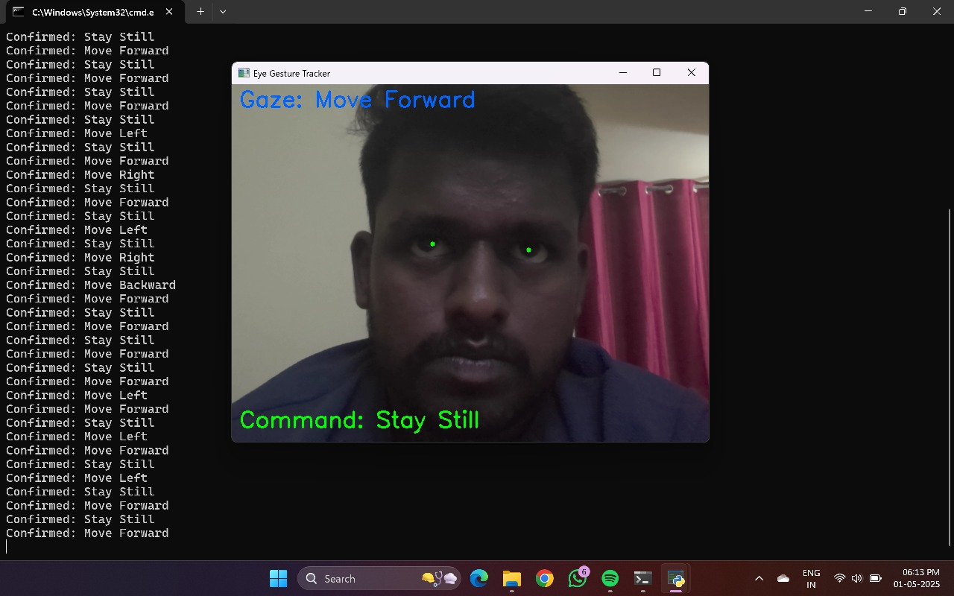
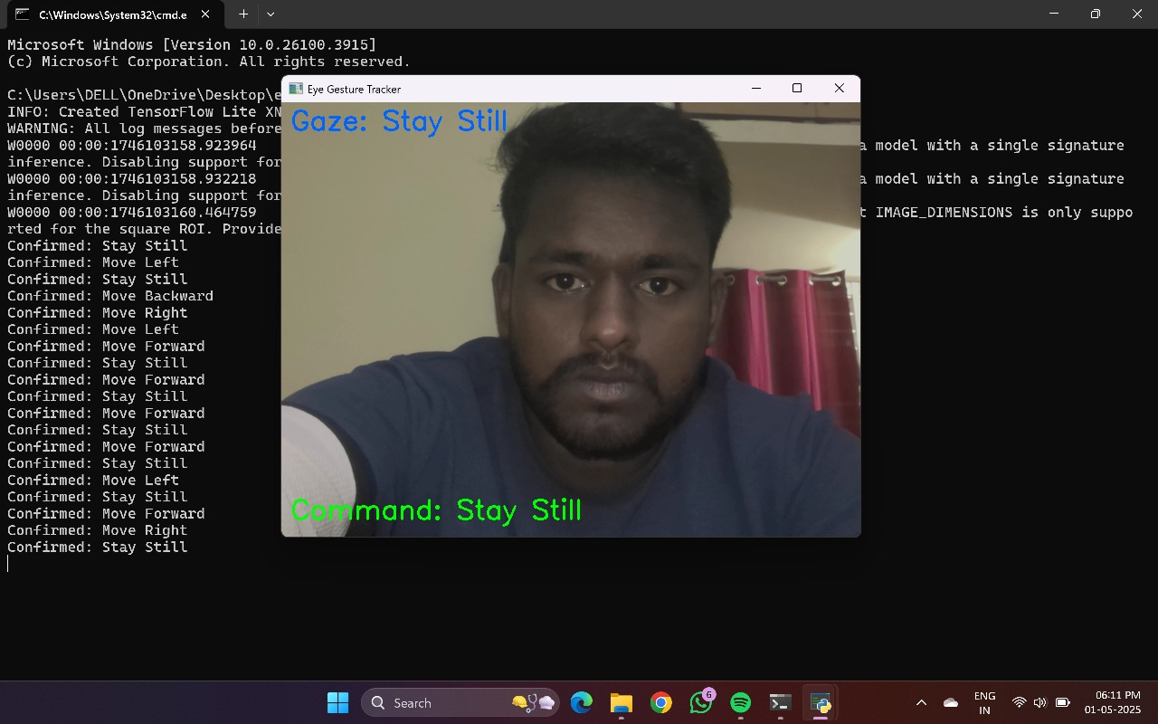
Move Forward
Stay Still

Slide 15
FUTURE ENHANCEMENT
Machine Learning-Based Calibration
Integrate adaptive learning models to automatically calibrate gaze and blink thresholds per user, improving accuracy and usability for different eye shapes and lighting conditions.
Multilingual Voice Feedback
Add support for multiple languages and customizable voice settings to make the system more accessible globally.
Predictive Text and Auto-Completion
Implement intelligent word prediction and sentence completion to reduce the number of eye gestures needed for communication.
Environmental Adaptability
Enhance performance under varying lighting conditions by using infrared-based pupil detection or combining RGB and IR cameras.

Slide 16
CONCLUSION
The eye gesture communication system offers a powerful and accessible tool for individuals with motor disabilities, enabling them to express needs and interact with their environment using only their eye movements and blinks.
By utilizing technologies such as MediaPipe, OpenCV, and voice synthesis, the system demonstrates a non-invasive, affordable, and real-time solution to communication challenges.
As technology continues to advance, integrating machine learning, predictive text, and smart device control will further enhance user experience and autonomy.
This project not only has the potential to improve quality of life but also represents a step forward in inclusive technology design, bridging the gap between physical limitations and digital communication.

Slide 17
REFERENCES
[01] N Wanluk, S Visitsattapongse, A Juhong (2016). Smart wheelchair based on eye tracking. 2016 9th Biomedical Engineering International Conference (BMEiCON). doi: 10.1109/BMEiCON.2016.7859594
[02] MA Eid, N Giakoumidis, A El Saddik(2016). A novel eye-gaze-controlled wheelchair system for navigating unknown environments: case study with a person with ALS. IEEE Access ( Volume: 4 ). doi: 10.1109/ACCESS.2016.2520093
[03] A Ishizuka, A Yorozu(2017). Motion control of a powered wheelchair using eye gaze in unknown environments. 2017 11th Asian Control Conference (ASCC). doi: 10.1109/ASCC.2017.8287148
[04] Aniwat Juhong, T Treebupachatsakul, C Pintavirooj (2018). Smart eye-tracking system. 2018 International Workshop on Advanced Image Technology (IWAIT). doi: 10.1109/IWAIT.2018.8369701
[05] N Oda (2018). Development of Power Assist Wheelchair Control with Driving Assistance using Fish-eye Vision. 12th France-Japan and 10th Europe-Asia Congress on Mechatronics. doi: 10.1109/MECATRONICS.2018.8495884
[06] A Rajesh, M Mantur (2017). Eyeball gesture controlled automatic wheelchair using deep learning. 2017 IEEE Region 10 Humanitarian Technology Conference (R10-HTC). doi: 10.1109/R10-HTC.2017.8288981

Slide 18
THANK YOU

