Slide 1
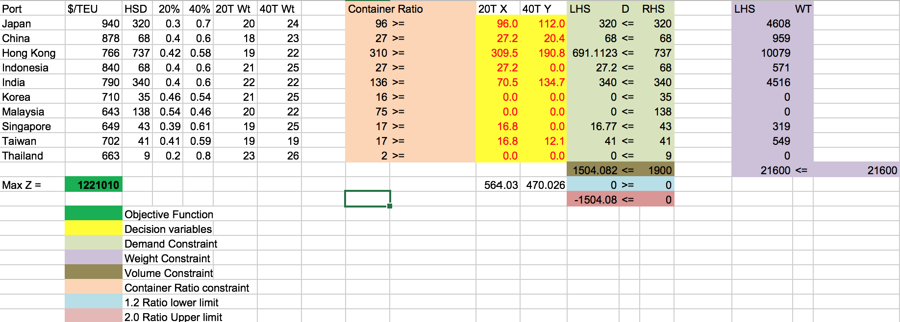
Q3. What is revenue gain between a fixed price strategy and a variable price strategy?
Scenario: Fixed Price High Season

Slide 2
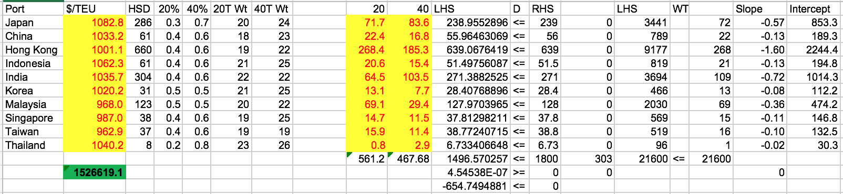
Q3. What is revenue gain between a fixed price strategy and a variable price strategy?
Scenario: Dynamic Price High Season

Slide 3
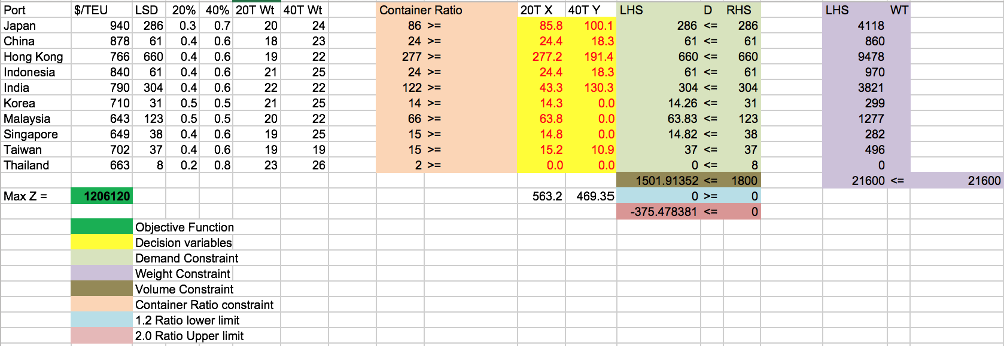
Q3. What is revenue gain between a fixed price strategy and a variable price strategy?
Scenario: Fixed Price Low Season

Slide 4
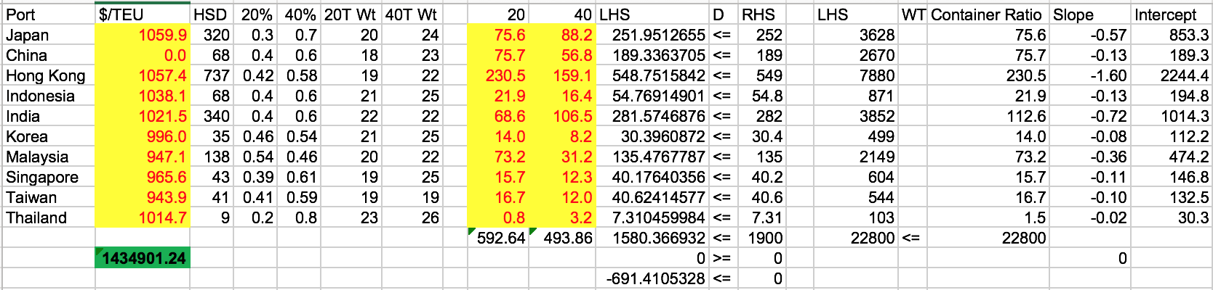
Q3. What is revenue gain between a fixed price strategy and a variable price strategy?
Scenario: Dynamic Price Low Season

Slide 5
 | High Season | Low Season
Fixed Price | 1,221,010 $ | 1,206,120 $
Variable Price | 1,526,619 $ | 1,434,901

