Slide 1
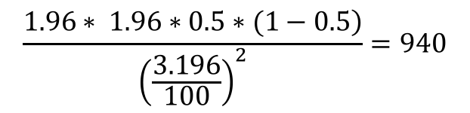

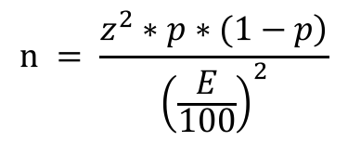
The Ontario poll has 940 people whereas the nation poll had 2,638 people. Why this difference?
$$͢$$
$$n = \frac{\left.z^{2}∗p∗(1−p\right)}{{\left(\frac{E}{100}\right)}^{2}}$$
$$\frac{\left.1.96∗ 1.96∗0.5∗(1−0.5\right)}{{\left(\frac{3.196}{100}\right)}^{2}}=940$$
How does smaller sample size affect the results?
Base | Sample | Large Population | Small Population
Population | Size | Margin of Error (%) | Margin of Error (%)
15,000,000 | 10,000 | 0.98 | 0.98
15,000,000 | 5,000 | 1.39 | 1.39
15,000,000 | 4,000 | 1.55 | 1.55
15,000,000 | 3,000 | 1.79 | 1.79
15,000,000 | 2,000 | 2.19 | 2.19
15,000,000 | 1,000 | 3.10 | 3.10
15,000,000 | 500 | 4.38 | 4.38
15,000,000 | 250 | 6.20 | 6.20
15,000,000 | 100 | 9.80 | 9.80
Table: Margin Error vs. Sample Size values
Figure: Margin Error vs. Sample Size line chart

Slide 2
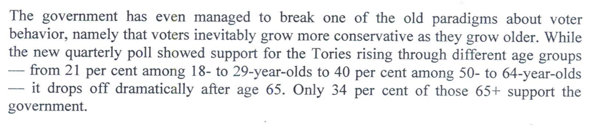
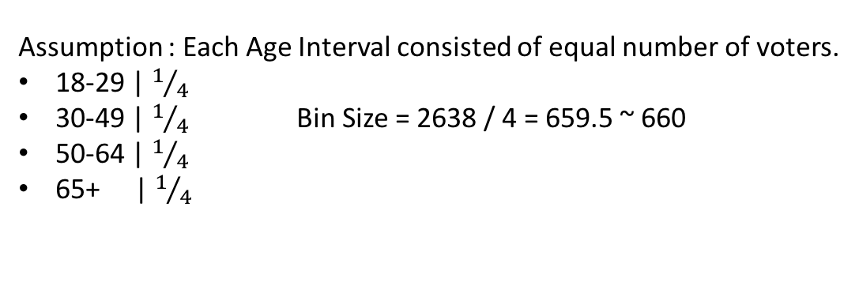
The journalist said that support drops off dramatically after age 65. Do you agree with this statement? If not, why is he wrong?
Assumption : Each Age Interval consisted of equal number of voters.
18-29 | $1/4$
30-49 | $1/4$ Bin Size = 2638 / 4 = 659.5 ~ 660
50-64 | $1/4$
65+ | $1/4$
E ≃ 4 %
Age | 18-29 | 50-64 | 65+
Sample Percentage | 21% | 40% | 34%
Population Interval | 17% - 25% | 36% - 44% | 30% - 38%
Table: Conservative vote % vs. Age

