Slide 1

Q-4 The case says that the sample consisted of 2,638 people. Where did this number come from?
Formula :
$E=z∗\sqrt{\frac{\left(1−p\right)∗p }{n}}$
$\frac{z^{2}∗p∗(1−p)}{{(\frac{E}{100})}^{2}}=n$
Taking Margin Error as 1.908% the formula yields;
$\frac{1.96∗ 1.96∗0.5∗(1−0.5)}{{(\frac{1.908}{100})}^{2}} = 2638$

Slide 2
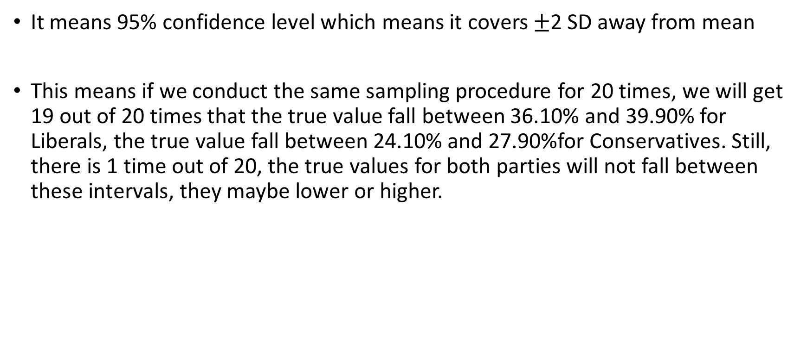
Q-5 The case also says the results are accurate 19 times out of 20. What does this mean?
It means 95% confidence level which means it covers $±$2 SD away from mean
This means if we conduct the same sampling procedure for 20 times, we will get 19 out of 20 times that the true value fall between 36.10% and 39.90% for Liberals, the true value fall between 24.10% and 27.90%for Conservatives. Still, there is 1 time out of 20, the true values for both parties will not fall between these intervals, they maybe lower or higher.

