Slide 1
City Center Hospital
Hypothesis Testing
MCDA 5520 Case 4
Present by: Sreeraj Punnoli
Caner Irfanoglu
Diven Sambhwani

Slide 2
Contents
Part 1
Design and purpose of the experiment
Survey Framework
Box plots
Challenges on gathering data and effects
Part 2
Why use 2 - sample t test?
Bartlett’s variance test & Calculating t-values
Visualization of Rejection zone
Interpretation of t & p-values
Part 3
Comparison of p-values with replicate data
Final Evaluation & Suggestions

Slide 3
PART 1
Design and purpose of the experiment
Survey Framework
Box plots
Challenges on gathering data and effects

Slide 4
Design and purpose of the experiment
City Centre Hospital (CCH) Group has developed a new computer system to assist nurses who were staffing inpatient care areas.
Inpatient Care at CCH consists of 7 floor with 4 wings at each floor.
CCH nursing staff includes Registered Nurses (RN) and Nursing Assistants (NA).
The new system Computerizes the patient records
Belief: The new System reduces the nurses’ time spend on administration work.
For Evaluation 2 surgical wings were selected.
Purpose: To Objectively prove their belief.

Slide 5
Survey Framework
Period: 12 hr Day shift tested for a week
“8 Blue” wing has 36 RNs and 13 NAs while “10 Gold” wing has 34 RNs and 12 NAs.
They were asked to note down the Categories of activity in every 5 Minutes interval.
Direct Patient Care | Non Nursing Tasks | Indirect Patient Care
Giving Medication | Food Service | Paperwork
Hygiene | House Keeping | Breaks
Assessments |  | Nursing Administration
Table 1: Nurse Task’s breakdown

Slide 6
Boxplots - I
Figure 1: Nurse Administration Boxplot
Figure 2: Direct Patient Care Boxplot

Slide 7
Boxplots - II
Figure 3: Indirect Patient Care Boxplot
Figure 4: Non-Nursing Tasks Boxplot

Slide 8

Challenges on gathering data and effects
Many Nurses checked more than 1 activity per 5 mins timeslot
There were many timeslots with no activity had been checked

Slide 9
PART 2
Why use 2 - sample t test?
Bartlett’s variance test & Calculating t-values
Visualization of Rejection Region
Interpretation of t & p-values

Slide 10
Why use 2 – sample t test?
In statistics, t-tests are a type of hypothesis test that allows you to compare means
The One Sample t Test determines whether the sample mean is statistically different
from a known or hypothesized population mean
The paired t-test and the 1-sample t-test are actually the same test in disguise!
2-sample t-test requires independent groups for each sample
The default null hypothesis for a 2-sample t-test is that the two groups are equal

Slide 11
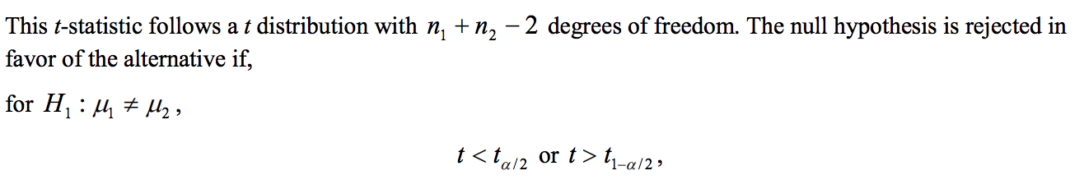
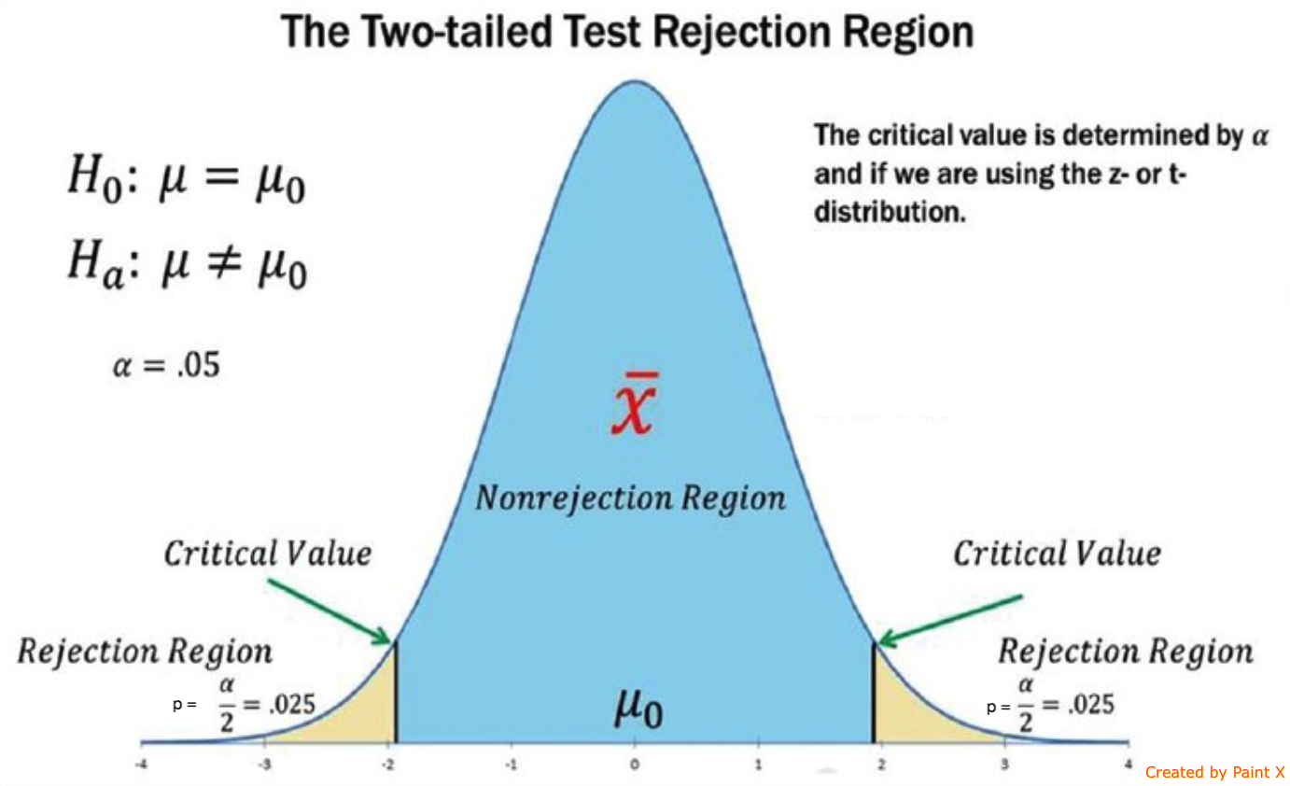
Visualization of Rejection Region
Figure 7: Two tailed distribution 95 % Interval

Slide 12
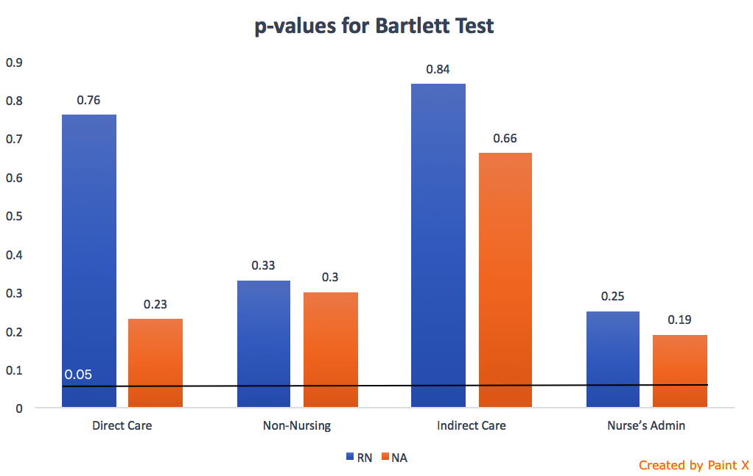
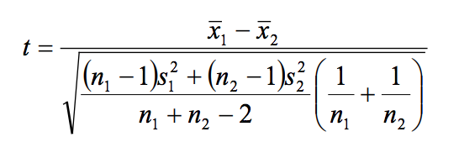
Bartlett’s variance test & Calculating t-values
When running a two-sample equal-variance t-test, the basic assumptions are that the distributions
of the two populations are normal, and that the variances of the two distributions are the same.
Figure 5: p-values for Bartlett test of homogeneity of variances

Slide 13
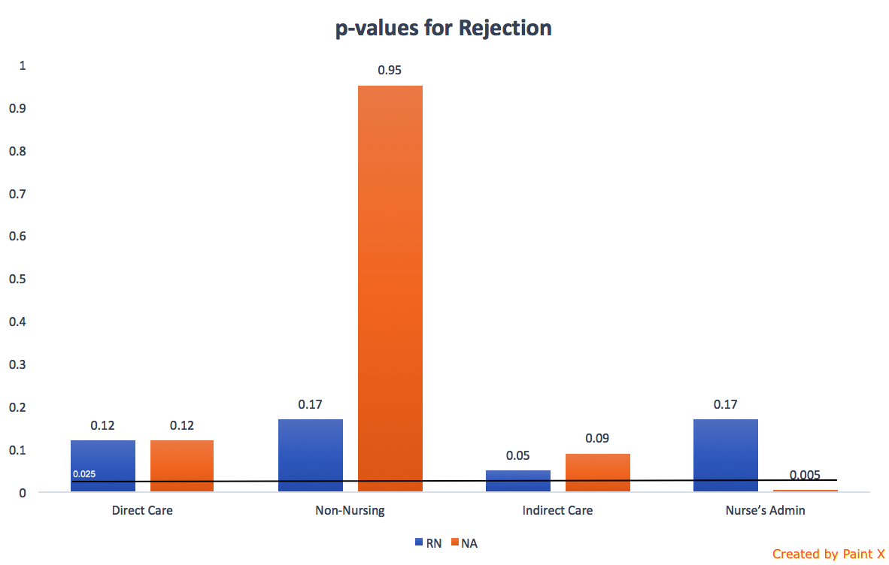
Interpretation of t & p – values
Nurse Type | Direct Care | Non-Nursing | Indirect Care | Nurse’s Admin
t-values
RN | -1.58 | -1.38 | 2.02 | 1.39
NA | -1.62 | 0.06 | 1.77 | 3.09
p-values
RN | 0.12 | 0.17 | 0.05 | 0.17
NA | 0.12 | 0.95 | 0.09 | 0.005
Table 2: t & p-values for each category of two samples
Figure 6: Bar chart for p-values

Slide 14
PART 3
Comparison of p-values with replicate data
Final Evaluation & Suggestions

Slide 15
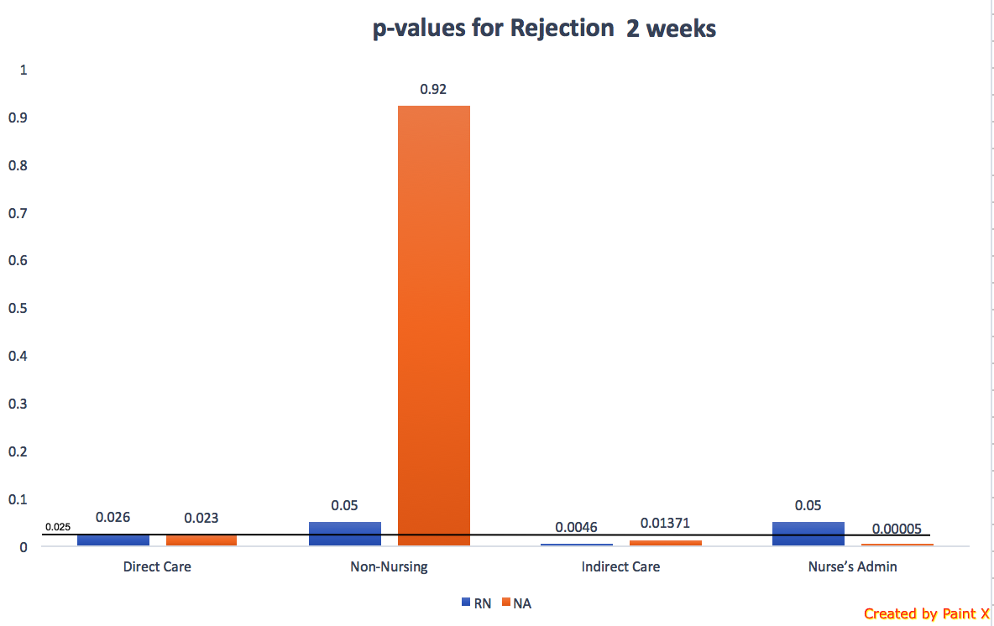
Comparing p-values with Replicated Data
Figure 8: Bar chart for p-values 1 week data
Figure 9: Bar chart for p-values 2 week data

Slide 16
Final Evaluation & Suggestions
New system looks promising
There may exist human factors
More data would help clarify
Currently null hypothesis can be rejected with 70% CL
1 more set of observations
For 95% CL rejection at least
Perform for at least 2 other wings

Slide 17


