Slide 1
Why two sample t – test ?
In statistics, t-tests are a type of hypothesis test that allows you to compare means
The One Sample t Test determines whether the sample mean is statistically different
from a known or hypothesized population mean
The paired t-test and the 1-sample t-test are actually the same test in disguise!
2-sample t-test requires independent groups for each sample
The default null hypothesis for a 2-sample t-test is that the two groups are equal

Slide 2
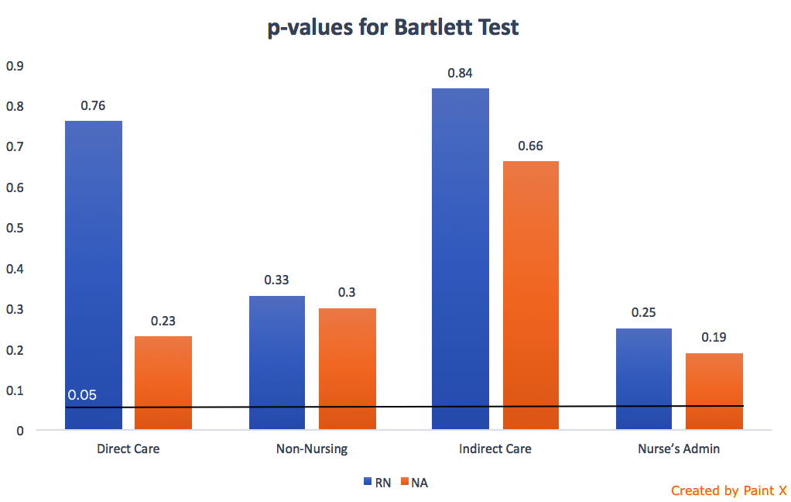
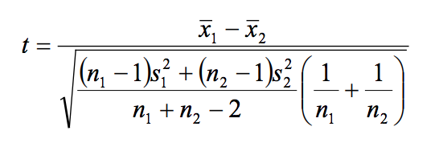
Formula for calculating t-values
When running a two-sample equal-variance t-test, the basic assumptions are that the distributions
of the two populations are normal, and that the variances of the two distributions are the same.
Figure: p-values for Bartlett test of homogeneity of variances

Slide 3
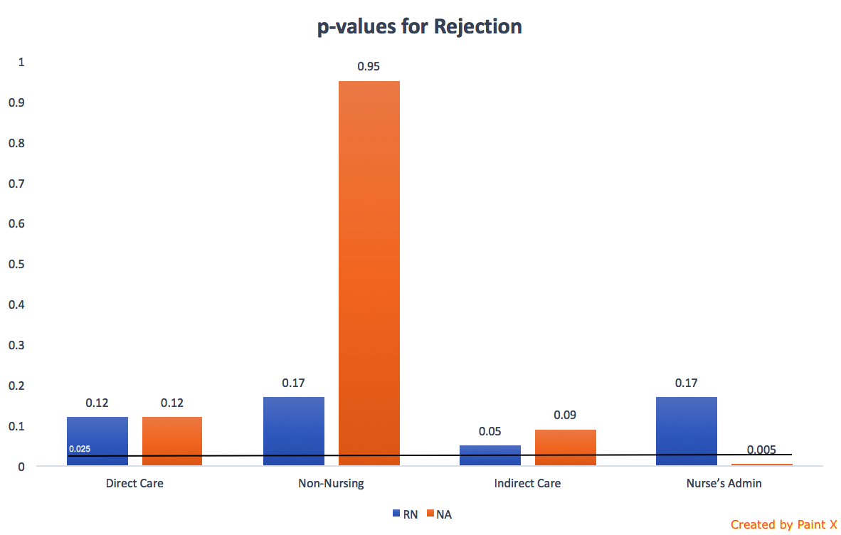
t & p – values
Nurse Type | Direct Care | Non-Nursing | Indirect Care | Nurse’s Admin
t-values
RN | -1.58 | -1.38 | 2.02 | 1.39
NA | -1.62 | 0.06 | 1.77 | 3.09
p-values
RN | 0.12 | 0.17 | 0.05 | 0.17
NA | 0.12 | 0.95 | 0.09 | 0.005
Table2: t & p-values for each category of two samples
Figure: Bar chart for p-values

Slide 4
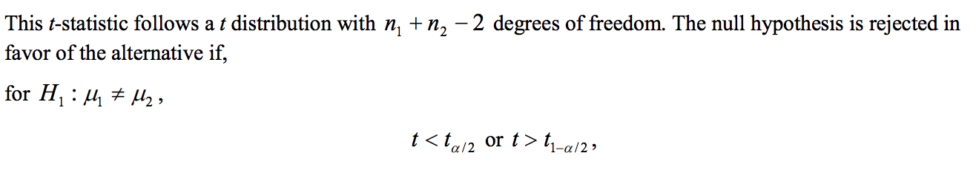
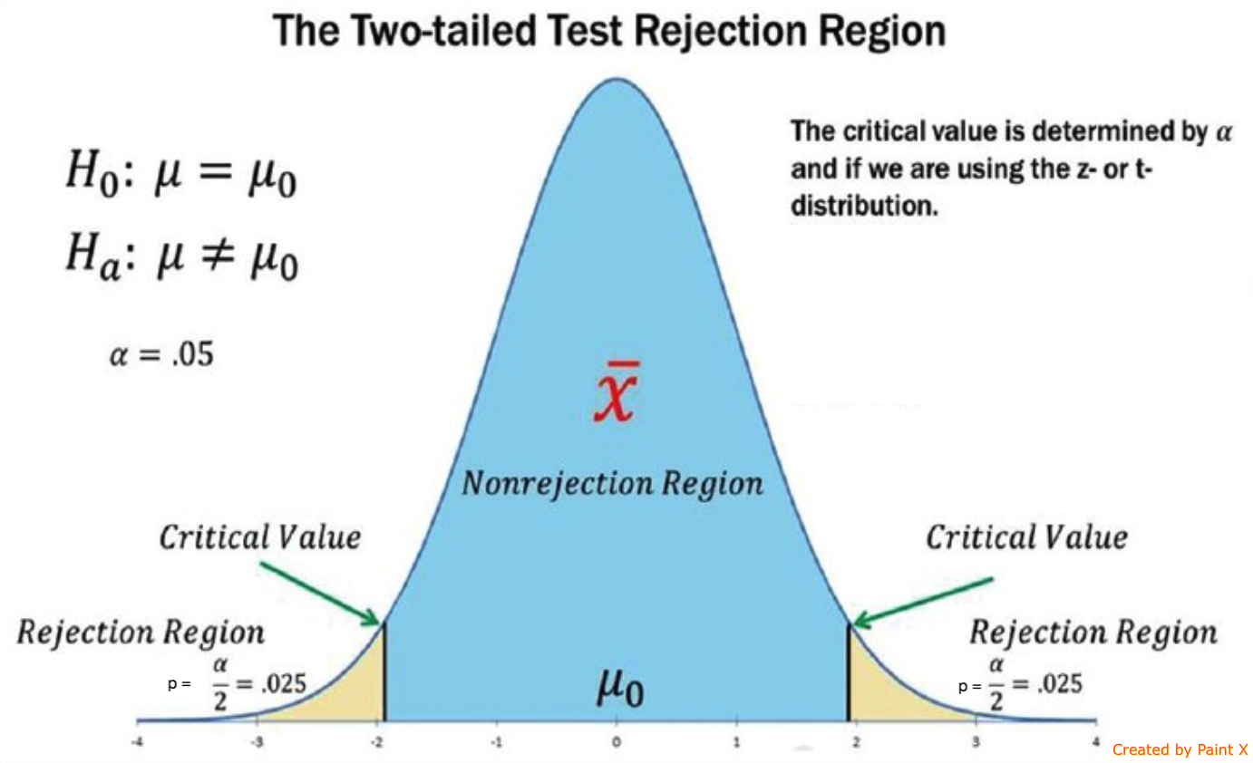
Visualization of 95 % Rejection Region

Slide 5
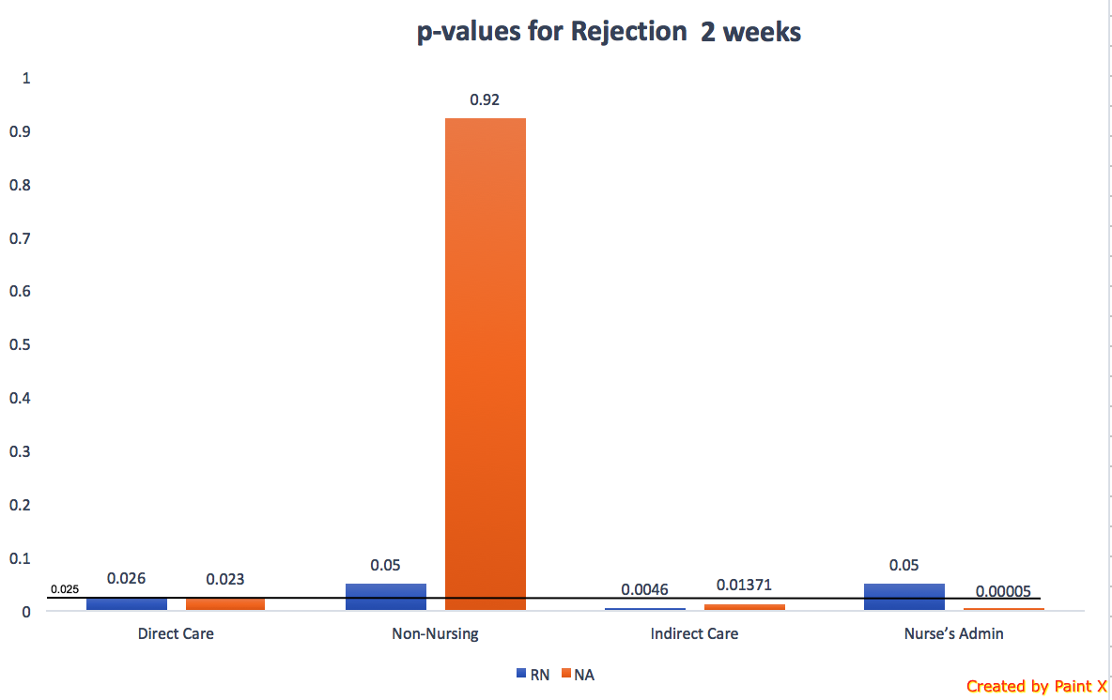
Comparing p-values with Replicated Data
Figure: Bar chart for p-values 1 week data
Figure: Bar chart for p-values 2 week data

