Slide 1
Analysis Assumptions– 1
We assume returns only depend on the order size and time to deliver
Goal is to do predict returns based on days to deliver and quantity
Since our prediction variable Returned is available we can use supervised learning algorithms
3 Candidates :
Logistic Regression
Linear Discriminant Analysis
k- Nearest Neighbors

Slide 2
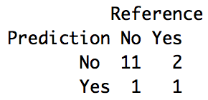
Analysis Assumptions – 2
We only have 75 samples and 2 predictors
Data is divided 80% train 20% test ratio
5 fold cross-validation is used to lower the variance
Accuracies are used as performance comparison metrics
Figure: Confusion Matrix for Logistic Regression

Slide 3
Conclusion
Best accuracy is obtained :
k-nn > Logistic Regression > LDA
Logistic Regression is selected for interpretability
Lanco should arrange their delivery dates based on the quantity
Figure: Logistic Regression Coefficients fit into cluster plot

