Slide 1
What statistical analysis is suitable to compare brand equity across brands? Why? Compare brand equity across brands for your chosen category.

Slide 2
One way Anova for comparing brand means
H₀ µ₂₆₃ = µ₂₆₄= µ₂₆₅= µ₂₆₆= µ₂₆₇
H₁ At least one brand has different mean
Pair | t-value | p-value | Significant
266 - 264 | 8.064 | 2.06 * 10⁻¹⁵ | Yes
264 - 263 | 0.45 | 0.33 | No
264 - 267 | 1.13 | 0.13 | No
264 - 265 | 2.72 | 0.003 | Yes
263 - 267 | 0.72 | 0.24 | No
263 - 265 | 2.32 | 0.01 | Yes
267 - 265 | 1.51 | 0.06 | No
Table : Pairwise brand comparison 95% CL
Conclusion : 266 > 264 = 263 = 267 > 265

Slide 3
Compare loyalty, relevance, familiarity, uniqueness and popularity for the brands of your chosen category using the appropriate statistical analysis.
MANOVA is the appropriate test for comparing differences of multiple dependent variables to an independent ( grouping ) variable.
Before performing MANOVA following assumptions needs to be tested
Independent random sampling
Level of measurement of the variables
Linearity of the dependent variables
Multivariate normality
Multivariate homogeneity of variance within groups
Multivariate homogeneity of variance between groups

Slide 4
Assumptions
Independent random sampling
Assuming surveyees do not effect each other
Level of measurement of the variables
Ordinal data is treated as interval data

Slide 5
MANOVA OUTPUT
H₀ No differences exist in the ratings of loyalty, familiarity,
uniqueness, relevance and popularity among different fast food brands.
H₁ There exist differences
Dependent Variable | F-value | Pr ( > F ) | Significant
Loyality | 12.11 | 1.09 * 10⁻⁹ | Yes
Familiarity | 36.77 | 2.20 * 10⁻¹⁵ | Yes
Uniqueness | 14.33 | 1.77 * 10⁻¹¹ | Yes
Relevance | 6.18 | 6.28 * 10⁻⁵ | Yes
Popularity | 57.42 | 2.20 * 10⁻¹⁵ | Yes
Table : MANOVA output
Conclusion : All 5 metrics vary depending on brand

Slide 6
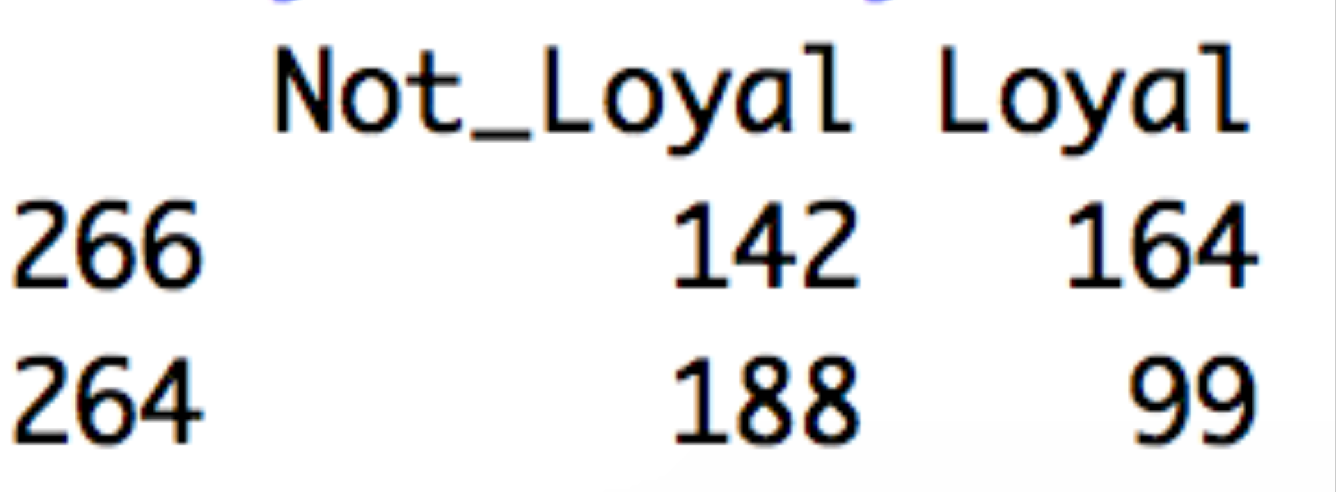
Comparing metrics for brands
Performing Chi-Sq on binaries and Anova for 1-10 scale.
Dependent Variable | Test | Comparison
Loyality | Chi - Sq | 266 > rest
 | Anova | 266 > rest & 263 > 265
Familiarity | Chi - Sq | 266 > rest
 | Anova | 266 > 264 = 263 > 267 = 265
Uniqueness | Chi - Sq | 266 > rest
 | Anova | 266 > rest
Relevance | Chi - Sq | 266 > rest
 | Anova | 266 > rest
Popularity | Chi - Sq | 266 > 264 > 263 = 265 = 267
 | Anova | 266 > 264 > 263 = 267 > 265
Table : Comparison of brands for dependent variables

