Slide 1
Build a model that will help Orion to predict winning bids and allow the company to maximize total contribution (profit).
Assumptions
Neglect Multi Collinearity (Independent)
Based on lowest price of bid
Type of bid is not taken into consideration
Based on the Cost of Orion buses (Company specific)

Slide 2
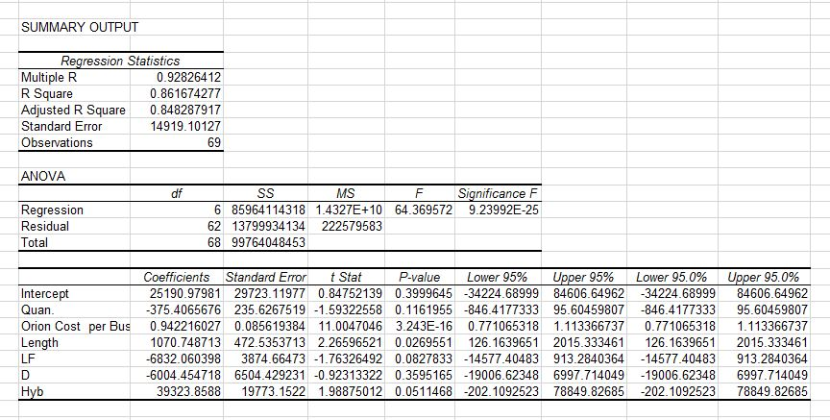
Regression Analysis

Slide 3
Regression Model
Winning Bid = µ0 + µ1*Quantity + µ2*Orion_Cost_Per_Bus + µ3*Length + µ4*Low_Floor + µ5*Fuel_D
+ µ6*Fuel_Hyb + E
Instead of µ use x here
We don’t have the model with Mark up ?
Refer to ANOVA results in the last slide to justify selection of variables
Winning Bid = 25190.98 - 375.41 * Quantity + 0.94 * Orion_Cost_Per_Bus + 1070.75 * Length
- 6832.06 * Low_Floor - 6004.45 * Fuel_D + 39323.86 * Fuel_Hyb
Where Low_Floor, Fuel_D, Fuel_Hyb takes values 0 or 1
Profit = Winning Bid - Orion Production Cost

Slide 4
Advantages
R Square value is 84.83 %
Simple
Easy to interpret and modify

Slide 5
Limitations
Neglecting Multi Collinearity (Independent)
Based on lowest price of bid
Type of bid is not taken into consideration
Based on the Cost of Orion buses (Company specific)

Slide 6
How much would be the bid for the contract ?
Given Values:
Quantity: 5
Orion Cost : $234,229
Length : 30
Low floor
Diesel
Coefficients:
Intercept- 6000.59
Quan- 480.24
Orion_Cost- 1.03
Length- 1131.26
HighFloor-6047.12
Diesel- 4963.74
Mean: 264,110.90
Standard Deviation: 15,264.99
Needs to be updated withcoefficients mean and standard deviation calculated in the previous part

