Slide 1
Data Types of the Variables
Data
Categorical
Numerical
Ordinal
Nominal
Interval
Ratio
Clarity
Wholesaler
Carat
Color
Certification
Price
Polish
Symmety
Cut

Slide 2
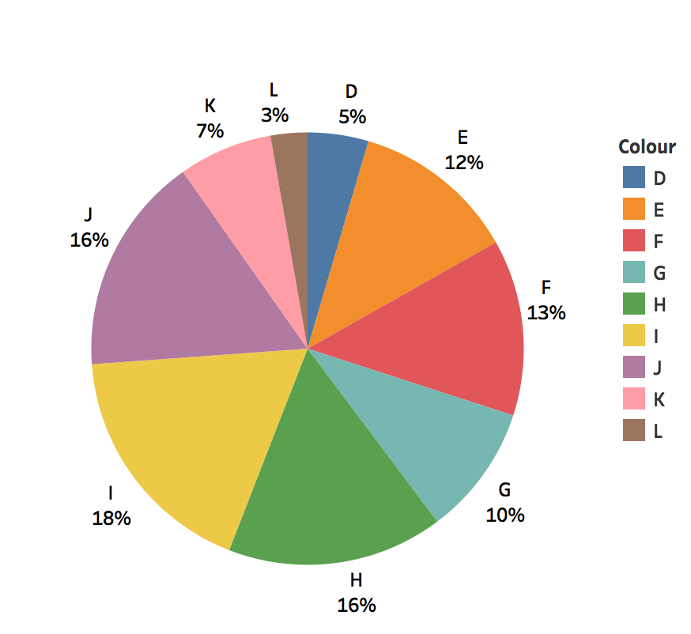
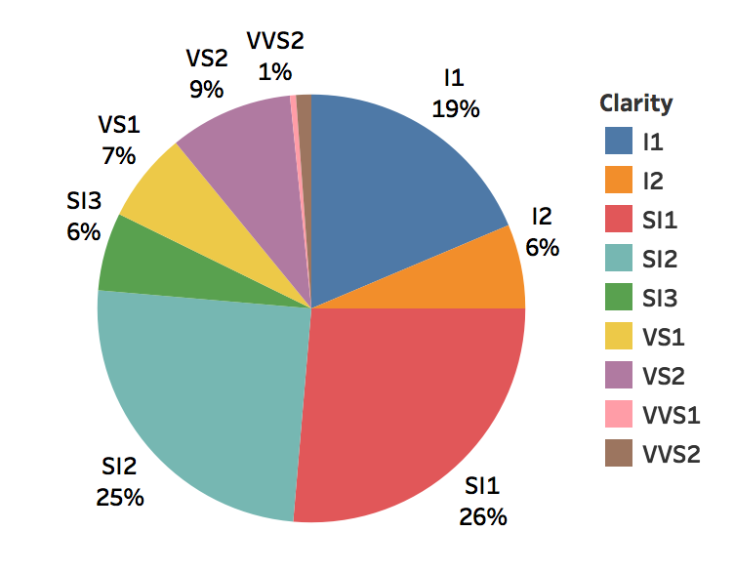
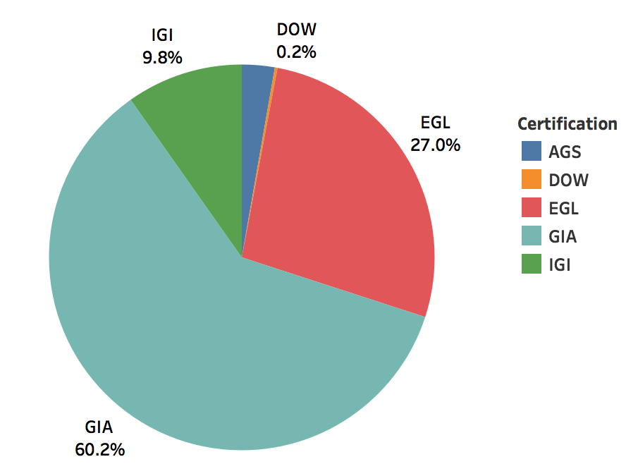
Descriptive Analysis
Distribution of Independent Variables – I
Colour
Clarity
Certification

Slide 3
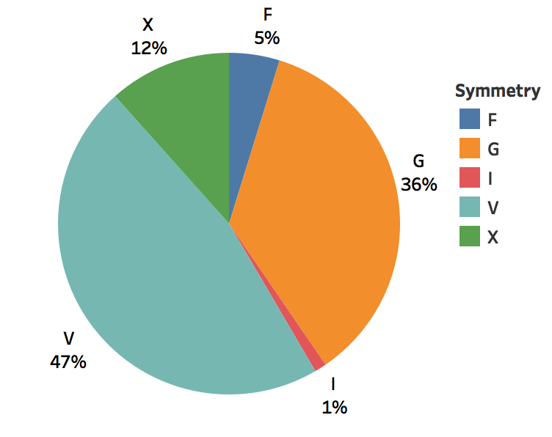
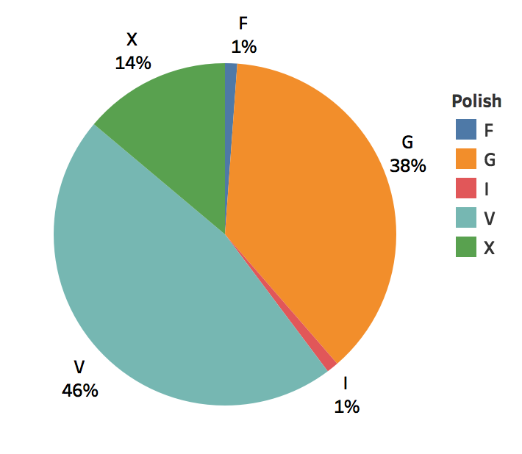
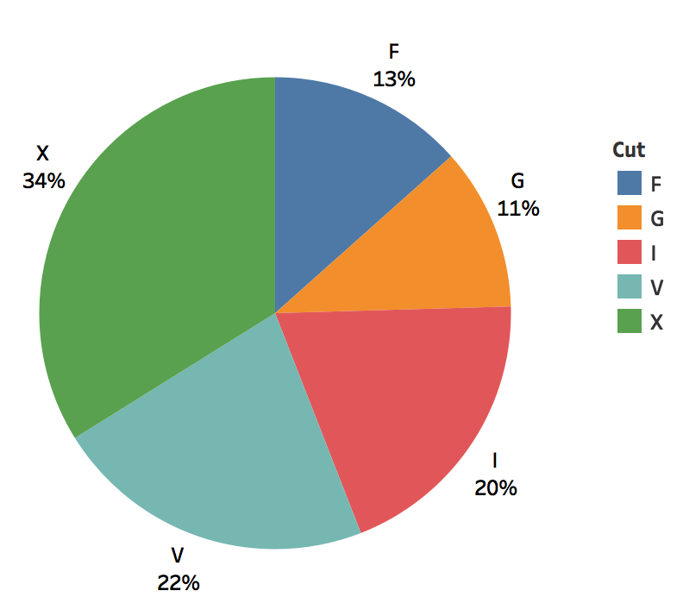
Descriptive Analysis
Distribution of Independent Variables – II
Symmetry
Polish
Cut

Slide 4
Descriptive Analysis
Density Distribution for Price

Slide 5
Descriptive Analysis
Density Distribution for Price
Note for the group !!
We do this only for carat because
We think it is most significant predictor

Slide 6
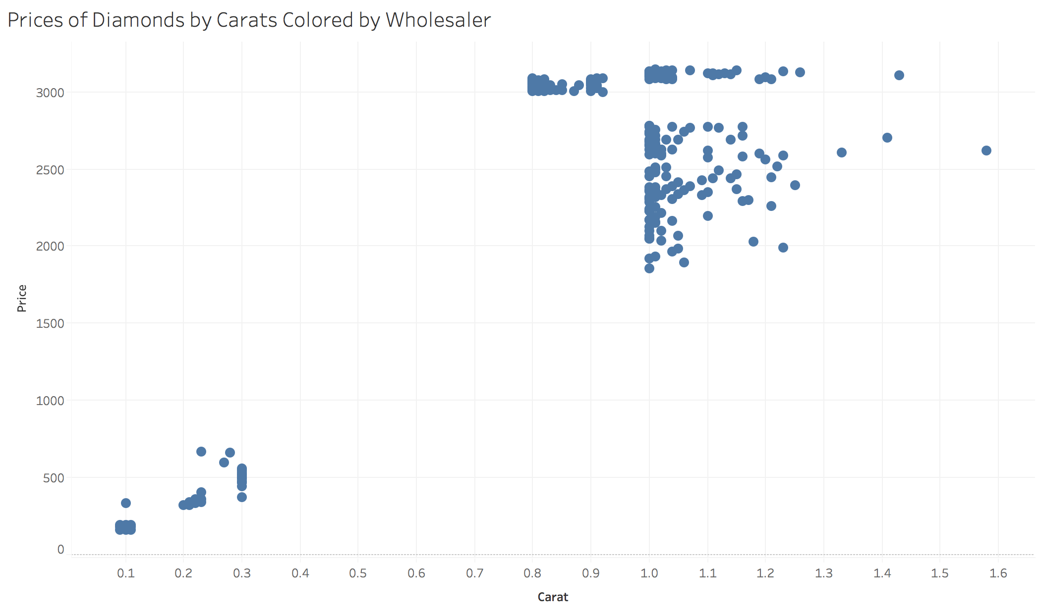
Descriptive Analysis
Bivariates
Price vs Carat

Slide 7
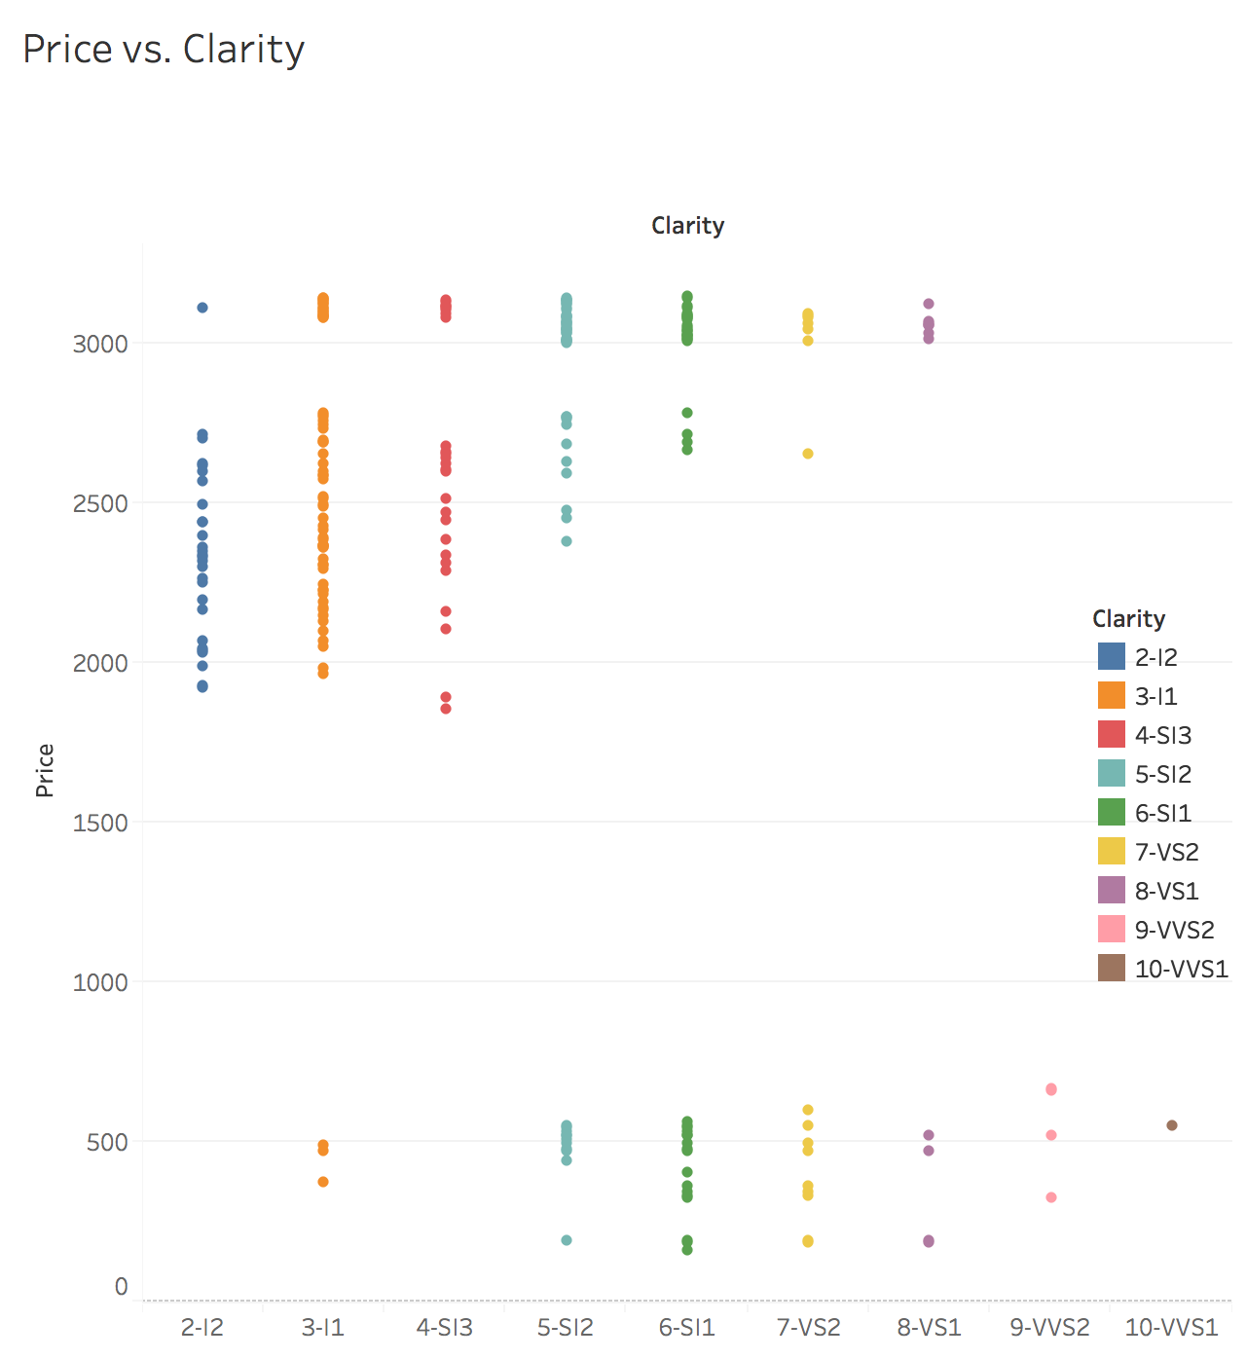
Descriptive Analysis
Bivariates
Price vs. Clarity

Slide 8
Descriptive Analysis
Bivariates
Price vs Cut

Slide 9
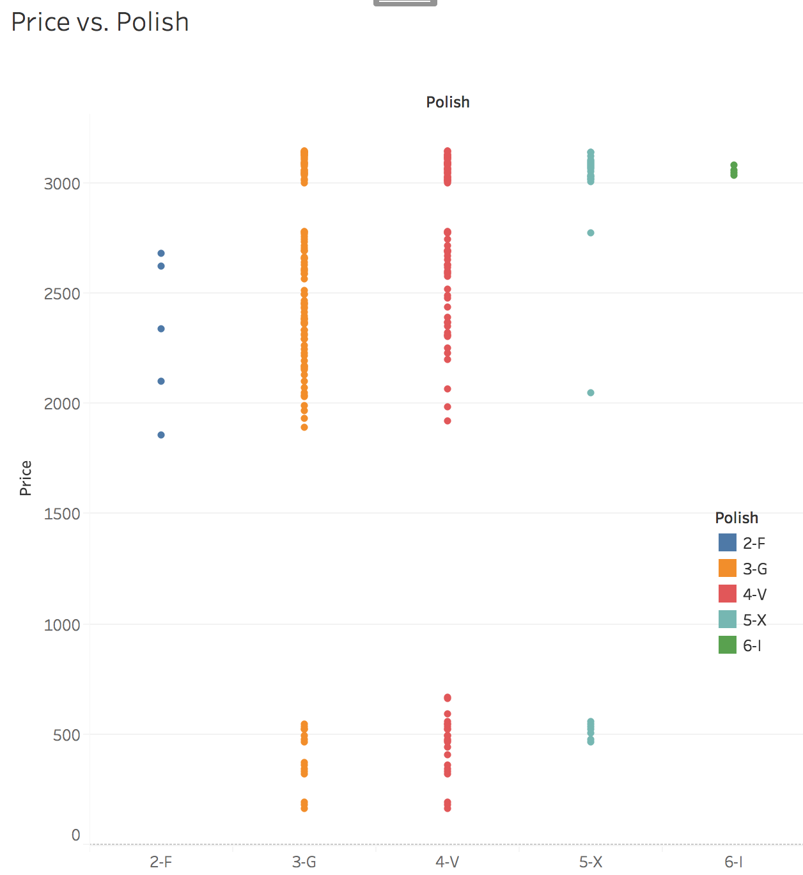
Descriptive Analysis
Bivariates
Price vs Polish

Slide 10
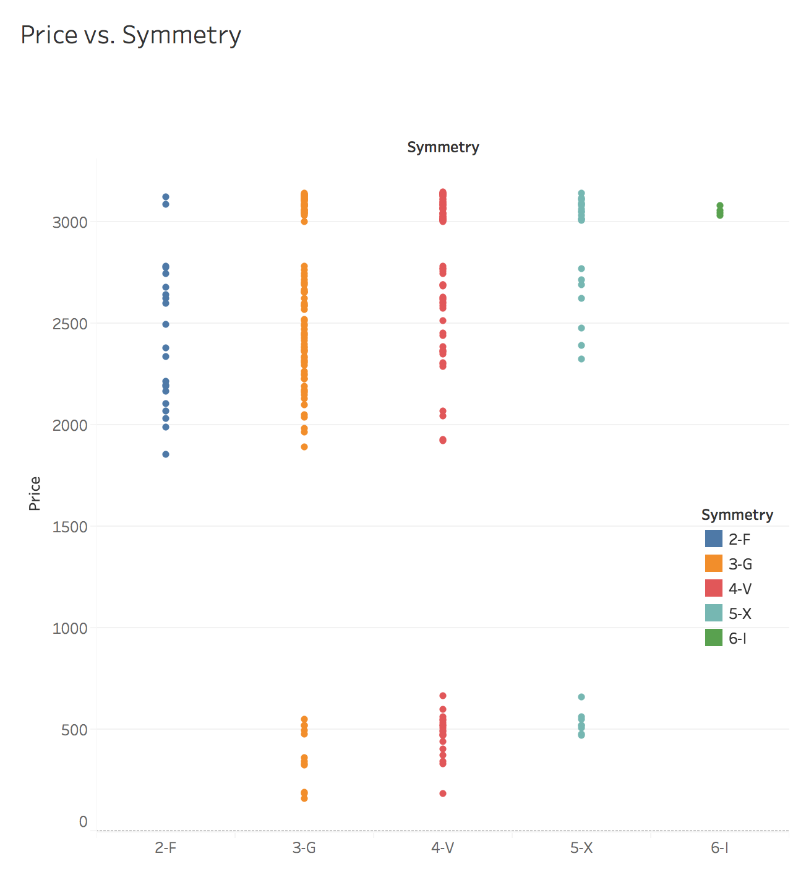
Descriptive Analysis
Bivariates
Symmetry

Slide 11
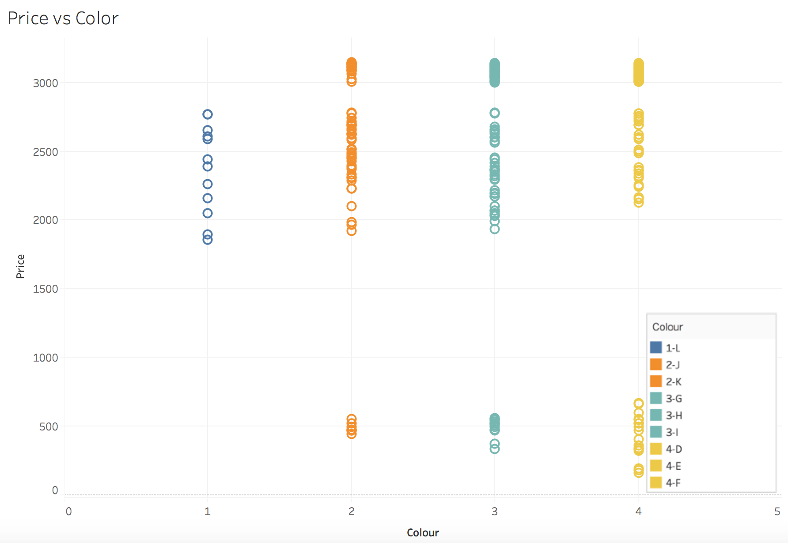
Descriptive Analysis
Bivariates
Price vs Color

Slide 12
Descriptive Analysis
Bivariates
Price vs Color

Slide 13
DIVEN – I
ANOVA

Slide 14
DIVEN - II
MULTICOLLINEARITY

Slide 15
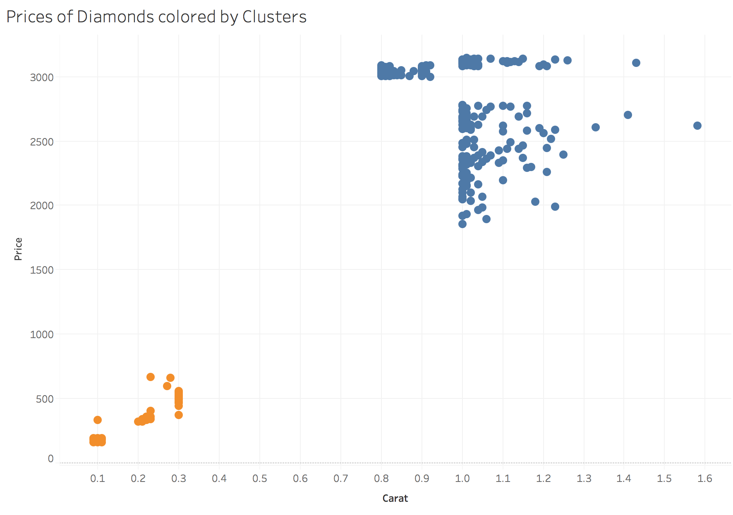
WHY PERFORMING ANALYSIS ON BLUE CLUSTER
Carat is a significant predictor
Professor’s Diamond lies in the blue cluster
Using all available data may lead bias, since
Lower carat and Higher carat traits may differ
Most of the data for blue cluster lies between
0.8 - 1.3 carats, which is a relatively small interval
Blue cluster is more favorable under linearity assumption (Carat vs. Price not linear for the whole carat range - as given in the pdf )
It would be better if Diven covers this part Sreeraj already has many slide. We can finalize when practicing!!

Slide 16
Feature Engineering Part I
Getting to know variables
Price is the prediction variable (Dependent)
Carat, Clarity, Color, Polish, Symmetry, Cut, Certification, Wholesaler are predictors (Independent variables)
Categorical Variable levels should be distinct based on their price prediction ability
Wholesaler needs to be excluded from prediction, since it is not a diamond characteristic (May introduce bias)
THIS PART CAN BE VISUALIZED WITH A TREE MAP. I WILL WORK ON THAT IF THERE’S ENOUGH TIME!!

Slide 17
Feature Engineering Part II
Grouping Ordinal Variables by Predictive Ability
Clarity
Originally had 7 levels.
Grouped to 3 levels
Variable Name | Original Levels | Final Levels | Levelling Criteria(s) | Original R-squared | After ReGrouping R-squared
Clarity | I2 I1 SI3 SI2 SI1 VS2 VS1 | Flawed Naked Eye 10x Zoom Flaws 30x Zoom Flaws | Some Levels Insignificant for price | 0.403 | 0.265

Slide 18
Feature Engineering II
Grouping Ordinal Variables by Predictive Ability
Color
Variable Name | Original Levels | Final Levels | Levelling Criteria(s) | Original R-squared | After ReGrouping R-squared
Color | L J,K G,H,I F,D,E | Near Colorless Lightly Yellow | Some Levels Insignificant for price | 0.065 | 0.021

Slide 19
Feature Engineering II
Grouping Ordinal Variables by Predictive Ability
Polish
Variable Name | Original Levels | Final Levels | Levelling Criteria(s) | Original R-squared | After ReGrouping R-squared
Polish | F G V X I | F + G V X + I | Small sample size for F and I | 0.149 | 0.133

Slide 20
Feature Engineering II
Grouping Ordinal Variables by Predictive Ability
Symmetry
Variable Name | Original Levels | Final Levels | Levelling Criteria(s) | Original R-squared | After ReGrouping R-squared
Symmetry | F G V X I | F G V + X + I | Small sample size for I Low predictive ability difference between V-X | 0.141 | 0.133

Slide 21
Feature Engineering II
Grouping Ordinal Variables by Predictive Ability
Cut
Variable Name | Original Levels | Final Levels | Levelling Criteria(s) | Original R-squared | After ReGrouping R-squared
Cut | F G V X I | F G V X I | All levels distinct Bin Sizes are large enough | 0.144 | 0.133

Slide 22
Feature Engineering II
Grouping Ordinal Variables by Predictive Ability
Certification
Variable Name | Original Levels | Final Levels | Levelling Criteria(s) | Original R-squared | After ReGrouping R-squared
Certification | AGS GIA EGL DOW IGI | AGS + GIA EGL + DOW + IGI | Two most respected labs vs. others | 0.082 | 0.054

