Slide 1

Managing & Programming Database MCDA5540
Team Project Halifax Science Library (HSL) Presentation
Team Members:
Caner Adil Irfanoglu (A00425840)
Sunil Padikar (A00428089)
Vinay Govindan (A00429120)
Gaganpreet Singh (A00429660)

Slide 2
PROJECT OVERVIEW
The Halifax Science Library (HSL) maintains an SQL database about various publications
The Database should be capable of helping Library Management following 3 functions:
Selling Library items and keeping record information about these sales(transactions)
Record each scientific magazine with articles in that magazine
Record data for monthly expenditures [Only Design Requirement]
Source Computing and Data Analytics 5540 -- Team Project pdf

Slide 3
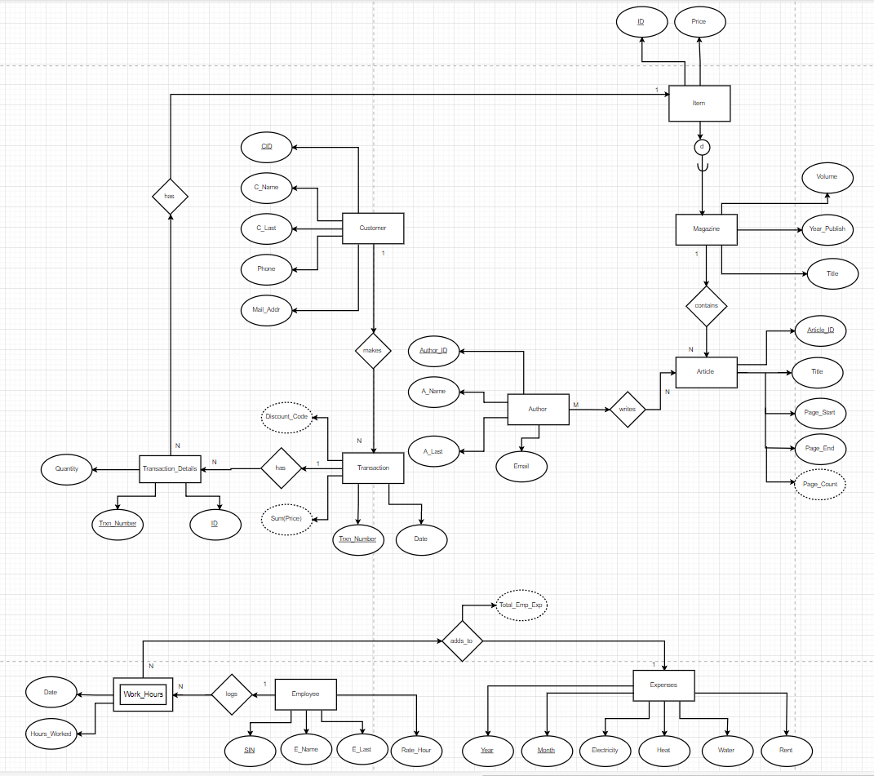
Customer
EER DIAGRAM
Attributes:
CID
First Name
Last Name
Telephone Number
Mail Address
Relationship/(s)
Customer makes Transaction
Cardinality
1 to N with Transaction
Normalization
All fields depend on CID and not the other way around.
✓BCNF – ✓3NF - ✓ 2NF – ✓1NF

Slide 4
Transaction
EER DIAGRAM
Attributes:
Trxn_Number
Date
Discount_Code (Derived)
Total Price (Derived)
CID (Foreign Key)
Relationship/(s)
Customer makes Transaction
Transaction has Transaction Details
Cardinality
N to 1 with Customer
1 to N with Transaction_Details
Normalization
When customer levels up their discount code will change even though CID remains the same. So, Discount Code is only determined by Trxn_Number and so are the other fields.
✓BCNF – ✓3NF - ✓ 2NF – ✓1NF

Slide 5
Author
EER DIAGRAM
Attributes:
Author_ID
Author Name
Author Last
Email
Relationship/(s)
Author writes Article
Cardinality
M to N with Article
Normalization
All fields depend on Article_ID.
✓3NF - ✓ 2NF – ✓1NF

Slide 6
Writes
EER DIAGRAM
Attributes:
Author_ID (Foreign Key)
Article_ID (Foreign Key)
Normalization
Both Author_ID and Article_ID form the candidate key and there is no partial or transitive dependency .
✓BCNF – ✓3NF - ✓ 2NF – ✓1NF

Slide 7
Article
EER DIAGRAM
Attributes:
Article_ID
Title
Page_Start
Page_End
Page Count (Derived)
Magazine_ID(Foreign Key)
Relationship/(s)
Author writes Article
Magazine contains Article
Cardinality
N to M with Article
N to 1 with Magazine
Normalization
All fields depend on Article_ID and not the other way around.
✓BCNF – ✓3NF - ✓ 2NF – ✓1NF

Slide 8
Magazine
EER DIAGRAM
Attributes:
Volume
Year Published
Title
ID (Foreign Key)
Relationship/(s)
Magazine contains Article
Cardinality
1 to N with Article
Superclass
Item
Normalization
3NF, BCNF as Maganize_ID and Year_Publish depends only on Title+ Volume & not the other way around.
✓BCNF – ✓3NF - ✓ 2NF – ✓1NF

Slide 9
Item
EER DIAGRAM
Attributes:
ID
Price
Relationship/(s)
Transaction Details has Item
Cardinality
1 to N with Transaction Details
Subclass
Magazine
Normalization
Price is uniquely identified by the primary key ID and price cannot determine ID uniquely hence the relation is in BCNF
✓BCNF – ✓3NF - ✓ 2NF – ✓1NF

Slide 10
Transaction Details
EER DIAGRAM
Attributes:
Trxn_Number (Foreign Key)
ID (Foreign Key)
Quantity
Relationship/(s)
Transaction Details has Item
Transaction has Transaction Details
Cardinality
N to 1 with Item
N to 1 with Transaction
Normalization
Customer can purchase same items on different transactions. Trxn_Number is required alongside with ID.
Also, Trxn_Number is not sufficient to determine quantity, since the transaction can include same quantities of different items.
So, Quantity is only determined by using Trxn_Number and ID and not the other way around.
✓BCNF – ✓3NF - ✓ 2NF – ✓1NF

Slide 11
Employee
EER DIAGRAM
Attributes:
SIN
Employee Name
Employee Last
Rate_Hour
Relationship/(s)
Employee logs Work_Hours
Cardinality
1 to N with Work_Hours
Normalization
All fields depend on SIN and not the other way around.
✓BCNF – ✓3NF - ✓ 2NF – ✓1NF

Slide 12
Work_Hours
EER DIAGRAM
Attributes:
Date
SIN (Foreign Key)
Hours Worked
Relationship/(s)
Work Hours adds_to Expenses
Employee logs Work_Hours
Cardinality
N to 1 with Expenses
N to 1 with Employee
Normalization
All fields depend on Date & SIN and not the other way around.
✓BCNF – ✓3NF - ✓ 2NF – ✓1NF

Slide 13
Expenses
EER DIAGRAM
Attributes:
Year
Month
Electricity
Heat
Water
Rent
Total_Emp_Exp (Derived)
Relationship/(s)
Work Hours adds_to Expenses
Cardinality
1 to N with Work_Hours
Normalization
All fields depend on Year & Month and not the other way around.
✓BCNF – ✓3NF - ✓ 2NF – ✓1NF

Slide 14




PART1 – Data to Mongo DB
1
5
data2mongo.sh
Make_coll_ordparts.js
Make_coll_ordparts1.js
mongo2sql.sh
2
4
6
7
New_tables.sql
3
9
8
PART2 – Data from Mongo DB to MYSQL DB

Slide 15


Part 3 – PHP Flow
main.php
show_tables.php
add_article.php
add_customer.php
Create_new_transaction.php
Cancel_transaction.php
print_tables.php

Slide 16
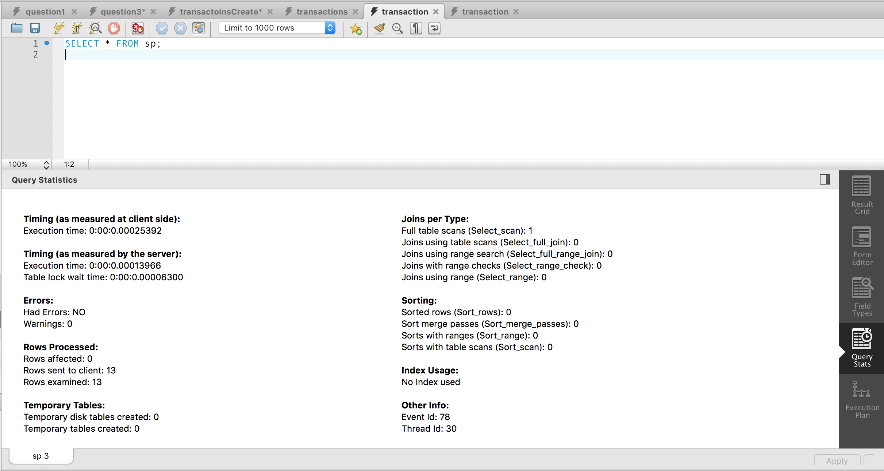
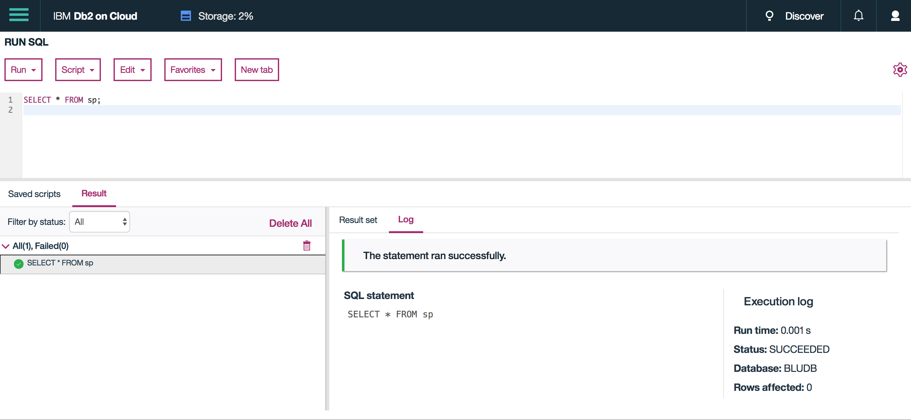
BONUS PART – PERFORMANCE COMPARISONS 1
Result: MySQL > DB2 (Possible Rounding Error) – Full Table Scan

Slide 17
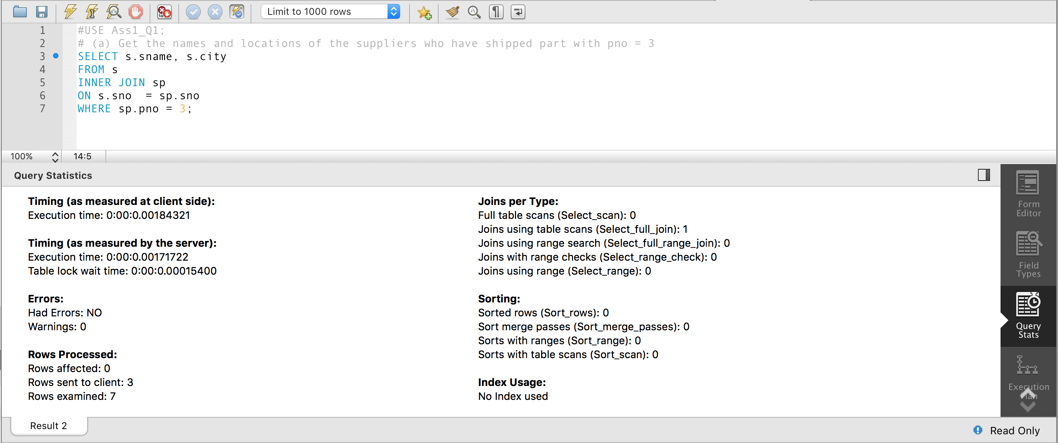
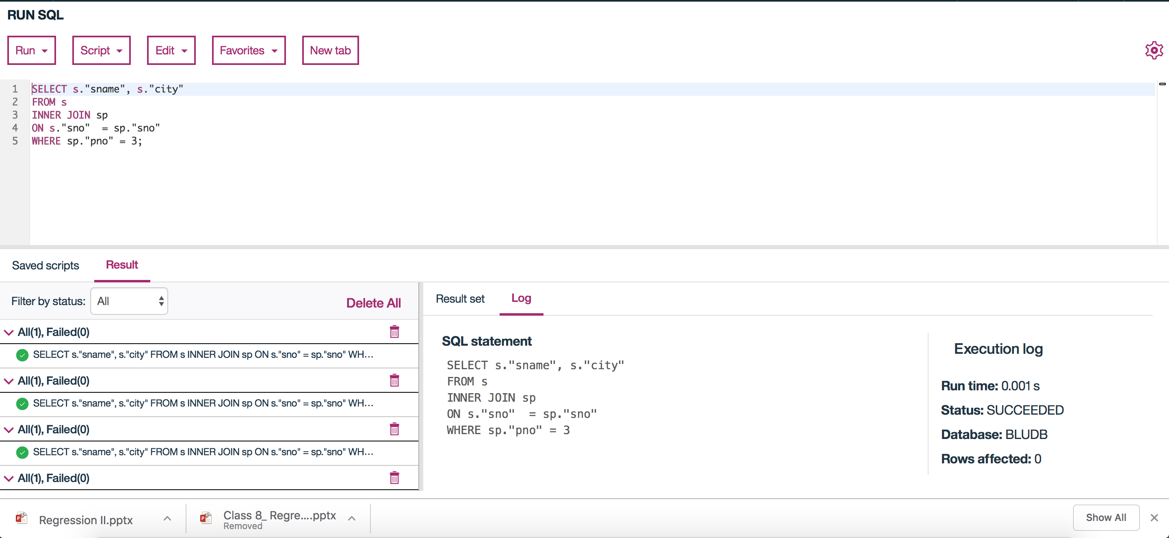
BONUS PART – PERFORMANCE COMPARISONS 2
Result: DB2 > MySQL – Full table scan + unique key lookup

Slide 18
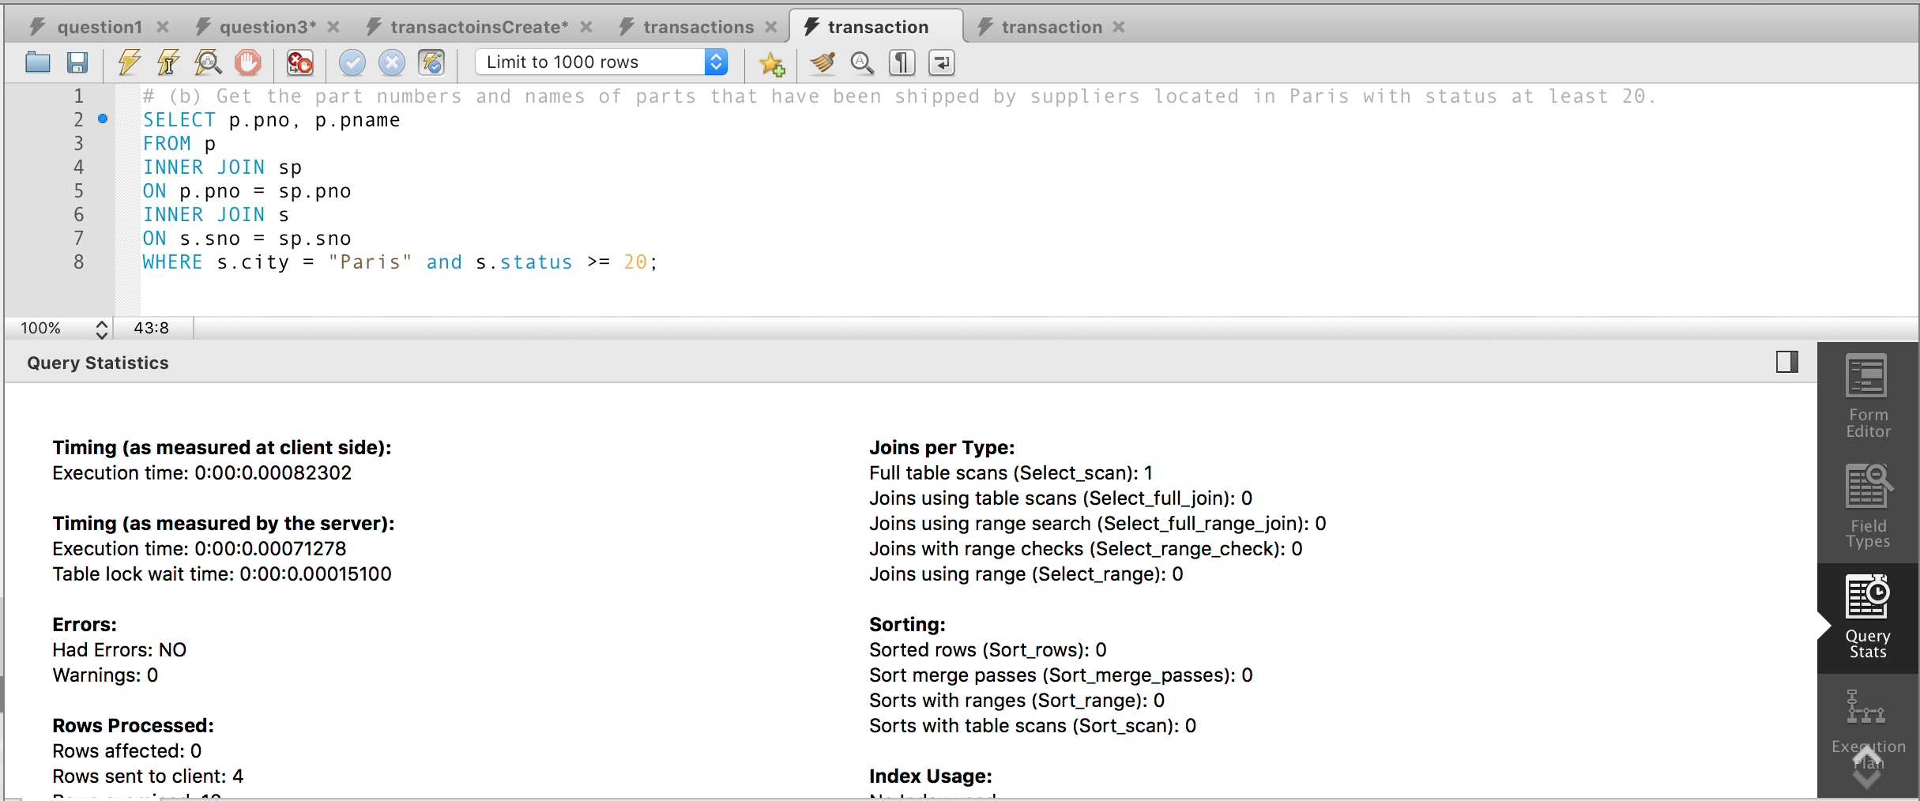
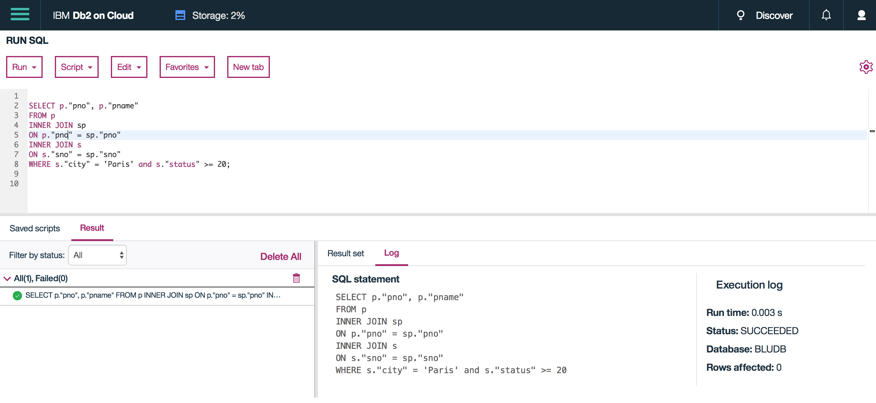
BONUS PART – PERFORMANCE COMPARISONS 3
Result: MySQL > DB2 - Full table scan + unique key lookup + non-unique key lookup

Slide 19


