Slide 1

Good to Great Company
MCDA 5570
Managing Information Technology and Systems
Present by: Caner Irfanoglu

Slide 2
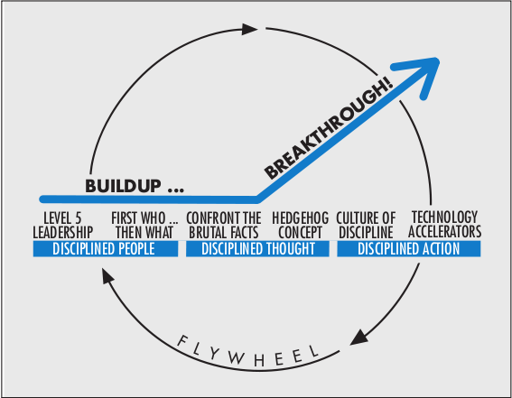
Source: https://www.jimcollins.com/concepts/the-flywheel.html

Slide 3

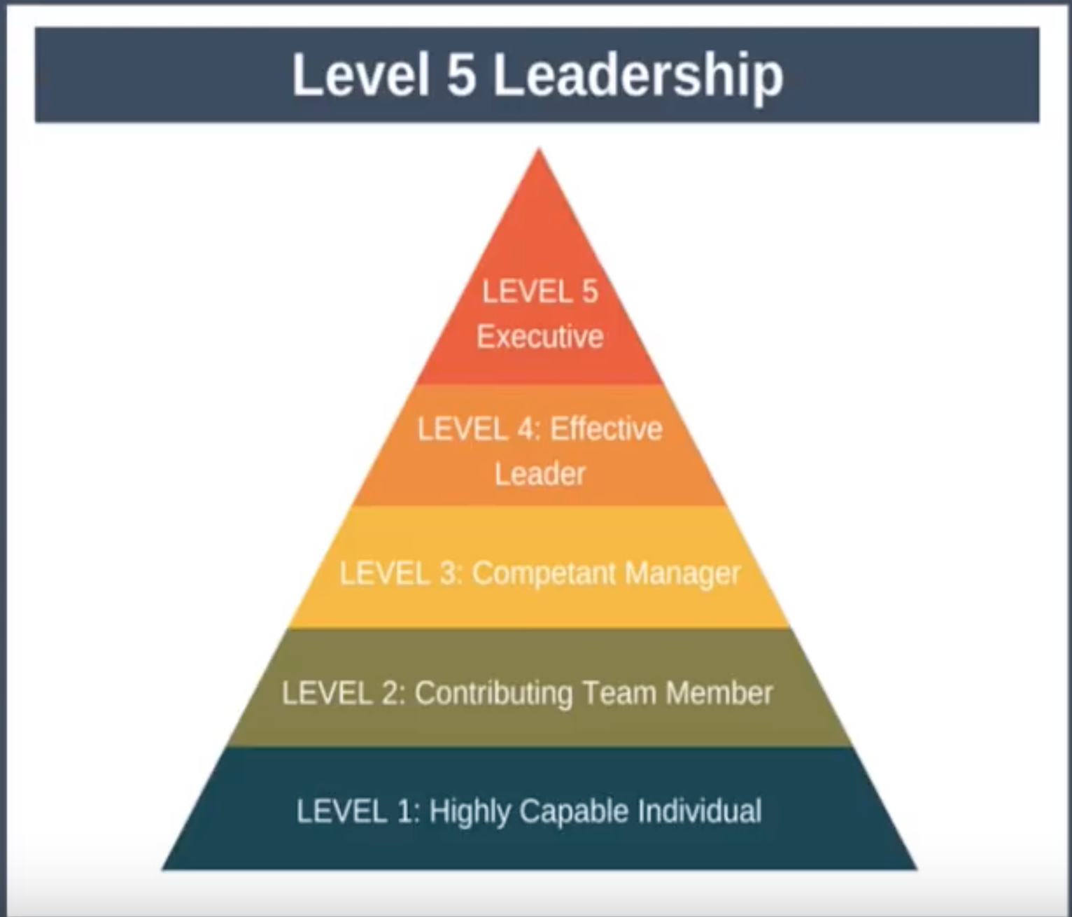
Source: https://www.jborden.com/good-to-great-the-level-5-leader/

Slide 4
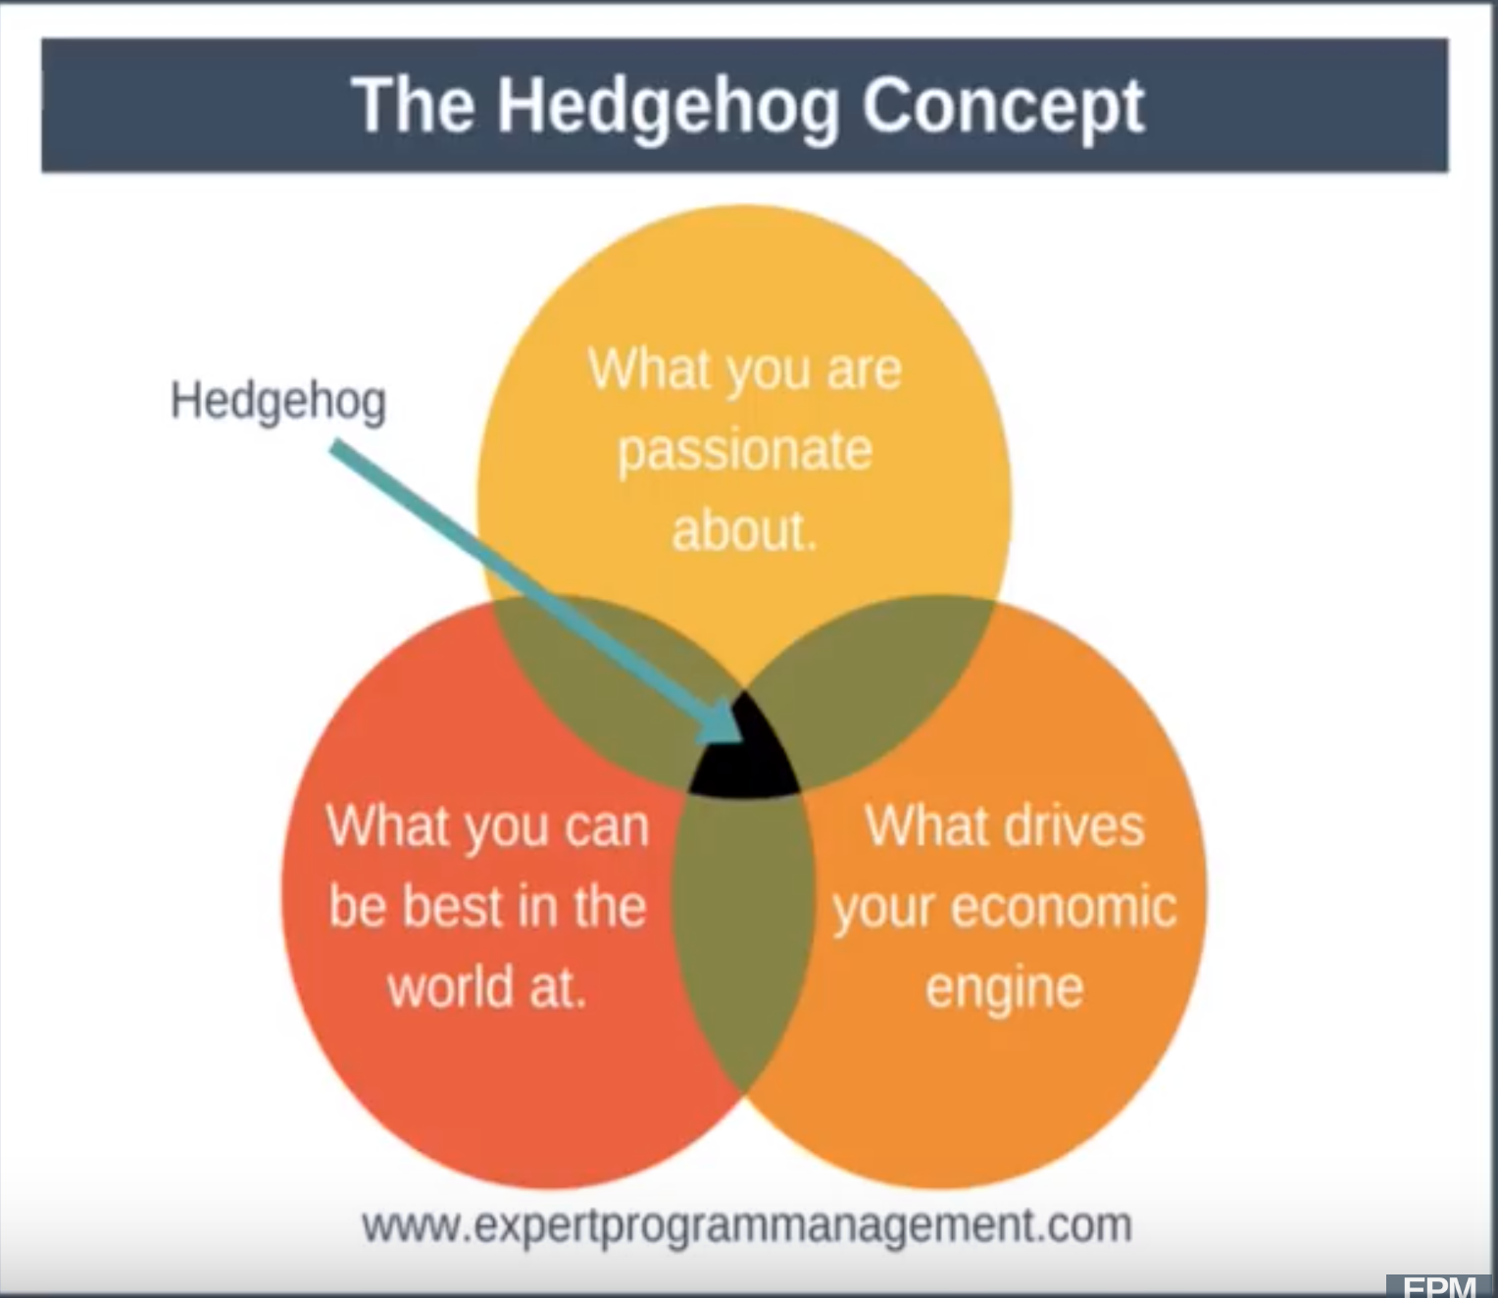
Source: https://slideplayer.com/slide/9176061

Slide 5
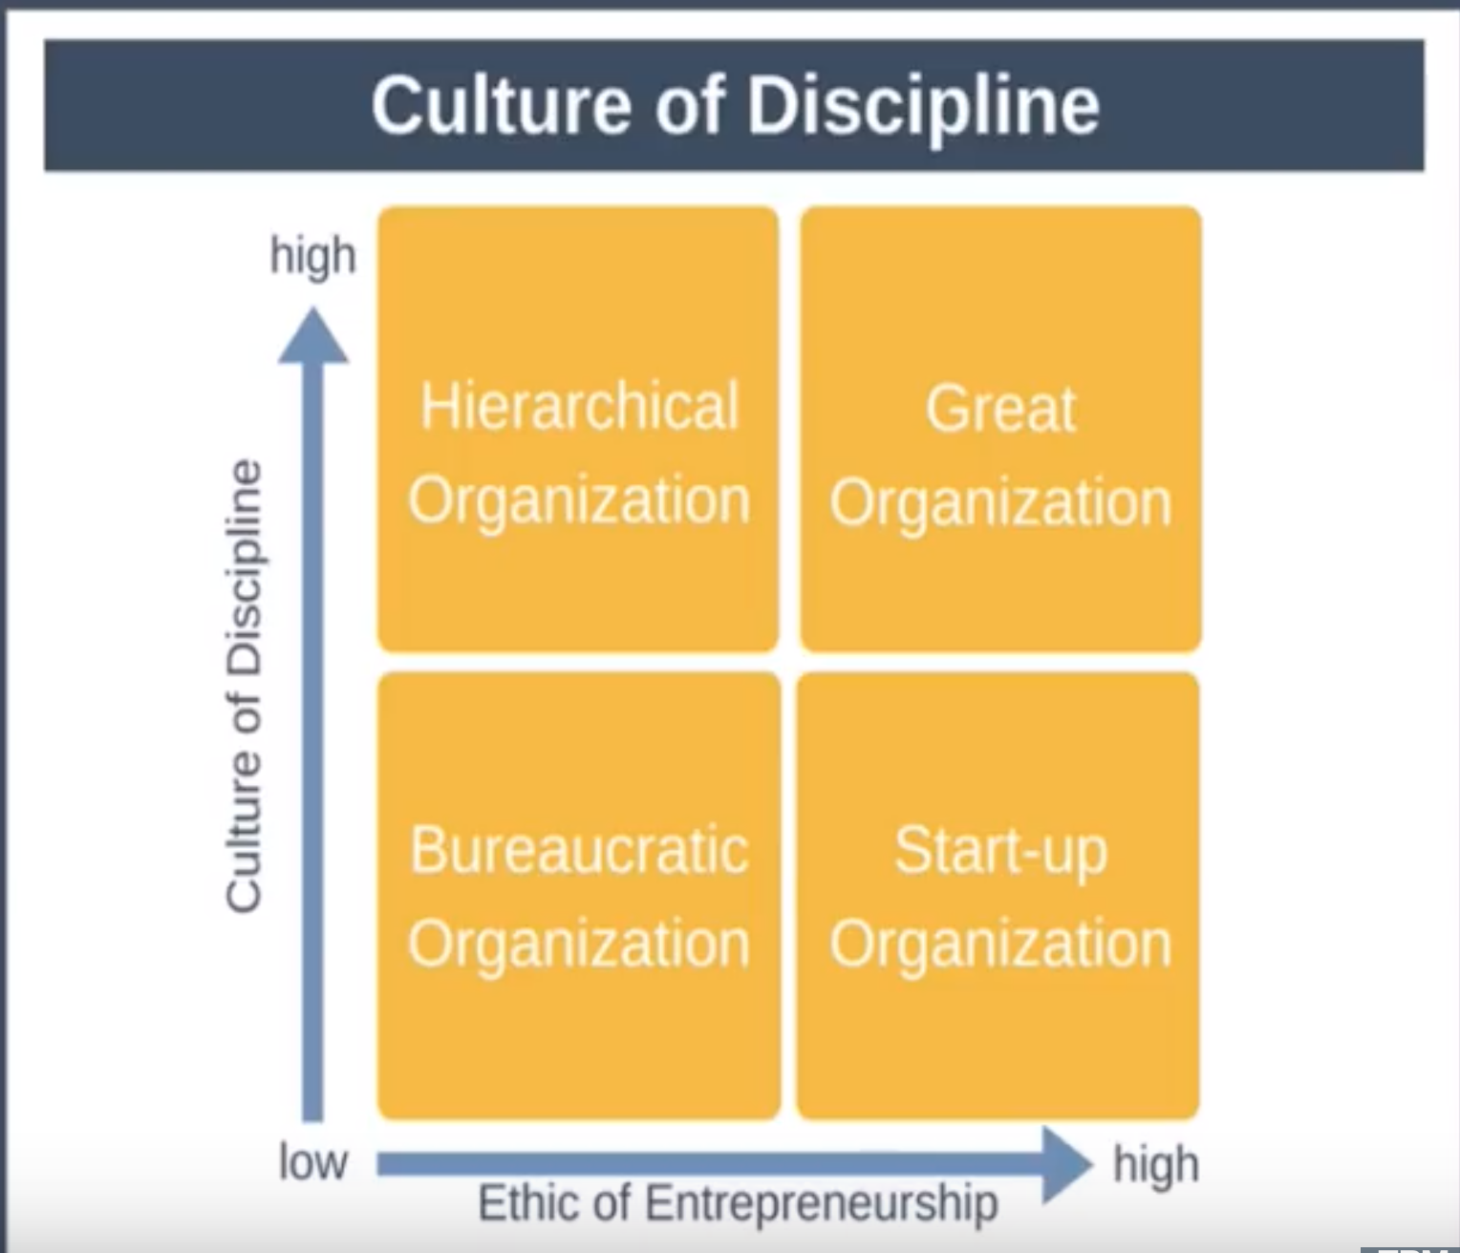
Source: https://expertprogrammanagement.com/2018/05/good-to-great-collins-summary/

Slide 6


