Slide 1


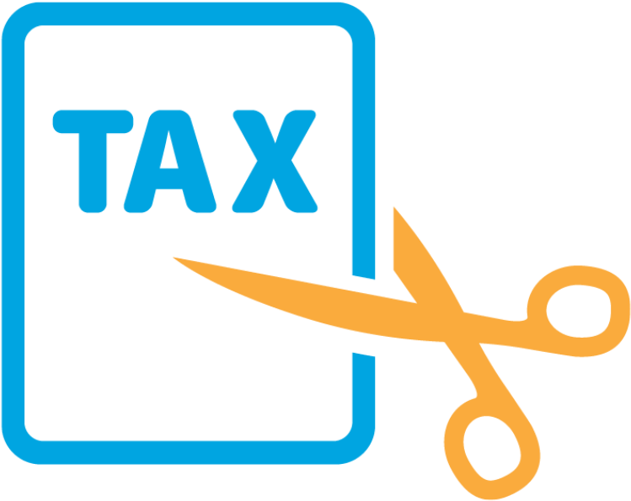


ECONOMY ?
How to boost
New Brunswick’s

Slide 2
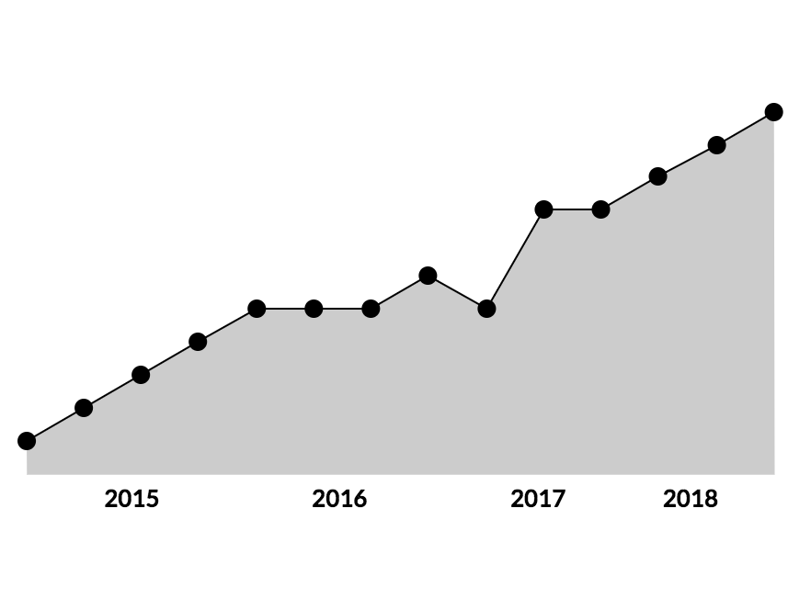
Why Invest In Cannabis?
Factors Favoring Cannabis Investment
Yearly Increase in Consumption
30%
Market Size by the end of 2020
$15.6b
Cannabis has the Highest Yield per Acre
$1.1m
Returns Expected
35%

Slide 3
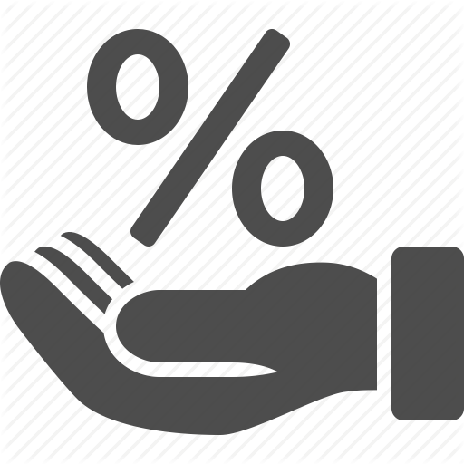


New Brunswick & Cannabis
Why New Brunswick is the right choice
Attract Farmers
Cannabis farming doesn't require large investment or area which can be used to attract new farmers and investments
Transportation ready
Multimodal, modern transportation infrastructure, with more than
18,000 km
Total Share
0.6%
Possesses less than 1 percent of market
Source https://www2.gnb.ca/content/gnb/en/gateways/about_nb/transportation.html

Slide 4
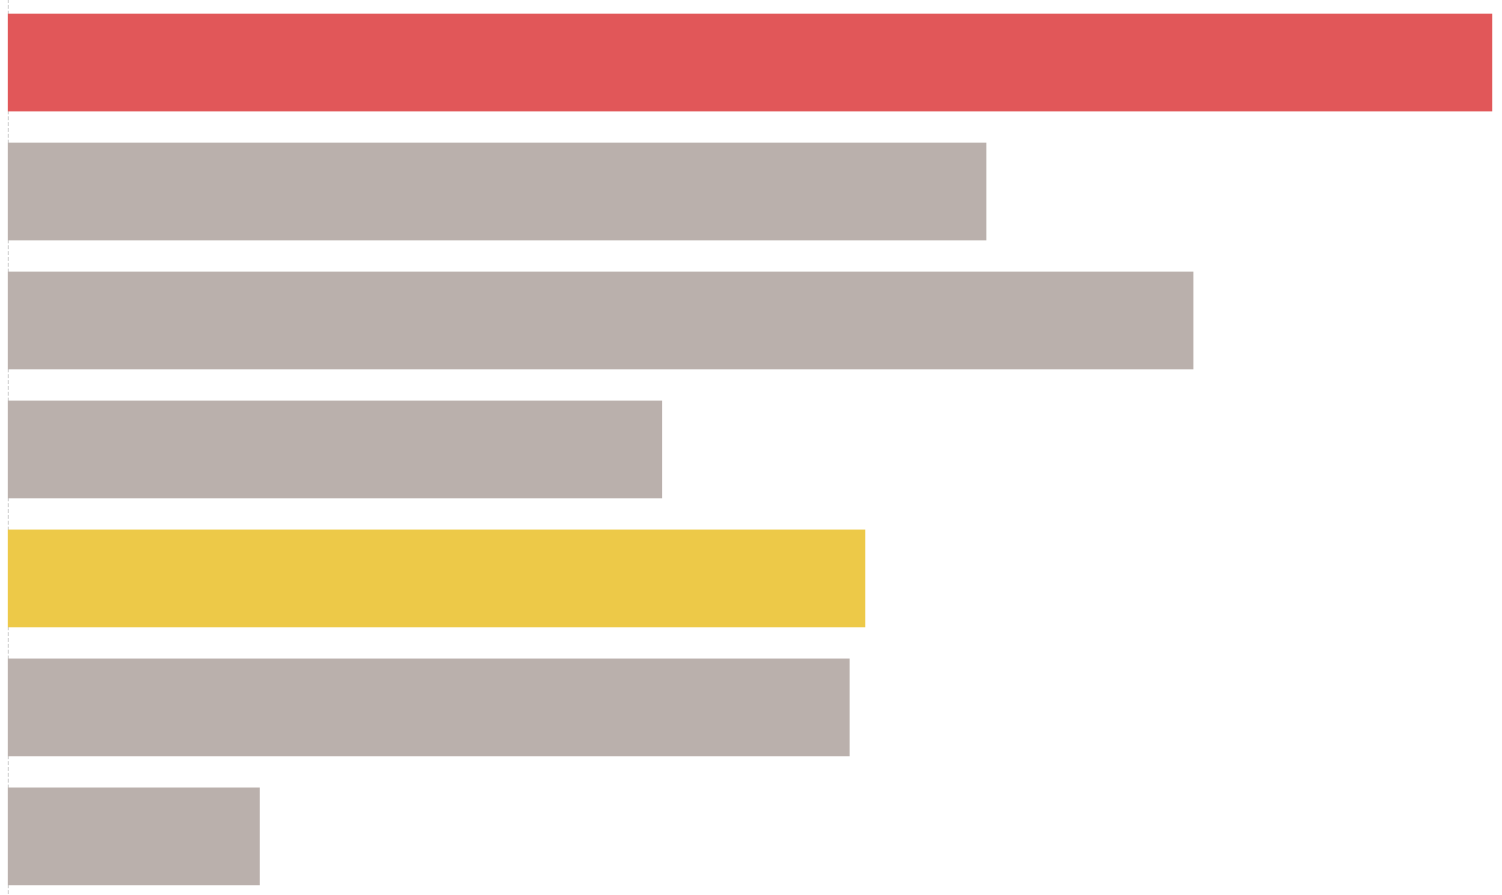
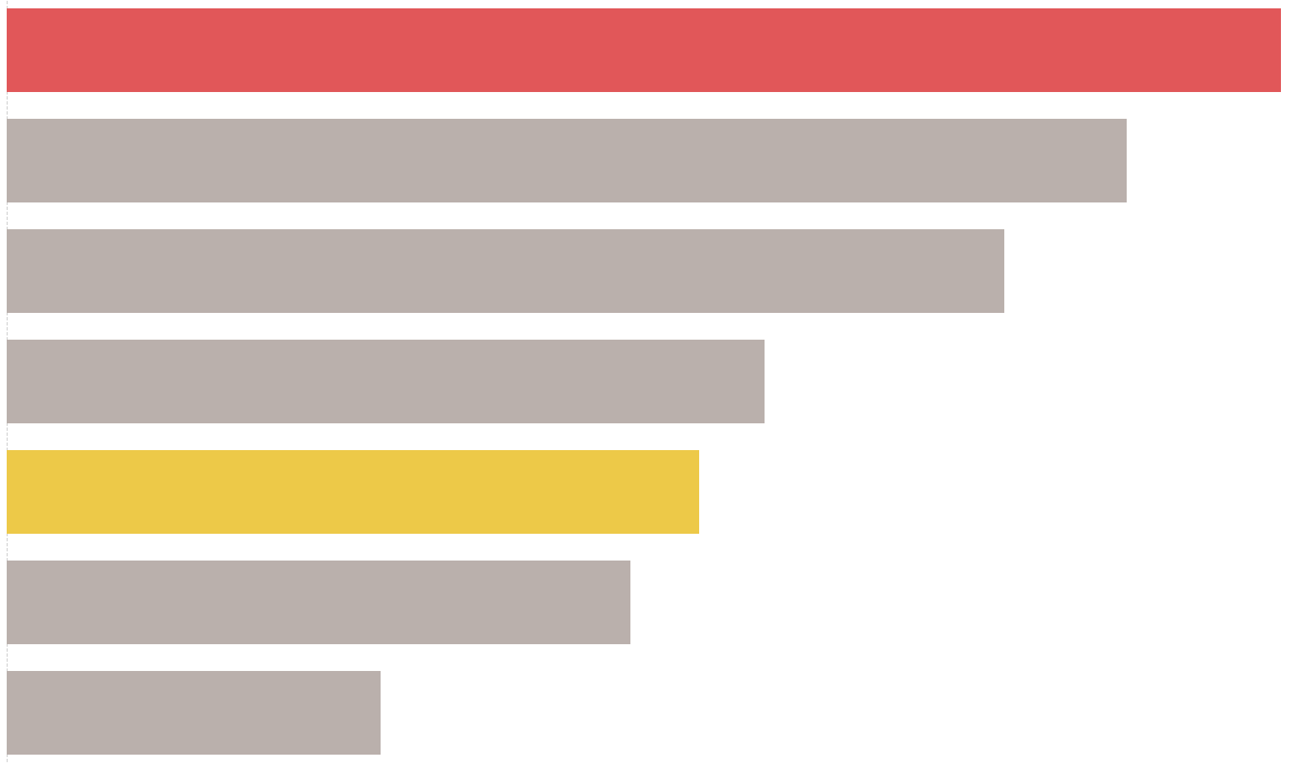
Reducing Taxes
Residential Taxes
Commercial Taxes
$15.88
New Brunswick
New Brunswick
$42.38
$9.88
Quebec
Quebec
$37.23
$11.98
Nova Scotia
Nova Scotia
$33.18
$6.62
Ontario
Ontario
$25.20
$8.66
Canada
Canada
$23.02
$8.51
Alberta
Alberta
$20.76
$2.55
B.C.
B.C
$12.44
*Values are representing taxes per $1000 of Assessment
City’s Property Tax is directly linked to its competitiveness. Higher investments will strengthen the provincial workforce by developing and attracting people.

Slide 5
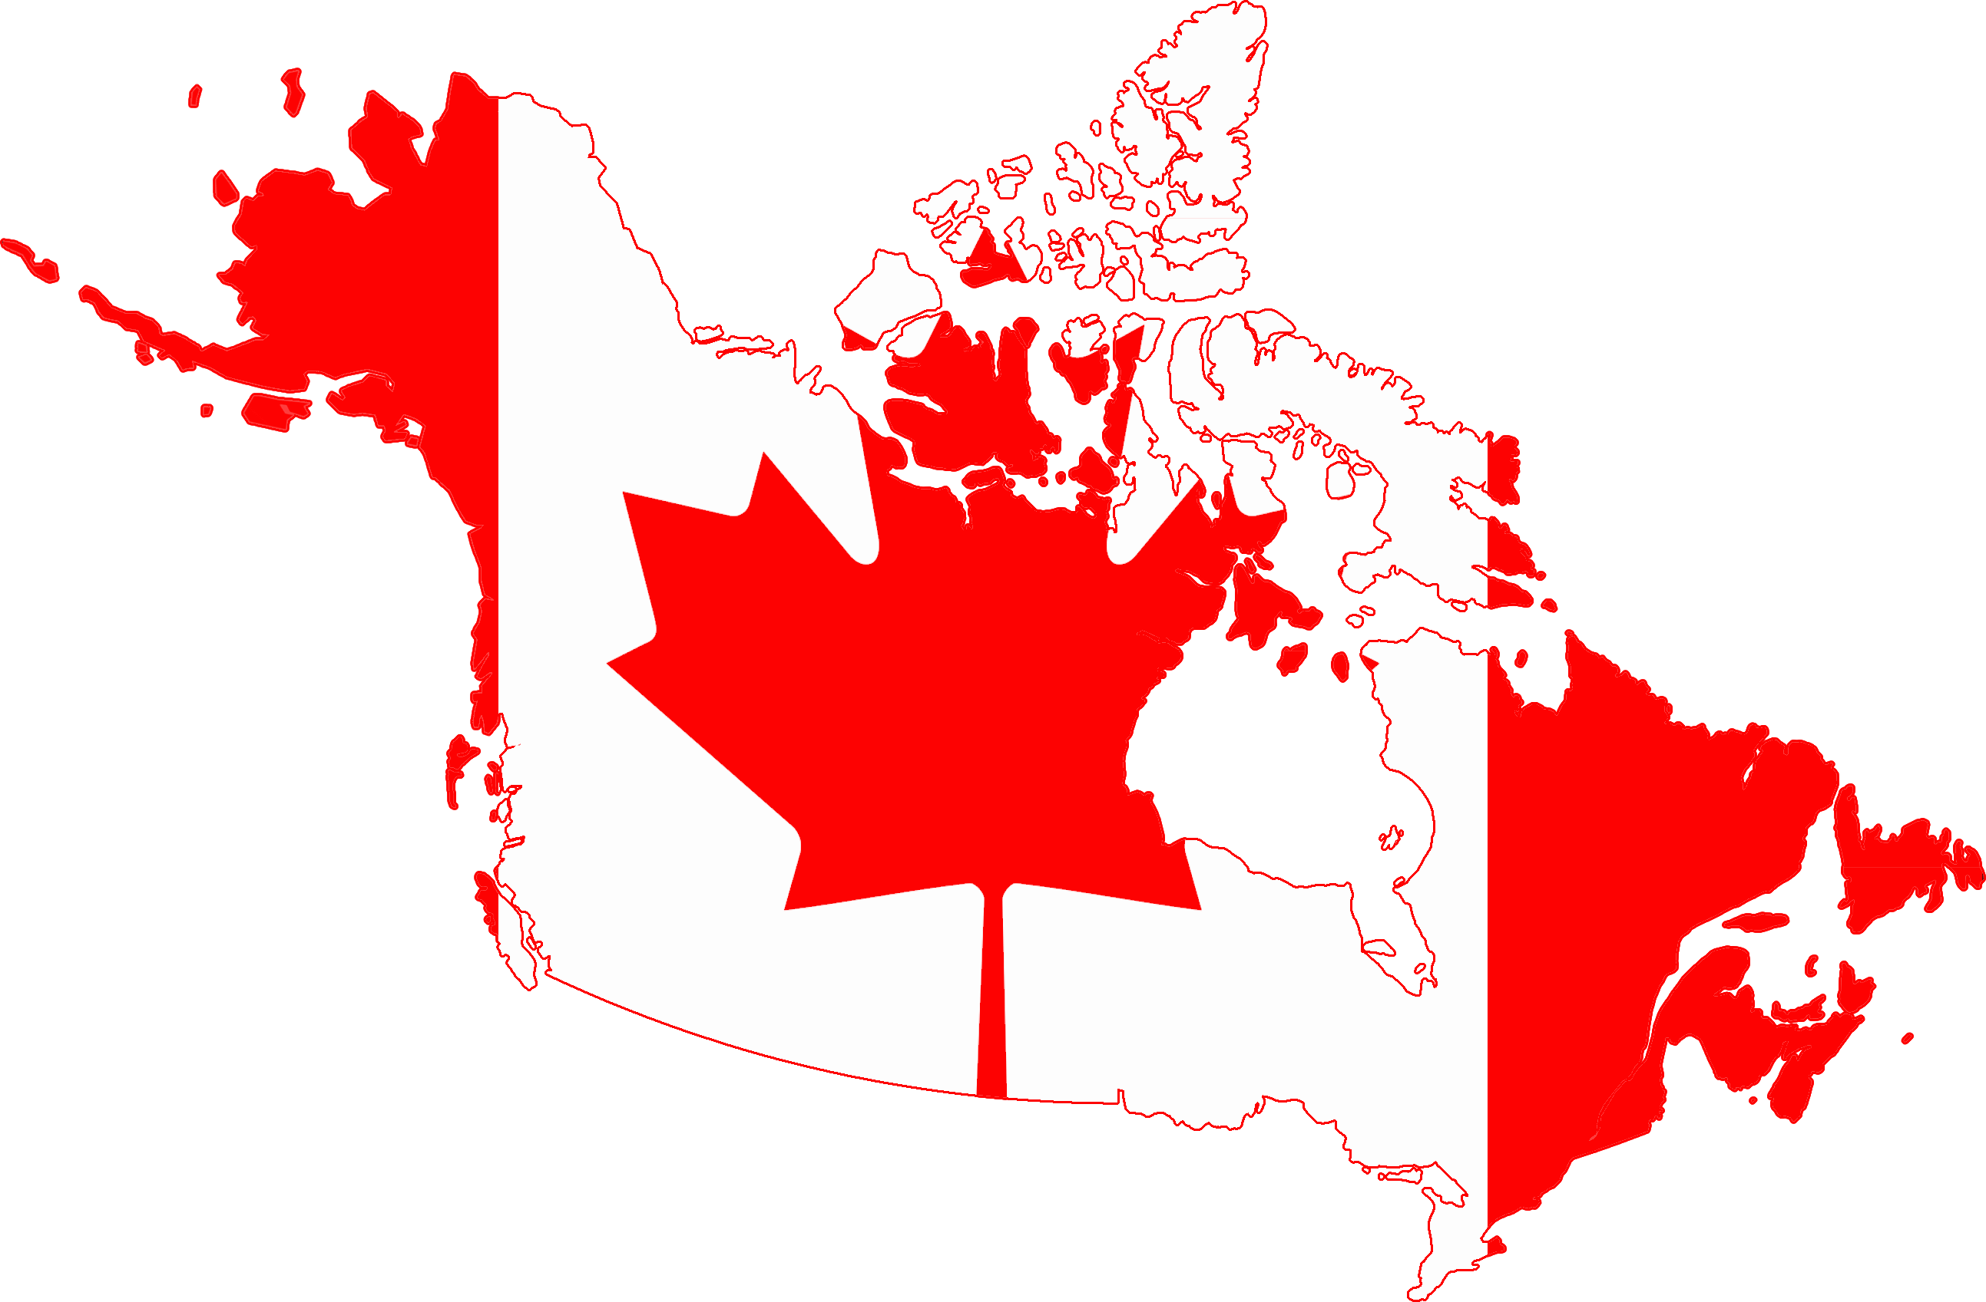

Focus on Manufacturing
Workforce in Manufacturing Canada vs. N.B.
#2
11.4%
of Work Force
Largest
Industry
#12
3.3%
of Work Force
Largest
Industry
Source gnb.socrata.com, www.statcan.gc.ca

Slide 6
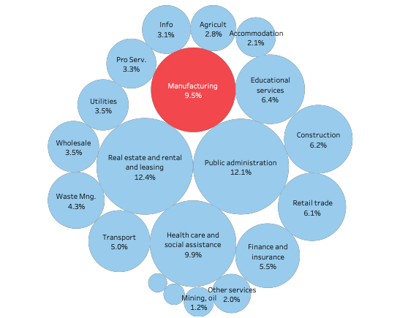
Focus on Manufacturing
GDP Contribution of Manufacturing to N.B
#4 PLACE
WITH 9.5%
GDP Contribution
Growth in Manufacturing will help New Brunswick residents and economy.
Source gnb.socrata.com, Statistics Canada - Gross Domestic Product by Industry - Provincial and Territorial

Slide 7


