Slide 1
Evaluation and Prediction of
Cell Phone Sales
Based on Various Techniques
Lingwei Cao, Cheng Qian, Zhaoyang Tian
Tsinghua High School
Advisor: Hao Wu, Dianjun Wang

Slide 2
Content
Research Background and Purposes
Train of Thought and Methods
Conclusions and Evaluation
Acknowledgement

Slide 3
Research Background
Research Purposes and significance

Slide 4

Research Background
Technology advancement
Online shopping
Fast-pace life
Manufacturers and sellers
Key to promoting sales
Cellphones

Slide 5
1
Rank influential factors
2
Purpose
Determine specific characteristics
3
Predict sales volume with given characteristics
1
Grey Relational Analysis
——Fatao Wang 2013
Previous Researches
2
C2C Model
——Youzhi Xue 2012
BP Neural Network Fitting
——Yanli Ma 2014
3
fail to analyze influential factors in a systematic and comprehensive way
Defects
fail to reveal specific characteristics that contribute to higher sales volume

Slide 6
Raw Data
Ali Express
Data Extraction
Extract relevant variables
Data Process
Modeling
Reduce variables
qualitative conclusions
single variable
Optimization
quantitative conclusions
Application
predict sales volume
Sensitivity Analysis
Conclusion
statistic results
strength and weakness
multi-variables
precision assessment

Slide 7
Assumptions
To simplify real-world implications without the loss of the core

Slide 8

Basic Assumptions
$$convert rate=\frac{number of people who buy the cellphones}{number of people who click the pictures}$$
$$click rate=\frac{number of people who click the pictures}{number of people who browse the website}$$
$$click rate×convert rate=sale rate$$
Sales volume

Slide 9
Application
To predict sales volume with given characteristics

Slide 10
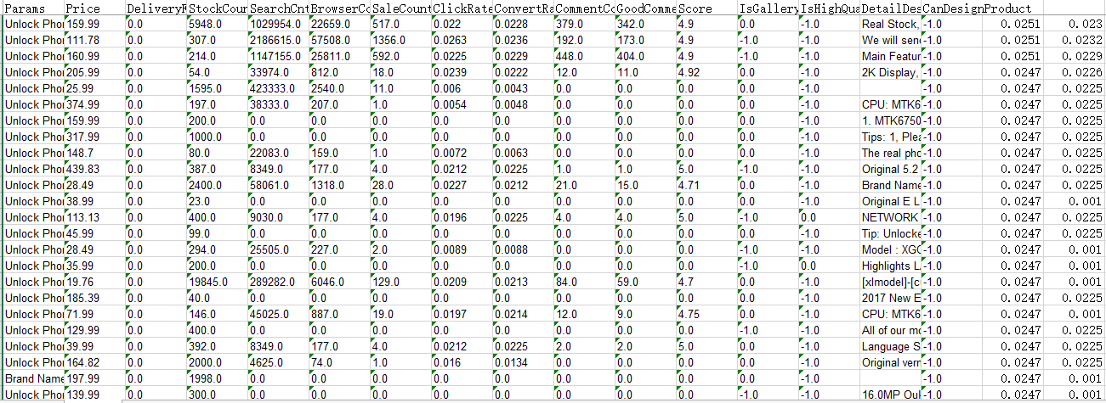
test sets
four modeling process
predict sales volume

Slide 11
Sensitivity Analysis
To assess the accuracy and stability of models

Slide 12
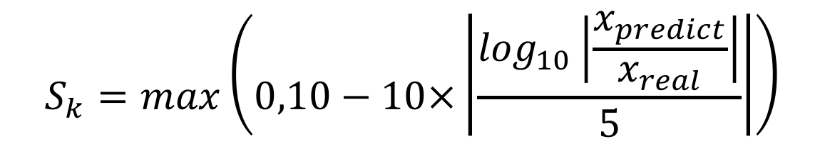
Scoring formula to the application:
$$S_{k}=max\left(0,10−10×\left|\frac{\log_{10}\left|\frac{x_{predict}}{x_{real}}\right|}{5}\right|\right)$$
Click rate：9.81
Convert rate：9.74

Slide 13
detect the stability of our model, especially when the given data are not accurate
Sensitivity analysis
continuous variables
1% increase or decrease
Principal Component Regression: 1%
discrete variables
change the value of one property to adjacent category each time
eg. 2G to 4G
Bayes Distinction: 0
BP neural network: 1%
largest unchanged
The output changes 1%

