Slide 1

Tsinghua High School
Evaluation and Prediction of Cell Phone Sales Based on Various Techniques
Lingwei Cao, Cheng Qian, Zhaoyang Tian
Tsinghua High School
Advisor: Hao Wu, Dianjun Wang

Slide 2
Agenda
Research Background
Assumptions
Data Extraction and Process
Modeling
Optimization
Application
Sensitivity Analysis
Conclusion

Slide 3

01
Research Background
Research Purposes and General Process

Slide 4


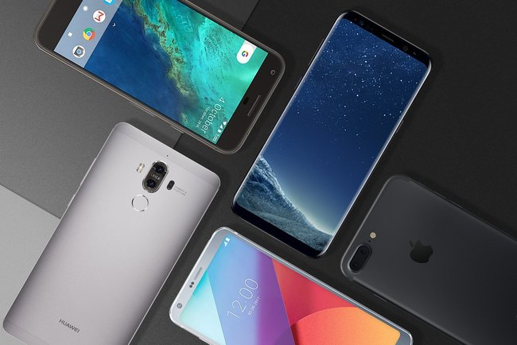

Problem definition
Technology advancement
Online shopping
Fast-pace life
Manufacturers and sellers
Target： Cellphones
Key factor
Sales promotion

Slide 5
Research Background
Previous Researches
Grey Relational Analysis——Fatao Wang 2013
C2C Model——Youzhi Xue 2012
BP Neural Network Fitting——Yanli Ma 2014
Weakness
Fail to analyze influential factors in a systematic and comprehensive way
Fail to reveal specific characteristics that contribute to higher sales volume
Purpose
Predict sales volume with given characteristics
Determine specific characteristics
Rank influential factors

Slide 6
Raw Data
Ali Express
Data Extraction
Extract relevant variables
Data Process
Modeling
qualitative conclusions
single variable
Reduce variables
General Research Process
Conclusion
Application
statistic results
strength and weakness
precision assessment
predict sales volume
quantitative conclusions
multi-variables
Sensitivity Analysis
Optimization

Slide 7
02
Assumptions
To simplify real-world implications without the loss of the core

Slide 8
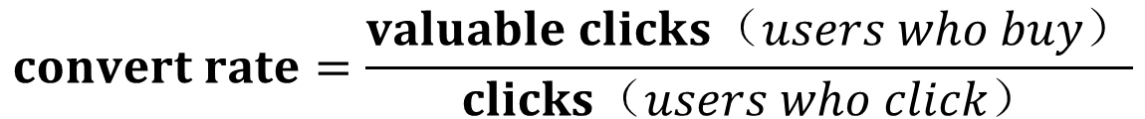
Basic Assumptions
$$convert rate=\frac{valuable clicks（users who buy）}{clicks（users who click）}$$
$$click rate=\frac{clicks（users who click）}{ views （users who browse）}$$
$$click rate×convert rate=sale rate$$
Sales volume

Slide 9
03
Data Extraction and Process
Find key independent variables

Slide 10

Information Entropy
What is Information Entropy
Why choosing it
Sift out the most important independent variables
How to apply it to independent variables
Based on relationship with Category Convert and Click Rate
ROM(GB) | Group number in Category Click Rate | 1 | 2 | 3 | 4 | 5 | Information entropy
 | 2 | 0 | 3 | 2 | 1 | 0 | 1.459148
 | 4 | 5 | 6 | 13 | 7 | 0 | 1.89366
 | 8 | 64 | 38 | 63 | 54 | 8 | 2.122787
 | 16 | 110 | 89 | 132 | 143 | 36 | 2.205866
 | 32 | 64 | 44 | 82 | 63 | 29 | 2.242444
 | 64 | 83 | 38 | 62 | 49 | 16 | 2.160525
 | 128 | 3 | 4 | 5 | 7 | 0 | 1.931295
 | 256 | 0 | 0 | 1 | 0 | 0 | 0

Slide 11
Information Entropy
How to apply it to independent variables
Apply the result to find information gain
 | Category Click Rate | Category Convert Rate
Global information entropy | 2.200779 | 2.081891
 | Sum of the products | Information Gain
ROM | 2.174619842 | 0.026159369
Ranking of variables depends on Category Click Rate | Information Gain
Comment Count | 0.732792417
Good Comment Count | 0.680453664
Search Count | 0.392386753
Score | 0.173242295
Brand | 0.124112475
Is Gallery Featured | 0.060358001
Battery Capacity(mAh) | 0.050232189
RAM(G) | 0.031072544
Ranking of variables depends on Category Convert Rate | Information Gain
Comment Count | 0.950131659
Good Comment Count | 0.910616696
Search Count | 0.631528548
Score | 0.288394004
Brand | 0.261397755
Is Gallery Featured | 0.220147548
Battery Capacity(mAh) | 0.102065066
Highest camera resolution | 0.067310002

Slide 12
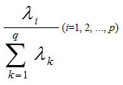
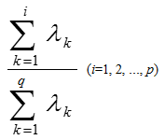




Principal Component Analysis
Principal Component Analysis (PCA) processes the data again, reduces parameters and retains the original data information as much as possible.
Using formulas above to standardize data, calculating eigenvectors and total contribution rates of PCA. The first 14 principal components (whose contribution rate over 80%) were selected.
$$z_{1}=a_{11}x_{1}+a_{21}x_{2}+a_{31}x_{3}+a_{41}x_{4}+a_{51}x_{5}+…+a_{26 1}x_{26}$$
$$z_{2}=a_{12}x_{1}+a_{22}x_{2}+a_{32}x_{3}+a_{42}x_{4}+a_{52}x_{5}+…+a_{26 2}x_{26}$$
$$…$$
$$z_{14}=a_{1 14}x_{1}+a_{2 14}x_{2}+a_{3 14}x_{3}+a_{4 14}x_{4}+a_{5 14}x_{5}+…+a_{26 14}x_{26}$$

Slide 13
04
Modeling
Qualitative conclusion and in-depth analysis

Slide 14
04
Modeling
Qualitative conclusion and in-depth analysis

Slide 15

Weight Determination Technique
Target Layer (RAM)
P₁
P₂
P₃
Scheme Layer(Click Rate)
C₁
C₂
C₃
C₄
C₅
$$Aw=λw$$
Among phones with middle display resolution, both phones with higher click rate and lower click rate takes a large proportion.
Losgistic Regression
Click Rate | Convert Rate
0.115124 | 0.162528
KNN Algorithm

Slide 16
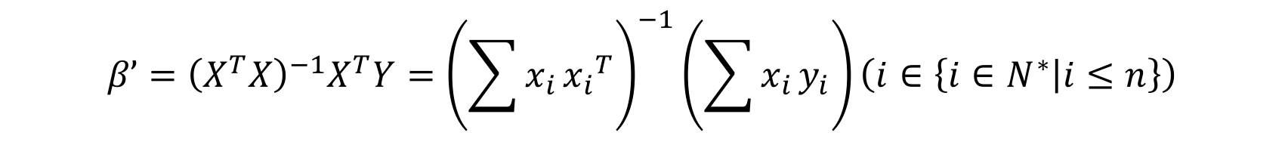
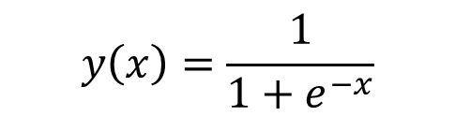

Losgistic Regression
$$y_{n}=β_{0}+β_{1}x_{1}+β_{2}x_{2}+β_{3}x_{3}+β_{4}x_{4}+β_{5}x_{5}+β_{6}x_{6}\left(n∈\left\{1,2\right\}\right)$$
$$β’={\left(X^{T}X\right)}^{−1}X^{T}Y={\left(\sum{x_{i}}{x_{i}}^{T}\right)}^{−1}\left(\sum{x_{i}}y_{i}\right)\left(i∈\left\{i∈N^{∗} | i≤n\right\}\right)$$
$$P\left\{{\hat{θ}}_{1}<θ<{\hat{θ}}_{2}\right\}=1−α$$
$$P\left\{{\hat{β}}_{n 1}<β<{\hat{β}}_{n 2}\right\}=1−α \left(n∈\left\{n∈N^{∗} | n≤2\right\}\right)$$
$$y\left(x\right)=\frac{1}{1+e^{−x}}$$

Slide 17
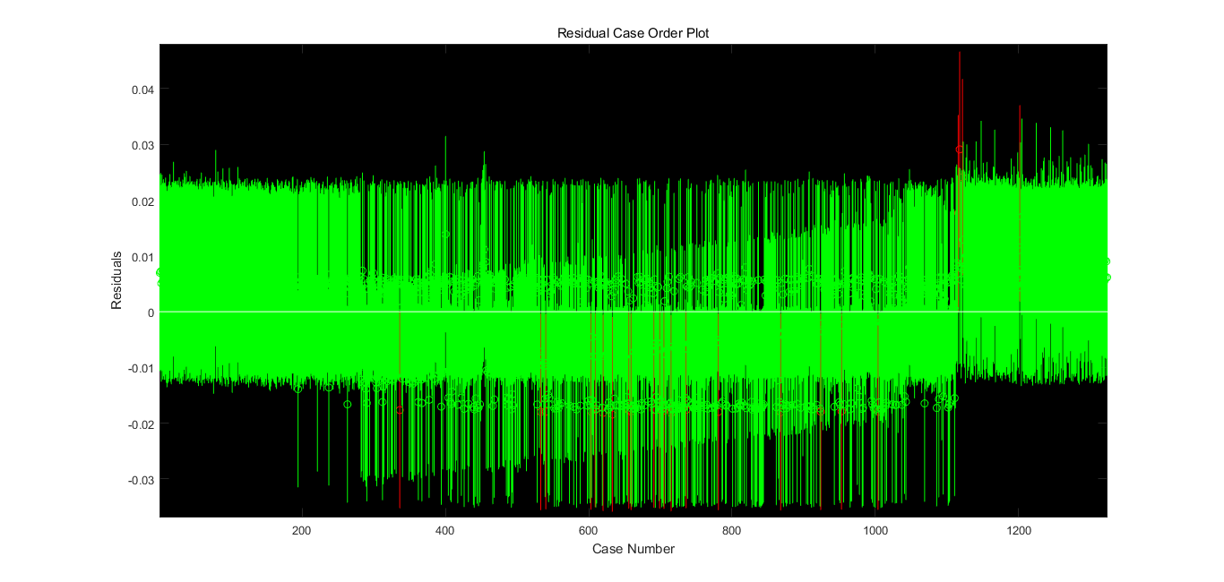
Losgistic Regression
Not much Outliers.

Slide 18
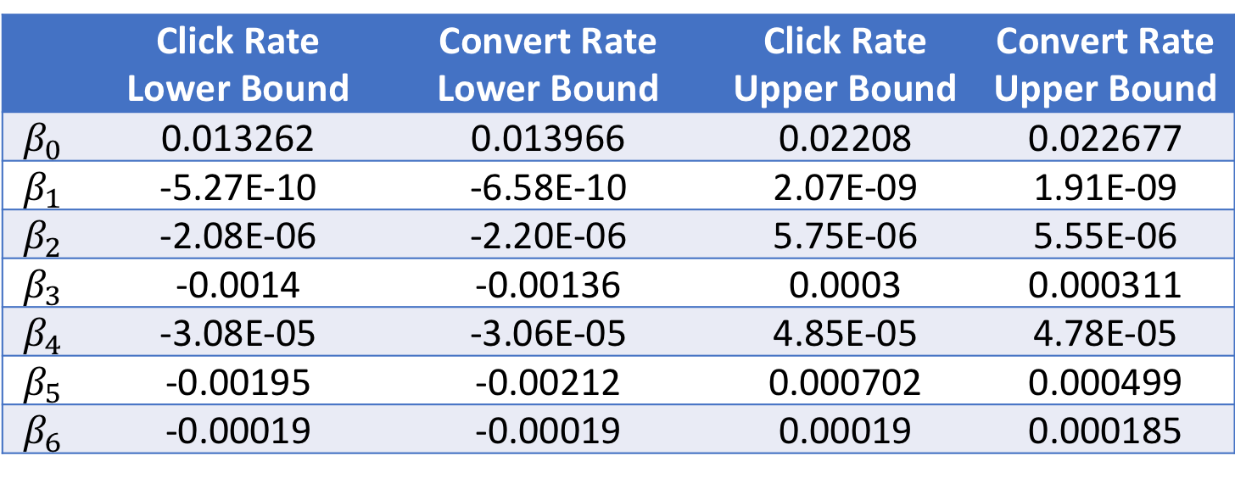
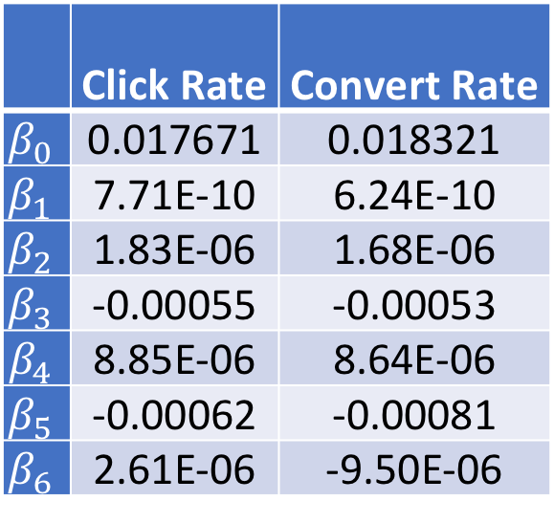
Losgistic Regression
 | Click Rate | Convert Rate
$$β_{0}$$ | 0.017671 | 0.018321
$$β_{1}$$ | 7.71E-10 | 6.24E-10
$$β_{2}$$ | 1.83E-06 | 1.68E-06
$$β_{3}$$ | -0.00055 | -0.00053
$$β_{4}$$ | 8.85E-06 | 8.64E-06
$$β_{5}$$ | -0.00062 | -0.00081
$$β_{6}$$ | 2.61E-06 | -9.50E-06
The low correlation coefficients in Logistic Regression is insufficient to reveal the features of each variable precisely.
Click Rate | Convert Rate
0.115124 | 0.162528
 | Click Rate Lower Bound | Convert Rate Lower Bound | Click Rate Upper Bound | Convert Rate Upper Bound
$$β_{0}$$ | 0.013262 | 0.013966 | 0.02208 | 0.022677
$$β_{1}$$ | -5.27E-10 | -6.58E-10 | 2.07E-09 | 1.91E-09
$$β_{2}$$ | -2.08E-06 | -2.20E-06 | 5.75E-06 | 5.55E-06
$$β_{3}$$ | -0.0014 | -0.00136 | 0.0003 | 0.000311
$$β_{4}$$ | -3.08E-05 | -3.06E-05 | 4.85E-05 | 4.78E-05
$$β_{5}$$ | -0.00195 | -0.00212 | 0.000702 | 0.000499
$$β_{6}$$ | -0.00019 | -0.00019 | 0.00019 | 0.000185

Slide 19
05
Optimization
Optimize the algorithms and quantitative conclusions

Slide 20
Principal Component Analysis
$${y_{n}}^{∗}=β_{1}′z_{1}+β_{2}′z_{2}+β_{3}′z_{3}+…+β_{14}′z_{14}\left(n∈\left\{n∈N^{∗} | n≤2\right\}\right)$$
$$y_{n}=β_{0}+β_{1}x_{1}+β_{2}x_{2}+β_{3}x_{3}+…+β_{26}x_{26}\left(n∈\left\{1,2\right\}\right)$$
Click Rate | Convert Rate
0.805032 | 0.826614

Slide 21
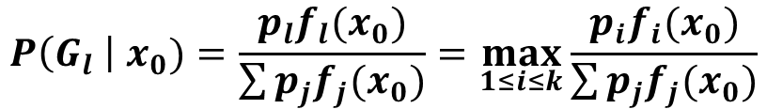
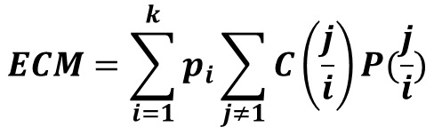
Bayes Distinction
 | High sales | Low sales
High display resolution | 7 | 1
Low display resolution | 3 | 9
$$P\left(G_{l} \right| x_{0})=\frac{p_{l}f_{l}(x_{0})}{\sum{p_{j}f_{j}(x_{0})}}=\max_{1≤i≤k}{\frac{p_{i}f_{i}(x_{0})}{\sum{p_{j}f_{j}(x_{0})}}}$$
$$ECM=\sum_{i=1}^{k}{p_{i}\sum_{j≠1}{C\left(\frac{j}{i}\right)P(\frac{j}{i})}}$$

Slide 22
Bayes Distinction
RAM to Click rate (the smaller the category is, the lower the click rate is)
 | Category 1 | Category 2 | Category 3 | Category 4
0.125 | 2 | 0 | 0 | 0
0.5 | 7 | 0 | 0 | 1
1 | 49 | 0 | 1 | 7
1.5 | 1 | 0 | 0 | 0
2 | 91 | 0 | 15 | 25
3 | 41 | 1 | 64 | 19
4 | 1 | 13 | 68 | 2
6 | 0 | 11 | 22 | 0
8 | 0 | 0 | 1 | 0
Phones with higher display resolution are apt to reveal more satisfactory sales condition. Phones with middle RAM may experience low sales or high sales.

Slide 23
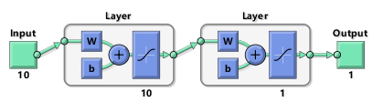
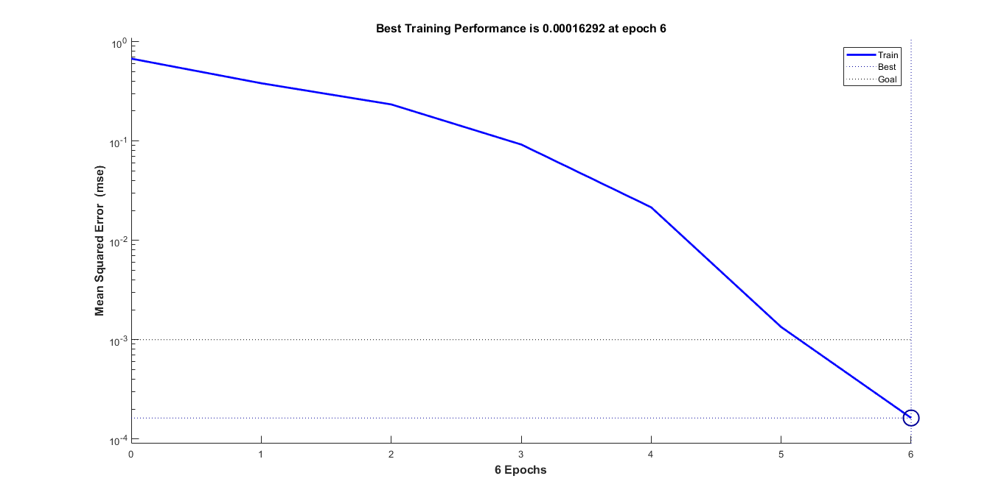
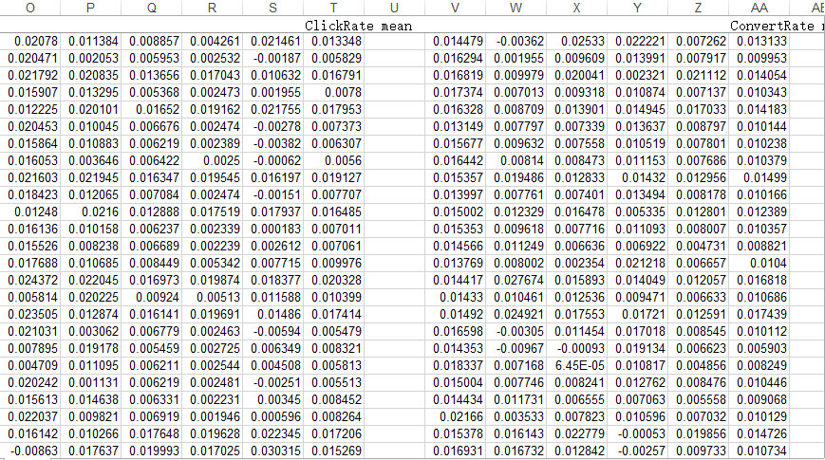
BP Neural Network
Model with 10 layers do not consume too much time, while it has a better performance. The error is decreasing rapidly. The error of some data in the table lower than 1%.

Slide 24
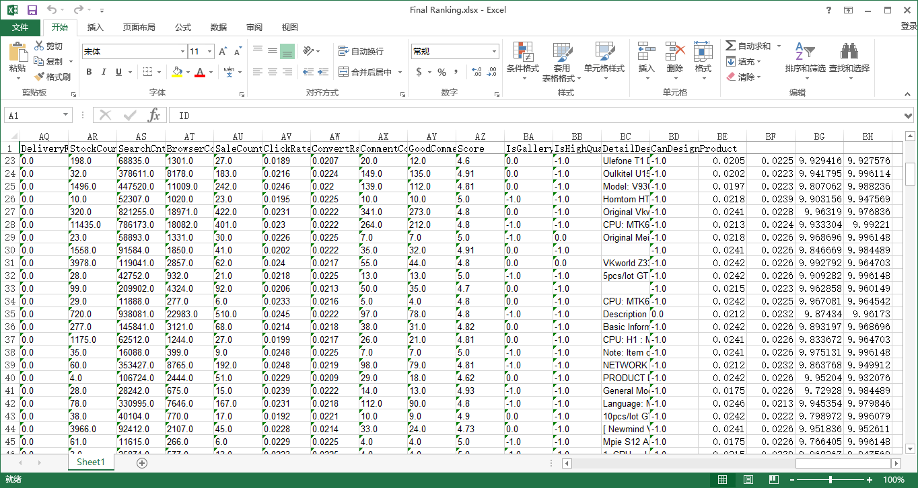
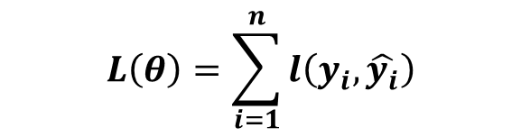
Age | Monthly shopping Amount | Usually asking or answering on Quora
14 | Less than 1000 yuan | Asking
16 | Less than 1000 yuan | Answering
24 | More than 1000 yuan | Asking
26 | More than 1000 yuan | Answering
XGBoosting Algorithm
$$L\left(θ\right)=\sum_{i=1}^{n}{l\left(y_{i},\hat{y_{i}}\right)}$$
Combining several weak classifier into a strong classifier through minimizing loss function and error.

Slide 26
Tsinghua High School
06
Application
To predict sales volume with given characteristics

Slide 27
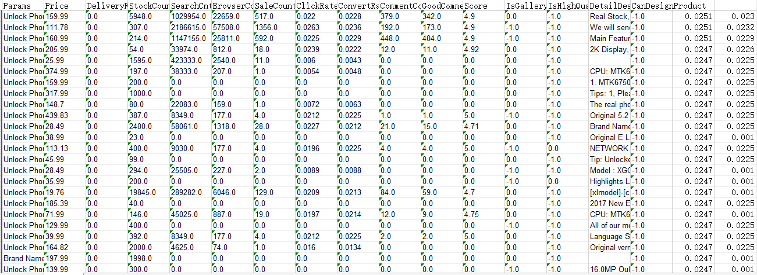
Application
test sets
four modeling process
predict sales volume

Slide 28
07
Sensitivity Analysis
To assess the accuracy and stability of models

Slide 29
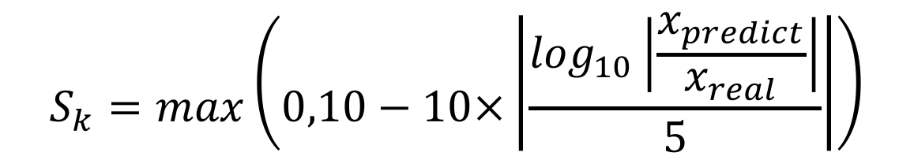
Sensitivity Analysis
Scoring formula to the application:
$$S_{k}=max\left(0,10−10×\left|\frac{\log_{10}\left|\frac{x_{predict}}{x_{real}}\right|}{5}\right|\right)$$
Click rate：9.81
Convert rate：9.74

Slide 30
Sensitivity Analysis
detect the stability of our model, especially when the given data are not accurate
Sensitivity analysis
continuous variables
1% increase or decrease
Principal Component Regression: 1%
discrete variables
change the value of one property to adjacent category each time
eg. 2G to 4G
Bayes Distinction: 0
BP neural network: 1%
largest unchanged
The output changes 1%

Slide 31
08
Conclusion
Strength and weakness

Slide 32
Ranking of independent variables
Conclusion from data extracting:
Ranking of independent variables | Independent variables
1 | Comment Count
2 | Good Comment Count
3 | Search Count
4 | Score
5 | Brand
6 | Is Gallery Featured
7 | Battery Capacity(mAh)
8 | Highest camera resolution

Slide 33
Conclusion of modeling and optimization
Most popular traits
middle display resolution
low or high recording resolution
high camera resolution
middle price
Traits of high Category Click Rate
High RAM, ROM and CPU
Traits of best model predicted
Phone of middle battery capacity
gold or white color
high camera resolution

Slide 34
Discovery in analysis
Priority
Insensitive variables
RAM,ROM,CPU when improving the phone’s quality
Change in display resolution and camera resolution

Slide 35
Strengthen of our methods
Qualitative analysis
Display straightforward analysis towards important independent variables
Variables ranking
Give quantitative methods for the analysis of independent variables and the ranking of most important ones.
Quantitative optimization
Present quantitative analysis towards specific traits of cell phones to guide further optimization
predict the sales volume of cell phones based on the testing set
Application value

Slide 36
Tsinghua High School
Thank You
Lingwei Cao, Cheng Qian, Zhaoyang Tian
Tsinghua High School
Advisor: Hao Wu, Dianjun Wang

