Slide 1

Emotional Analysis & Evaluation of Pros and Cons Regarding Students’Activities ----Based on Comprehensive Education Evaluation System in Tsinghua University High School
Date: 05/23/2019
Presenter: Zhaoyang Tian

Slide 2
Agenda
1
Introduction
2
Modeling
3
Conclusion

Slide 3
Introduction

Slide 4

Introduction

Slide 5
Introduction
The government is transforming the enrollment system to comprehensive-quality-oriented
The new college enrollment system concentrates on the all-round developments of students rather than their test scores
Students voluntarily upload the photos and text descriptions to reveal their special activities and strength that cannot be reflected in class or by scores.

Slide 6
Introduction
Achievements
Design and purpose of CQE
Ideas of Student Assessment system
Limitations
Small amount of data
Specific Experiment
A elaborate technique to analyze students' interest
My research

Slide 7
Introduction
To demonstrate the data set in a brand new manner.
To evaluate the positive and negative feelings behind the data.
To judge the most popular and welcomed activities among school students.
To evaluate the positive and negative aspect of the popular activities.

Slide 8
Introduction
End
Beginning
Conclusion
JIEBA Segmentation
Supporting Vector Machine
Word Frequency Analysis
SnowNLP
Original Emotional Analysis
WORDCLOUD

Slide 9
Modeling

Slide 10
Data Extraction
Data in the CEES system of grade in Tsinghua University High School
Activities:
Sports
Innovation
Oversea Study
Club Events
Arts

Slide 11
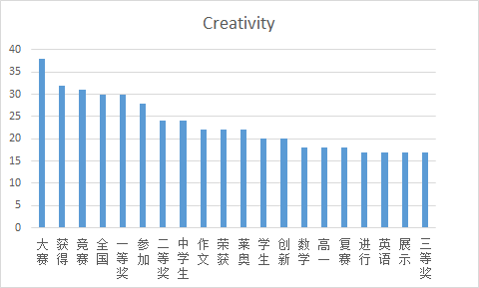
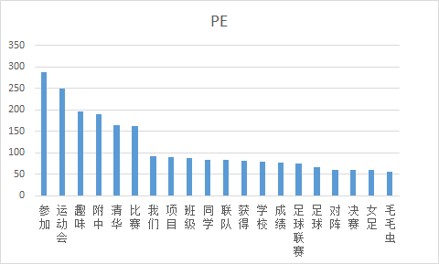
JIEBA Word Segmentation
This paper divides sentences into separate words.
This paper conducts word frequency analysis with stopwords.

Slide 12
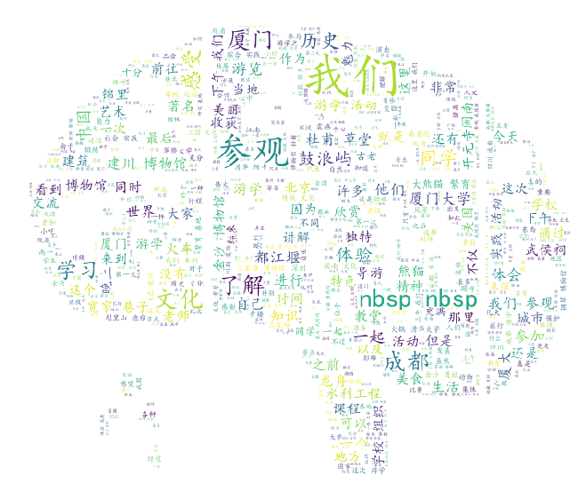
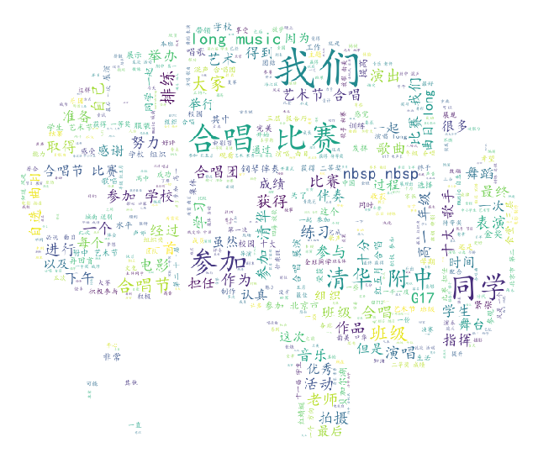
JIEBA Word Segmentation
With the aid of WORDCLOUD module, this paper generates wordclouds through sets of parameters

Slide 13
Emotional Analysis
End
Number of reverse words
Beginning
Cross-test
Number of exclamation marks
Enumeration of word lists
Score of a paragraph
Weight
Preparation of the data
Number of Degree words
4
Score of a single sentence
2
Number of Negative words
0.5
Number of Positive words

Slide 14
Supporting Vector Machine
华侨大学 | 15
大熊猫 | 25
四川 | 20
川剧 | 15
变脸 | 11
辩论 | 20
模联 | 34
艺术节 | 12
明哲 | 7
李宁杯 | 7
电影 | 13
电视台 | 6
合唱节 | 16
艺术节 | 18
合唱 | 198
运动会 | 249
足球 | 66
篮球 | 31
数理化 | 16
创新英语 | 17
高研 | 13
力学 | 13
厦门 | 84
成都 | 79
都江堰 | 36
武侯祠 | 34
龙舟 | 31
草堂 | 27
宽窄 | 23
Extract keywords related to hot activities

Slide 15
Evaluation of Pros & Cons
Search the pieces of data that contains the fields of the names of hot activities
Find the positive and negative aspects of the activities manually

Slide 16
Conclusion

Slide 17
Conclusion
“Nervous”(紧张) : treated as negative in sports activities
Too less words in a piece of data: a negative one
“Visit”(参观), “observe”(观察): negative/ “participate”(参加), “involvement”(体验): positive
Data related to innovative achievements, excursion experience, club events are very likely to be viewed as positive.
A piece of descriptive data is more likely to be positive than a piece of narrative data.

Slide 18
Limitations
The correlation coefficients between original emotion evaluation method and SnowNLP are relatively low
There is no quantitative conclusion
Adjust the weights of degree words
If more data given, I could find the information entropy of the keywords

Slide 19

[1] https://gzzp.bjedu.cn, Comprehensive Quality Evaluation Platform for Beijing General High School Students [EB/OL].
[2] Ze L., Reflections on the Evaluation of Comprehensive Quality in the Reform of College Entrance Examination [J], Contemporary Educational Science, 2017(4): 32-36, 45.
[3] Bingbing X., From Comprehensive Quality Assessment to Key Competencies Assessment----Research on the Transition of Student Assessment in High School [D]. Shanghai, China: East China Normal University, 2016.
[4] Zhaohui C., Study on Implementation of Senior High School students' Comprehensive Quality Assessment [D]. Zhengzhou, China: Henan University, 2016.
[5] Huoyun C. Zheng K., Research on Comprehensive Quality Evaluation of Senior High School Students [J], Global Education, 2010(9): 3-8,12.
[6] Jing W. Xi J. Dong L., Evaluation of Students’ Comprehensive Quality with the Aim of Promoting Development—The Concept and Practice of the Construction of the Second Class Transcript [J], Learning Resource and Technology, 2018(9).
Bibliography

Slide 20
[7] Xiaoming W. Nianjin D., History and Evolution of Ten Years Reform of the Comprehensive Quality Evaluation of Students in General Senior High School [J], Modern Education and Management, 2015(11): 74-79.
[8] Zhijun L. Hongxia Z., Evaluation on Senior High School Students Comprehensive Quality: Reality, Problem and Prospect [J], Curriculum, Teaching Material and Method, 33(1): 18-23.
[9] Long C., The Difficulty and Breakthrough of "Hard Link" between Comprehensive Quality Evaluation and College Enrollment [J], Journal of The Chinese Society of Education, 2017(7): 19-23.
[10] Dianjun W. Hui J. Weidong Meng. The High School Attached to Tsinghua University, Development and Application of the Comprehensive Student Quality Evaluation System Based on Big Data: Innovative Practice of the High School Attached to Tsinghua University [J], Chinese Examinations, 2018(1): 46-52, 66.
[11] https://blog.csdn.net/daniel\_ustc/article/details/48195287, Source Code Analysis of Chinese Word Segmentation in JIEBA Module [EB/OL].
[12] https://www.cnblogs.com/bymo/p/9334981.html, Keyword extraction based on WORDCLOUD Module: The use of wordcloud, source code analysis, generation of Chinese word cloud, and code rewriting [EB/OL].
[13] https://blog.csdn.net/google19890102/article/details/80091502, Emotional Analysis----Deepening the Principle and Practice of SnowNLP [EB/OL].
[14] https://blog.csdn.net/jzy3711/article/details/84760981, Positive and Negative Emotional Words [EB/OL].
[15] https://blog.csdn.net/qq\_16953611/article/details/82414129, Sklearn----SVM [EB/OL].
[16] Haiwei W. Yu X. Yalin W. A bivariate hierarchical Bayesian approach to predicting customer purchase behavior [J], Journal of Harbin Engineering University, 2007, 28(8): 949-954.

Slide 21
Thanks for your listening
Date: 05/23/2019
Presenter: Zhaoyang Tian

