Slide 1
How To Increase Sales For Future Months Through Association Analysis
By: Ryan Canfield
12/8/2022

Slide 2
Objective:
The objective is to use the transaction data to increase the sales of less popular items.
Using association analysis, we’ll look at patterns to see items are frequently bought together, and from this, we can move items to a better spot or make sales and deals to help sell the item.
This will create more revenue and make the store more money.

Slide 3
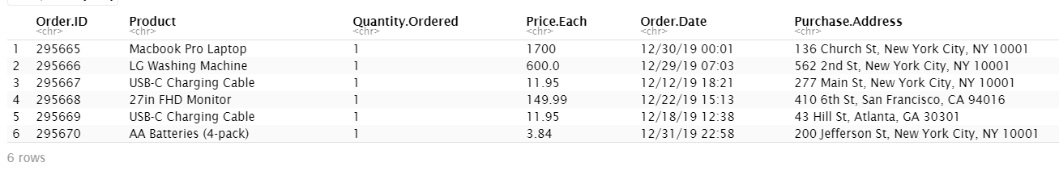
December Transactions
The data set is about Transactions taken from the month of December from an electronic store like Best Buy, or Radio Shack.
Found on Kaggle, taken from the year 2019 in the US
6 columns or variables and 25,117 rows or observations

Slide 4
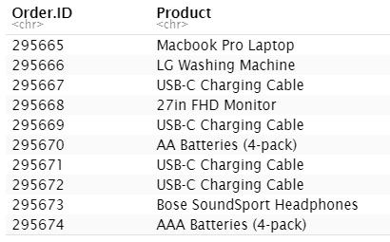
Data Pre-Processing
No Missing observations.
Originally had 6 columns but we narrowed it down to 2 because it messed with results.
Order ID, Product, Quantity Ordered, Price Each, Order Date, Purchase Address, -> Order.ID and Product.
Turned it into a transaction object using read.transactions() from the arules() package.

Slide 5
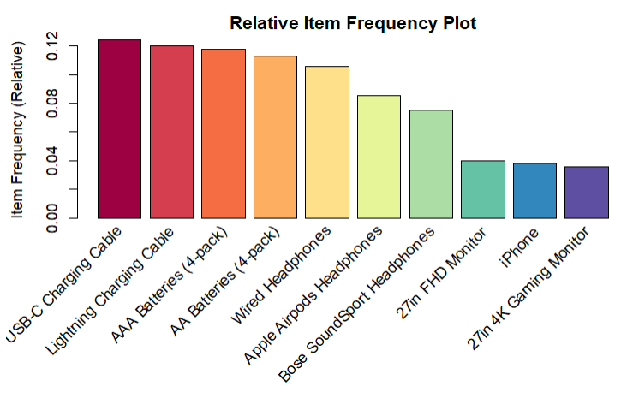
Top 10 Most Purchased Items

Slide 6
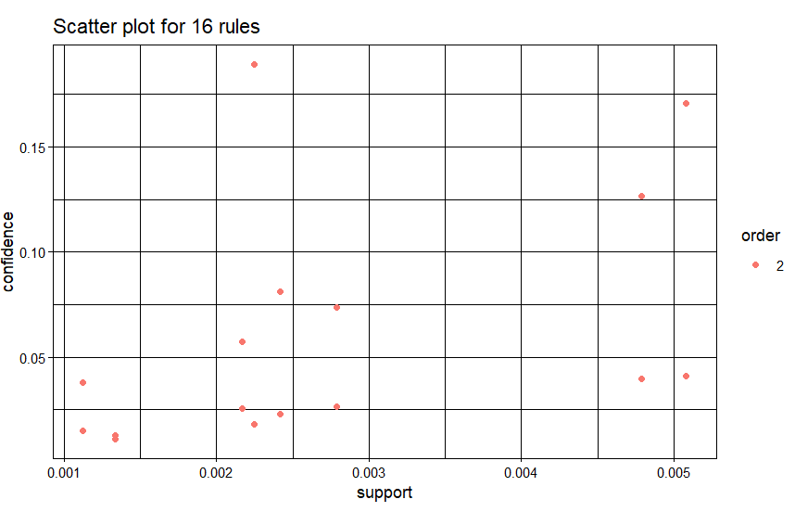
Generating Frequent Itemsets
After testing a range of support and confidence values I found support = 0.001 and confidence = 0.01

Slide 7
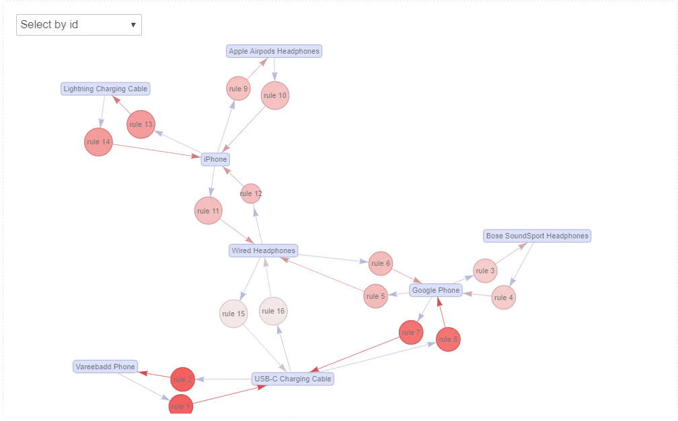
Interactive Graph

Slide 8
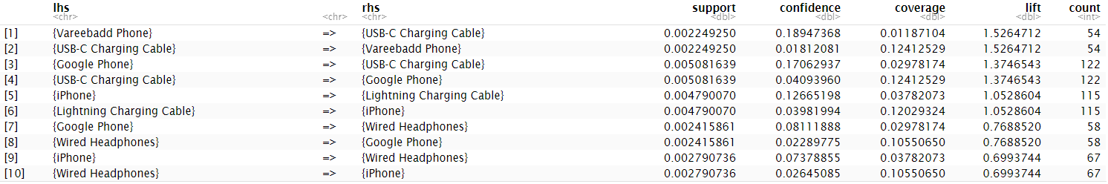
Rules Sorted by Lift
Farther the value is away from 1 the more dependent the items are on each other.

Slide 9
3 Rules to Take a Closer Look At
Association rule #1
[1]{Vareebadd Phone} => {USB-C Charging Cable} - lift - 1.5264712
[2]{USB-C Charging Cable} => {Vareebadd Phone} - lift - 1.5264712
Association rule #2
[13]{Google Phone} => {Bose SoundSport Headphones} - lift - 0.5025476
[14]{Bose SoundSport Headphones} => {Google Phone} - lift - 0.5025476
Association rule #3
[15]{Wired Headphones} => {USB-C Charging Cable} - lift - 0.1017781
[16]{USB-C Charging Cable} => {Wired Headphones} - lift - 0.1017781

Slide 10
Conclusion
I would recommend to the client that for Rule 1, to give a discount on different lengths of USB-C cable like a 3ft 6ft and 10ft cord bundle deal. Another recommendation would be to give them a deal on a wireless plan for the first few months either give them a few at a discount or a couple months free if they buy a certain level.
I would recommend to the client for Rule 2 to give them a Spotify subscription for a discounted price. Another recommendation maybe could be to do something gym related since they are sports headphones. You could either do water bottles or gym memberships etc.
I would recommend to the client for Rule 3 to put discounts on other accessories keyboards or mice. You could also move the monitors closer to these products since they are already popular.

