Slide 1
FIN4080 · GROUP PROJECT · 27 OCTOBER 2026
When a star analyst speaks,
information or authority?
20,980
2,683
2018-2024
rating revisions
A-share stocks
sample period
13.2% carry a New Fortune star label
Two channels. Four tests.
OPENING
1
Notes:
不自我介绍。开场直接说：过去七年，中国分析师对 A 股做了 20,980 次评级调整，其中 13.2% 来自新财富明星分析师。我们要问的是，市场在反应信息，还是在反应标签。

Slide 2
WHY CHINA
A retail-heavy market with limits on arbitrage
is a natural laboratory for authority effects.
RETAIL TURNOVER
T+1 AND PRICE LIMITS
NEW FORTUNE RANKING
Attention and status can move prices.
Arbitrage is costly; daily reactions are truncated.
An annual, public star label. The 2018 vote was suspended.
The setting gives the test power. It does not make the effect automatic.
WHY CHINA
2
Notes:
美国文献给机制，中国给一个机制更容易被看见的市场。散户换手高，T+1 和涨跌停让套利更贵，新财富提供每年更新、公开可查的明星标签。我们不是说中国特殊，而是说这里检验有力量。

Slide 3
ONE QUESTION, FOUR TESTS
Two channels, same announcement reaction,
different long-run paths.
INFORMATION
INFLUENCE
H1. Star revisions produce larger announcement CAR and volume.
Star
Star
↓
↓
H2. Information: drift continues. Influence: drift reverses.
Better information
Attention and authority
↓
↓
H3. Information: better forecasts. Influence: similar or worse.
Larger reaction
Larger reaction
↓
↓
Continued drift
No accuracy edge
H4. The premium differs by direction and broker tier.
↓
↓
Better forecasts
Partial reversal
H1 cannot separate the channels.
H2 and H3 do the work.
Q1 to Q4 are four tests of this contrast, not four separate questions.
Milgram (1963); Bonner, Hugon and Walther (2007); Loh and Stulz (2011); Fang and Yasuda (2009, 2014).
MECHANISM
3
Notes:
两种解释都预测明星上调有更大的公告日反应，所以只做事件窗口不够。真正能分开它们的是反应之后是继续还是反转，以及明星的预测是不是更准。

Slide 4
DATA AND SAMPLE
From 520,567 records to 20,980 usable revisions.
20,980
2,683
2,171
13.2%
events
stocks
analysts
star events
12,131 upgrades / 8,849 downgrades
1
Raw rating detail
2
Remove duplicates
3
Keep upgrades / downgrades
4
Drop IPO < 6m and ST
→
→
→
520,567
517,871
21,471
20,980
Unit: one analyst-stock rating revision.
Not a report. Not an initiation.
42,276 initiations are stored separately and excluded.
iFinD THS_iwencai, pulled 5 October 2026. Market data: Dretwd and H00300.
DATA
4
Notes:
观测单位是一个分析师对一只股票的一次评级调整，不是一篇研报，也不是首次覆盖。首次覆盖没有上一次评级，iFinD 标成未知，单独存了 42,276 条。

Slide 5
MEASURING AUTHORITY
Three proxies: star status, seniority, and broker tier.
STAR
SENIORITY
BROKER TIER
New Fortune list in force. 2,774 events, 13.2%. 2018 inherits 2017.
Years since first report. Source floor June 2009. Event-day variant differs by at most 0.027 years.
Cumulative rating-record share: 50% and 90%. 13 / 26 / 85 houses. Stable identity, in-year display.
A 2018 国泰君安 report is never relabeled 国泰海通.
MEASUREMENT
5
Notes:
明星用新财富当年在任榜单。资历从首篇报告算到报告日，数据源只到 2009 年 6 月。券商层级按评级记录累计份额切 50% 和 90%。改名合并并成稳定身份，但页面显示当年名称。

Slide 6
EMPIRICAL DESIGN
One event window, one drift path, two accuracy metrics.
ANNOUNCEMENT
DRIFT
ACCURACY
CAR[-1,+1], [-1,+5], [-5,+5]
AV = log volume minus [-120,-11] mean
80% valid observations required
CAR +2 to +60, +120, +250
Holding returns 63, 126, 252 days
Direction-adjusted, market-adjusted
|forecast EPS - actual EPS| / price x 100
FY0 and FY1
Winsorised at 1/99
CAR_i = sum_t (r_i,t - r_m,t)
AV_i = ln V_i,0 - mean ln V_i,t
Event day = first trading day at or after the report date. Suspended days are missing, never zero.
DESIGN
6
Notes:
公告日窗口三个，异常成交量是事件日成交量减前 120 到前 11 天均值。漂移从 +2 开始，排除公告日反应。准确度用持有收益和自己的 EPS 预测误差。事件日是报告日后第一个交易日，3,857 个事件顺延。停牌是缺失，不是零。

Slide 7
FINDING 1 · Q1 · RETURNS AND VOLUME
Star upgrades move both price and volume.
Star downgrades move neither.
UPGRADES
DOWNGRADES
UPGRADE · CAR[-1,+1]
UPGRADE · ABNORMAL VOLUME
+0.37 pp
+0.053
star minus non-star, t = 2.17
log points, t = 2.85
DOWNGRADE · CAR[-1,+1]
DOWNGRADE · ABNORMAL VOLUME
+0.06
-0.011
t = 0.35, n.s.
log points, t = -0.53, n.s.
Price and volume move together, and only for upgrades.
Source: iFinD; authors' calculations. All cells are star minus non-star.
FINDING 1
7
Notes:
Q1 有两半：收益和成交量；每一半又要分上调和下调。明星上调的 CAR 是 +0.37，t=2.17；异常成交量是 +0.053 个对数点，t=2.85，约等于成交量高 5%。明星下调的 CAR 是 +0.06，t=0.35；成交量是 -0.011，t=-0.53，两个都不显著。所以 Q1 的答案是四个格子里只有上调的两个格子动了。

Slide 8
FINDING 1 · Q1 · WHERE DOES THE CAR PREMIUM COME FROM?
The CAR premium is concentrated in price-limit events.
Window | Full sample | Excluding limit-hit events
[-1,+1] | +0.37 (p = 0.030) | +0.21 (p = 0.134)
[-1,+5] | +0.54 (p = 0.021) | +0.20 (p = 0.310)
[-5,+5] | +0.99 (p = 0.0004) | +0.65 (p = 0.008)
Removes 8.7% to 16.0% of upgrade events.
The 3-day and 5-day CAR premiums lose significance. The 11-day CAR premium remains.
This check covers CAR, not abnormal volume.
Only the 11-day CAR window survives. We do not call the 3-day CAR result robust to price limits.
Source: iFinD; authors' calculations. Market-adjusted CAR.
FINDING 1
8
Notes:
这一页只检验 CAR 的边界，不检验成交量。剔除窗口内出现涨跌停的事件：三日 0.37 降到 0.21，不显著；五日 0.54 降到 0.20，不显著；十一日 0.99 还剩 0.65，仍显著。短窗口 CAR 显著性不能说是稳健的。成交量没有做同样的剔除，页面上要讲清楚。

Slide 9
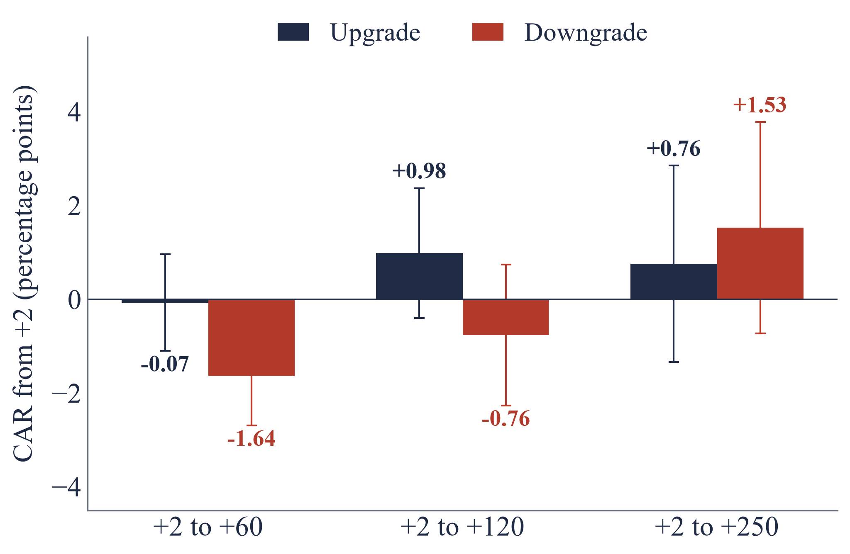
FINDING 2 · Q2 · DRIFT OR REVERSAL?
Star downgrades drift down, then reverse.
Star upgrades do not drift.
STAR MINUS NON-STAR CAR
Horizon | Downgrade | Upgrade
+2 to +60 | -1.64 (p=.002) | -0.07 (p=.90)
+2 to +120 | -0.76 (p=.32) | +0.98 (p=.16)
+2 to +250 | +1.53 (p=.18) | +0.76 (p=.48)
Downgrades: -1.64 at +60, then +1.53 at +250.
Upgrades: no differential drift.
Consistent with delayed following, not proof of over-following: the downgrade announcement reaction itself is not larger.
Source: iFinD; authors' calculations. Market-adjusted CAR from +2.
FINDING 2
9
Notes:
Q2 要同时回答上调和下调。下调在 +2 到 +60 继续跑输 1.64，p=0.002；到 +120 缩小到 0.76，不显著；到 +250 变成 +1.53，也不显著。上调三个窗口都不显著。这个形态更像延迟反应之后的部分反转，不能说是过度反应，因为下调的公告日反应本身并不比非明星大。

Slide 10
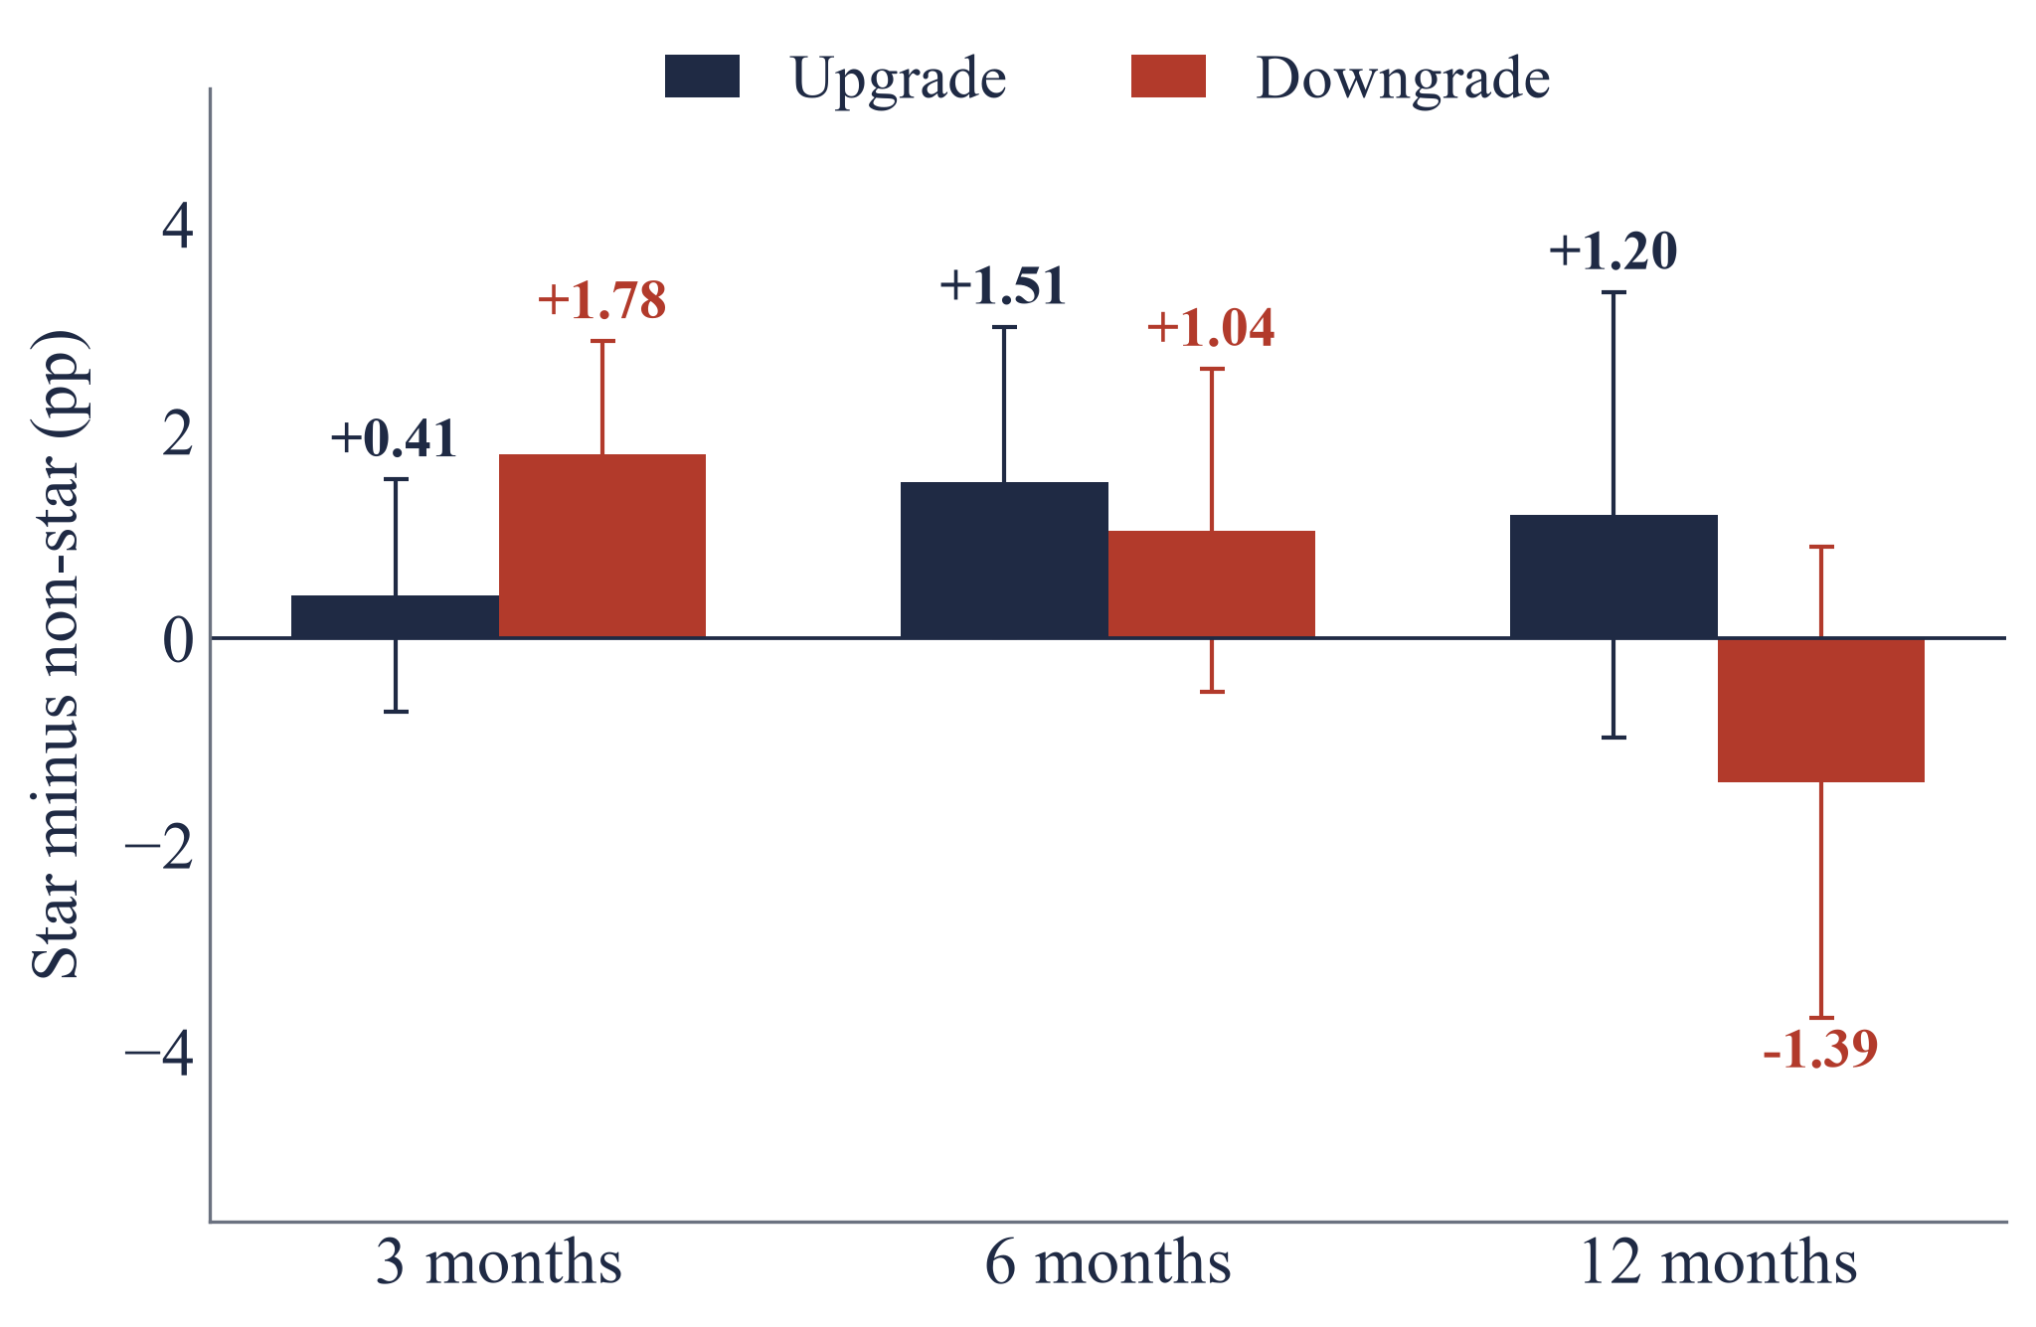
FINDING 3 · Q3 · ARE STARS MORE ACCURATE EX POST?
Stars show a short-lived return edge,
not better forecasts.
HOLDING RETURNS (STAR MINUS NON-STAR)
FORECAST ERRORS (STAR MINUS NON-STAR)
FY0 UPGRADE
FY0 DOWNGRADE
+0.28
+0.46
p = 0.002
p = 0.002
FY1 UPGRADE
FY1 DOWNGRADE
+0.40
+0.94
p = 0.009
p < 0.001
Holding returns: +1.51 at 6m (up, p=.048); +1.78 at 3m (down, p=.001); no 12m persistence.
Forecast errors: larger in all four cells.
A short-lived return edge, not a stable accuracy advantage.
Source: iFinD; authors' calculations. Holding returns market-adjusted; forecast error winsorised at 1/99.
FINDING 3
10
Notes:
Q3 有两个准确度指标，必须同时回答。持有收益短期支持明星：上调 6 个月多 1.51，p=0.048；下调 3 个月多 1.78，p=0.001；但 12 个月都不显著。预测误差方向相反，四个格子明星都更大，FY1 下调差 0.94，p 小于 0.001。所以答案是短期有一点持有收益优势，但没有稳定的预测准确度优势。符号误差没有显著差异，不是更乐观，而是更分散。

Slide 11
FINDING 4 · Q4 · DOES THE PREMIUM VARY?
The premium is one-sided.
Tier differences are not stable.
DIRECTION
BROKER TIER
Upgrade premium
+0.39
p = 0.021
Top-tier star upgrade
+0.55
p = 0.017
Interaction -0.29 (p = 0.197)
Top vs mid -0.63 (p = 0.072)
5-day window
+0.58
p = 0.014
Mid-tier star downgrade
+0.62
p = 0.007
Interaction -0.70 (p = 0.025)
Abnormal volume
+0.049
p = 0.009
Rolling tier
23.1%
reclassified
Interaction -0.057 (p = 0.041)
Top +0.49 (p=.046); mid +0.33 (p=.129)
Regression estimates with controls; raw differences are in Finding 1.
Small tier: 2 star upgrades, 0 star downgrades; excluded from interaction models.
Tier is descriptive, not causal. Star and tier are highly collinear.
FINDING 4
11
Notes:
Q4 有两半：方向和券商层级。方向是不对称的，五日窗口上调 +0.58，和下调的交互 -0.70，成交量交互 -0.057，都显著。层级看起来有故事，但滚动层级 23.1% 的事件换层后，头部上调还在，中部下调掉到 0.33，不显著。小层级只有 2 条明星上调、0 条下调，无法估计。所以层级只能当描述，不能当因果渠道。

Slide 12
ROBUSTNESS
The headline survives three checks.
Price limits are the boundary.
SUSPENSION
CLUSTERING
ST PROXY
0.37 -> 0.37; 0.99 -> 0.99
p = 0.035 / 0.028 / 0.0006; no 5% sign changes
4,915 stock-days flagged; short-window unchanged
ALTERNATIVE STAR
ROLLING TIER
REPLICATION
same-year, month, lag1; 2018 in-force
23.1% reclassified; tier significance unstable
max abs diff ~1e-13; event dates and N match
Raw price-limit check: 0.37 -> 0.21 (p = 0.134); 0.54 -> 0.20 (p = 0.310); 0.99 -> 0.65 (p = 0.008).
Bonferroni across 30 main specifications: five results survive at p < 0.0017.
ROBUSTNESS
12
Notes:
停牌整条剔除结论不变。按股票聚类，五个主结果没有一格显著性翻转，6 个月上调在 0.050 边界，不当强结果。ST 代理 4,915 个股票日，短窗口不变。替代 star 和独立复跑通过。唯一没通过的是涨跌停，短窗口溢价消失。

Slide 13
WHAT DOES THIS MEAN?
The market follows the label, not the forecast.
INFORMATION STORY
INFLUENCE STORY
Better access and skill -> larger reaction -> continued drift -> better forecasts.
Supported by short-run holding returns. Contradicted by larger forecast errors and no 12-month persistence.
Status -> attention -> trading -> price impact -> no accuracy edge -> partial reversal.
Supported by the announcement premium and downgrade drift. Not pure influence, because short-run returns exist.
Verdict: influence with a short-lived information component.
INTERPRETATION
13
Notes:
如果是纯信息 story，应该看到持续漂移和更准的预测，这两条都没有。如果是纯影响力 story，短期持有收益也不应该占优。所以最合适的读法是混合：明星标签放大注意力，短期可能有一点信息，但长期没有稳定能力溢价。

Slide 14
CONCLUSION
Stars move markets without better forecasts.
1
Announcement: +0.37 pp and +0.053 log volume on star upgrades; no downgrade premium.
2
Persistence: -1.64 pp drift after star downgrades, then reversal; no upgrade drift.
3
Accuracy: larger absolute forecast errors in all four cells; holding edge only short-lived.
Reputation can coordinate attention without improving information.
CONCLUSION
14
Notes:
三句话：明星上调有更大的公告日冲击，下调没有；明星下调后短期继续跑输然后部分反转，上调没有漂移；明星预测并不更准，绝对误差四个格子都更大，持有收益优势只在短期。合起来，声誉可以协调注意力，但没有改善信息。

Slide 15
BACKUP
Definitions, data, and the tests behind the headline.
DEFINITIONS
DATA
EXTRA RESULTS
star: New Fortune list in force, 2018 inherits 2017
seniority: years since first report, 2009 floor
tier: cumulative rating-record share, 50% / 90%
CAR: sum of market-adjusted returns
AV: log volume minus [-120,-11] mean
iFinD THS_iwencai, 2018-2024
Dretwd total returns; H00300 market index
20,980 events; 2,683 stocks; 2,171 analysts
20,248 events matched to forecasts
FY0 20,067; FY1 19,626
stock-clustered p-values for all main tests
Bonferroni: five survivors at p < 0.0017
suspension, ST, price-limit, rolling-tier checks
independent replication: max diff ~1e-13
full tables in the written report
Q&A map: Q1 7-8; Q2 9; Q3 10; Q4 11. Data source, event definition, endogeneity, alternatives, multiple testing.
BACKUP
15
Notes:
答辩备份，不主动讲。被问到数据来源、变量定义、多重检验时翻到这一页。

