Slide 1
Introduction to Outlier Detection
Quentin Cangelosi
PyData Munich – June 27th 2018
Notes:
2min

Slide 2
Definitions
What is an outlier?
How can outliers be detected?
Notes:
3min

Slide 3
Outliers?
Global Anomalies
X3
Local Anomalies
X1
c2
Micro Cluster
feature 2
c3
c= clusters
X= observations
X2
c1
Inspired from [Goldstein et al., 2016]
feature 1

Slide 4
How can outliers be detected?
Supervised
Data: labelled outliers
Methods: Ordinary Classifiers (SVM, NN, Random Forest, etc.)
Semi-supervised
Data: Training dataset free of outliers
Methods: one-class SVM, autoencoders, etc.
Unsupervised
Data: unlabelled dataset
Methods: Local Factor Outlier, Isolation Forest, one-class SVM, etc.

Slide 5
(Unsupervised) Methods
One-class SVM, Local Outlier Factor, Robust Covariance and Isolation Forest
Notes:
8min

Slide 6

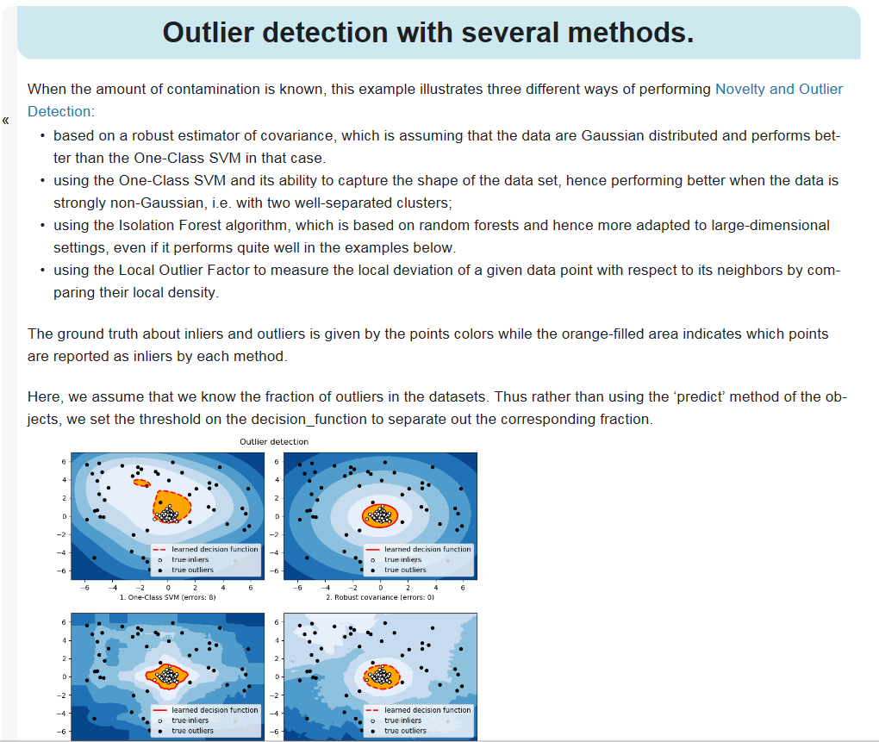
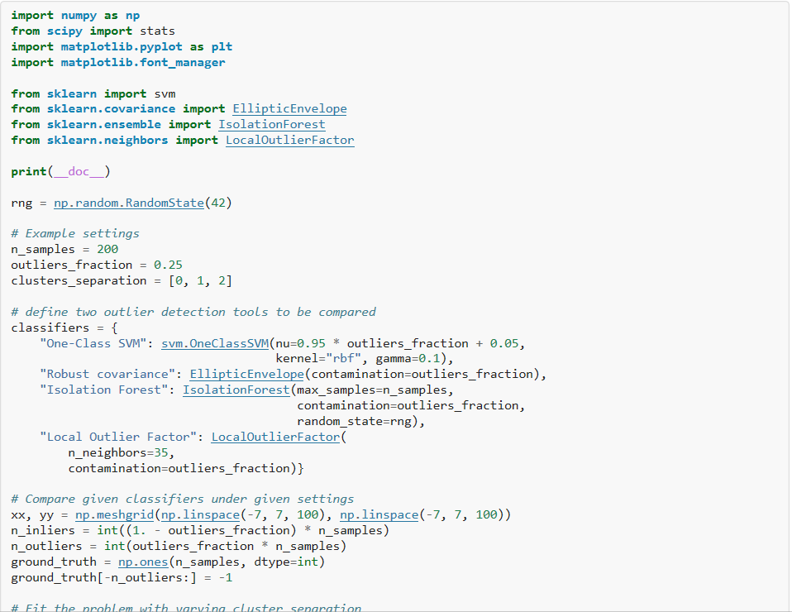
Using the Scikit-learn library
Outlier detection with several methods
http://scikit-learn.org/

Slide 7
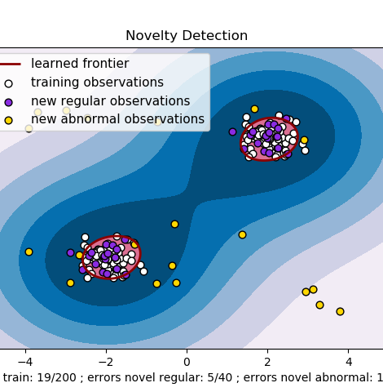
One-class SVM [Schölkopf et al. 1999]
Support Vector Machine Classifier with a single class
Using the optimised margins to identify outliers
Parameters
kernel=‘rbf’
nu=0.5

Slide 8
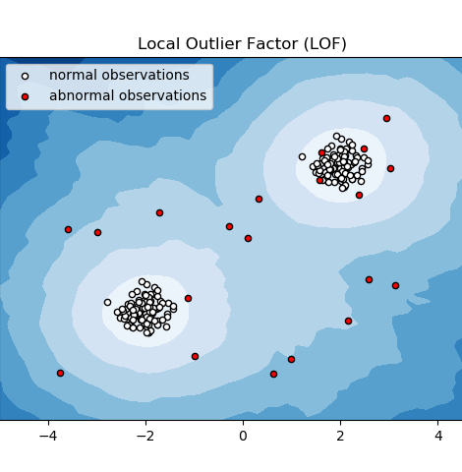
Local Outlier Factor [Breunig et al., 2000]
Computes the local density of a given data point
Compare this density with the neighboring densities to highlight outliers
Parameters:
n_neighbors=20
metric=‘minkowski‘
contamination=0.1

Slide 9
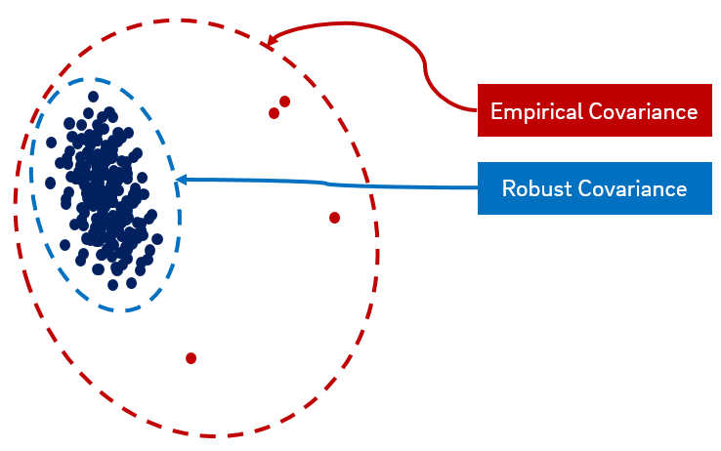
Robust Covariance
Fit an elliptic envelope to the data using a robust covariance estimate
Use the robust Mahalanobis distance as a distance-to-normality metric to detect outliers
Parameters:
support_fraction= [n_sample + n_features + 1] / 2
contamination = 0.1

Slide 10
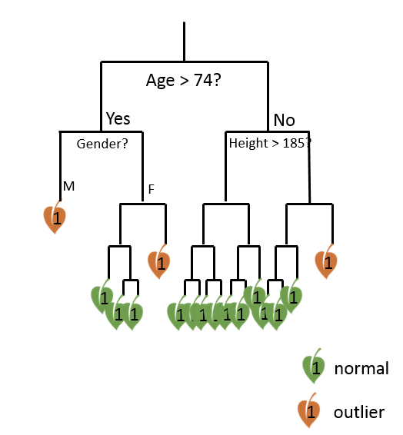
Isolation Forest [Liu et al., 2008]
Drawing Random Decision Trees with only one observation per leaf
Using the depth to identify outliers
Parameters
n_estimators = 100
contamination = 0.1

Slide 11
Isolation Forest [Liu et al., 2008]
Drawing Random Decision Trees with only one observation per leaf
Using the depth to identify outliers
Parameters
n_estimators = 100
contamination = 0.1

Slide 12
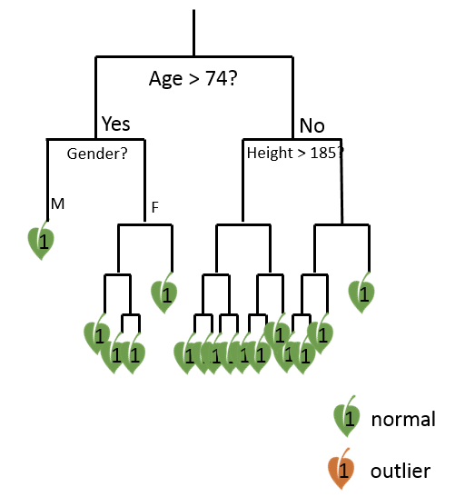
Isolation Forest [Liu et al., 2008]
Drawing Random Decision Trees with only one observation per leaf
Using the depth to identify outliers
Parameters
n_estimators = 100
contamination = 0.1

Slide 13
Isolation Forest [Liu et al., 2008]
Drawing Random Decision Trees with only one observation per leaf
Using the depth to identify outliers
Parameters
n_estimators = 100
contamination = 0.1

Slide 14
Isolation Forest [Liu et al., 2008]
Drawing Random Decision Trees with only one observation per leaf
Using the depth to identify outliers
Parameters
n_estimators = 100
contamination = 0.1

Slide 15
Isolation Forest [Liu et al., 2008]
Drawing Random Decision Trees with only one observation per leaf
Using the depth to identify outliers
Parameters
n_estimators = 100
contamination = 0.1

Slide 16
Comparison
How do the methods perform?
How to select the most appropriate method?
Notes:
3min

Slide 17
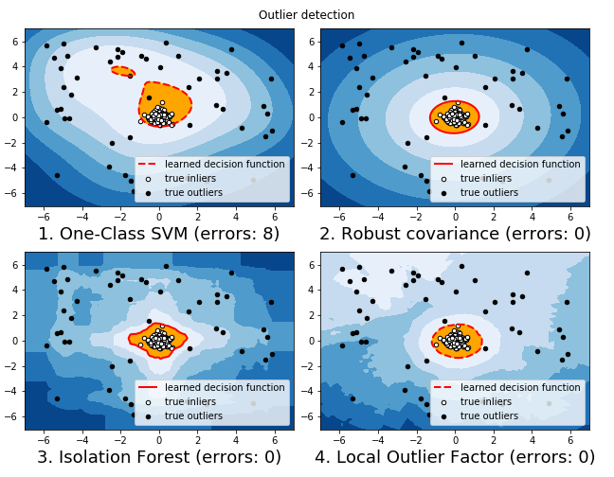
Methods Comparison Single Gaussian Cluster
One-class SVM more sensitive to outliers
Robust Covariance and Local Outlier Factor present more regularity in their decision margins

Slide 18
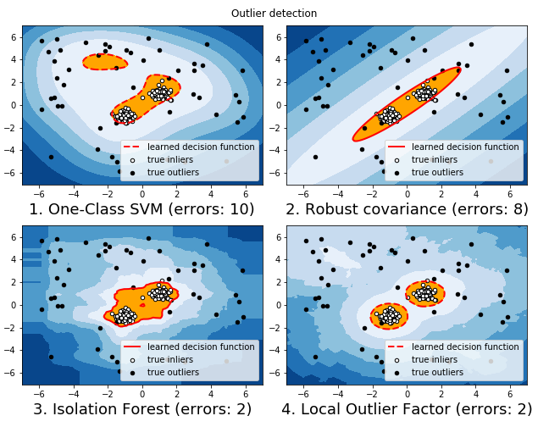
Methods Comparison Two Gaussian Clusters
Robust Covariance fits a single cluster for the two real clusters
Local Outlier Factor identifies correctly the two clusters

Slide 19
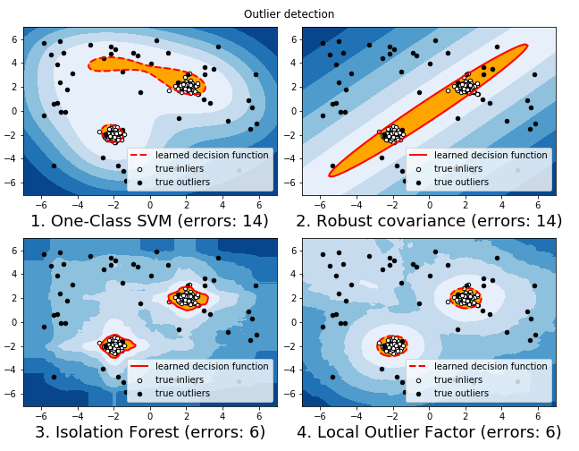
Methods Comparison Two Gaussian Clusters - 2

Slide 20
Conclusion
Different types of outliers require different approaches (global, local or contextual)
Scikit-learn offers easy-to-use unsupervised methods:
Knowledge of the dataset needed to select the most appropriated method
One-class SVM | sensitive to global anomalies
Robust covariance | assuming a Gaussian distribution
Local Outlier Factor | based on local densities
Isolation Forest | flexible and free of assumption
Notes:
1min

Slide 21
References
Schölkopf, Bernhard, et al. "Support vector method for novelty detection." Advances in neural information processing systems. 2000.
Liu, Fei Tony, Kai Ming Ting, and Zhi-Hua Zhou. "Isolation forest." Data Mining, 2008. ICDM'08. Eighth IEEE International Conference on. IEEE, 2008.
Breunig, Markus M., et al. "LOF: identifying density-based local outliers." ACM sigmod record. Vol. 29. No. 2. ACM, 2000.
De Maesschalck, Roy, Delphine Jouan-Rimbaud, and Désiré L. Massart. "The mahalanobis distance." Chemometrics and intelligent laboratory systems 50.1 (2000): 1-18.
P. J. Rousseeuw. Least median of squares regression. J. Am Stat Ass, 79:871, 1984.
Scikit-learn, version 0.19.1, Outlier detection with several methods, http://scikit-learn.org/
Scikit-learn, version 0.19.1, Novelty and Outlier Detection, http://scikit-learn.org/
Goldstein, Markus, and Seiichi Uchida. "A comparative evaluation of unsupervised anomaly detection algorithms for multivariate data." PloS one 11.4 (2016): e0152173.

Slide 22
Thank you!
Any question?
Quentin Cangelosi – quentin.cangelosi@eon.com

