Slide 1
Hyperledger-Fabric Open source, led by IBM and Linux foundation Supply chain management
Lecture 23: Permission Blockchains (Part 1)

Slide 2
Permissioned blockchain
Each node has an identity provided by the Membership Service Provider(MSP)
Various level of identities: Trusted to non-trusted
Certain tasks are assigned to certain identities
Many voting based PoS blockchains can be converted to permissioned blockchains by allowing voting/mining rights to only certain identities
Allow only certain identities to mine

Slide 3
Why need a permissioned blockchain
Identities on blockchain can be linked to identities in real world
Can track misbehavior (like certain DoS attacks) to identities
Weaker adversary assumption justified
Implications
No need for sybil/spam resistance
No need for on-chain incentives
No need for currency implementation
Potentially very efficient and scalable

Slide 4
This lecture: Hyperledger Fabric
Modular permissioned blockchain
Pluggable consensus
Privacy preserving
Horizontal compute scaling: not requiring all nodes to execute State Transition function.
Main contribution: Order-Execute to Execute-Order-Validate structure

Slide 5
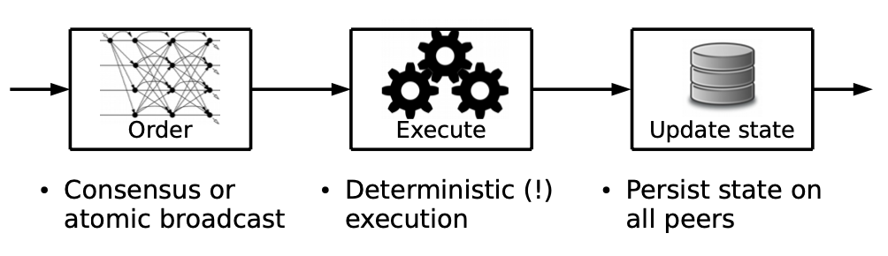
Order-Execute
Source:https://arxiv.org/pdf/1801.10228.pdf

Slide 6
Order-execute: Bitcoin
State transition function is executed
After ordering the block

Slide 7
Limitations of Order-execute (as discussed in paper)
Sequential execution can be throttled by a compute heavy state transition
Bypassed by transactions paying for execution cost
Cannot be done without any native cryptocurrency
Non-deterministic code
Eg. Map iterator in go
Can lead to forks after ordering
Need to use limited languages like Solidity
Confidentiality in execution
Notes:
Map iterator in Go is non-deterministic

Slide 8
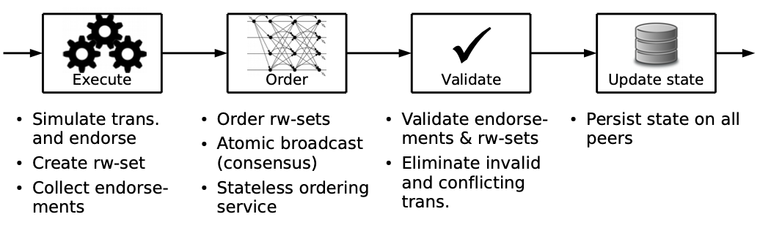
Hyperledger: Execute-Order-validate
Source:https://arxiv.org/pdf/1801.10228.pdf

Slide 9
Chaincode and Endorsements
Chaincode: smart contract + endorsement policy
Smart contract implements the state transition function for an application
State created by one Chaincode cannot be accessed by another Chaincode
Chaincode can invoke another chaincode
Each Chaincode specifies an endorsement policy
Eg. Need to collect 4 out of 10 signatures from a list of endorsers
Endorsers sign transactions that performs correct execution

Slide 10
State management
State is maintained in a versioned key-value store
(key, value, version)
Each transaction has
Readset: (key, value, version) accessed by the transaction
Writeset: (key, value, version) changed by the transaction
Endorsers sign a transaction along with the readset and writeset

Slide 11


Execution-Phase
Peer
Tx
Endorsement
Tx
Endorsers
Tx
TX: A->B: $10
Initial state:
A,2:20, B,1:10
Final state:
A,3:10, B,2:20
Tx
Ordering Service

Slide 12
Ordering Service
A set of nodes responsible for consensus
Receive transactions with endorsements from peers
Orders them through some consensus mechanism
Can be Total-order broadcast of transactions
Can be any BFT based consensus algorithm
Can be Bitcoin like algorithm
Do not perform any validation

Slide 13
Validation
Performed by all peers
Endorsement policy evaluation: Check if the transaction has sufficient endorsements as specified by the Chaincode policy
can be done in parallel
State update check: Check if the readset uses the correct version of keys and the writeset updates the key version (Sequential, however do not need to perform execution)
Local state update: Update the local state (sequential)

Slide 14
Endorsement policy evaluation
Example 1:
Chaincode A endorsement policy: need 2 of 3 endorsement from endorsers X,Y,Z
Chaincode A transaction: Contains endorsement from X,Z: Pass
Chaincode A transaction: Contains endorsement from W,X: Fail
Chaincode A transaction: Contains endorsement from Y: Fail
Example 2:
Chaincode B endorsement policy: need endorsement from central bank

Slide 15
State update
State update check example:
Tx: Readset: (Alice:20,1),(Bob:10,2) , Writeset: (Alice:10,2),(Bob:20,3)
Local state: (Alice:20,3), (Bob:10,2)
Tx readset does not match with local state: Fail
State update:
Locally store a validity bitmask
TX1
TX2
TX3
TX4
1
0
1
1
Block
Validity
bitmask

Slide 16
Concurrent execution
Each Chaincode can use different set of endorsers
Chaincode A
Fabric chain
Chaincode C
Chaincode B
= Endorsers

Slide 17
Confidentiality
The Chaincode execution code can be made private, only make the chaincode endorsement policy and other metadata public
Chaincode A
Fabric chain
Other endorsers have limited knowledge of Chaincode A’s execution

Slide 18
Deterministic execution
Random execution won’t collect enough endorsements
TX: A->B: 9
TX:
A->B:U[8,11]
Peer
Tx
Endorsement
Tx
TX: A->B: 10
Endorsers
Tx
TX: A->B: 10
Initial state:
A,2:20, B,1:10
Final state:
A,3:10, B,2:20
Tx
TX: A->B: 11
All endorsements are different,
No transaction satisfies the endorsement policy
TX: A->B: 8

Slide 19
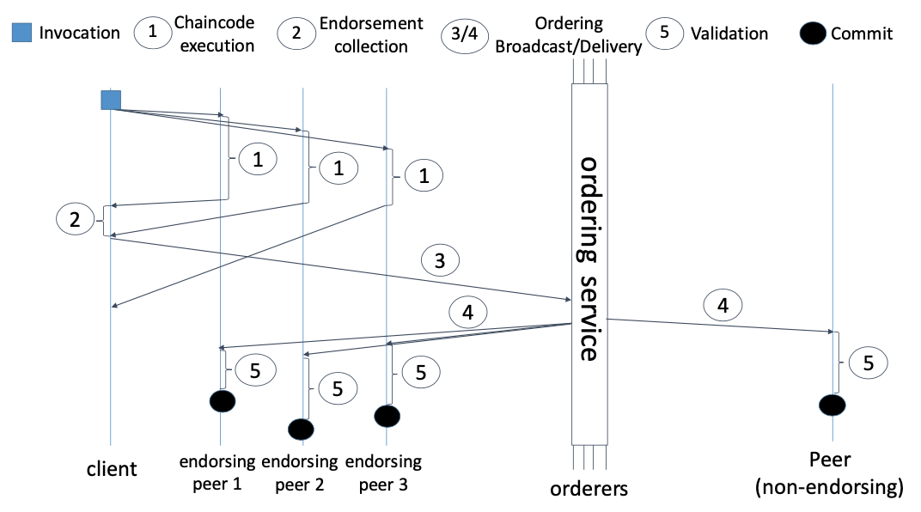
Overview
Source:https://arxiv.org/pdf/1801.10228.pdf

Slide 20
Discussion
Similarity with sharding
Shard validators can be compared to endorser set
Zilliqa transaction sharding:
Small set of validators sign the validity of transactions(Endorsers)
Endorsement submitted to directory shard (Ordering service)

