Slide 1


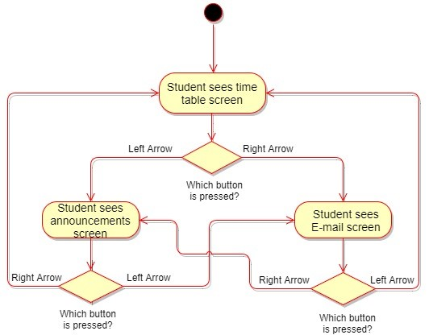
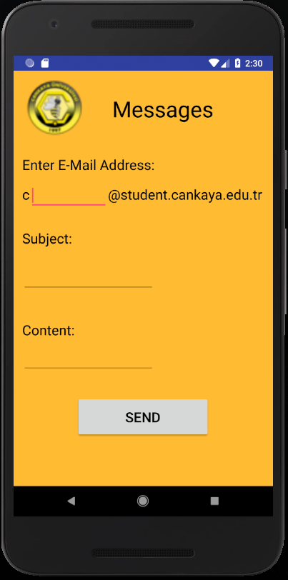
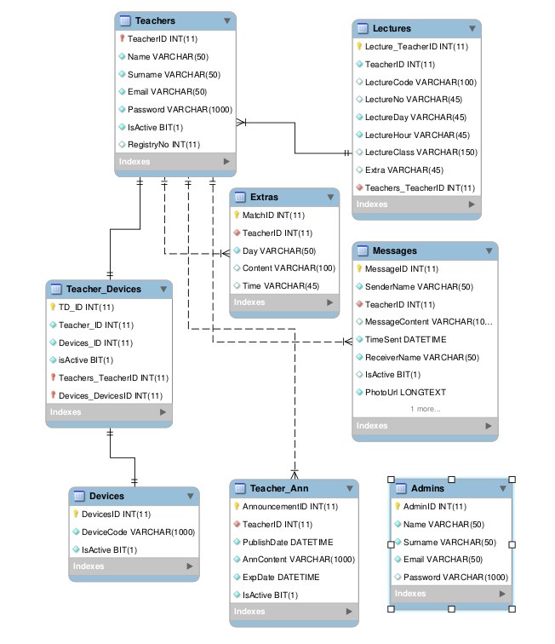
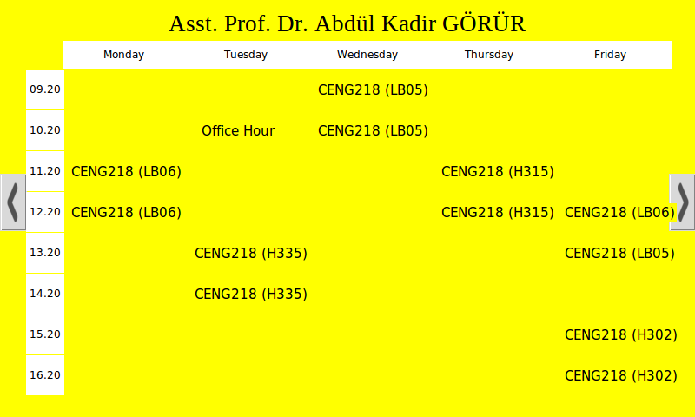
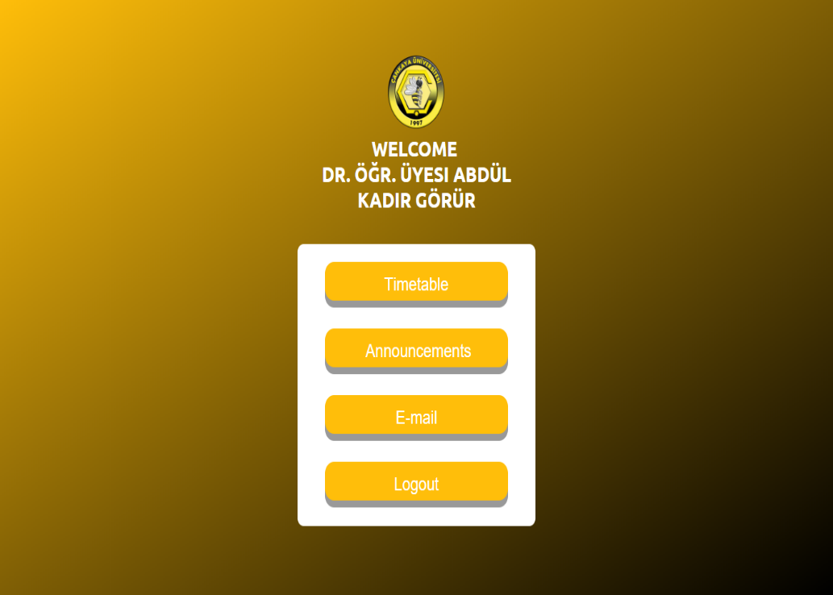
ADROIT SYSTEM FOR ONLINE TIME TABLE
AND ANNOUNCEMENT
Timur ATİLA–Özlem KILIÇ-Hatice Nazlı KUŞ-Utku KILAVUZ
Advisor: Dr. Instructor Abdül Kadir GÖRÜR
Çankaya University, Department of Computer Engineering
Abstract
The interaction between teachers and students is very significant in academic life. This interaction can become difficult. Especially, when the teachers are out of office. In these circumstances, teachers leave notes on their doors. These paper notes may get lost or get damaged and do not attract attention. With this project, these problems will be solved. Students will be able to check the teachers’ time tables, check the published announcements and send messages via using a touchscreen. On the other hand, teachers will be able to add a new announcement and edit their time tables using a mobile application or a website. Finally, admins will verify the new registered devices and add the teachers to the database. The purpose of this project is to ease the communication and interaction between teachers and students in all circumstances, prevent paper waste and design a usable and practical real-time communication system using Raspberry Pi with a touchscreen and a motion sensor, a DBMS and a web server.
Keywords: Time Table, Announcement, Raspberry Pi, Touchscreen, Motion Sensor, DBMS, Web Server.
Figure 1 – Activity Diagram
Figure 5 – Reply Page on
Mobile Application
Results & Conclusion
In this project, we have aimed to ease the communication and interaction between teachers and students, and the project will also prevent paper waste. We have planned to use latest technological products. The purposes of selecting these products are increasing the level of usability, visuality and easy access.
To develop this project, we have researched about Raspberry Pi, Touchscreen, Motion Sensor, MySQL database etc. We have used C#, ASP.NET and Python programming languages. All of these experiences have contributed a lot of knowledge to us for our future career.
Introduction
Students may find it difficult to interact and communicate with teachers because teachers are not always present at the school or the papers hung on the doors of the teachers can get damaged or lost. This can lead to critical announcements or updates not reaching to the students. Adroit System for Online Time Table and Announcement project will play a big role to avoid these problems.
Figure 2 – ER Diagram
Acknowledgement
We would like to thank to our advisor Abdül Kadir Görür who has supported us all the time with his ideas, feedbacks and help. Additionally, we would also like to thank Murat Saran, Efe Çiftci and Ulaş Güleç for their help.
Solution
The usage of touchscreens increases the usability and visuality. They are also compatible with Raspberry Pi which we will use as our microcomputer. Another thing which is compatible with Raspberry Pi is the motion sensor. Motion sensor will be used for energy saving and reducing carbon footprint. Many of the embedded systems use database. Usage of database will allow us to keep track of the data of students, teachers and admins. In this way, the data can be read or written when necessary. With the usage of all the mentioned components this system will help both teachers and students while communicating and will solve the mentioned problems.
Figure 3 – Timetable on Touchscreen
Figure 4 –
Teacher Homepage on Website
Figure 6 – Project Staff

