Slide 1

Department of Computer Engineering
Biometric Identification based on Face and Iris Recognition
Tolga Özalp 201311042
Utku Özcan 201311045
Edanaz PEKDEMİR 201311050
Advisor : Yrd. Doç. Dr. Gül TOKDEMİR
Co-Advisor : Doç. Dr. Reza ZARE HASSANPOUR

Slide 2
Contents
Problem
Analysis
Solution
Results and Conclusion
References

Slide 3
Problem
Illimunation
Pose and Facial Expression
Image Quality
Alcohol Consumption
Distance

Slide 4
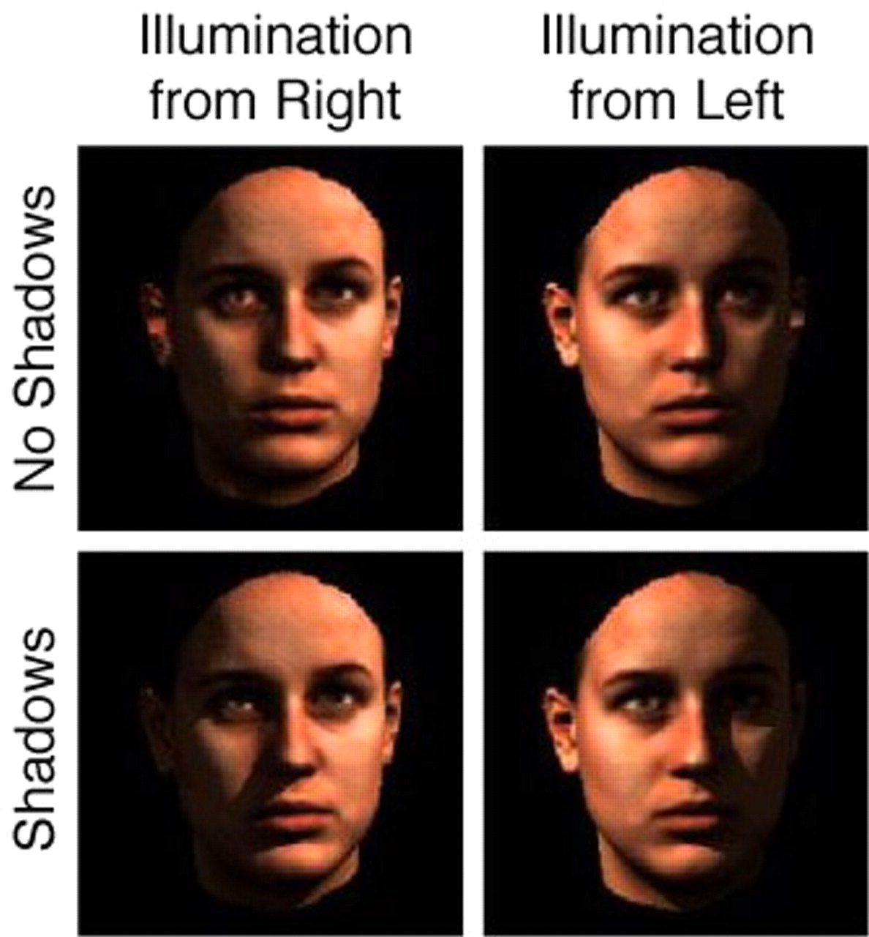
Analysis of Illimunation
The difference of illumination effect to face recognition in a bad way like lighting of ambient can change among indoor and outdoor environments and because of the 3D of human face shape, illumination angle makes shadow some points on the face, so nodal points can be affected in a bad way and some information cannot be reached, so experts still struggle with this problem and they go on improving new image preprocessing algorithm for illumination variations.

Slide 5
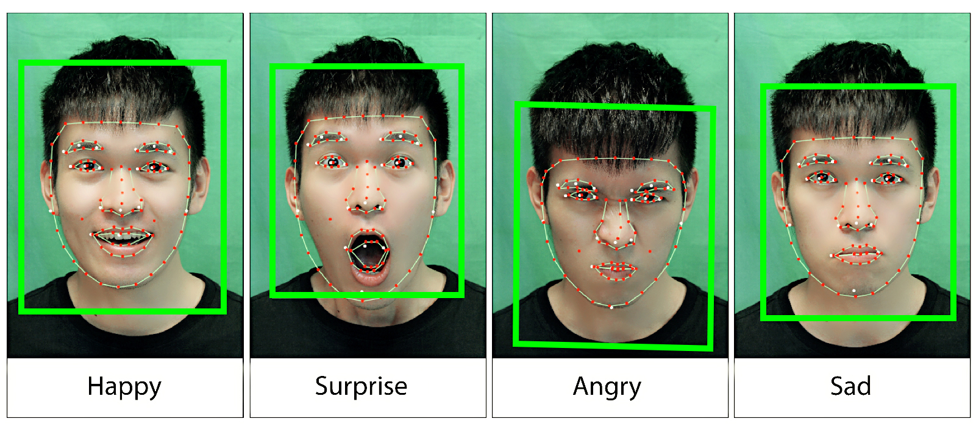
Analysis of Pose and Facial Expression
Changing the pose and facial expression can cause loss of nodal points on the face because of changing the measure of existent parts at a human face like lip and nose, so recognition fail rate can increase than before and experts need to robust the algorithms to ensure consistency.

Slide 6
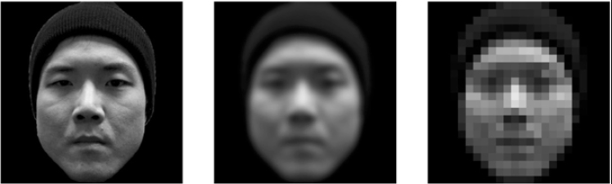
Analysis of Image Quality
Iris Recognition devices can be fooled by using HD image. Also, researchers encounter with the rate of rejection of poor quality image, so they need to reduce delay the enrollment and verification because it can annoy the employee while that all things happen consistently and they need to decrease failure to enroll rate (FTE).

Slide 7
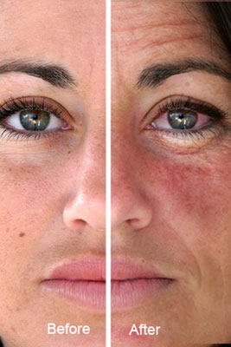
Analysis of Alcohol Consumption
Researchers can trick Iris scanners with digital codes of stored Irises and also alcohol consumption affects pupil like dilates/constricts and it leads to deformation in the iris patterns, so it increases the rate of the false matches, so company owner should apply some restriction about consuming alcohol or system admin can re-register the employees to the system every certain period.

Slide 8
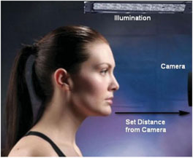
Analysis of Distance
If the employee who does not know about the Iris Recognition system, s/he may have some trouble because the employee needs to stand maximum 1 meter far away from the camera as stationary, otherwise the camera cannot detect the his/her face and iris correctly, so authorized person should inform every employee who needs to use recognition system or we need to robust algorithm for distance measurement.

Slide 9
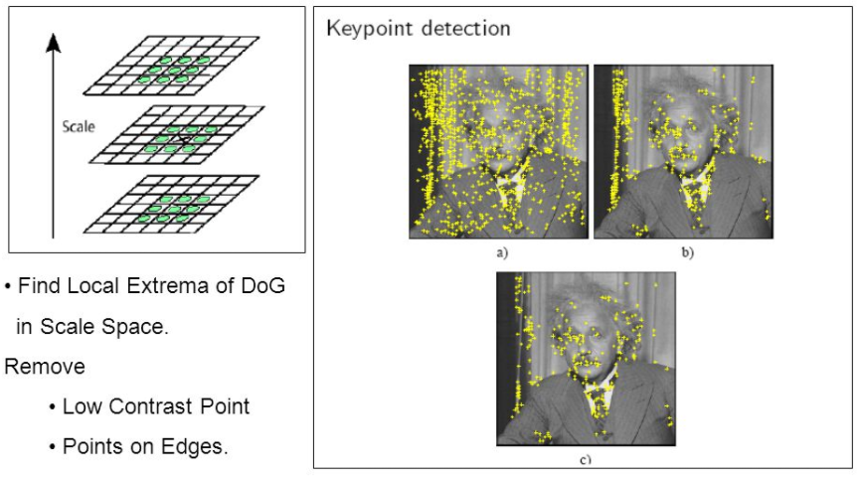
Our solution
We are using Scale-invariant feature transform (SIFT) which is the fastest and reliable algorithm for working security system process. It is also more accurate than any other descriptors and it is independent of rotation, luminance, and scale, so its acceptable level is higher than other algorithms. Also, the acceptable level of Face and Iris recognition system can be adjustable according to company’s request.

Slide 10
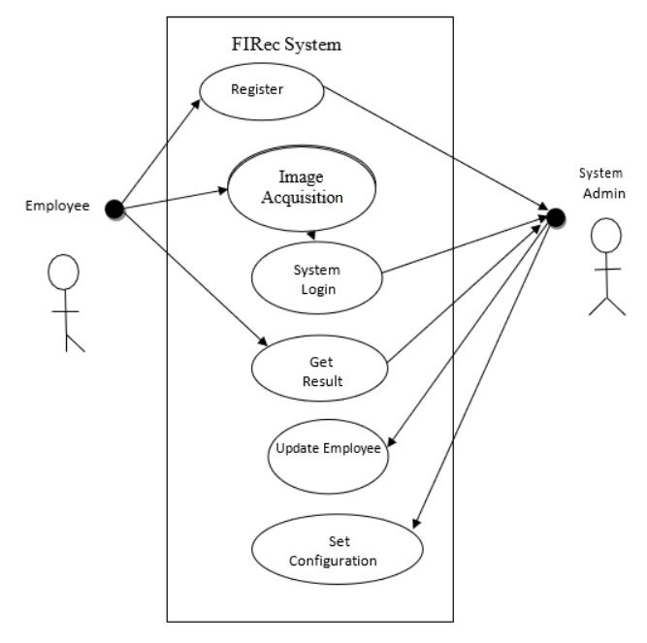
Solution

Slide 11
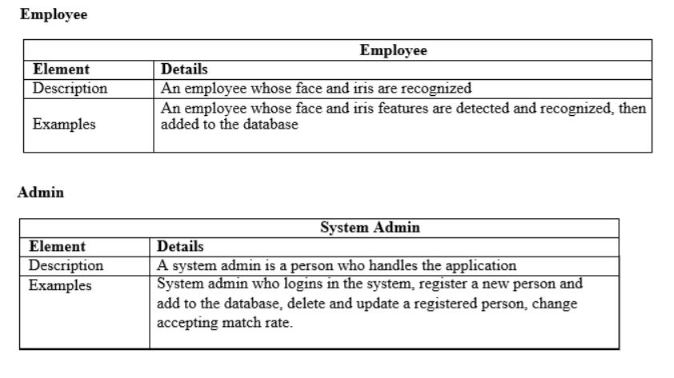
Solution

Slide 12
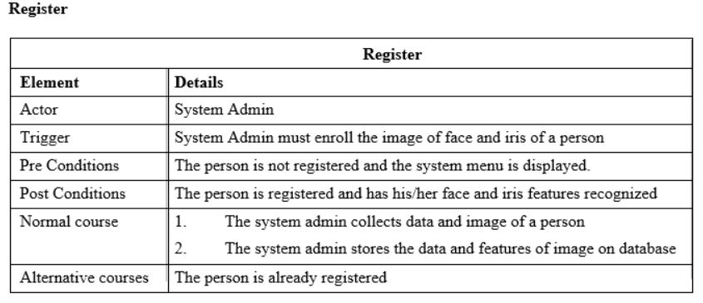
Solution

Slide 13
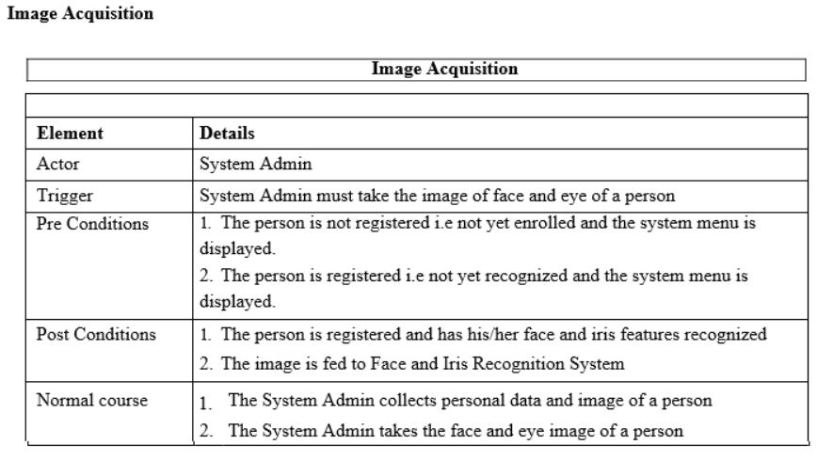
Solution

Slide 14
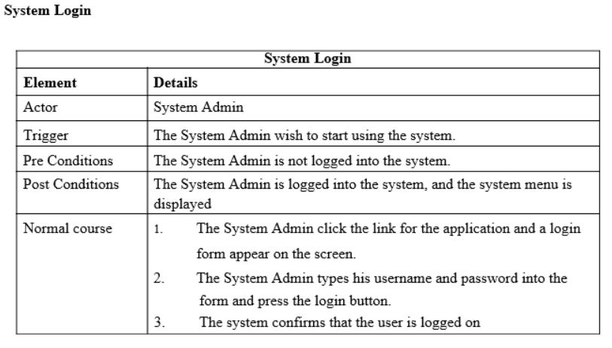
Solution

Slide 15
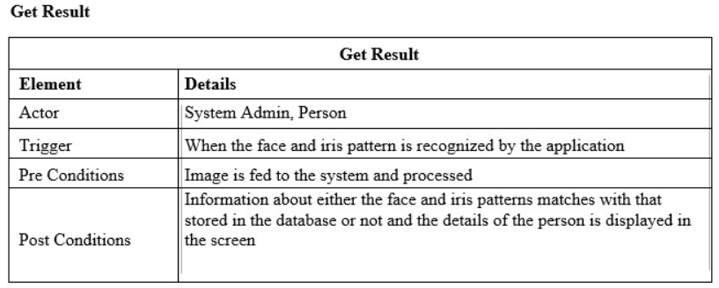
Solution

Slide 16
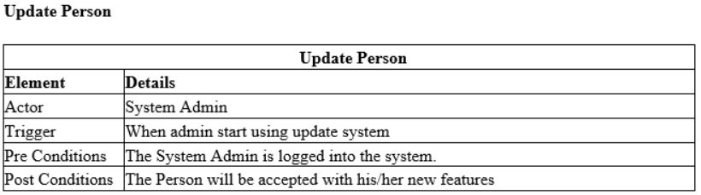
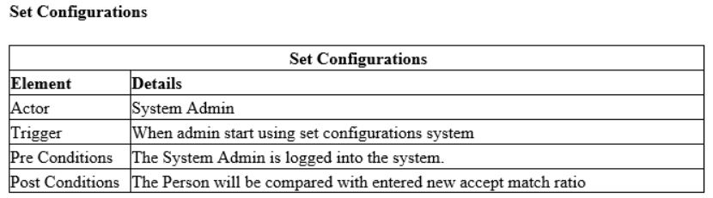
Solution

Slide 17
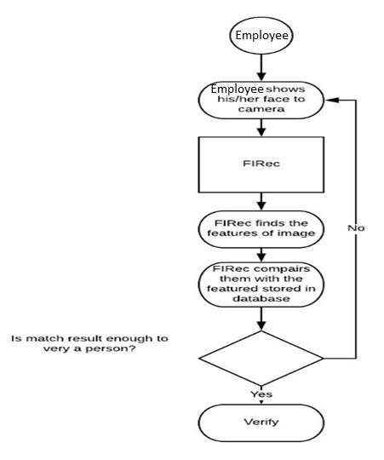
Solution

Slide 18
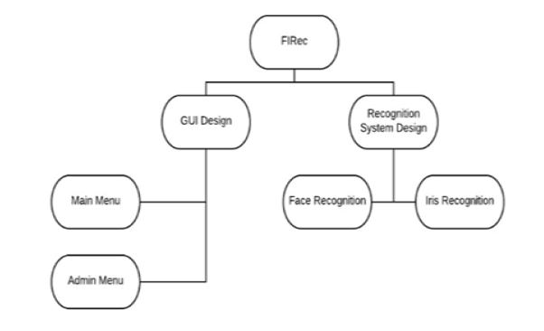
Solution
The employee can register and verify his/her face and iris. Also, admin can login the system from the main menu.
Responsibilities of recognition part belongs to recognition design.

Slide 19
Solution
MATLAB will be used for the project because MATLAB has some advatages for image processing:
A very large (and growing) database of built-in algorithms for image processing and computer vision applications.
The ability to call external libraries, such as OpenCV

Slide 20
Solution
A large user community with lots of free code and knowledge sharing.
The MATLAB Desktop environment, which allows you to work interactively with your data, helps you to keep track of files and variables, and simplifies common programming/debugging tasks.

Slide 21
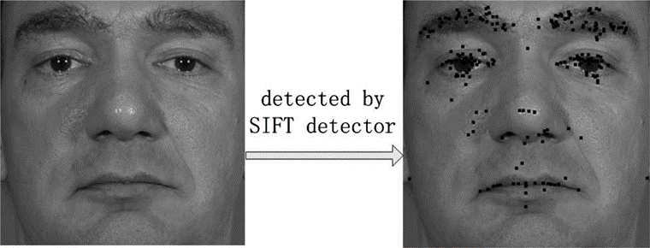
Results
We will using Scale-invariant feature transform (SIFT) which is the fastest and reliable algorithm for working security system process. It is also more accurate than any other descriptors and it is independent of rotation, luminance, and scale, so its acceptable level is higher than other algorithms. Also, the acceptable level of Face and Iris recognition system can be adjustable according to company’s request.

Slide 22
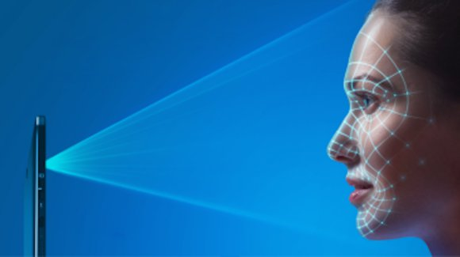
Advantages
There are some advantages the FIRec project.
Firstly, it is the safest and easiest to use according to other security products.
It provides very high accuracy.
It provide to improve customer experience.
There is no known way to replicate an iris because it is unique at every person.

Slide 23
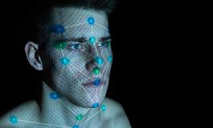
Disadvantages
Except some advantages, the FIRec project has some disadvantages like illumination, external factors.
Firstly, difference of illumination and pose and facial expression affect to face recognition in a bad way like lighting of ambient can change among indoor and outdoor environments and because of the 3D of human face shape, illumination angle makes shadow some points on the face.

Slide 24
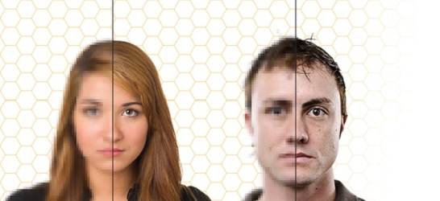
Disadvantages
In addition, changing the pose and facial expression can cause loss of nodal points on the face because of changing the measure of existent parts at a human face like lip, nose so, recognition fail rate can increase than before.
Also, researchers encounter with the rate of rejection of poor quality images, so they need to reduce delays the enrollment and verification because it can annoy the users while that all things happen consistently.

Slide 25
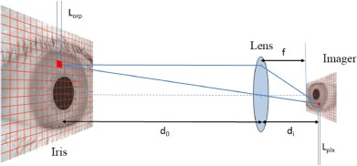
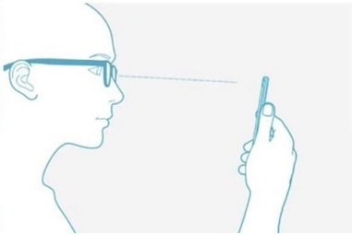
Disadvantages
Iris Recognition devices can be fooled by an HD image and lighting effect to an accuracy of scanners in a bad way. Iris Recognition’s cost is more expensive than other recognition systems.
Furthermore, If the person who does not know about the FIRec project, s/he may have some trouble because the employee needs to stand maximum 1 meter far away from the camera as stationary.

Slide 26
Conclusion
In conclusion, our team will develop FIRec project which is to design to provide a security system which holds a personal information keep in safe and decrease the rate of information theft against who want to steal your private information. This project involves developing an iris detection system in order to verify the uniqueness of the human iris and face by detecting the iris pattern from the image.

Slide 27
References
Wang Y., Tan T., Jain A.K. (2003) Combining Face and Iris Biometrics for Identity Verification. In: Kittler J., Nixon M.S. (eds) Audio- and Video-Based Biometric Person Authentication. AVBPA 2003. Lecture Notes in Computer Science, vol 2688. Springer, Berlin, Heidelberg [Accessed 28 October 2017].
A. K. Jain, R.M. Bolle, and S. Pankanti. Biometrics: Personal Identification in a Networked Society. Kluwer, 1999. [Accessed 09 November 2017]
Kawaguchi, T., & Rizon, M. (2003). Iris detection using intensity and edge information. Pattern Recognition, 36(2), 549-562. doi:10.1016/s0031- 3203(02)00066-3/ [Accessed 09 November 2017].
Ko, T. Multimodal Biometric Identification for Large User Population Using Fingerprint, Face, and Iris Recognition. 34th Applied Imagery and Pattern Recognition Workshop (AIPR05). doi:10.1109/aipr.2005.35 [Accessed 09 November 2017].
Findbiometrics,2017[Online].Available: https://findbiometrics.com/solutions/iris -scanners-recognition/ [Accessed 29 October 2017].

