Slide 1


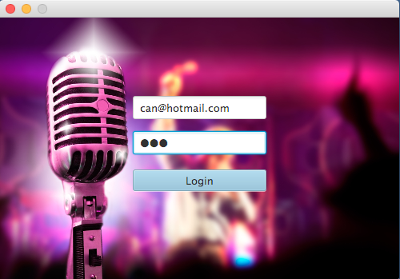
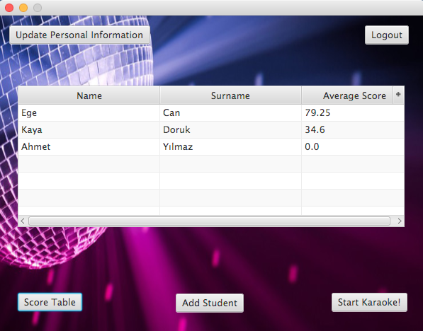
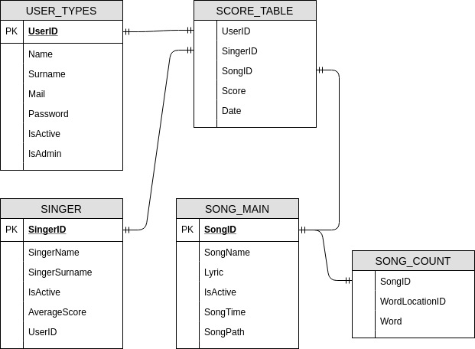
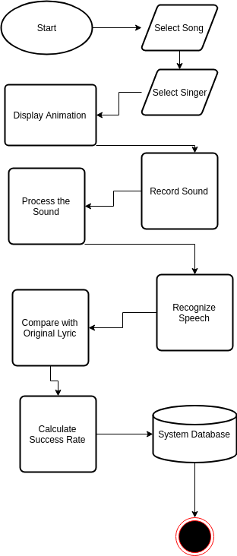
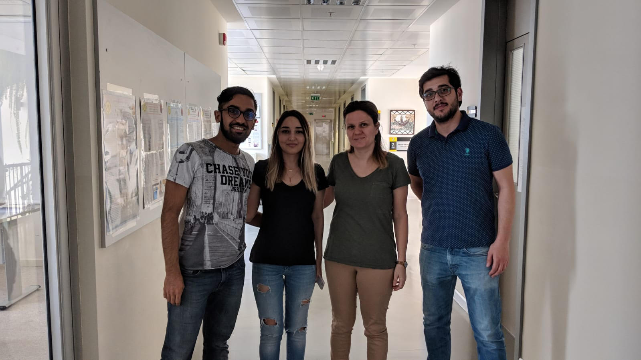
DEVELOPMENT OF A KARAOKE APPLICATION FOR
LANGUAGE LEARNING
Mehmet Ali BEKERECİ – Ege Naz ALARSLAN – Tolga KARAMAN
Assist. Prof. Dr. A. Nurdan Saran
Çankaya University, Department of Computer Engineering
Abstract
Karaoke is an application that is used for entertainment. In karaoke, although scoring seems based on the rate of singing song correctly, scoring is calculated according to whether the sound signals such as peaks and pit areas in the spectrum, match or not in the coding part. In the Karaoke which is our senior project, is an application that based on the correct pronunciation of the words during singing and score is designated according to these words, different from other karaoke applications. Aim of this karaoke application is teaching English to the children who are pre-kindergarten level or elementary school level.
Key words: Karaoke, Speech Recognition, Correct Pronunciation
Solution
This application consists of three main parts which are displaying lyrics in the screen, recording singer's voice and operate with that sound, displaying the score table. In the part of displaying lyrics to the screen in the application, user will select singer from singer list and select a song in the playlist that they’ve chosen and managed. After that, application will open karaoke panel for singer to see the lyrics of song. In the recording singer's voice and operate with that sound part of the application, singer will sing the song that she/he had chosen earlier, by using microphone simultaneously with the screen that shows lyrics of the song and application will record singer's voice and start examining that sound. After the examination of the sound, application will calculate the success rate of similarity between original song and singer's voice and send the details of success to the score table. In the part of displaying the score table in the application, user can see the details of success rate which consist of percentage of similarity and number of words that match with the original song, which song that user sing, which singer sing a song, and date.
Figure 3 – Finished Product
Results & Conclusion
In conclusion, we have created karaoke application that is based on the natural language learning process and to teach English to children who are kindergarten level and elementary school level.
For developing this project, we have done in-depth investigation about related works, usable tools, usable source and programming language. We have analyzed the karaoke applications used nowadays and methods of speech recognizing needed to control the correct pronunciation. As a consequence of these research, we have learned new concepts about computer science like that Sphinx libraries, Java programming language and their integration.
Introduction
Pronunciation of same word or sentence will not give same digital signals phonetic identity which is theoretical in practice, the speech-sounds produced by human beings do no more than approximate to this ideal to a greater or less degree, pitch which is perceptual property of sounds, speaker, microphone and environment. Although this issue shows the difficulty of speech recognition, we have tried to reduce this issue with using that CMU Sphinx API for speech recognizing and Java programming language for integration and implementation of these API and method in the our karaoke application.
In order to calculate score for each song, we deem suitable to compare original lyric with text that created from recorded sound in real-time. For this purpose, we have decided to use Sphinx4 libraries for approaching the real-time solution for our goal. Despite the fact that Sphinx libraries can recognize the speech, it cannot specify some data for displaying the specific values for specific time of starting the sound or song etc. Therefore, in order to handle the sound process period successfully and calculate and use valid data for specific time, we decided to use Java Speech libraries with Sphinx libraries.
Acknowledgement
We are grateful to Assist. Prof. Dr. A. Nurdan Saran due to helping to us in every steps of our project.
Figure 1 – Database
Figure 2 – Activity Diagram

