Slide 1

Sensor Programming with Using Android Platform
Esra YILMAZ – 201411070
Ahmet KARA – 201611674
Advisor: Sibel TARIYAN ÖZYER

Slide 2
Sensor Programming with Using Android Platform
Definition: Sensors capable of detecting explosives or weapons have vital preventive measures to detect their position, especially in military territories, to prevent terrorists from taking countermeasures against possible terrorist attacks by civilian and military personnel.
Available on a variety of devices like Android-based mobile phones, tablets and smart clocks.
Data transfer takes place using sensors.
Main goal is to detect enemies in the military field.

Slide 3
Main Features
The Robot is controlled by the user via Bluetooth.
The user can control the robotics basic movements(move forward, backward, right, left )
The user can take the robot in automatic mode and let the car drive its own way.
The robotic vehicle can detect whether the obstacles facing the vehicle are human or not. If the obstacle is a living entity, as for that is the human
The red led on the robot lights up and it will calculate the shortest distance it can avoid and will proceed in that direction.
If any object we are comparing is inanimate, it will calculate the shortest distance it can avoid and will proceed in that direction.

Slide 4
Main Contribution Pros and cons to similar projects
Pros:
The robot has two modes. Automatic mode and user mode.
While the robot is in automatic mode, it measures the furthest distance from the obstacle and escapes from obstacles.
Live detection with PIR sensor

Slide 5
Cons:
Short-range operation of Bluetooth connection.
If the robot is far away from a device with a Bluetooth connection, the connection is disconnected.
It's not a military measure because it's a prototype.
Because power consumption is so high, energy will be insufficient in the long run.

Slide 6
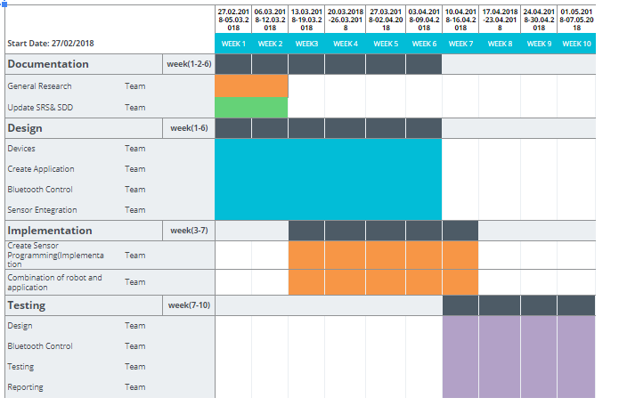
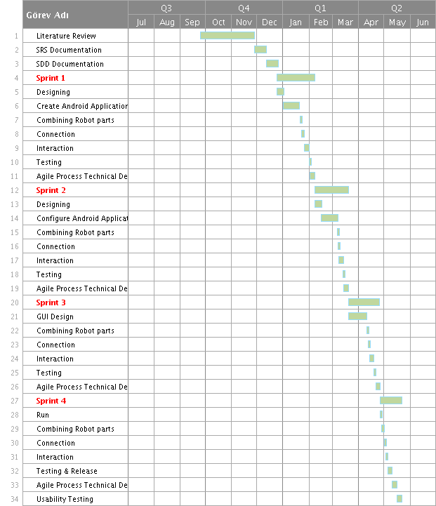
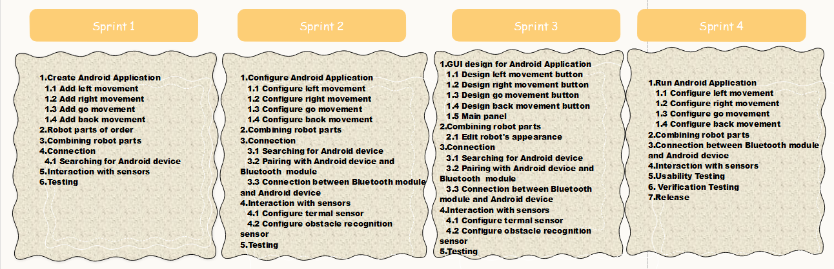
Workplan

Slide 7
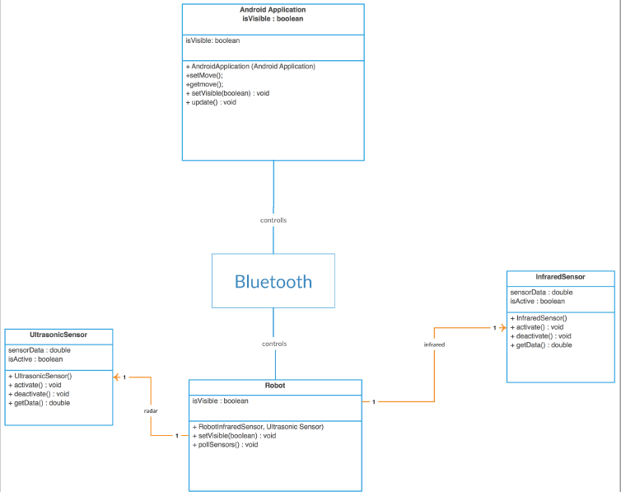
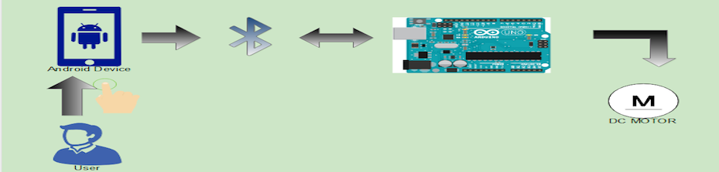
Methods

Slide 8
Materials
Bluetooth technology
Smartphone with the Android operating system,
The microprocessor (Arduino Uno R3)
DC Motor.
Robotic car platform
PIR sensor
Red led
9V battery
Ultrasonic Sensor
Motor Shield
Servo-motor

Slide 9
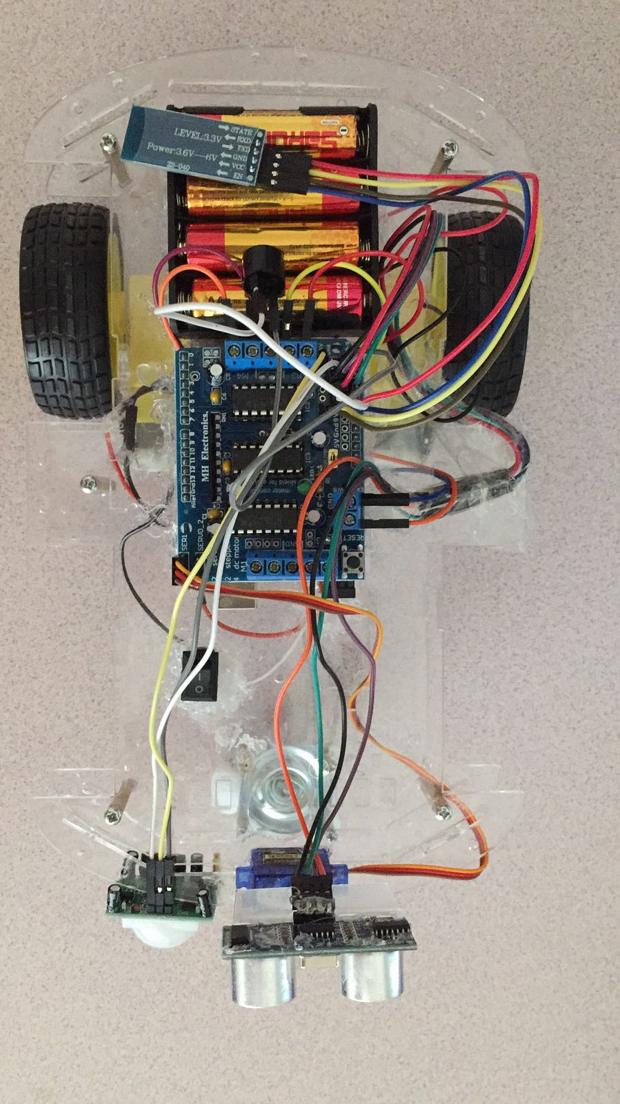
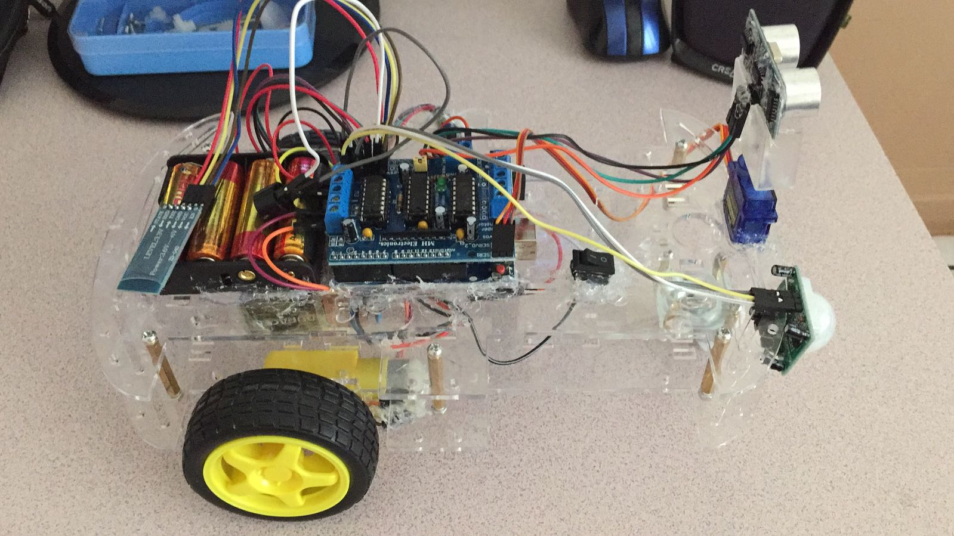
Potential Risks and Expected Outputs / Obtained Results
As a result of excessive use, the eyes of the user may be deteriorated and the user may
be exposed to radiation.

Slide 10


