Slide 1


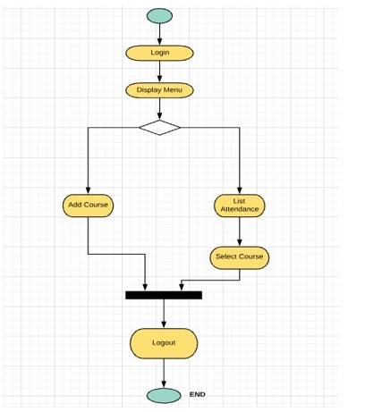
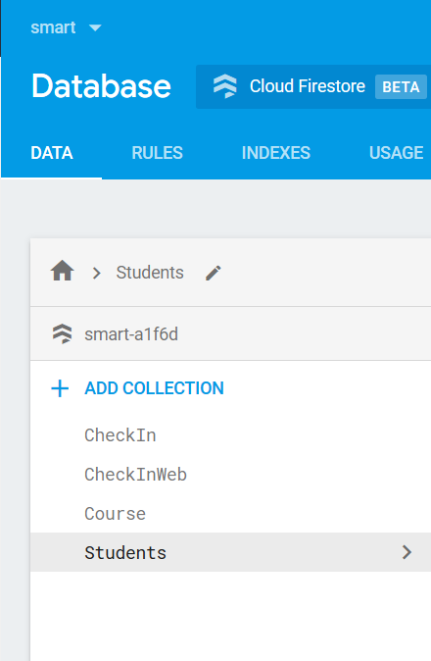
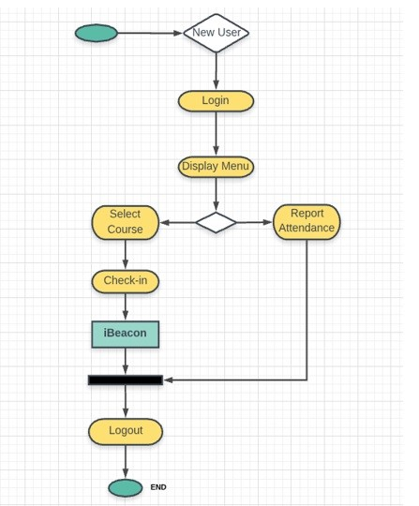
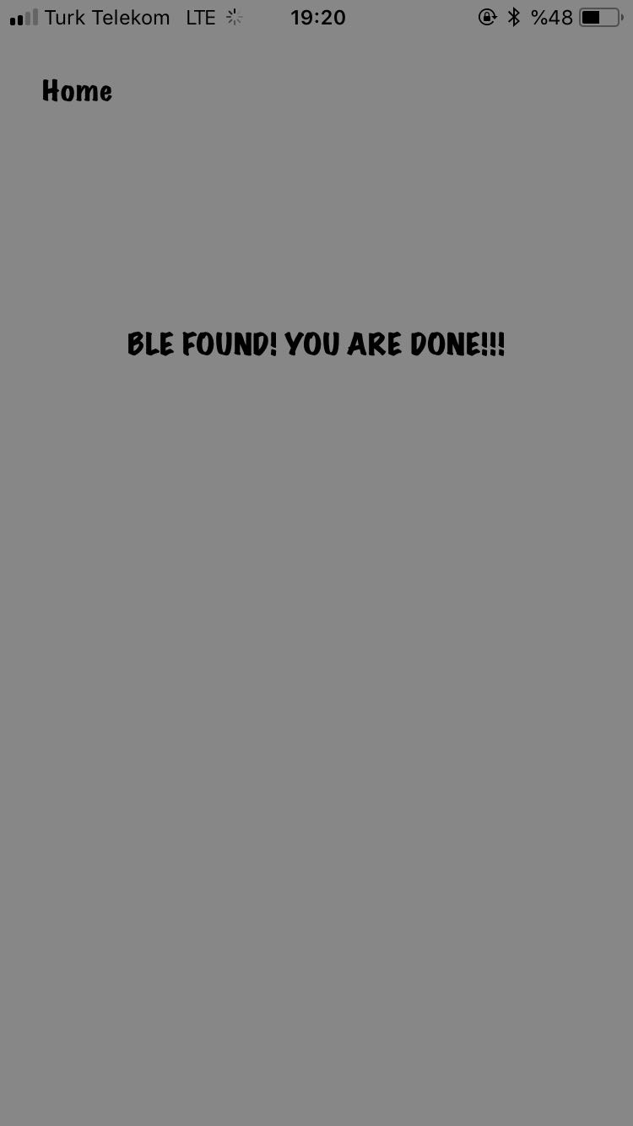
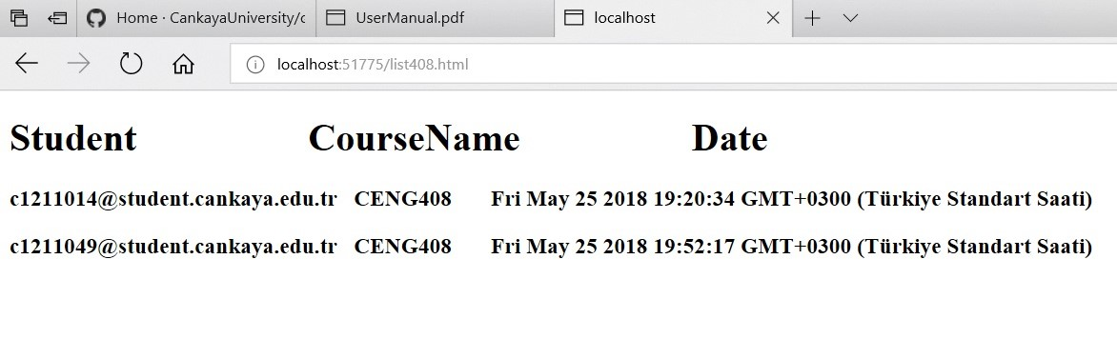


SMART ATTENDANCE SYSTEM
Berkay Çınar -Merve Çınar-Muhammed Taşkın
Advisor: Murat Saran
Çankaya University, Department of Computer Engineering
Abstract
It is time-consuming for teachers to keep track of students' attendance. This system aims to control student’s status in the class with the help of bluetooth low energy (BLE) 4.0. iBeacon is the preferred BLE device for the project. This device communicates with students' smartphones. The mobile application on the smartphone detects that the student enters the lecture hall and records this information for follow-up. For registration to occur, the student must have a certain amount of time in class coordinates. After that students can check-in . According to the preferred option, the information of the students is sent to the web application through database. The web application is designed for use by teachers. Teachers have the right to open lessons, delete lessons and access student absenteeism through web application. The system consists of three basic components: (1) iBeacon, (2) Web application, (3) iOS mobile application.
Keywords: Bluetooth Low Energy, iBeacon, Web Application, Mobile Application , iOS
Company Info
Çankaya University department of Computer Engineering is our company.
Results & Conclusion
The Smart Attendance System aims to be a system of documenting student participation through mobile phone.
Advantages of our Project which are more secure system, using less energy , low cost and time consuming.
We have learned using new programming language including swift as programming language. In addition, we used No-SQL Technologies such as Firebase Cloud Firestore.
Figure 1 – Web Application Flowchart
Introduction
The target audience is teachers and students. Smart attendance system allows students to record their attendance knowledge via phone. This project will provide teachers and students with time-saving opportunities in the lessons. The main purpose of the project is to introduce technological practice and safe new methods instead of traditional attendance methods. This project is designed with bluetooth low energy technology and iBeacon device is used. This device will enable to communicate with student’s phones.
Figure 5– No-SQL Database
Acknowledgement
Our consultant in the project, Assist. Prof. Dr. Murat Saran, helped us very much and supported us a lot. Thanks to him, we have made our project a bigger site by further improving.
Figure 2 – Mobile Application
Flowchart
Solution
1.Related Technologies are :
Swift language
JavaScript , HTML language
BLE 4.0 (iBeacon)
No-SQL
2.System Features for Mobile Application :
Login
List Attendance
Check-in
2.System Features for Web Application :
Login
Add Course
Report Attendance
Figure 3 – Finished Product
Figure 3 –
Mobile Application
Check-in Page
Figure 4 –
Web Application
List Attendance Page

