Slide 1
DIET PLAN BUILDER AND NUTRITIONAL VALUE COUNTER
Project Members:
Berke EREN
Burak ALIM
Furkan ELBASAN
Advisor:
Abdül Kadir GÖRÜR

Slide 2
Contents
Problem
Analysis
Solution
Results and Conclusion
References
Demo

Slide 3
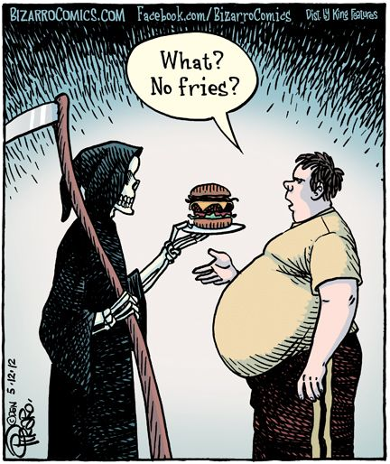
Problem

Slide 4
Analysis
People are afraid of hearing the magical word: diet. They think they cannot eat what they want. Also, there are applications for diet planning but all of them are in English.
So, we want an application in Turkish. Also, we have an expert assistance.

Slide 5
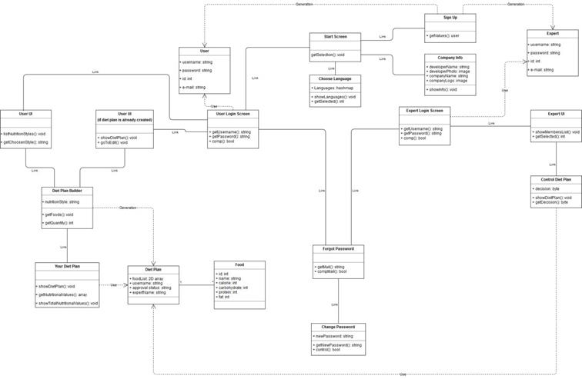
Solution

Slide 6
Solution
We used Java Language, MongoDB and Android Studio Integrated Development Environment(IDE).

Slide 7
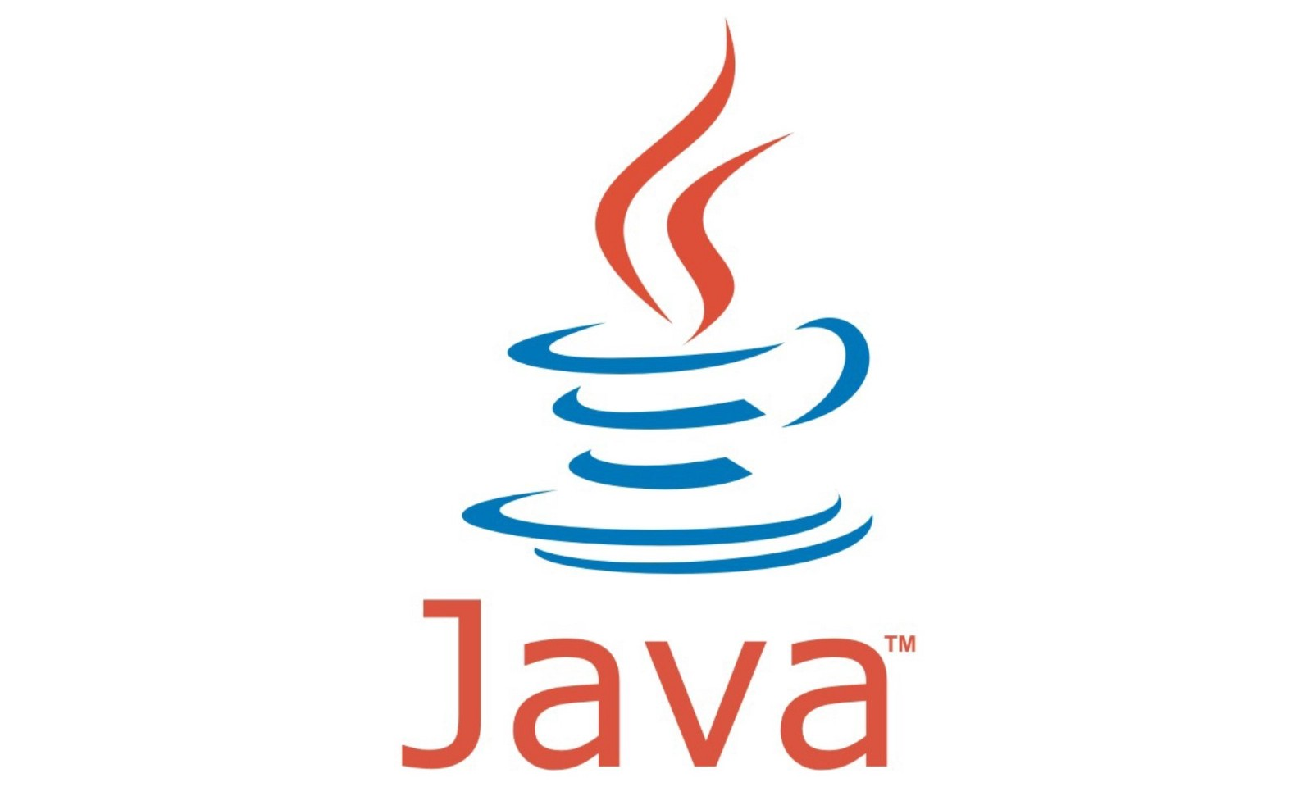
Java

Slide 8
Java
Java is a general-purpose programming language that is class-based, object-oriented and designed to have as few implementation dependencies as possible.[1]

Slide 9

MongoDB

Slide 10
MongoDB
MongoDB stores data in flexible, JSON-like documents, meaning fields can vary from document to document and data structure can be changed over time.[2]
It is NoSql type database.
With this feature, MongoDb does not use query language.

Slide 11
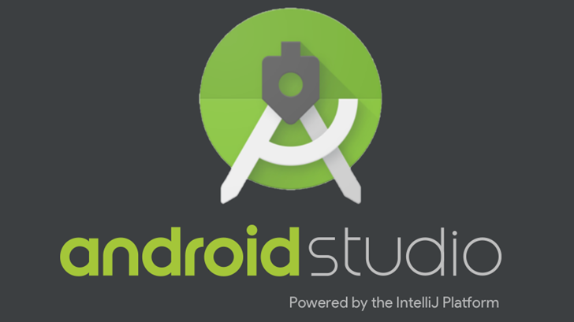
Android Studio IDE

Slide 12
Android Studio IDE
Android Studio is the official Integrated Development Environment (IDE) for Android app development.[3]

Slide 13
Results and Conclusions
Advantage(s)
Our application is in Turkish
Our application has expert support
Disadvantage(s)
Our dataset is small

Slide 14
References
[1] Java (programming language). [ONLINE] Available at: http://www.wikizeroo.net/index.php?q=aHR0cHM6Ly9lbi53aWtpcGVkaWEub3JnL3dpa2kvSmF2YV8ocHJvZ3JhbW1pbmdfbGFuZ3VhZ2Up. [Accessed 13 May 2019]
[2] What is MongoDB. [ONLINE] Available at: https://www.mongodb.com/what-is-mongodb. [Accessed 13 May 2019]
[3] Meet Android Studio. [ONLINE] Available at: https://developer.android.com/studio/intro. [Accessed 13 May 2019]

Slide 15
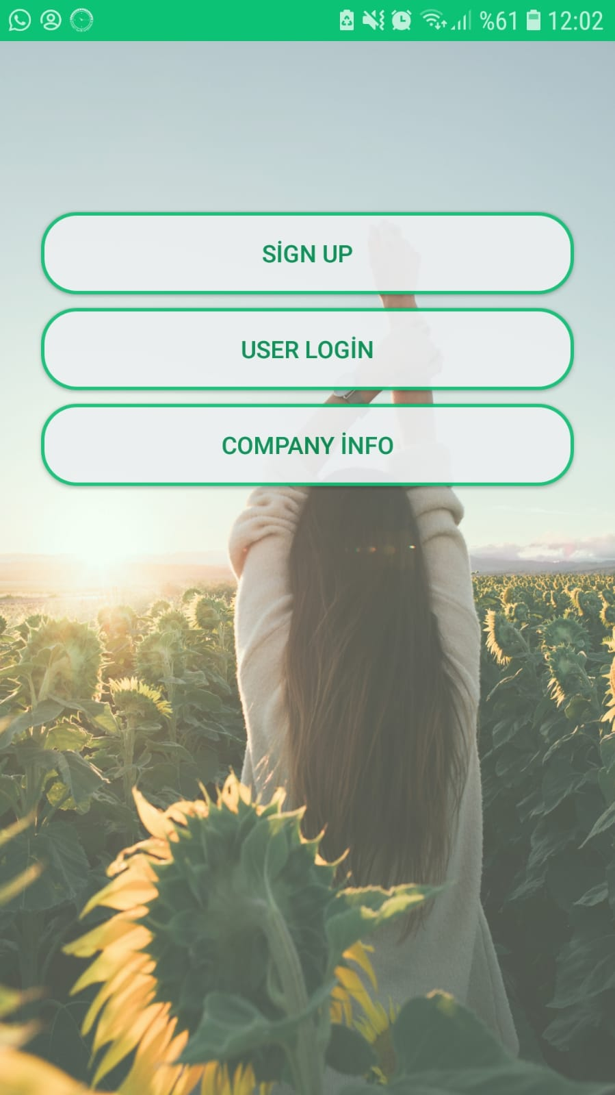
Demo

Slide 16
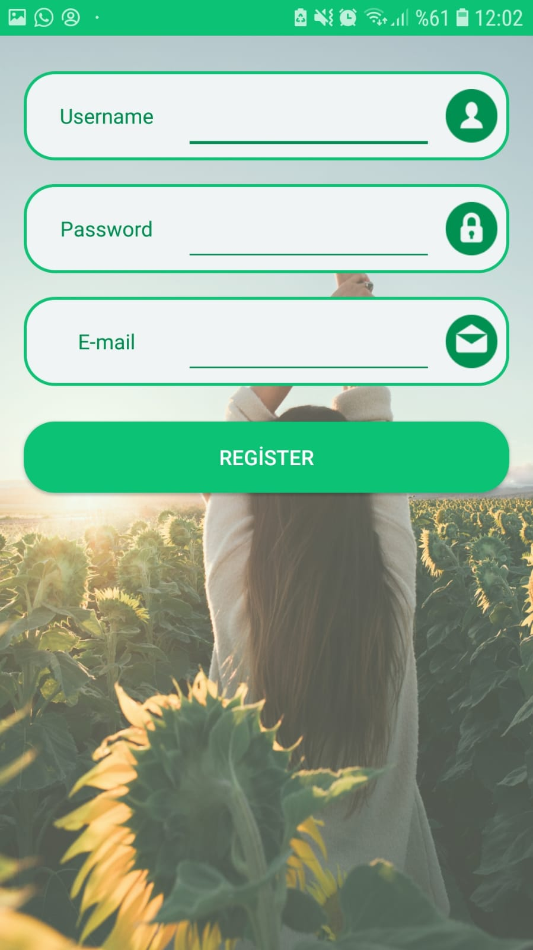

Slide 17
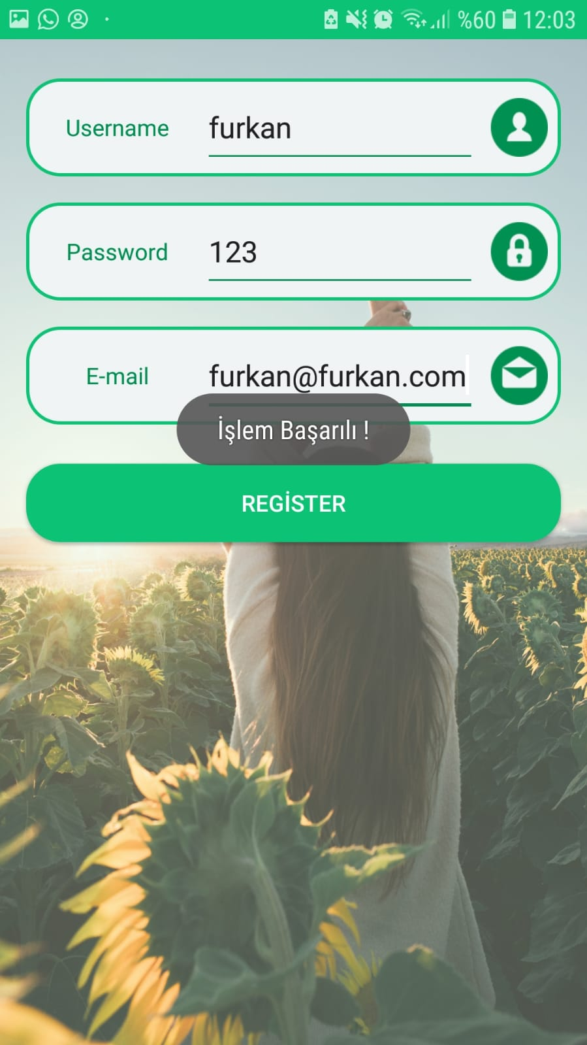

Slide 18
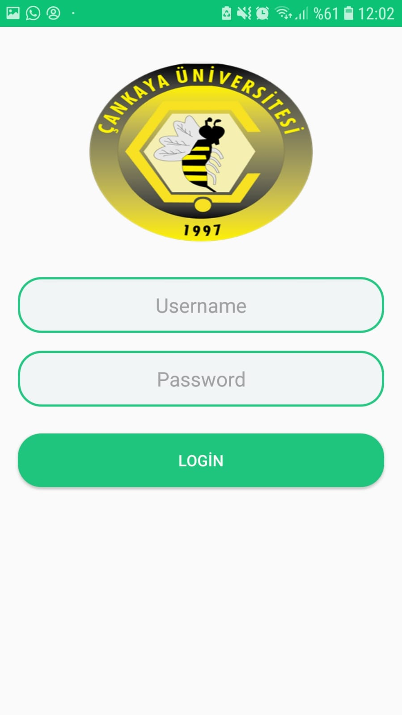

Slide 19
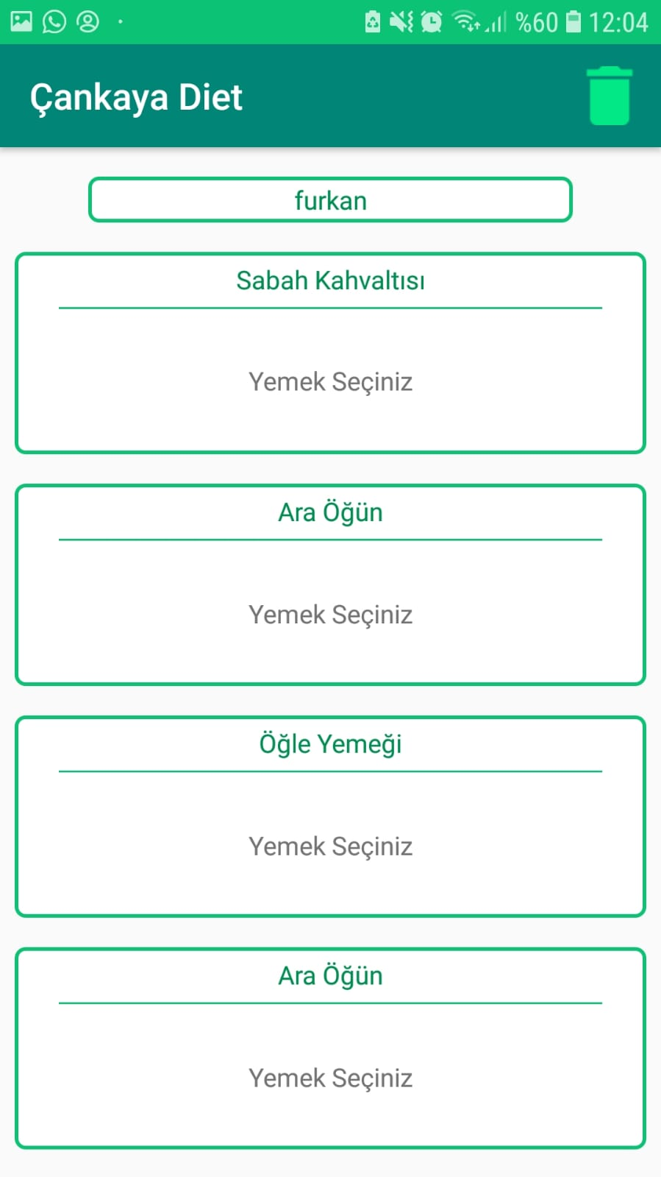

Slide 20
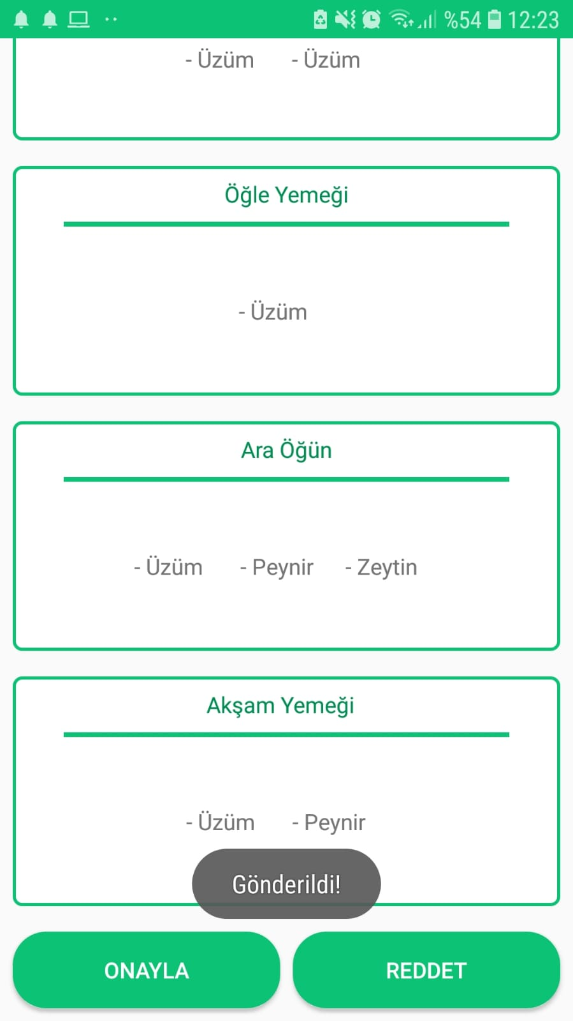

Slide 21


