Slide 1


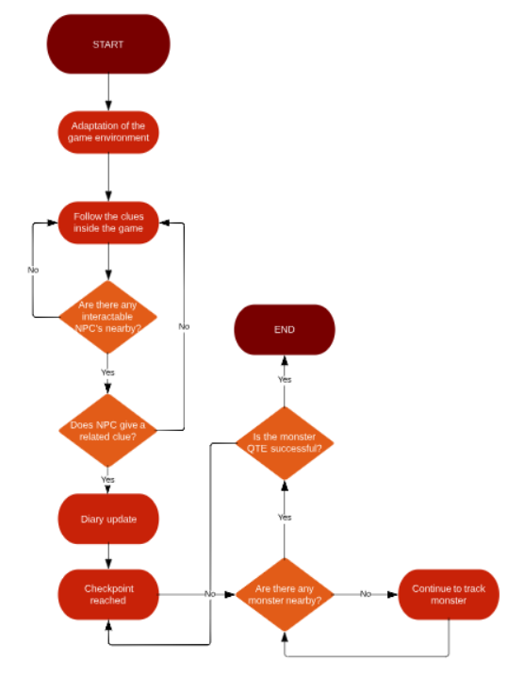
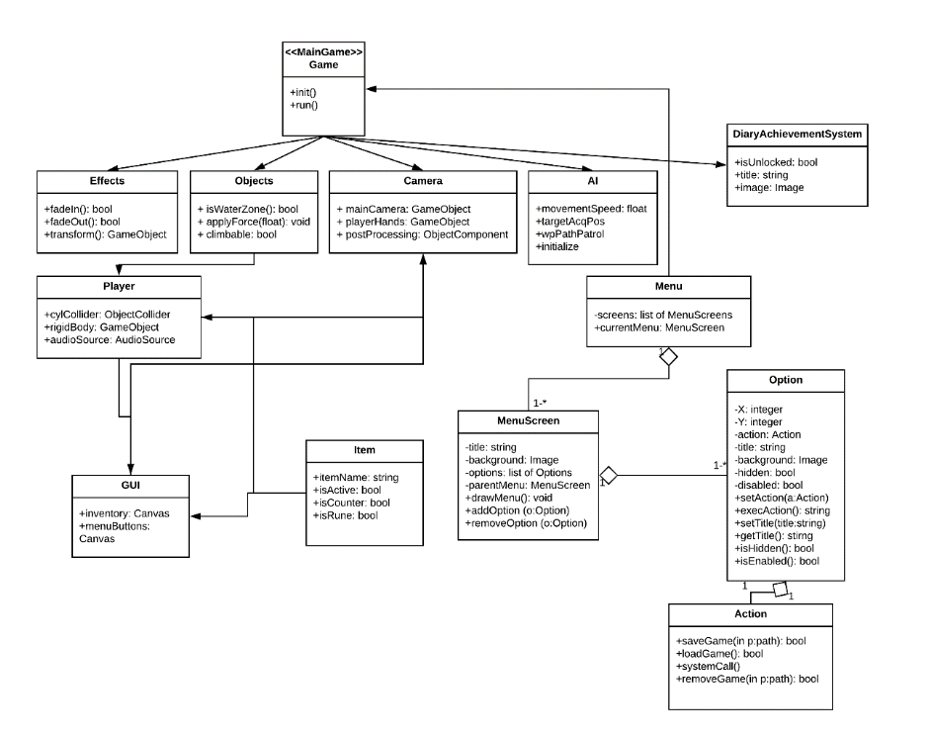

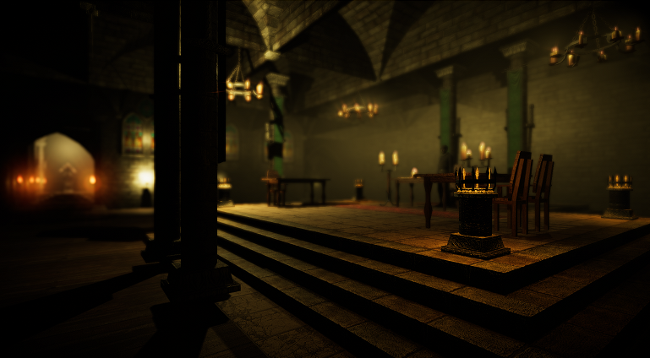
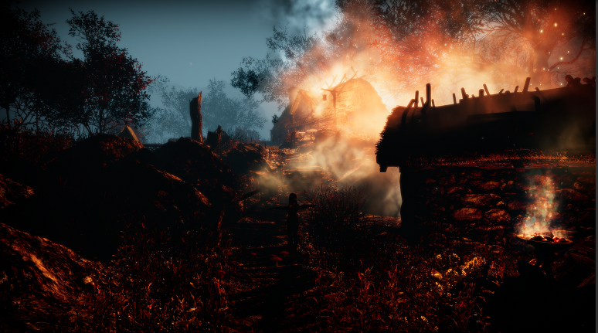
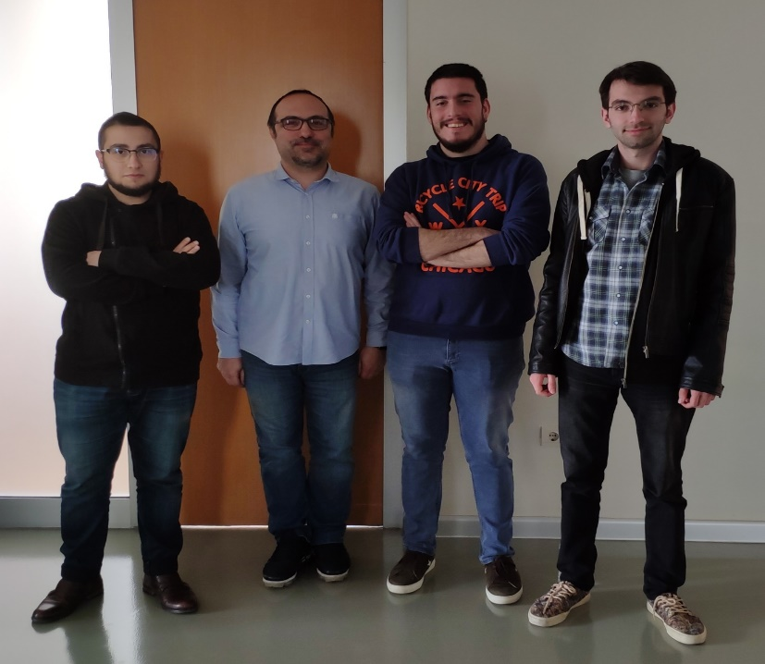


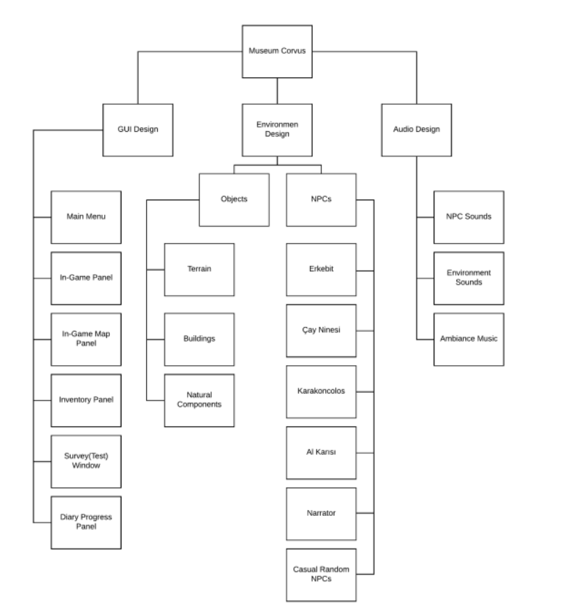

MUSEUM CORVUS: A Virtual Heritage Museum with
Believable Agents Based on Turkish Horror Folklore
Hasan Saygın Dikbayır – Oğulcan Merdivanlı
Utku Mert Değirmenci
Doç. Dr. Murat Yılmaz
Dr. Öğr. Üyesi Ulaş Güleç
Çankaya University, Department of Computer Engineering
Abstract
Drawing on the fields of cultural heritage, digital storytelling on a set of believable agents, this project proposes a virtual museum, which is populated with virtual agents based on the Turkish horror folklore. Using the emerging trends in the field of game research, the goal is to demonstrate how selected characters from Turkish horror folklore could adequately be storied in a virtual museum environment, which aims to safeguard and transmit cultural heritage. This work aims to advance the immersion in interactive environments by exploring a selected set of believable agents. We conduct a case-based reasoning approach to simulate virtual agents roles for exploring cultural heritage. In particular, virtual agents that would play different museum-based roles and ultimately interact with other role-based agents and some of which need to engage into interactions with human participants.
Keywords : Virtual Reality, Cultural Heritage, Virtual Heritage, Virtual Museum, Horror Culture
Company Info
Portakal Teknoloji was founded in early 2003 with the idea of creating smart ERP software for our company founding partner Bora Güngören. It is designed as a commercial business model in R & D for the established as a result of a lack of entrepreneurial support mechanisms in Turkey. Portakal Teknoloji has been an active company in the field of information security, providing research projects, products, specially developed modules for the customers and offering consultancy services.
Figure 2 - Flowchart
Figure 6– Company Logo
Introduction
The concept of virtual museums enables an experience based on the heritage of different cultures. Folklore, folk tales, decors, myths and motifs are part of cultural heritage. The scope of this project is the treatment of the cultural elements belonging to horror stories of Turkish culture with a virtual museum concept. As a result of this, they will become more believable and passed to virtual environment by using dramatic elements of a game. Consequently, we revive this rich culture from its forgotten past and to allow people to interact with unique entities from the Turkish culture.
Results & Conclusion
In this project, we conducted various researches of virtual museums and tried to show their implementation. We have also created a museum about Turkish horror culture and riches. To reach complete understanding of our project we have described virtual reality. The project aims to realize the learning process of Turkish horror culture in a much more enjoyable and efficient way. We offer a new approach to storytelling using agents and VR technology in our project. In a 3D modeled realistic chilling environment, visitors will learn Turkish horror culture and unique characters. The scenario of the game will make it easier to dive into the story and provide an unforgettable experience.
It was a pioneering project of Turkish Horror Culture. In our project, we offer a cheaper and more efficient framework for future projects.
Figure 3 – Class Diagram
Solution
The system consists of three main components, and each component has own sub-system. GUI design provides interaction between the player and the system. Using the GUI system, we aimed to attract the user into the game with interactions. Moreover, the user could adjust the audio-image quality at the desired features. The game will contain different environment such as main story terrain and the museum lobby section. Main story will be experienced in the main map and player will interact with narrator and statues inside the museum lobby. The environments will contain non-player characters and objects. Sound design gives the game it’s reality closeness as player needs to experience a unique living environment. According to main story, related sounds such as wind, fire, ambiance music, voice actings.
Figure 4 – Finished Product
Acknowledgement
In the process of development of the project, we would like to thank our advisor Murat Yılmaz and Ulaş Güleç, and Bora Güngören and Gerisi Hikaye Team for their help.
In addition, our project has been endorced by "Tübitak 2209 - b – Industry - Oriented Undergraduate Thesis Support Program".
Figure 5 – Finished Product
Figure 1 – Modularization of System
Figure 7– Project Memebers

