Slide 1
HUMAN INTERFACE DEVICE 3D POINTER
Project Members
Arzu KARATAŞ
Göktürk BİLGETÜK
Metehan Göksel KURTULAN
Advisor
Faris Serdar TAŞEL

Slide 2
CONTENTS
Definition
Purpose
Problem
Anaylsis
Solution
Results and Conclusion
References

Slide 3
DEFINITION
Human Interface Device: 3D Pointer
involves an API(Application Programming Interface) and hardware design of a 3D pointer device which is composed of multiple ultrasonic distance sensor connected to an Arduino device.

Slide 4
PURPOSE
Gathering data from multiple ultrasonic distance sensors in real time by using Arduino.
Computing 3D position of the pointer object.
Recognizing special gestures.
Preparing a software package comprising an API.
Testing the device in virtual 3D environment.

Slide 5
PROBLEM
The aim of this study is to transfer the spatial data in real life to the computer in 3D and visualize it in various field.
Cost.
Maintenance and installation.
Usage areas.
System sizes.
Interaction requirements.

Slide 6
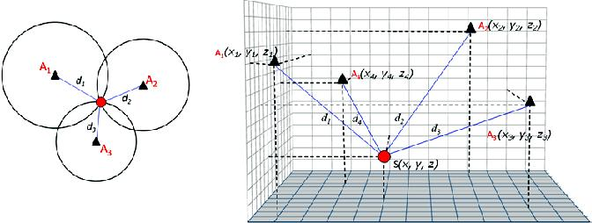
ANALYSIS
Trilateration Technique

Slide 7
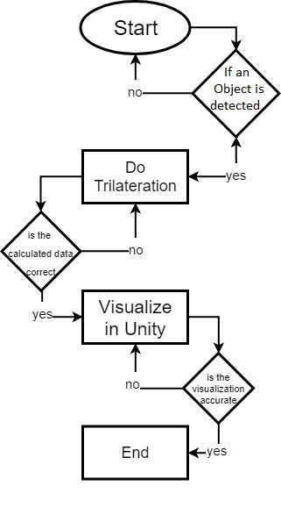
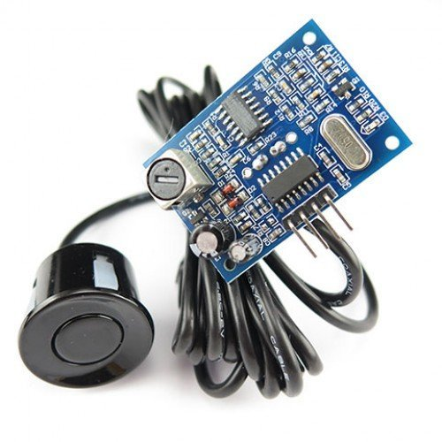
SOLUTION
Ultrasonic Sensors
Trilateration
Arduino
Unity

Slide 8
Result and ConclusIon
Some companies have developed such devices to mainly use for virtual reality and entertainment. Haptic devices are also used in industry. In this project, a cost efficient, easy-to-setup device will be designed which can be controlled by free hand.
Some Advantages:
Using 3D applications interactively.
Ease of maintenance and installation.
Can be used in desired sizes.
Providing 3D input for utilization.

Slide 9
References
1. Othman, S. N. (2010). Node positioning in zigbee network using trilateration method based on the received signal strength indicator (RSSI). European Journal of Scientific Research, 46(1), 048-061.
2. Bowman, D., Kruijff, E., LaViola Jr, J. J., & Poupyrev, I. P. (2004). 3D User interfaces: theory and practice, CourseSmart eTextbook. Addison-Wesley.
3. Nishida, Y., Aizawa, H., Hori, T., Hoffman, N. H., Kanade, T., & Kakikura, M. (2003, October). 3D ultrasonic tagging system for observing human activity. In Intelligent Robots and Systems, 2003.(IROS 2003). Proceedings. 2003 IEEE/RSJ International Conference on (Vol. 1, pp. 785-791). IEEE.
4. Hazas, M., & Hopper, A. (2006). Broadband ultrasonic location systems for improved indoor positioning. IEEE Transactions on mobile Computing, (5), 536-547.
5. Manolakis, D. E. (1996). Efficient solution and performance analysis of 3-D position estimation by trilateration. IEEE Transactions on Aerospace and Electronic systems, 32(4), 1239-1248.

Slide 10
Thanks for lIsteNING!
Question?

