Slide 1
License Plate Recognition Using Deep Learning
Team Members
Mert Yumuşak 201411071
Mert Sert 201411052
Bengisu Şeyma Aydoğdu 201411008
Rüştü Kaan Varlı 201411064
Advisors
Prof. Dr. Erdoğan DOĞDU
Assoc. Prof. Dr. Reza ZARE HASSANPOUR

Slide 2
Outline
In collaboration with
TÜBİTAK
License Plate Recognition
Problem
Solution
Technology Used
Potential Risk
Application
Result
Demo

Slide 3

In collaboration with

Slide 4

TÜBİTAK
2209/B Industry Oriented Graduate Thesis Support
(2209/B Sanayi Odaklı Lisans Bitirme Tezi Destekleme Programı) (Approved on March 2019)

Slide 5
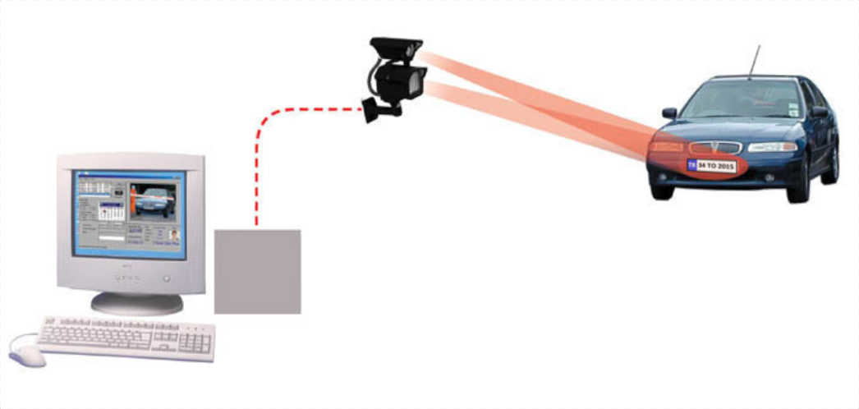
License Plate Recognition
Source: Lichkanenko, I.. G.(2009). Research of methods and search for an efficient algorithm for the problem of vehicles license plates recognition.
http://www.tech-faq.com/automatic-number-plate-recognition.html

Slide 6
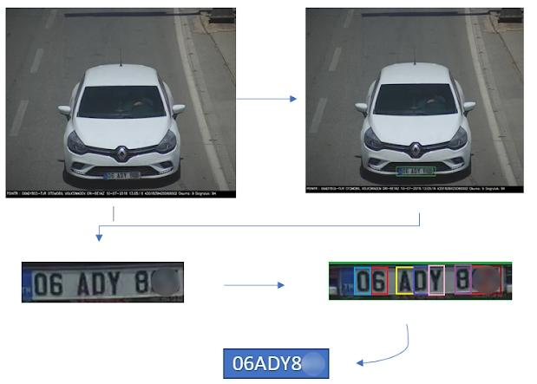
Problem
Plate location detection
Segmentation
Character recognition

Slide 7
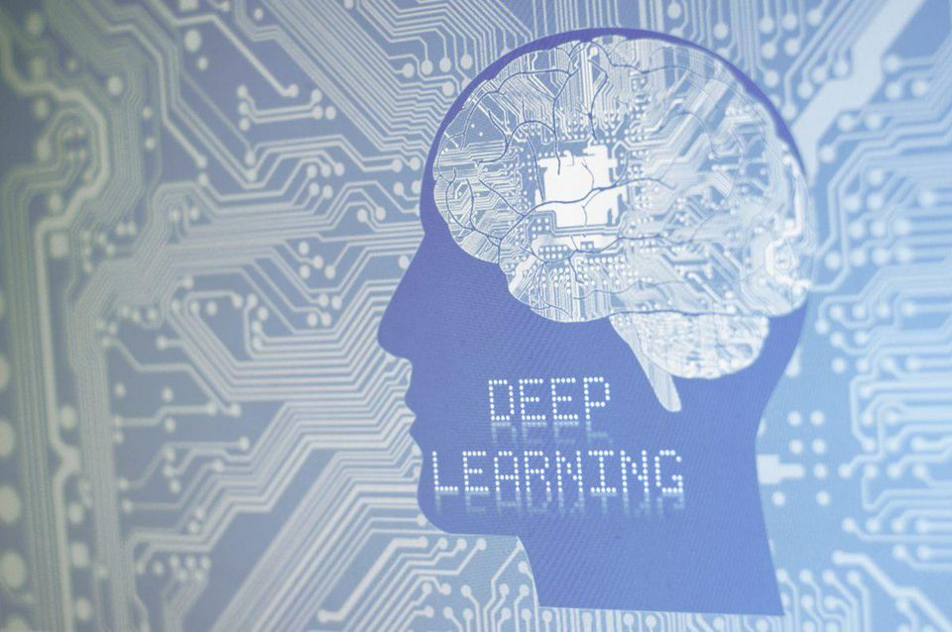
Solution
Source: Marr. B. (2018). What Is Deep Learning AI? A Simple Guide With 8 Practical Examples
https://www.forbes.com/sites/bernardmarr/2018/10/01/what-is-deep-learning-ai-a-simple-guide-with-8-practical-examples/

Slide 8





Technology Used
Python
Tensorflow
Keras
Flask
Angular.js

Slide 9
Potential Risk
Risk | Precautions | Potential Impact | Plan B | Priority
Problem in vehicle or plate detection | Testing algorithms. | System can not find plate. | Process image again. | High
Blurred, dark images | Upload correctly focused and illuminated images. | Characters can not read. | Apply image processing. | Low
Wrong character detection | Extend data set. | Inaccurate character recognition. | Process image again. | High
CPU overheating | Train dataset in smaller chunks | Damaging the CPU | Use Intel Movidius or upgrade CPU cooling hardware | High

Slide 10
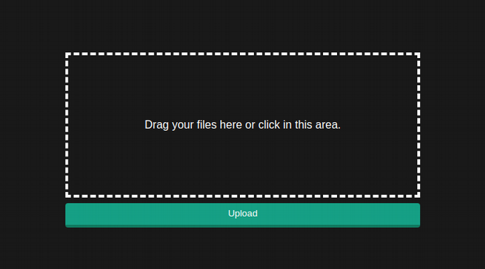
Application

Slide 11
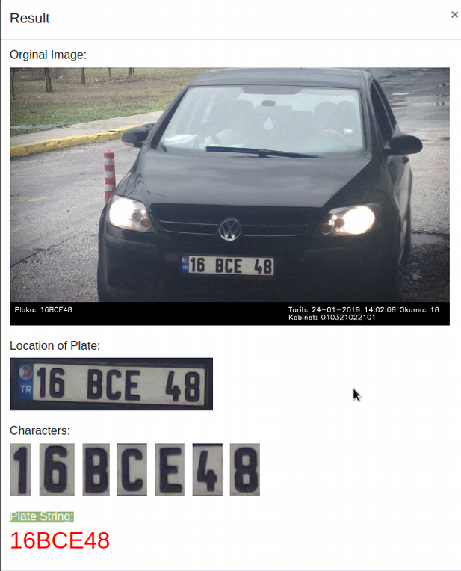
Application

Slide 12
Result
LICENCE PLATE RECOGNITION USING IMAGE PROCESSING | PLATE RECOGNITION USING DEEP LEARNING
Lower CPU cost | Higher CPU cost
Faster | Slower
Higher Accuracy Rate | Lower Accuracy Rate
Static solutions | Learning Solutions

Slide 13
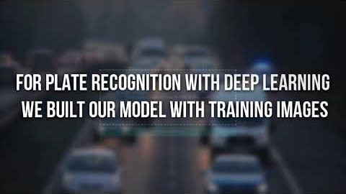
Demo
https://youtu.be/YaUnvP357KM

Slide 14
Acknowledgement
Prof. Dr. Erdoğan DOĞDU
Assoc. Prof. Dr. Reza ZARE HASSANPOUR

Slide 15


