Slide 1


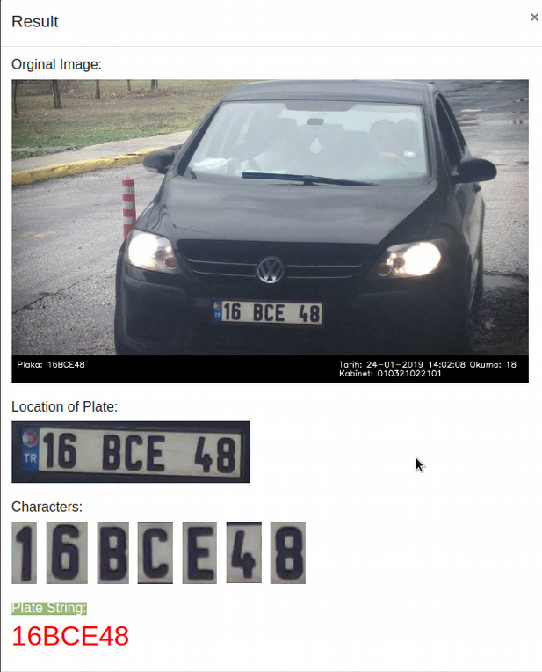
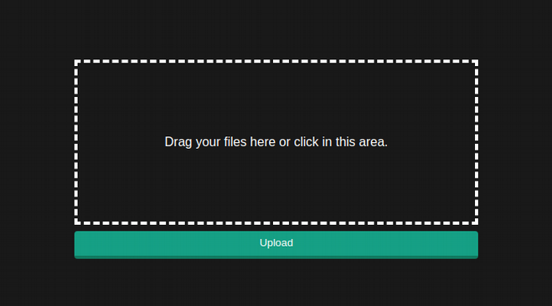

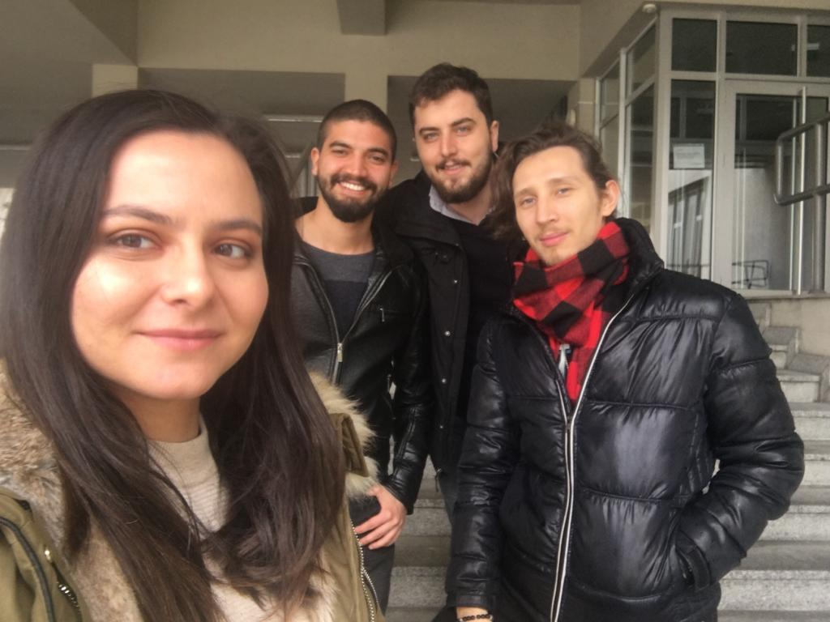

LICENSE PLATE RECOGNITION USING DEEP LEARNING
Mert Yumuşak – R. Kaan Varlı – Bengisu Şeyma Aydoğdu – Mert Sert
Prof. Dr. Erdoğan Doğdu
Doç. Dr. Reza Hassanpour
Çankaya University, Department of Computer Engineering
Abstract
Plate recognition systems are widely used around the world to produce automated running solutions in the field of traffic and security. These common systems bring complexity. Current license plate recognition systems use image processing, but deep learning has become the state of art in character recognition. The purpose of License Plate Recognition with Deep Learning is using deep learning techniques for character recognition instead of image processing techniques. Deep learning systems become better at performance as the data used over time increases. Image-based systems produce static solutions and are difficult to improve over time. This is the success of deep learning methods.
Company Info
Our project partner ISSD company, system design and integration in Turkey, digital signal processing, software development and is a company operating in the electronics design issues, companies in the digital circuit designs and application specific algorithms, starting with developing and developed all the software which ended with the transfer of embedded platforms the whole process is realized. ISSD also manufactures solutions for traffic management, dynamic junction control system, license plate recognition and electronic monitoring and develops products that are market leaders. Solutions for plate recognition and electronic monitoring are generally based on image processing algorithms. The image processing algorithms developed by the company consist of processes that require high processing power as in most image processing algorithms. In addition, other solutions within our knowledge on producing plate recognition systems company in Turkey are developing the system with the image processing methods.
Introduction
With the increasing number in vehicles, traffic problem has become a major part in our society. The traffic problem in the world is getting bigger, complexity rises despite the work on this field. There are many different areas of the work done with traffic in the world. Nowadays, the technologies that are in place can cause too much cost for plate recognition systems. Developing a dataset with Turkish plates for deep learning model, which is one of the sub-branches of data science, aims to decrease the CPU cost used in character detecting on Turkish plates and increase the accuracy rate and compare it with the image processing.
Results & Conclusion
Developing a plate recognition system using image processing and deep learning is relevant to each other. Both
relate to processing input data, but they have different mythologies. Image processing is a conventional method
that is better for high processing power. Image processing techniques can be used to increase the power of deep
learning methods. Deep learning is the most recent approach to its use in the world. It has better and faster
solutions for high processing power. It also has the ability to better estimate because it uses large data sets. The
biggest expectation in our project is that the system performance is sufficient for the user.
Figure 2 - Flowchart
Solution
In the current plate recognition systems, image processing algorithms are used. It requires very high processing power, but also the accuracy rate of the plates cannot always give the expected performance. It requires very high processing power, but also the accuracy of the plates cannot always give the expected performance. Developing a new approach to achieving higher accuracy rates with higher performance than existing systems by using deep learning techniques, which is the sub-study area of the widely used data sciences branch, is one of the main objectives of this project. In this project, we aim to compare the existing plate recognition systems with the deep learning-based plate recognition systems and to develop a low cost and high-performance plate recognition system.
Acknowledgement
We are grateful for guidance we have received from Prof. Dr. Erdoğan Doğdu and Doç. Dr. Reza Hassanpour. We received the biggest support and courage from our advisers. We are also grateful to help we received from ISSD Inc. They let us to use company’s data and helped us during the project.
Figure 3 – Finished Product
[ company logo ]
Figure 1 – Finished Product
Figure 4 – Project Members

