Slide 1



Mobile Assistant for Cryptocurrency Markets
Team Members:
Berkay ÇINAR
Bilge NAS
Celal ŞAHİN
Advisor:
Dr. Faris Serdar TAŞEL

Slide 2
Contents
Problem
Solution
Contribution
Workplan
Technology Used
Materials and Methods
Success Criteria
Outputs
Challanges
Future Work
Demo

Slide 3
Problem
Displaying accurate prices of coins
Support different stock markets
Extraction of profitable exchange chains
Keeping order books up to date

Slide 4
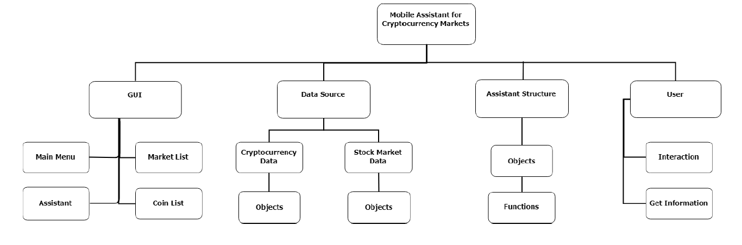
Solution
Building an application that assist users by providing updated values and exchange chains of cryptocurrencies.

Slide 5
Main Contribution
Users can access various stock markets within one application
Users can find different trading methods for a coin pair
It is a mobile app so you can access anywhere anytime
Plain and simple design

Slide 6
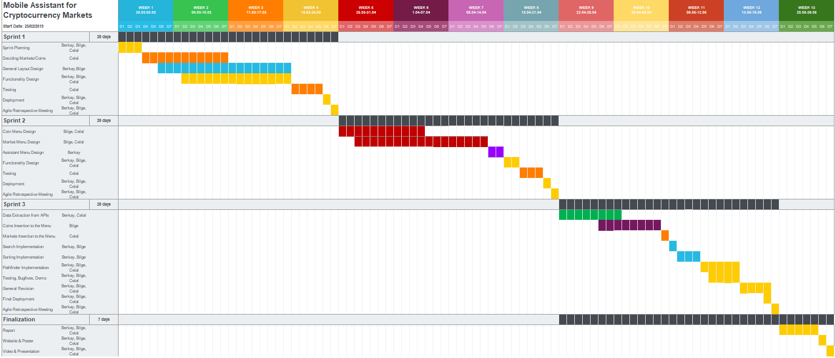
Workplan

Slide 7




Environment and Tools Used
Android Studio
NodeJS
React Native
Atom.io

Slide 8
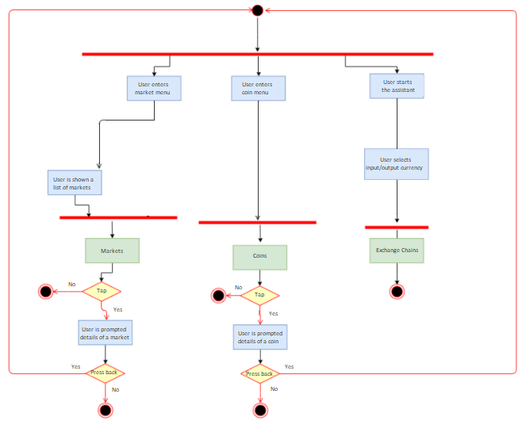
Materials and Methods

Slide 9

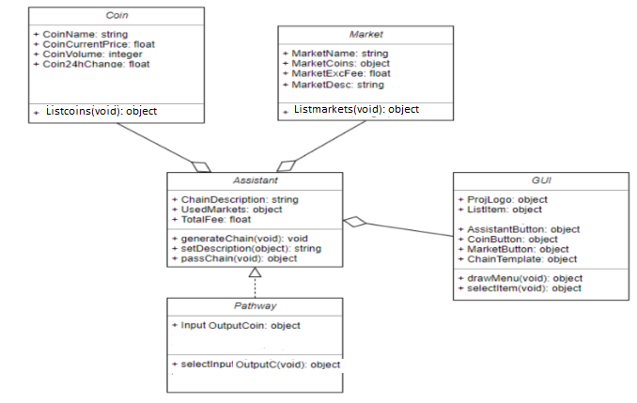
Materials and Methods

Slide 10
Success Criteria
Success Criterion | How to Measure
Efficiency of Exchange Paths | Checking if there are alternative routes in case a route is outdated
Accuracy of Prices | Checking prices from the market APIs directly
General Practicality | User feedbacks

Slide 11
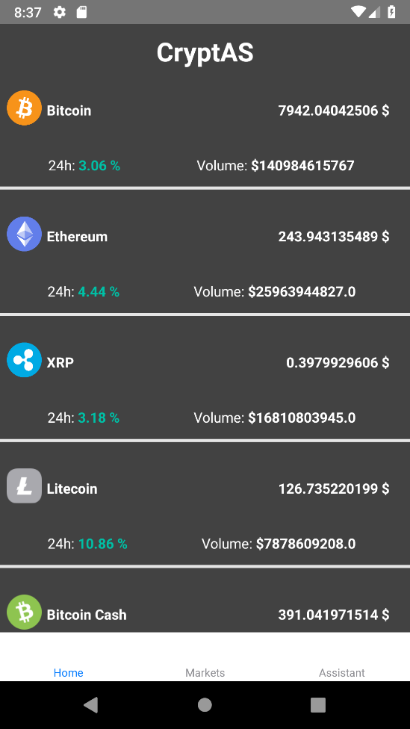
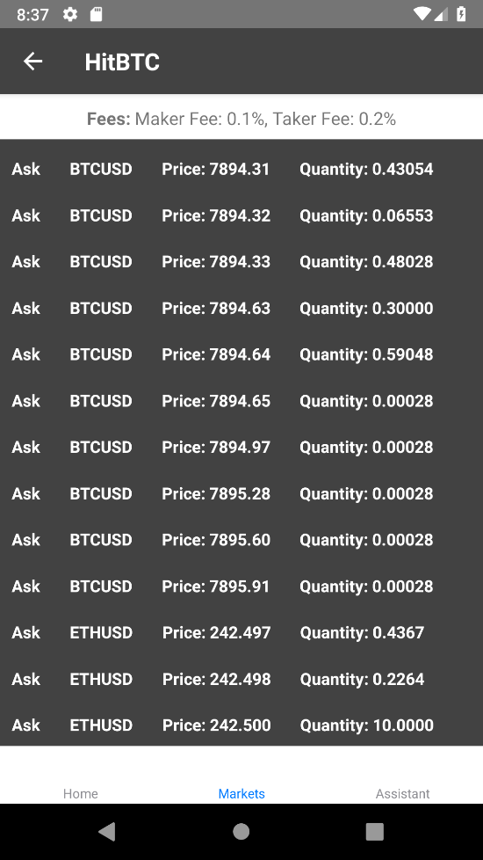
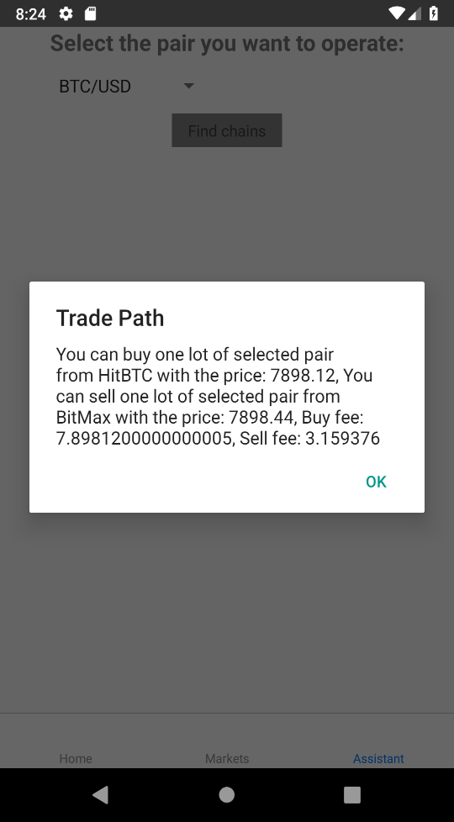
Outputs

Slide 12
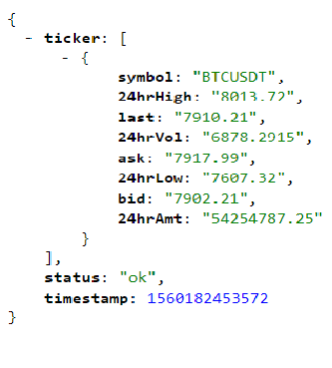
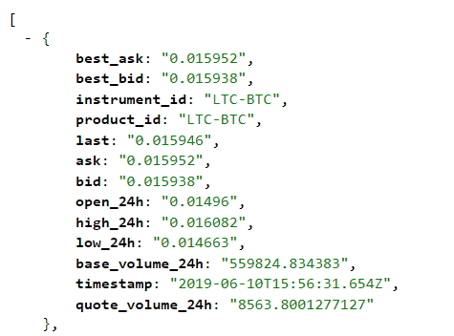
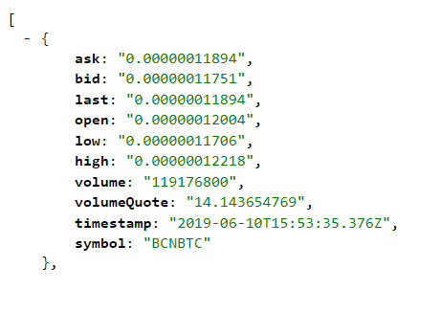
Challenges
Every exchange market has its own API
Some coin/market data are inaccessible via APIs
Not every coin pair are directly exchangable

Slide 13
Future Work
More markets can be supported
More coin pairs for assistant menu
Order books of different coins
More optimization

Slide 14
Project Demo

Slide 15
Thanks for listening!
Questions?

Slide 16
Mobile Assistant for Cryptocurrency Markets
A mobile application that gives insights for trading cryptocurrencies
Main Features
Track various cryptocurrencies
Search for coins in supported markets
Find profitable exchange chains
Responsive design
Works on Android environment

Slide 17

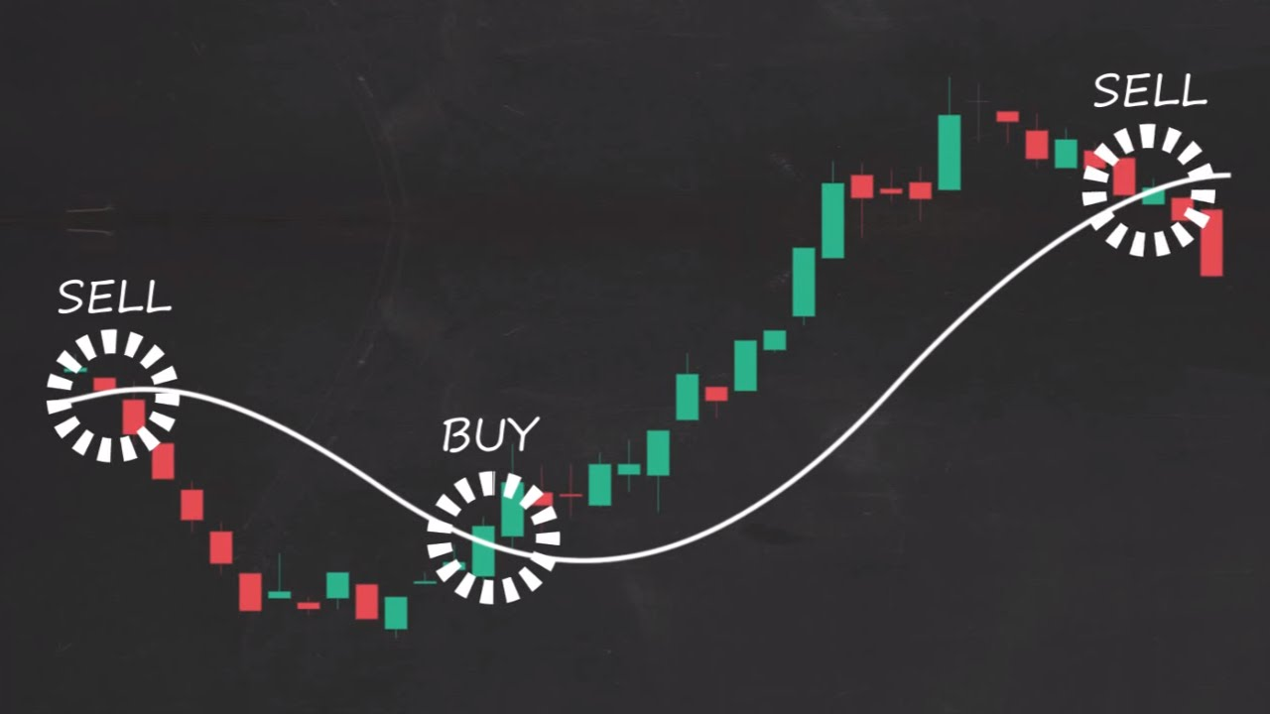
Cryptocurrency Trading
Exchange of cryptocurrencies
Buy/sell using real money and digital coins
More than 15000 markets

Slide 18
Previous Works
 | Blockfolio | Coinbase | CryptoAS
Platform | Android & IOS | Android & IOS | Android
Price sources | N/A | N/A | Various markets
Exchange Assistant | N/A | N/A | Available
Market Info | N/A | N/A | Supported coins and fee policies

Slide 19
Analysis
Mobile solutions for stock marketing
Using different algorithms for searching and AI
Continuous data flow with APIs
Pulling specific data from JSON files

Slide 20
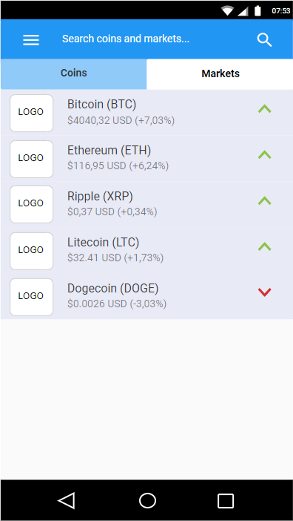
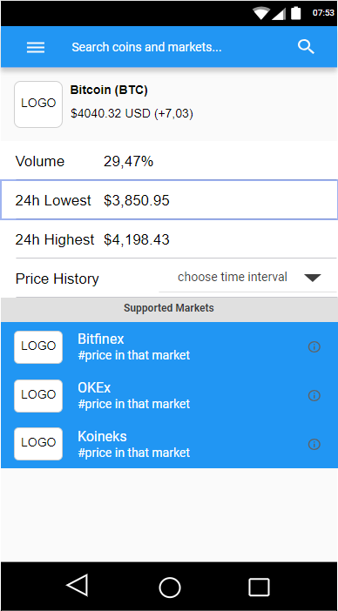
Design Concept

Slide 21
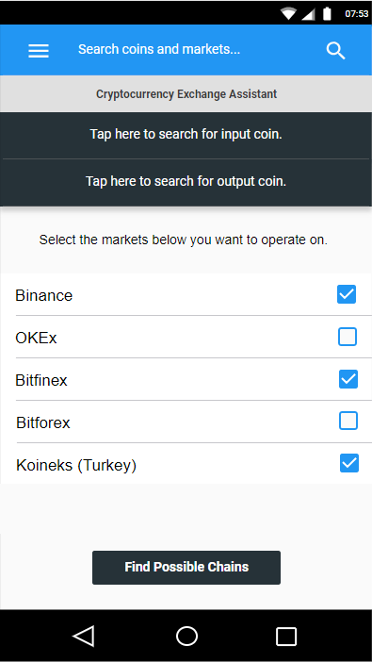
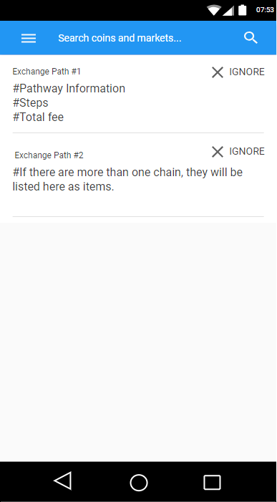
Assistant Design Concept

Slide 22
Results and Conclusions
Giving a simple and effective application for cryptocurrency and stock market enthusiasts
Bringing the chance to search through coins and markets easily
Assisting the users with giving them exchange paths for a coin pair

