Slide 1



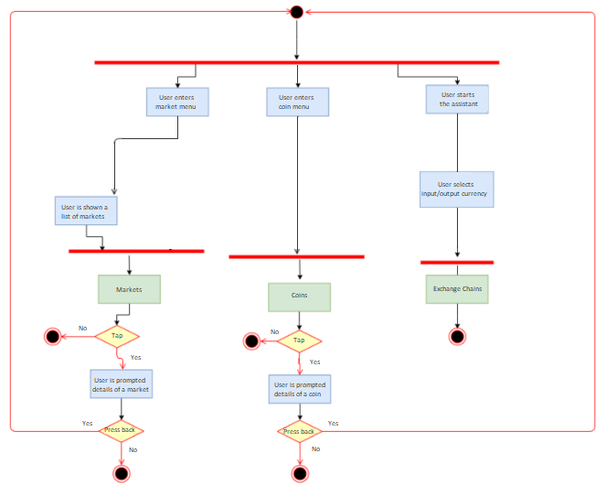
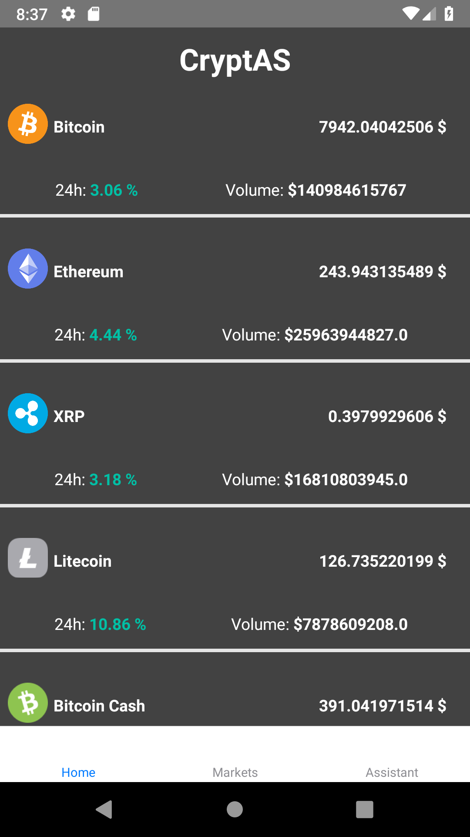
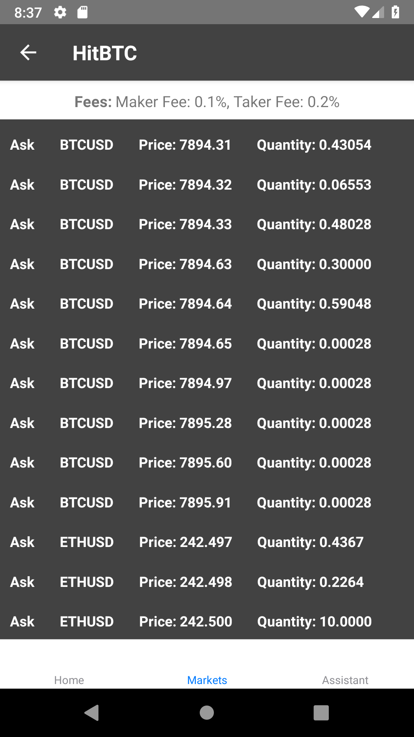
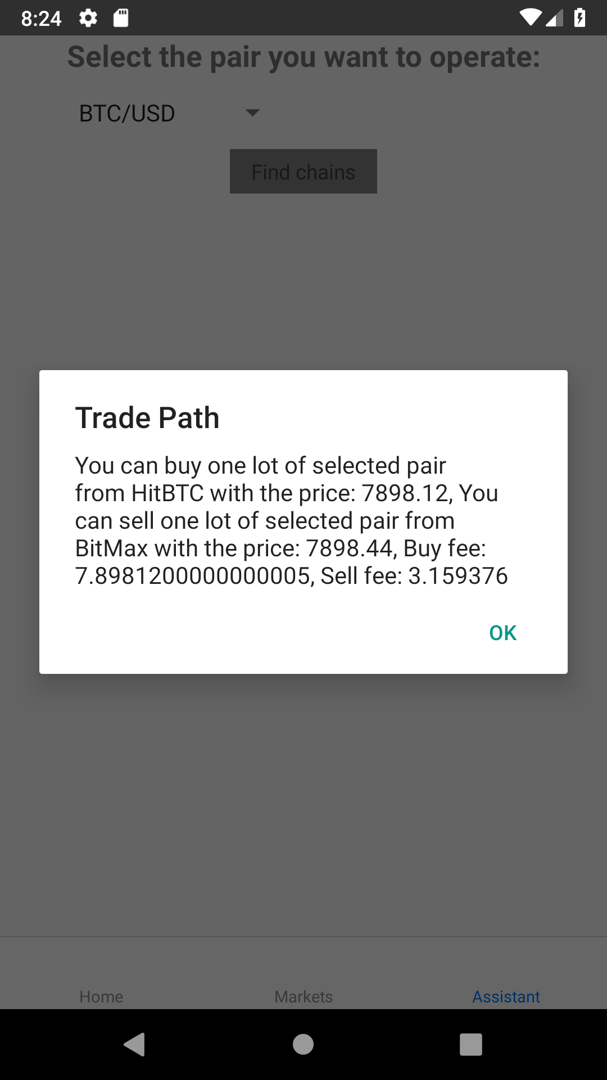
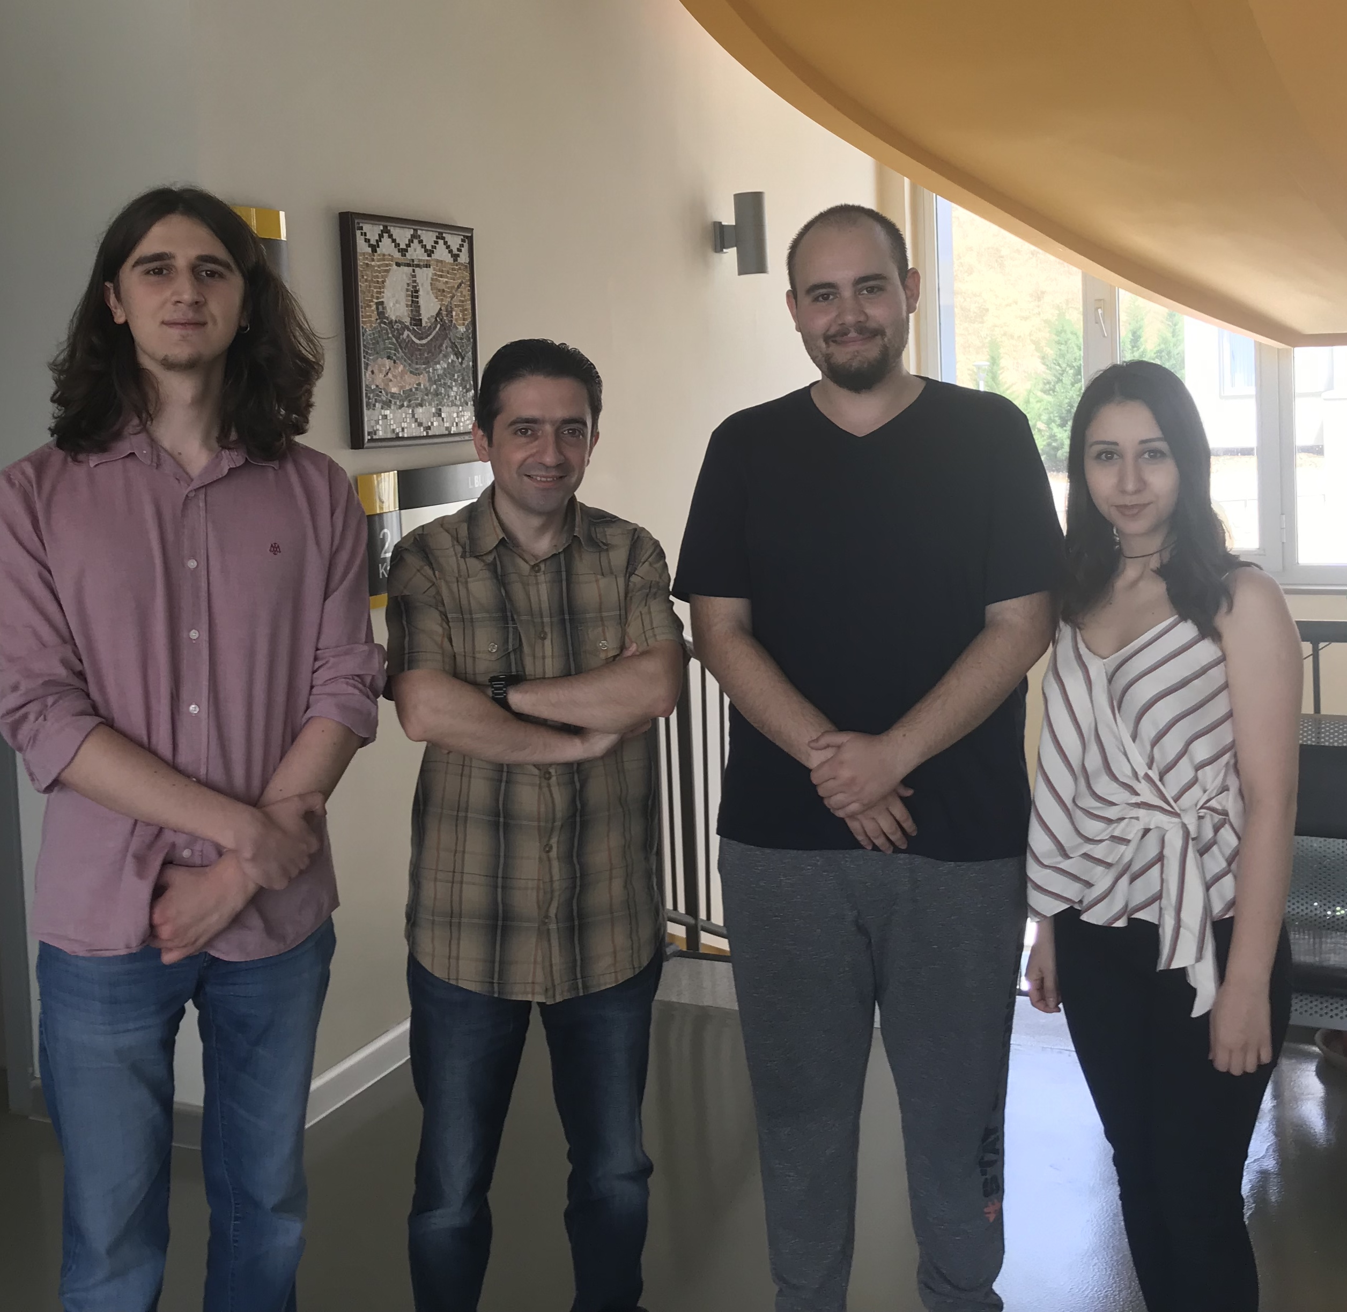
Mobile Asistant for Cryptocurrency Markets
Berkay ÇINAR – Bilge NAS – Celal ŞAHİN
Advisor: Dr. Faris Serdar TAŞEL
Çankaya University, Department of Computer Engineering
Abstract
The goal of our project is to develop a mobile application to assist users to track about their favourite crypto coins, track about the stock markets. To do so, this application suggests best coins to invest in by giving the user details (prices, fees etc.) about crypto coins fetched from various cryptocurrency markets.
Keywords:Android Development, Cryptocurrencies, Stock Market
Solution
Project aims to develop on React Native and NodeJS. We will build the front-end with React Native. This application will give insights about crypto coins, gives valuable information to who has interest in cryptocurrencies.
Our application helps users to track different cryptocurrencies from various markets. This will assist investors to have them realize what is the current situation of specific coin. One of the main features of the project is assistant. Assistant will work when the user selects input/output currency. After selection, user will tap “Find Possible Chains” button to see the most profitable exchange paths. Crypto coins’ values change quickly so, best chains may be change rapidly.
Introduction
Cryptocurrencies emerged into our lives because of the blockchain technology. These various coins build up the stock markets for digital currencies. As a result, people start to invest into these coins to make profit. Different stock markets entered to the field of trading. This investment in crypto coins got more popular as time passes.
Figure 1 – Activity Diagram
Results & Conclusion
This report contents detailed information about Mobile Assistant for Cryptocurrency Markets. In this project, our main goal is to help people who have interest in cryptocurrencies with mobile application by tracking different crypto coins from various stock markets. Our environment is the Android and we have planned to use React Native as a front-end and NodeJS as a back-end development tools.
Acknowledgement
We would like to express our appreciation to our advisor Dr. Faris Serdar Taşel because of his guidance and assistance. We improved with the project thanks to his valuable advices.
Figure 2 – Finished Product

