Slide 1




Mobile Assistant for Cryptocurrency Markets
Team Members:
Berkay ÇINAR
Bilge NAS
Celal ŞAHİN
Advisor:
Dr. Faris Serdar TAŞEL

Slide 2
Contents
Definiton
Problem
Previous Works
Analysis
Workplan
Materials and Methods
Solution
Design Concept
Results and Conclusion

Slide 3
Mobile Assistant for Cryptocurrency Markets
A mobile application that gives insights for trading cryptocurrencies
Main Features
Track various cryptocurrencies
Search for coins in supported markets
Find profitable exchange chains
Responsive design
Works on Android environment

Slide 4
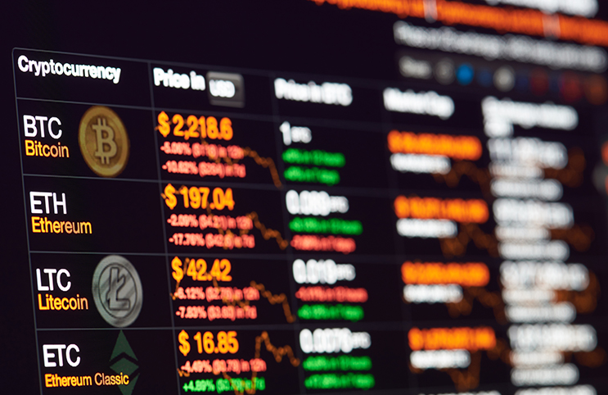
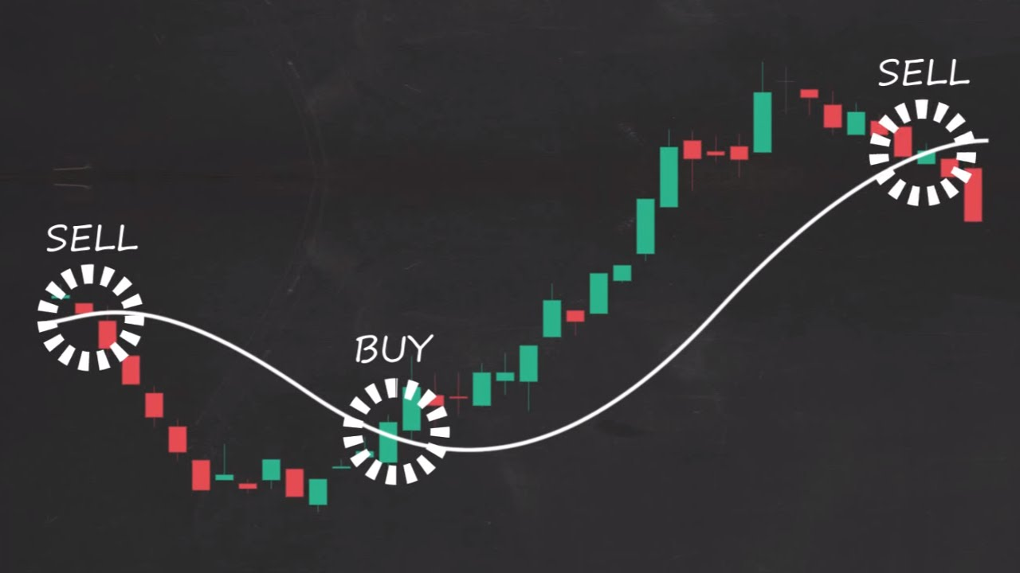
Cryptocurrency Trading
Exchange of cryptocurrencies
Buy/sell using real money and digital coins
More than 15000 markets

Slide 5
Previous Works
 | Blockfolio | Coinbase | CryptoAS
Platform | Android & IOS | Android & IOS | Android
Price sources | N/A | N/A | Various markets
Exchange Assistant | N/A | N/A | Available
Market Info | N/A | N/A | Supported coins and fee policies

Slide 6
Problem
Displaying accurate prices of coins
Support different stock markets
Extraction of profitable exchange chains
Keeping order books up to date

Slide 7
Analysis
Mobile solutions for stock marketing
Using different algorithms for searching and AI
Continuous data flow with APIs
Pulling specific data from JSON files

Slide 8
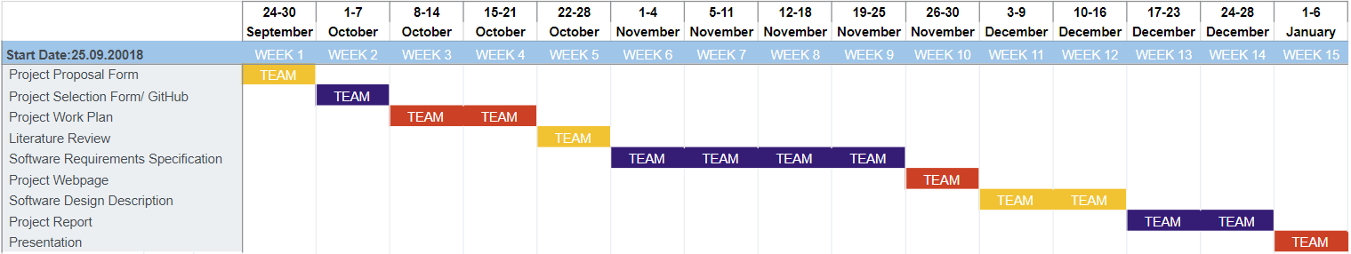
Workplan

Slide 9
Success Criteria
Success Criterion | How to Measure
Efficiency of Exchange Paths | Checking if there are alternative routes in case a route is outdated
Accuracy of Prices | Checking prices from the market APIs directly
General Practicality | User feedbacks

Slide 10
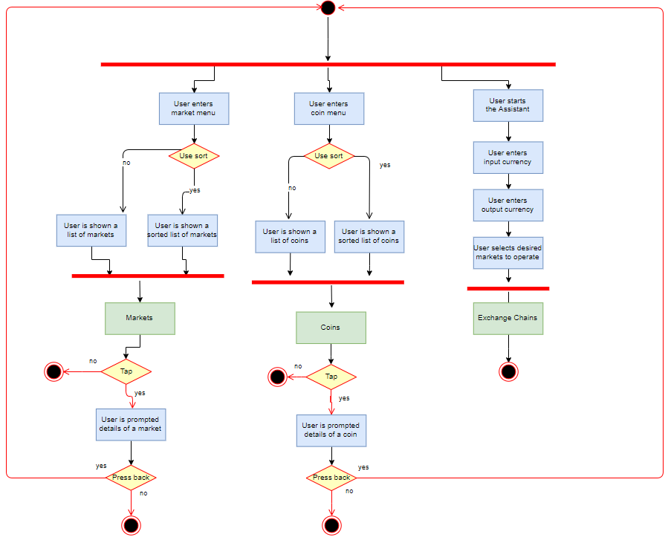
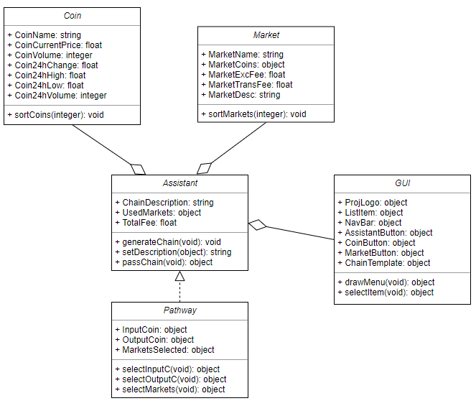
Materials and Methods

Slide 11
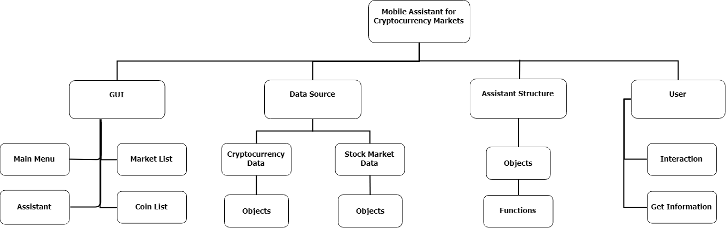
Solution
Building an application that assist users by providing updated values and exchange chains of cryptocurrencies.

Slide 12




Environment and Tools Used
Android Studio
NodeJS
React Native
Atom.io

Slide 13
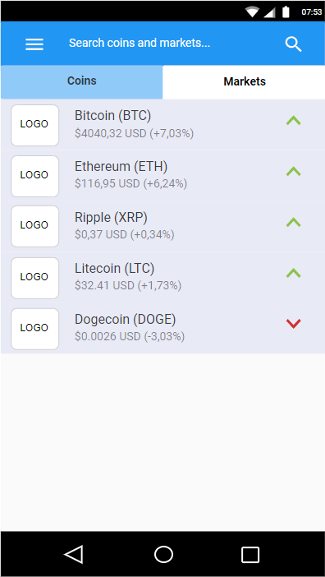
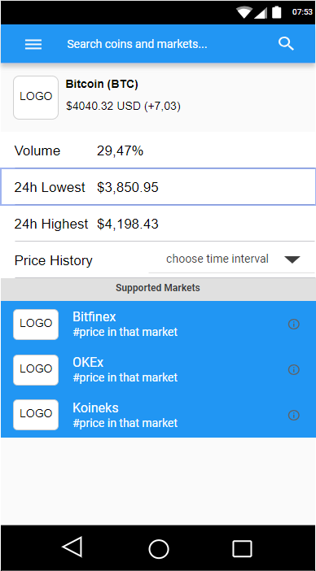
Design Concept

Slide 14
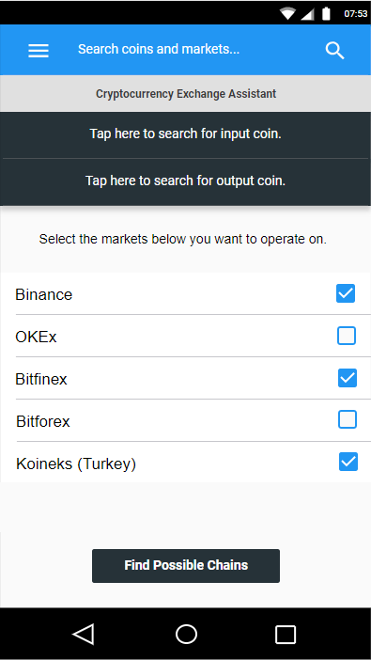
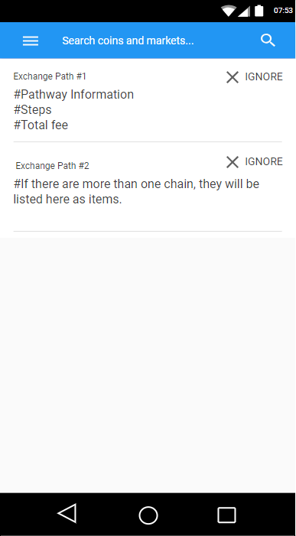
Assistant Design Concept

Slide 15
Results and Conclusions
Giving a simple and effective application for cryptocurrency and stock market enthusiasts
Bringing the chance to search through coins and markets easily
Assisting the users with giving them exchange paths for a coin pair

Slide 16
Thanks for listening!
Questions?

