Slide 1

Multı-label classıfıcatıon of news text
Team Members
Can Koral ADALI 201411002
Bihter ÖZUÇAK 201411048
Miray PADIR 201411050
Kardelen YILDIRIM 201311060
Advisor
Prof. Dr. Erdoğan DOĞDU
Co-Advisor
Asst. Prof. Dr. Roya CHOUPANI

Slide 2
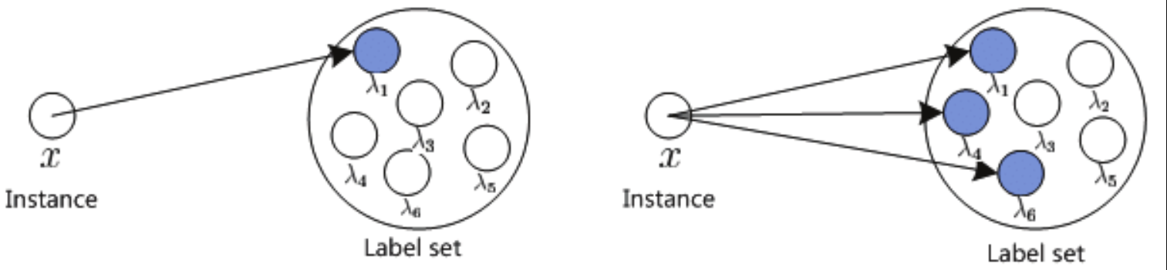
PROJECT DEFINITION
A website that can multi-label the given Turkish text documents by analyzing them with deep learning methods.
Multi-labeling the text document by given model.
Compatible with every web browser that can run JavaScript.
Multi-class and Multi-label

Slide 3

Maın features
Multi-label the given text document(s) in a short time.
Accuracy on given labels regarding success on models.
It can analyze one or many given text documents depending on upload.

Slide 4

PROBLEM
Many digital documents everywhere over the internet.
Manual labeling with subjects (labels) is difficult, even impossible.
An intelligent tool is needed for automatic labeling.

Slide 5
METHODS & TOOLS
We will apply deep learning methods. Such as Lda2vec and Word2vec with using Python.
System will use given news datasets for deep learning methods. So that, system can use it and create models.
System will try and find the best model for the given news text document(s) so that it can give better accuracy for labels to classified document(s).

Slide 6
METHOD COMPARISON

Slide 7
METHOD COMPARISON
Method Name | Pros | Cons
word2vec | A scalable model that generated word embeddings for large corpus (millions of unique words). | Word sense is not captured separately.
TF-IDF Vectors (N-gram) | Computationally efficient | Lack of generalization: [ride a horse], [ride a llama], [ride a zebra]
SVM | Works well with small datasets | Learning can take a very long time for large scale-problems
LDA | Fast classification Easy to implement | Training time Complex matrix operations
lda2vec | By providing an additional context vector in this model, it is possible to make better guesses of context words. | The downside of this approach is that the context/paragraph vectors resemble typical word vectors, making them less interpretable as, for example, the output of LDA.

Slide 8
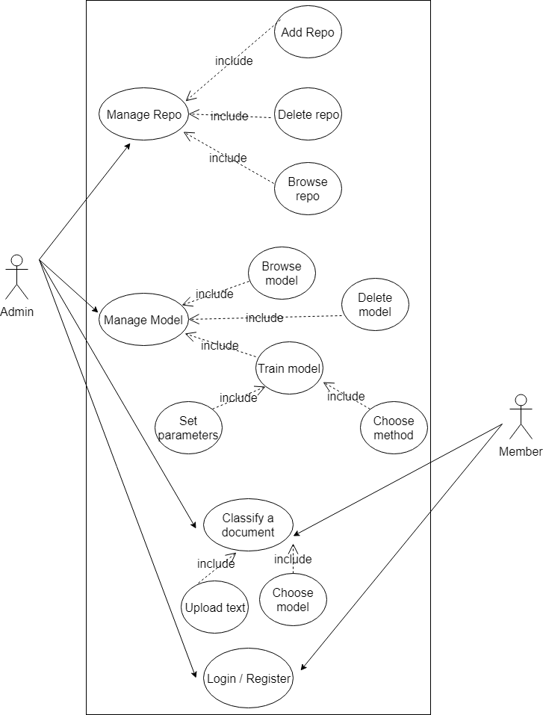
Use Case OF THE SYSTEM

Slide 9
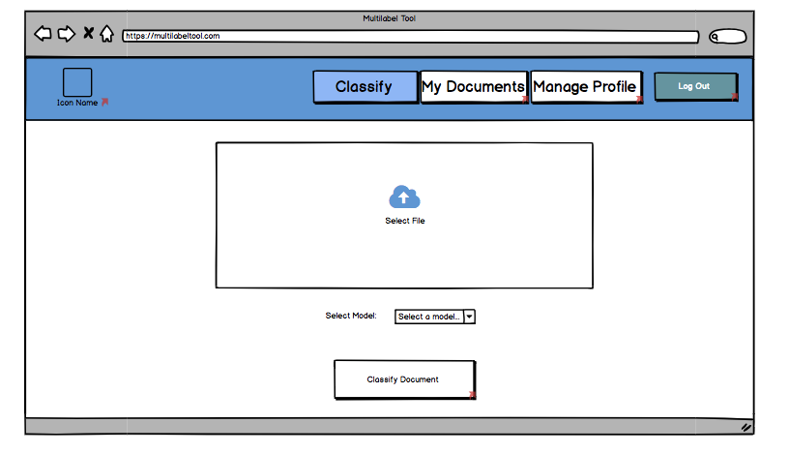
User Classıfy Interface

Slide 10
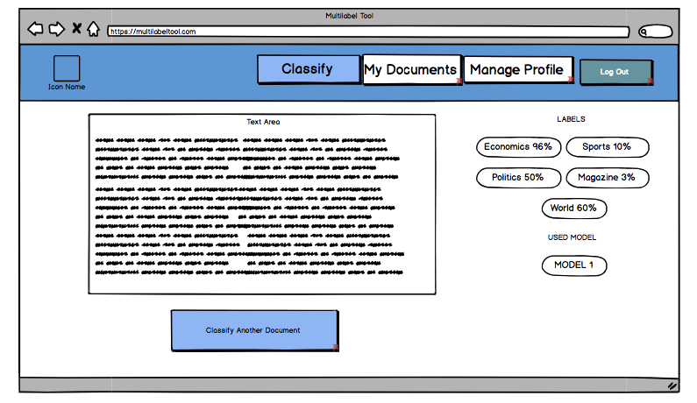
User Result Interface

Slide 11
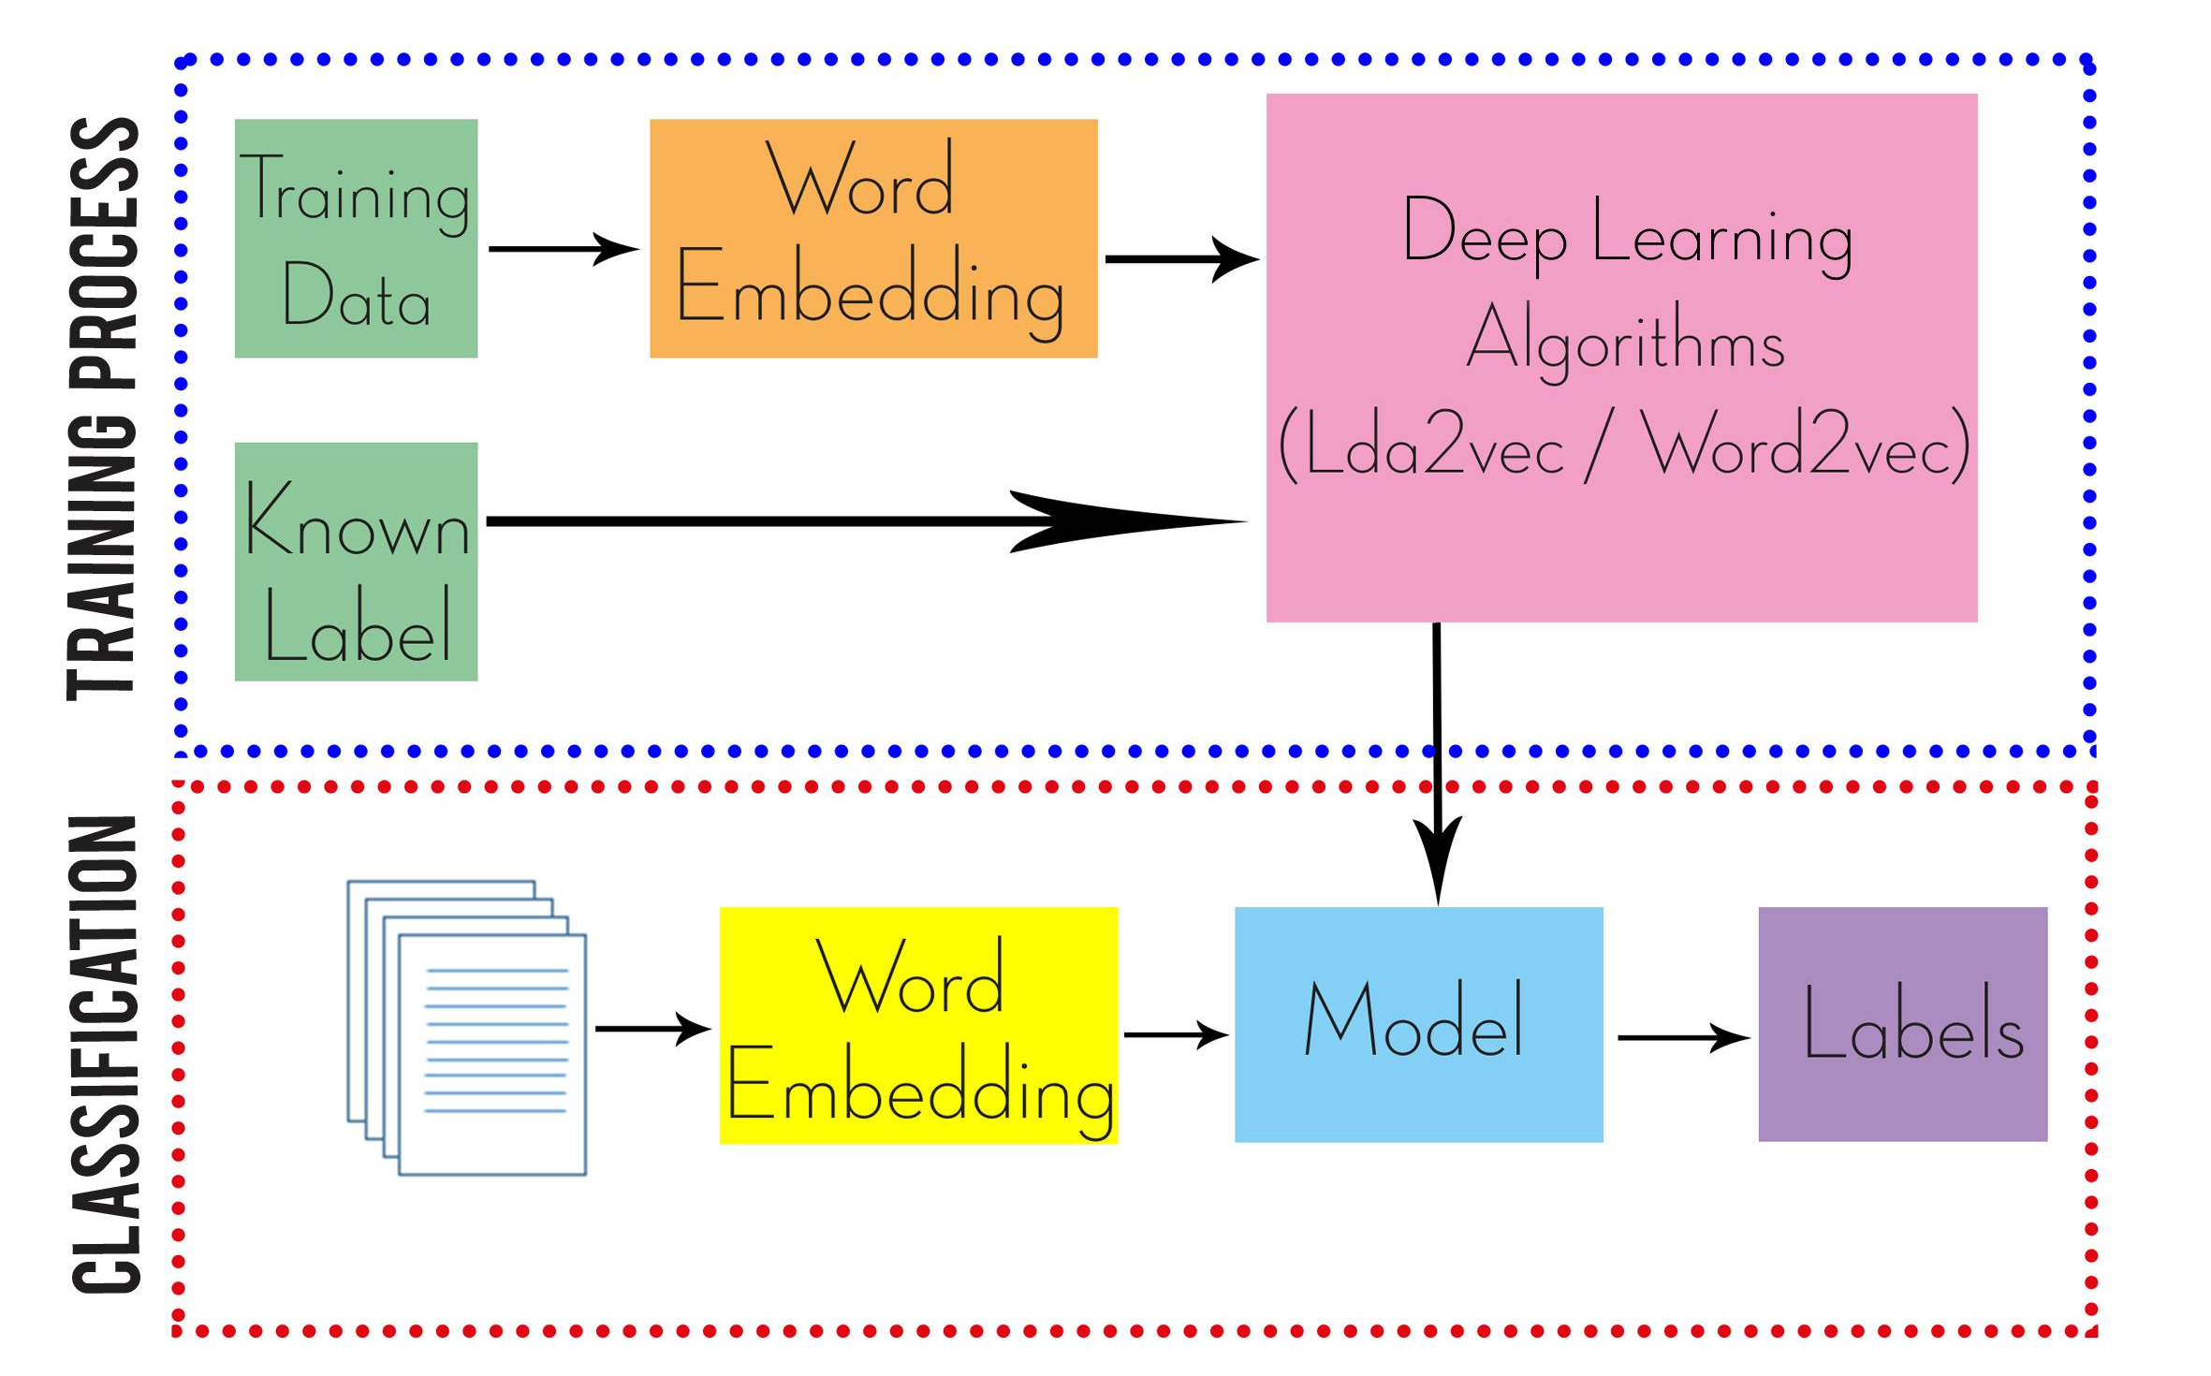
proposal

Slide 13
REFERENCES
Yaghoobzadeh, Y., Kann, K., & Schütze, H. (2018). Evaluating Word Embeddings in Multi-label Classification Using Fine-grained Name Typing. arXiv preprint arXiv:1807.07186
A. Clare and R. D. King, “Knowledge Discovery in Multi-Label Phenotype Data,” in: Lecture Notes in Computer Science. Springer,2001.
Auria, L., & Moro, R. A. (2008). Support vector machines (SVM) as a technique for solvency analysis.
Mohammad, A. H., Alwada’n, T., & Al-Momani, O. (2018). Arabic text categorization using support vector machine, Naïve Bayes and neural network. GSTF Journal on Computing (JoC), 5(1).
van Meeuwen, F. W. (2013). Multi-label text classi? cation of news articles for ASDMedia (Master's thesis).
.
.
.

Slide 14
ACKNOWLEDGEMENT
Prof. Dr. Erdoğan DOĞDU
Asst. Prof. Dr. Roya CHOUPANI

Slide 15
THANK YOU FOR LISTENING SUGGESTIONS?

