Slide 1
Mega Reji
A gamified mobile application framework for stage management system
İsmail Berkcan GÜLTEN
Arzu KAYA

Slide 2
Contents
Mega Reji
Gamification
Problem
Similar Projects
Work Plan
Methods
Solution
Planned Work
Acknowledgement
References
Company Information

Slide 3
Company Information
UTRLAB is a Human Computer Interaction (HCI) expert with user
experience research and design experience.
Founded in 2008.
Active Working Areas
◦E-commerce
◦Mobile Applications
◦Defense Applications
UTRLAB services include:
◦Advanced Usability testing
◦User Interaction research
◦Human Computer Interaction Services

Slide 4
MEGA REJİ
A film production application that involves gamified system for whole film production team.
Communication with each other, writing scenario, scheduling etc.
Compatible with website and mobile devices.
Main Features
Contact with each other instantly
Make arrangements on schedule
Deal with instant changes

Slide 5

Gamification
Gamification is becoming a popular and significant technological progress in work life.
Gamification is the using game design items in non-game environment [1].
The study of incentive mechanisms (i.e. reward system)

Slide 6
Gamified System Examples
Foursquare and Swarm
Bana Bak
Scrumknowsy
Nike +

Slide 7
Problem
By development in technology, companies has started to use technology in their work life.
In film production the main problem is tendency of work to be complicated, because there are lots of level in film production groups.

Slide 8
Similar Projects
Virtual Callboard [2] | Yamdu [3] | Edictive [4] | Setkick [5] | Studio Binder [6]
Announcements: Post an announcement for a specific production or entire site. | Announcements: Create announcement for all crew in order to inform them. | Dashboard: Visually track the project and individual work; introduce gamification through project status to the teams work.
 | Call Sheets: Users generate their daily call sheets using data they already created in pre-production and distribute them automatically. | Call Sheet Calendar: Users can deliver their call sheet digitally and receive confirmation of who has and has not seen it. | Call Sheets: Users Generate a digital callsheet for each day of production from your stripboard. | Call Sheets: Mobile and tablet
Send notes and e mail: Send notes individuals or groups of users at the same time. |  | Internal & External Messaging: Users can collaborate effortlessly with their crew, stakeholders easily.
Forum discucssions: People can post a topic of discussion, attach files or images. | Tasks: Assign trackable tasks to departments, crew members, and/or yourself. | Task and Scheduling: Schedule then allocate tasks and milestones for your crew and colleagues on the project. Visually track progress. |  | Task& Calendar: Users can use production calendar easily by clicking and dragging events.
File sharing: User can share file with entire production or departments, also user can create folders in order to organize the files. | Document Management: Stores all files in one place and accessible from anywhere, anytime. |  | Script Import: Users can easily import script in PDF format. | File Sharing: Studio Binder provides a cloud for file sharing and storing. Users can upload their files and other users can access these files.
Scheduling Calls: Organize, publicize, and track individual and production schedules. | Project Calendar: Easily invite specific crew members or departments to events and meetings, like PPMs, etc. | Calendar: A schedule calendar of your entire project with tasks, milestones and call sheet dates and durations.
Track attendance: Managers can calculate the number of hours worked by each person in a given week. | Shooting Scheduling: Scheduling with scene numbers, roles, short synopsis, estimated shooting time, etc. Also, users are able to connect their shooting schedule with their production schedule so that they are constantly synchronized. |  |  | Shooting Schedules: Users can create their professional shooting schedule with an elegant drag-and-drop stripboard interface.

Slide 9
Virtual Callboard | Yamdu | Edictive | Setkick | Studio Binder
 | Production Scheduling: Create and evaluate different production scenarios.
Creating customized report template: File a report and report editing | Breakdowns: Each department should knows needs and contributes the breakdowns part. | Script: Script writer can write scenerio and link to his/her production cast, crew, locations etc. Right from the script. | Sheet Breakdown: Setkick provides to users complete set of breakdown and stripboarding tools built right inside their browser. | Script Breakdowns: Import scripts and tag elements like props and wardrobe.
 | Financing: Easily create unlimited financing scenarios, keep track on deadlines for fundings, and manage contracts and deliverables for your partners. | Budget: User can track production budgeted to the user’s actual production spend.
Contact Sheets: Create and print customized contact sheets. |  |  |  | Contact List: Manage and send messages to talent, crew, vendors, clients and more.
User Management: Each user has username and password. | Crew Management: Generate contact lists and reach crew and its contact information. |  | Crew Management: Manager can access cast and crew contact information easily. | Cast and Crew Management: Make film crew lists of potential hires, cast auditions, or favorite production crew by department.
Multi- Production Management | Casting Database: Collect, present, discuss and select cast members for all roles of project and distribute important information. | Portfolio and Management: Manager can assign user roles to all his/her account users giving everyone only the level of access they need.
Archive | Costumes
 | Makeup
 | Location Scouting: Users make location proposals accessible to the crew, to get valuable input. |  | Location: Setkick provides a map for choosing a location.
 | Props Management

Slide 10
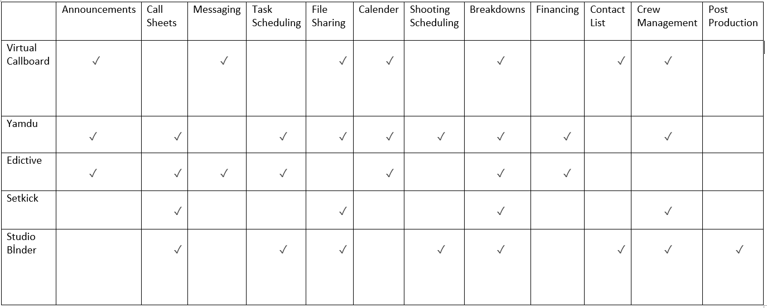
Table 1: Comparison of main features of similar projects

Slide 11
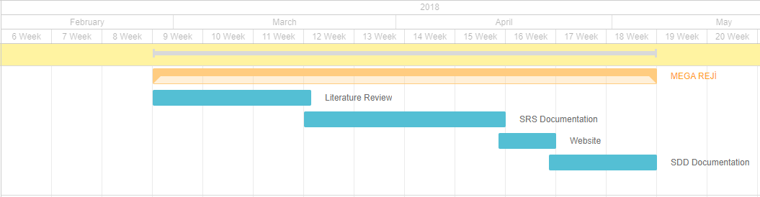
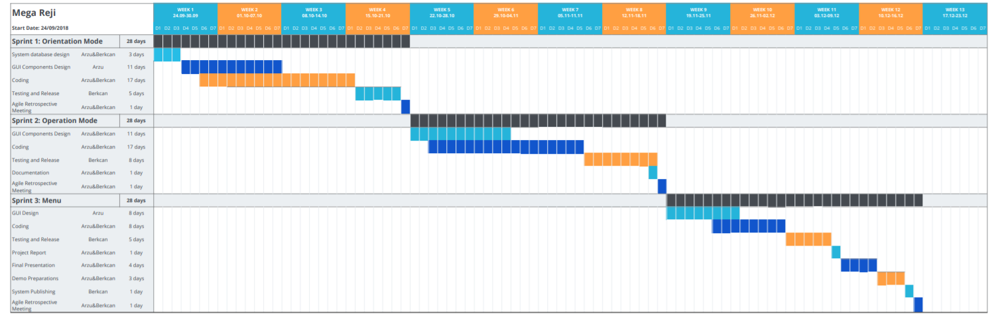
Workplan
Our Gannt Chart
Our Planning Gannt Chart

Slide 12
Research Process
System Analysis Requirements
Preliminary System Architecture
Apply Gamification to System
Releases
Release 1 (Preliminary Product)
Release 2 (Gamified Product)
Release 3
User Study
Final Release
20- 30 Participant Group
Tobii

Slide 13
Solution
Mega Reji aims to create an environment which has adaptation, comprehensiveness and usefulness by gathering all features of previous applications.
Participants are incentivized to fulfill their tasks during film
production.

Slide 14
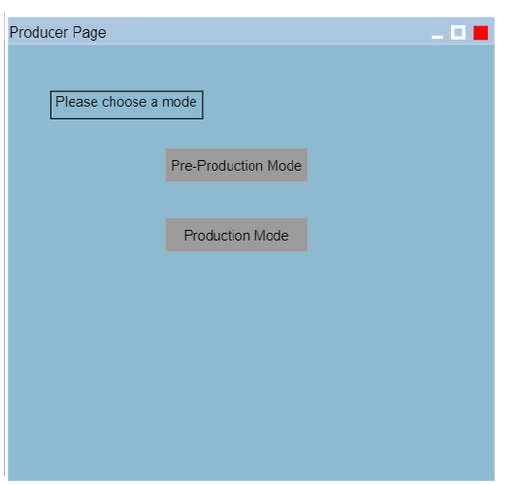
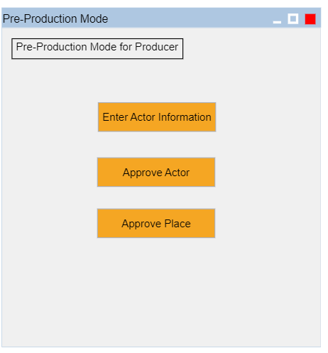
Planned Work

Slide 15
Acknowledgement
Dr. Murat YILMAZ
Dr. Ali BERKMAN

Slide 16
References
[1]. S. Deterding, D. Dixon, R. Khaled, L. E. Nacke, Gamification: Toward a definition, 2011, p.2
[2]. VirtualCallboard. [online] Available at: http://www.virtualcallboard.com [Accessed 25 Feb. 2018].
[3]. The production management software for films and media. [online] Available at: https://yamdu.com [Accessed 25 Feb.. 2018].
[4].Edictive. Film & Video Production Management Software Application. [online] Available at: http://edictive.com [Accessed 25 Feb. 2018].
[5]. Setkick. Setkick - Beautifully simple production management for film & TV. [online] Available at: https://setkick.com [Accessed 25 Feb. 2018].
[6].StudioBinder. StudioBinder: Project Management for Video Professionals. [online] Available at: https://www.studiobinder.com [Accessed 25 Feb. 2018].
[7]. Utrlab.com. (2018). UTRLAB | UX and Design. [online] Available at: http://www.utrlab.com/?lang=en [Accessed 28 May 2018].

Slide 17


