Slide 1


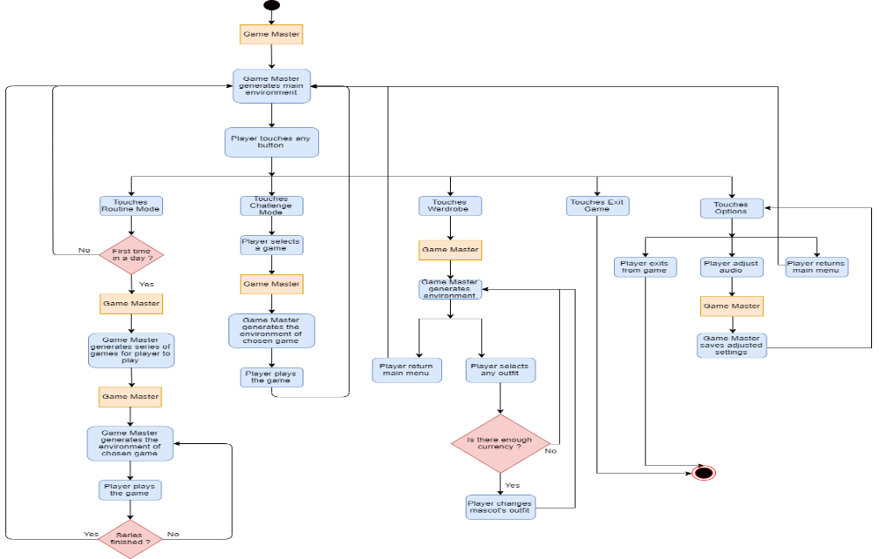
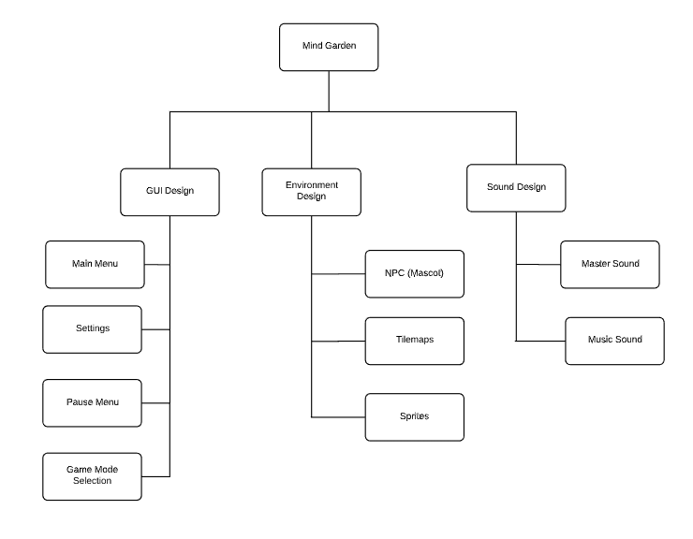
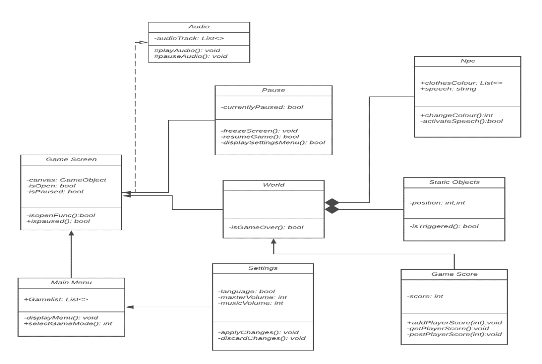
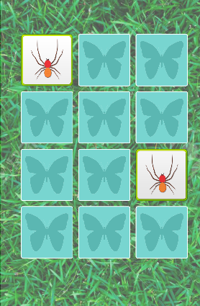
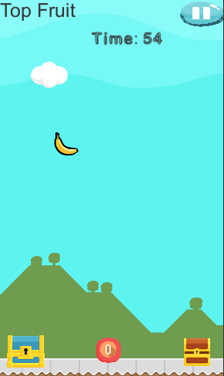
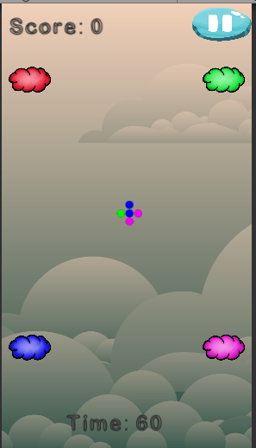
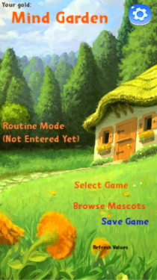

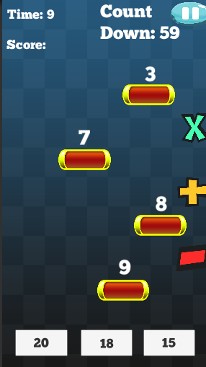



MIND GARDEN: A Serious Game to Improve the
Specific Fields of Child Intelligence
Ali Kaan GÖKSU– Emre KASAR
Eyüp TAŞKIN- Kazım Ataol ÖZÜSEVEN
Advisor: Assist.Prof.Dr. Murat SARAN
Çankaya University, Department of Computer Engineering
Abstract
Technology is developing day by day and its use to help to learn is becoming more widespread. "Mind garden" aimed to teach while having fun. It aims to improve the specific fields of child intelligence by playing games. Namely, visual intelligence, kinesthetic intelligence, analytical intelligence, etc. Mind garden has a screen timer to avoid children's waste of time. Also, It has adaptive difficulty to keep children's attention. Mind garden developed for mobile devices to increase usability. We aim to create an entertaining yet instructive environment to keep children’s attention in both education and entertainment.
Keywords : mobile games, educational games, child intelligence
Figure 1 – Activity Diagram
Introduction
The problem with the education system is that it is not always fun, and it shouldn't, but this contradiction creates a dull environment for those who need the most children. Lack of attention they gave to education makes the concept not efficient and loses its purpose.
Figure 3 – Use case realizations
Solution
We believe entertainment is a solution to this problem. The primary target group was preschool- and young children, with a focus on reading, mathematics, and science. We aim to create a series of serious games and collect them on one platform to improve children's mindsets. The reason for creating multiple games is to reach out to multiple attributes of a child mentality and improve them at the same time efficiently and enjoyable.
Figure 2 – Class Diagram
Figure 7 – Finished Product
Results & Conclusion
Education life could be difficult. Everyone has a different approach to different lectures. To make these approaches more confident, making people adapt and improve their mental attributes is very promising for finding their learning style and adapting education life. Mind Garden can be a small game platform at the start, but it has an endless development process. New games and new learning styles will appear as humankind gets bigger and better. Mind Garden is an adaptable, never-ending software application that will extend its capabilities as it extends children’s capabilities.
Figure 4 – Finished Product
Acknowledgement
We are grateful for guidance we have received from Assist. Prof Dr. Murat SARAN. The help we received from him was a great asset to improve this project and ourselves.
Figure 6 – Finished Product
Figure 5 – Finished Product
Figure 8– Project Members

