Slide 1



Ankades Educational Social Sharing Platform
Nihan Nur AYDIN Buğra Ahmet ÇAĞLAR Furkan Anıl ERDEM
Advisor: Nurdan SARAN

Slide 2

Contents
Project Description
Problem Statement
Literature Review
Web Based Learning
Solution
Used Technologies
Results and Conclusions
Ankades Educational Social Sharing Platform General Structure

Slide 3

Ankades Educational Social Sharing Platform Project Description
Ankades Educational Social Sharing Platform is a platform that aims to provide web based learning education to users.
Why is so important ?
The system generally aims to participate in an organized learning experience.
This e-learning system can be used on the Web.
DESCRIPTION

Slide 4

PROBLEM STATEMENT
We define problems as follows:
Accuracy of information,
Ease of access to requested information,
Lack of Turkish resources,
Ethics of information accessed,
The ban on access to certain websites in Turkey.

Slide 5
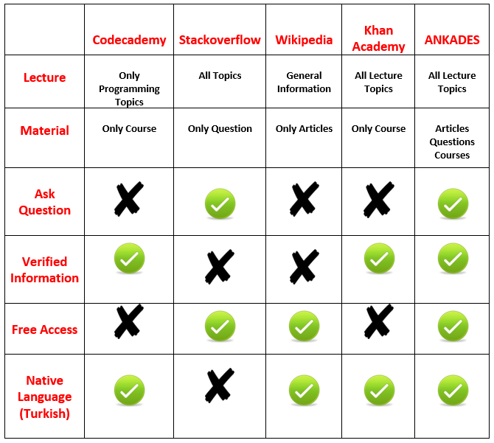
Literature Review

Slide 6
Disadvantages
The accuracy and quality of information may vary. Current and clean environment is needed.
Social isolation
Sharing control
Advantages
To be able to use many different course materials
Fast access to resources
Can encourage independent and active learning
Provides additional resources for learning
WEB BASED LEARNING

Slide 7
Solution
Accuracy of information:
information approved by the teacher or moderator
Ease of access to requested information:
user-friendly theme in design

Slide 8
Solution
Lack of Turkish resources:
Ethics of information accessed:
Terms of use:
Investigate shared content:
Article
Courses
Questions
Exam Archive
That the ban on access to certain websites in Turkey

Slide 9



Used Technologies
FRONTEND
Django
Bootstrap 4
Javascript
DATABASE
Postgresql
BACKEND
Django

Slide 10
Results and Conclusions
Free access
Access to accurate and verified information
Access to multiple resources from the same platform
Native language resource support

Slide 11
ANKADES Educational General Structure
General Structure:
https://mm.tt/1385733538?t=2z3rlSF6D9

