Slide 1
COOK HUB
CENG407 – InnovatIve System DesIgn and Development I
Students
Evrim Tugay MUTLU - 201411039
Batuhan HASANOĞLU - 201511030
Tolga TOLLUOĞLU - 201511061
Didem ERDİVAN - 201511021
Advisor
Assistant Dr. Instructor Roya CHOUPANI

Slide 2
COOK HUB
Cook Recipes and Virtual Fridge

Slide 3
Sections
01
Problems and Suggestions
02
Recommender System and AI
03
Search Function and UI
04
Techs and Future Works

Slide 4
Time
Memorizing
Recommend recipes via AI Agent
User can find easy-to-prep recipe with tags
Find any recipe and cooking tips with easy to use mobile applicaiton
Health
Reaching
Giving information about recipes calories
Protect the user by restrict food for them.
Find avaible ingredients in the home from anywhere
Problems And Suggestions
New Tastes
Courage the user for trying to new recipes according to their taste

Slide 5
METHODS & COMPARISION
Naive Bayes Method
Option A
An Improved Switching Hybrid Recommender
System Using Naive Bayes Classifier and Collaborative Filtering
Singular Value decomposition (SVD)
Option B
Support-vector machines are supervised learning models with associated learning algorithms that analyze data used for classification and regression analysis.
Option C
Jaccard Similarity Coefficient
This method is a classification algorithm that compares members for two sets to see which members are shared and which are separate.
Option D
Other Methods
KNN, AR, MF and Random Forest Algorithms

Slide 6

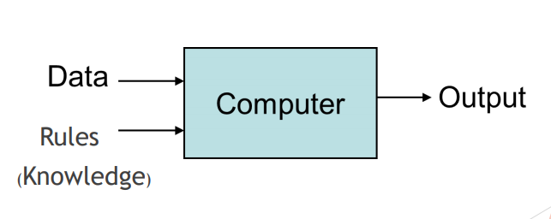
Recommendation System
Selected Foods
User gives input the AI with favorites and selected foods.
Working Principles of Recommendation System
Recommended Recipes
Data Analysis
Learning Machine takes the inputs and predict a recipe that is similar to the taste of user

Slide 7
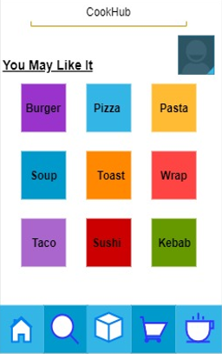

User Interface
Home Page
Profile
Starting point of application where recommendation recipes are suggested.
A collection of settings and information associated with a user. It can be defined as the explicit digital representation of the identity of the user
Search
My Recipe Book
Find desired recipe by three different searching method
Save recipes and make list for easy to access
Virtual Fridge
Shopping List
Add ingredients that already exists in home
A list of items needed to be purchased by a user

Slide 8

Search Function
Searching
User can search three different way in Cook Hub. Different ways will give the user different opportunities to find best recipe for them.
Seacrh by Recipe
Search by Ingredients
Search by Tags

Slide 9




TECHNOLOGIES
React Native
Python
JavaScript framework for writing real, natively rendering mobile applications
An interpreted, high-level, general-purpose programming language.
Python
React
MySQL
Kivy
MySQL
Kivy
Open-source relational database management system
Open source Python library for developing mobile apps and other multitouch application

Slide 10
FUTURE WORKS FOR CENG408
Accuracy
Increase recommendation accuracy
Application
Build a Cross-Platform Mobile Application with Python Kivy Framework
Learning Machine
Create a learning machine for Recomendation System of Cook Hub
Database
Building a database from the fetched csv. File
Next Step
Next Step
Next Step

Slide 11
ANY SUGGESTIONS ?

Slide 12
THANK YOU

