Slide 1


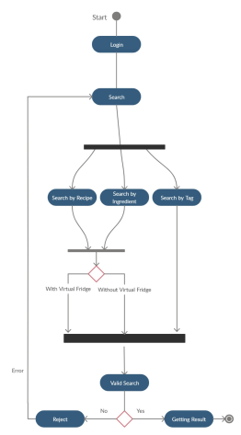
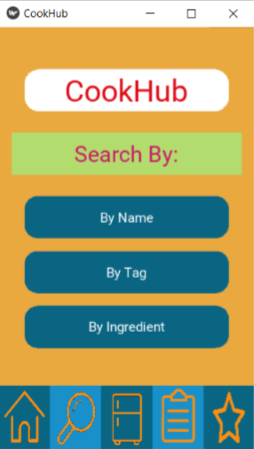
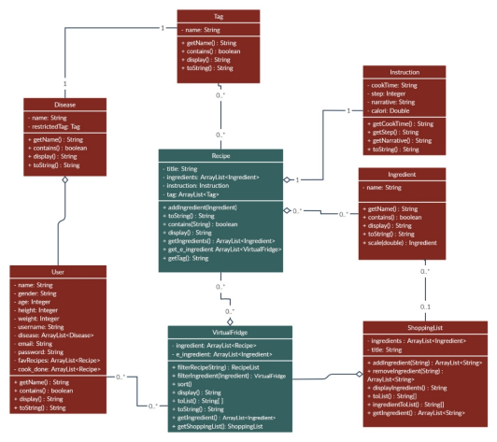
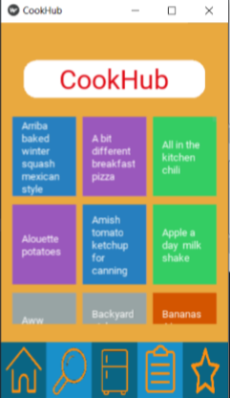

COOKHUB
Evrim MUTLU - H.Batuhan HASANOĞLU - Tolga TOLLUOĞLU - Didem ERDİVAN
ADVISOR - Roya CHOUPANI
Çankaya University, Department of Computer Engineering
Abstract
Most people today find themselves in a hustle. When cooking or eating food they do not even care about their wellbeing. We can search the recipes we like quickly via using internet. CookHub is an Android application recommended for recipes. You will find recipes that you're searching for. But the app will send you suggestions as well.
Keywords: Android Application, Health, Recipe Recommendation
Results & Conclusions
We have developed an android application that users can manually search for recipes. They can search for food recipes by 3 ways; search by tag, search by ingredient, search by recipe. The recipes presented to them as a result of the search and users can reach any kind of recipe whenever they require. Also users can add favorite foods to their lists and they can manage the shopping list by the required ingredients.
Figure 4 – Search Screen
Figure 1 - Flowchart
Introduction
With the developing technology, people meet all their needs with technology. For this the use of mobile devices is the most practical. People nowadays care about their time, and want to improve their business handling speed. So, instead of looking from a book, they tend to look at a recipe from applications. The application data sets contain a huge amount of data (millions of recipes). Users can't determine which of the data to choose from. CookHub is designed to help these people.
Acknowledgement
We would like to thank Dr. Roya CHOUPANI for helping us to develop this project. We are grateful for her support to us during the project.
Solution
Cook Hub is an Android application that recommends a recipe. You can generate your own virtual fridge which is used to cook section. You can also find some recipes that you're searching for. The app can also make suggestions to you, though.
Figure 2 – Database
Figure 3 – Finished Project

